Slide 1
Classification Techniques: Decision Tree Learning
Bamshad Mobasher
DePaul University

Slide 2
Classification: 3 Step Process
1. Model construction (Learning):
Each record (instance, example) is assumed to belong to a predefined class, as determined by one of the attributes
This attribute is called the target attribute
The values of the target attribute are the class labels
The set of all instances used for learning the model is called training set
2. Model Evaluation (Accuracy):
Estimate accuracy rate of the model based on a test set
The known labels of test instances are compared with the predicts class from model
Test set is independent of training set otherwise over-fitting will occur
3. Model Use (Classification):
The model is used to classify unseen instances (i.e., to predict the class labels for new unclassified instances)
Predict the value of an actual attribute

Slide 3
Classification Methods
Decision Tree Induction
Bayesian Classification
K-Nearest Neighbor
Neural Networks
Support Vector Machines
Association-Based Classification
Genetic Algorithms
Many More ….
Also Ensemble Methods

Slide 4
Decision Trees
A decision tree is a flow-chart-like tree structure
Internal node denotes a test on an attribute (feature)
Branch represents an outcome of the test
All records in a branch have the same value for the tested attribute
Leaf node represents class label or class label distribution
outlook
sunny
overcast
rain
humidity
P
windy
high
normal
true
false
N
P
N
P

Slide 5
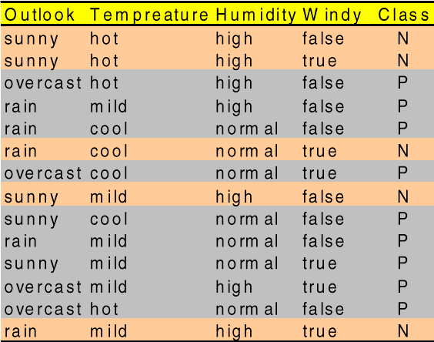
Instance Language for Classification
Example: “is it a good day to play golf?”
a set of attributes and their possible values:
outlook sunny, overcast, rain
temperature cool, mild, hot
humidity high, normal
windy true, false
A particular instance in the
training set might be:
<overcast, hot, normal, false>: play
In this case, the target class
is a binary attribute, so each
instance represents a positive
or a negative example.

Slide 6
Using Decision Trees for Classification
Examples can be classified as follows
1. look at the example's value for the feature specified
2. move along the edge labeled with this value
3. if you reach a leaf, return the label of the leaf
4. otherwise, repeat from step 1
Example (a decision tree to decide whether to go on a picnic):
outlook
So a new instance:
<rainy, hot, normal, true>: ?
will be classified as “noplay”
sunny
overcast
rain
humidity
P
windy
high
normal
true
false
N
P
N
P

Slide 7
Decision Trees and Decision Rules
outlook
If attributes are continuous, internal nodes may test against a threshold.
sunny
overcast
rain
humidity
P
windy
> 75%
<= 75%
> 20
<= 20
N
P
N
P
Each path in the tree represents a decision rule:
Rule1:
If (outlook=“sunny”) AND (humidity<=0.75)
Then (play=“yes”)
Rule2:
If (outlook=“rainy”) AND (wind>20)
Then (play=“no”)
Rule3:
If (outlook=“overcast”)
Then (play=“yes”)
. . .

Slide 8
Top-Down Decision Tree Generation
The basic approach usually consists of two phases:
Tree construction
At the start, all the training instances are at the root
Partition instances recursively based on selected attributes
Tree pruning (to improve accuracy)
remove tree branches that may reflect noise in the training data and lead to errors when classifying test data
Basic Steps in Decision Tree Construction
Tree starts a single node representing all data
If instances are all same class then node becomes a leaf labeled with class label
Otherwise, select feature that best distinguishes among instances
Partition the data based the values of the selected feature (with each branch representing one partitions)
Recursion stops when:
instances in node belong to the same class (or if too few instances remain)
There are no remaining attributes on which to split

Slide 9
Trees Construction Algorithm (ID3)
Decision Tree Learning Method (ID3)
Input: a set of training instances S, a set of features F
1. If every element of S has a class value “yes”, return “yes”; if every element of S has class value “no”, return “no”
2. Otherwise, choose the best feature f from F (if there are no features remaining, then return failure);
3. Extend tree from f by adding a new branch for each attribute value of f
3.1. Set F’ = F – {f},
4. Distribute training instances to leaf nodes (so each leaf node n represents the subset of examples S_{n} of S with the corresponding attribute value
5. Repeat steps 1-5 for each leaf node n with S_{n} as the new set of training instances and F’ as the new set of attributes
Main Question:
how do we choose the best feature at each step?
Note: ID3 algorithm only deals with categorical attributes, but can be extended
(as in C4.5) to handle continuous attributes

Slide 10
Choosing the “Best” Feature
Use Information Gain to find the “best” (most discriminating) feature
Assume there are two classes, P and N (e.g, P = “yes” and N = “no”)
Let the set of instances S (training data) contains p elements of class P and n elements of class N
The amount of information, needed to decide if an arbitrary example in S belongs to P or N is defined in terms of entropy, I(p,n):
Note that Pr(P) = p / (p+n) and Pr(N) = n / (p+n)
In other words, entropy of a set on instances S is a function of the probability distribution of classes among the instances in S.

Slide 11
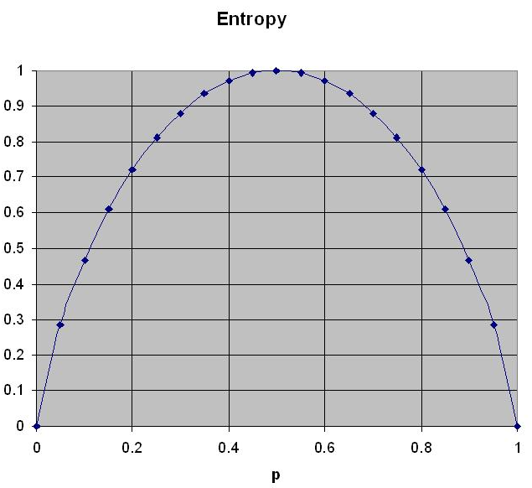
Entropy
Entropy for a two class variable

Slide 12
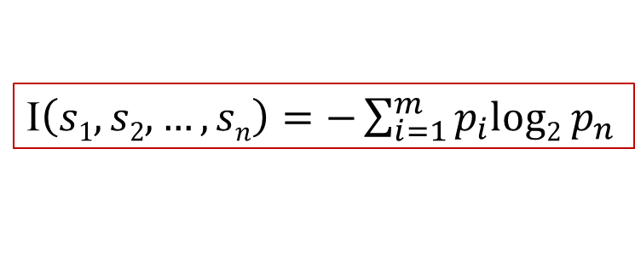
Entropy in Multi-Class Problems
More generally, if we have m classes, c₁, c₂, …, c_{m} , with s₁, s₂, …, s_{m} as the numbers of instances from S in each class, then the entropy is:
where p_{i} is the probability that an arbitrary instance belongs to the class c_{i}.
I$\left(s1,s2,…,sn\right)=−\sum_{i=1}^{m}{{p_{i}log2 p}_{n}}$

Slide 13
Information Gain
Now, assume that using attribute A a set S of instances will be partitioned into sets S₁, S₂ , …, S_{v} each corresponding to distinct values of attribute A.
If S_{i} contains p_{i} cases of P and n_{i} cases of N, the entropy, or the expected information needed to classify objects in all subtrees S_{i} is
The encoding information that would be gained by branching on A:
At any point we want to branch using an attribute that provides the highest information gain.
The probability that an arbitrary instance in S belongs to the partition S_{i}
where,

Slide 14
Attribute Selection - Example
The “Golf” example: what attribute should we choose as the root?
S: [9+,5-]
Outlook?
overcast
rainy
sunny
[4+,0-]
[2+,3-]
[3+,2-]
I(9,5) = -(9/14).log(9/14) - (5/14).log(5/14)
= 0.94
I(4,0) = -(4/4).log(4/4) - (0/4).log(0/4)
= 0
Gain(outlook) = .94 - (4/14)*0
- (5/14)*.97
- (5/14)*.97
= .24
I(2,3) = -(2/5).log(2/5) - (3/5).log(3/5)
= 0.97
I(3,2) = -(3/5).log(3/5) - (2/5).log(2/5)
= 0.97

Slide 15
Attribute Selection - Example (Cont.)
S: [9+,5-] (I = 0.940)
humidity?
high
normal
[3+,4-] (I = 0.985)
[6+,1-] (I = 0.592)
Gain(humidity) = .940 - (7/14)*.985 - (7/14)*.592
= .151
S: [9+,5-] (I = 0.940)
wind?
weak
strong
So, classifying examples by humidity provides
more information gain than by wind. Similarly,
we must find the information gain for “temp”.
In this case, however, you can verify that
outlook has largest information gain, so it’ll be
selected as root
[6+,2-] (I = 0.811)
[3+,3-] (I = 1.00)
Gain(wind) = .940 - (8/14)*.811 - (8/14)*1.0
= .048

Slide 16
Attribute Selection - Example (Cont.)
Partially learned decision tree
which attribute should be tested here?
S: [9+,5-]
Outlook
{D1, D2, …, D14}
sunny
overcast
rainy
?
yes
?
[2+,3-]
[4+,0-]
[3+,2-]
{D1, D2, D8, D9, D11}
{D3, D7, D12, D13}
{D4, D5, D6, D10, D14}
S_{sunny} = {D1, D2, D8, D9, D11}
Gain(S_{sunny}, humidity) = .970 - (3/5)*0.0 - (2/5)*0.0 = .970
Gain(S_{sunny}, temp) = .970 - (2/5)*0.0 - (2/5)*1.0 - (1/5)*0.0 = .570
Gain(S_{sunny}, wind) = .970 - (2/5)*1.0 - (3/5)*.918 = .019

Slide 17
Other Attribute Selection Measures
Gain ratio:
Information Gain measure tends to be biased in favor attributes with a large number of values
Gain Ratio normalizes the Information Gain with respect to the total entropy of all splits based on values of an attribute
Used by C4.5 (the successor of ID3)
But, tends to prefer unbalanced splits (one partition much smaller than others)
Gini index:
A measure of impurity (based on relative frequencies of classes in a set of instances)
The attribute that provides the smallest Gini index (or the largest reduction in impurity due to the split) is chosen to split the node
Possible Problems:
Biased towards multivalued attributes; similar to Info. Gain.
Has difficulty when # of classes is large

Slide 18
Overfitting and Tree Pruning
Overfitting: An induced tree may overfit the training data
Too many branches, some may reflect anomalies due to noise or outliers
Some splits or leaf nodes may be the result of decision based on very few instances, resulting in poor accuracy for unseen instances
Two approaches to avoid overfitting
Prepruning: Halt tree construction early ̵ do not split a node if this would result in the error rate going above a pre-specified threshold
Difficult to choose an appropriate threshold
Postpruning: Remove branches from a “fully grown” tree
Get a sequence of progressively pruned trees
Use a test data different from the training data to measure error rates
Select the “best pruned tree”

Slide 19
Enhancements to Basic Decision Tree Learning Approach
Allow for continuous-valued attributes
Dynamically define new discrete-valued attributes that partition the continuous attribute value into a discrete set of intervals
Handle missing attribute values
Assign the most common value of the attribute
Assign probability to each of the possible values
Attribute construction
Create new attributes based on existing ones that are sparsely represented
This reduces fragmentation, repetition, and replication

Slide 20
Classification Techniques: Decision Tree Learning
Bamshad Mobasher
DePaul University

