Slide 1
Classification and Prediction: Review of Basic Concepts
Bamshad Mobasher
DePaul University

Slide 2
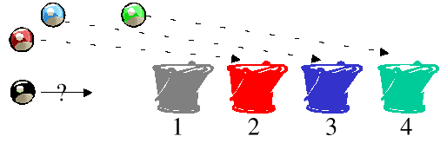
What Is Classification?
The goal of data classification is to organize and categorize data in distinct classes
A model is first created based on the data distribution
The model is then used to classify new data
Given the model, a class can be predicted for new data
Classification = prediction for discrete and nominal values (e.g., class/category labels)
Also called “Categorization”

Slide 3
Prediction, Clustering, Classification
What is Prediction/Estimation?
The goal of prediction is to forecast or deduce the value of an attribute based on values of other attributes
A model is first created based on the data distribution
The model is then used to predict future or unknown values
Most common approach: regression analysis
Supervised vs. Unsupervised Classification
Supervised Classification = Classification
We know the class labels and the number of classes
Unsupervised Classification = Clustering
We do not know the class labels and may not know the number of classes

Slide 4
Classification Task
Given:
A description of an instance, x ∈ X, where X is the instance language or instance or feature space.
Typically, x is a row in a table with the instance/feature space described in terms of features or attributes.
A fixed set of class or category labels: C={c₁, c₂,…c_{n}}
Classification task is to determine:
The class/category of x: c(x) ∈ C, where c(x) is a function whose domain is X and whose range is C.

Slide 5
Learning for Classification
A training example is an instance x∈X, paired with its correct class label c(x): <x, c(x)> for an unknown classification function, c.
Given a set of training examples, D
Find a hypothesized classification function, h(x), such that: h(x) = c(x), for all training instances (i.e., for all <x, c(x)> in D). This is called consistency.

Slide 6
Example of Classification Learning
Instance language: <size, color, shape>
size ∈ {small, medium, large}
color ∈ {red, blue, green}
shape ∈ {square, circle, triangle}
C = {positive, negative}
D:
Hypotheses? circle → positive? red → positive?
Example | Size | Color | Shape | Category
1 | small | red | circle | positive
2 | large | red | circle | positive
3 | small | red | triangle | negative
4 | large | blue | circle | negative

Slide 7
General Learning Issues (All Predictive Modeling Tasks)
Many hypotheses can be consistent with the training data
Bias: Any criteria other than consistency with the training data that is used to select a hypothesis
Classification accuracy (% of instances classified correctly)
Measured on independent test data
Efficiency Issues:
Training time (efficiency of training algorithm)
Testing time (efficiency of subsequent classification)
Generalization
Hypotheses must generalize to correctly classify instances not in training data
Simply memorizing training examples is a consistent hypothesis that does not generalize
Occam’s razor: Finding a simple hypothesis helps ensure generalization
Simplest models tend to be the best models
The KISS principle

Slide 8
Classification: 3 Step Process
1. Model construction (Learning):
Each record (instance, example) is assumed to belong to a predefined class, as determined by one of the attributes
This attribute is call the target attribute
The values of the target attribute are the class labels
The set of all instances used for learning the model is called training set
The model may be represented in many forms: decision trees, probabilities, neural networks, ….
2. Model Evaluation (Accuracy):
Estimate accuracy rate of the model based on a test set
The known labels of test instances are compared with the predicts class from model
Test set is independent of training set otherwise over-fitting will occur
3. Model Use (Classification):
The model is used to classify unseen instances (i.e., to predict the class labels for new unclassified instances)
Predict the value of an actual attribute

Slide 9
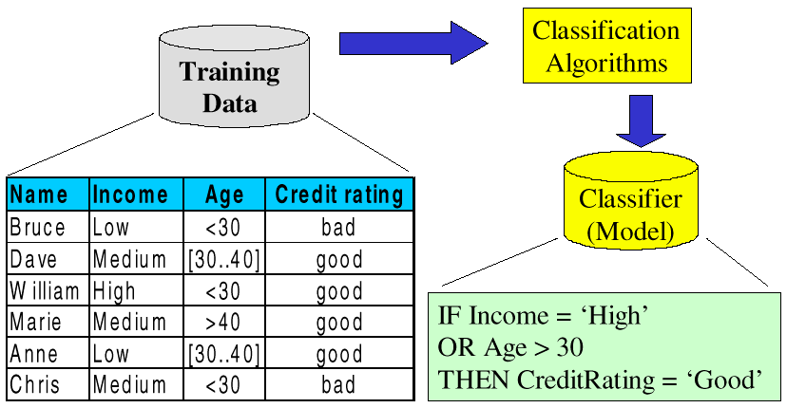
Model Construction

Slide 10
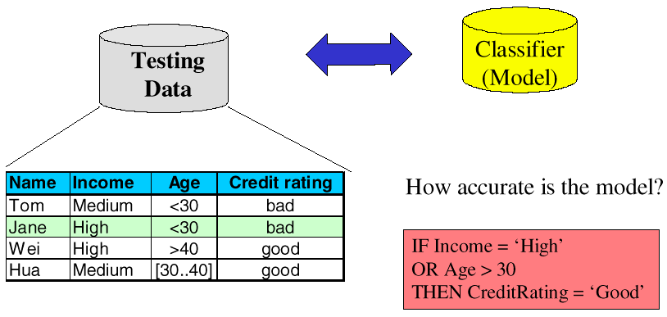
Model Evaluation

Slide 11
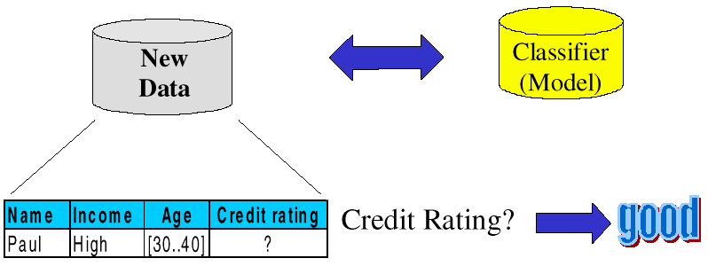
Model Use: Classification

Slide 12
Classification Methods
Decision Tree Induction
Bayesian Classification
K-Nearest Neighbor
Logistic Regression
Neural Networks
Linear Discriminant Analysis
Support Vector Machines
Genetic Algorithms
Many More ….
Also Ensemble Methods, e.g., Random Forest

Slide 13
Evaluating Models
To train and evaluate models, data are often divided into three sets: the training set, the test set, and the evaluation set
Training Set
is used to build the initial model
may need to “enrich the data” to get enough of the special cases
Test Set
is used to adjust the initial model
models can be tweaked to be less idiosyncrasies to the training data and can be adapted for a more general model
idea is to prevent “over-training” (i.e., finding patterns where none exist).
Evaluation Set
is used to evaluate the model performance

Slide 14
Test and Evaluation Sets
Reading too much into the training set (overfitting)
common problem with most data mining algorithms
resulting model works well on the training set but performs poorly on unseen data
test set can be used to “tweak” the initial model, and to remove unnecessary inputs or features
Evaluation Set is used for final performance evaluation
Insufficient data to divide into three disjoint sets?
In such cases, validation techniques can play a major role
Cross Validation
Bootstrap Validation

Slide 15
Cross Validation
Cross validation is a heuristic that works as follows
randomly divide the data into n folds, each with approximately the same number of records
create n models using the same algorithms and training parameters; each model is trained with n-1 folds of the data and tested on the remaining fold
can be used to find the best algorithm and its optimal training parameter
Steps in Cross Validation
1. Divide the available data into a training set and an evaluation set
2. Split the training data into n folds
3. Select an algorithm and training parameters
4. Train and test n models using the n train-test splits
5. Repeat step 2 to 4 using different algorithms / parameters and compare model accuracies
6. Select the best combination (of algorithms and parameters)
7. Use all the training data to train the final model
8. Assess the final model using the evaluation set

Slide 16
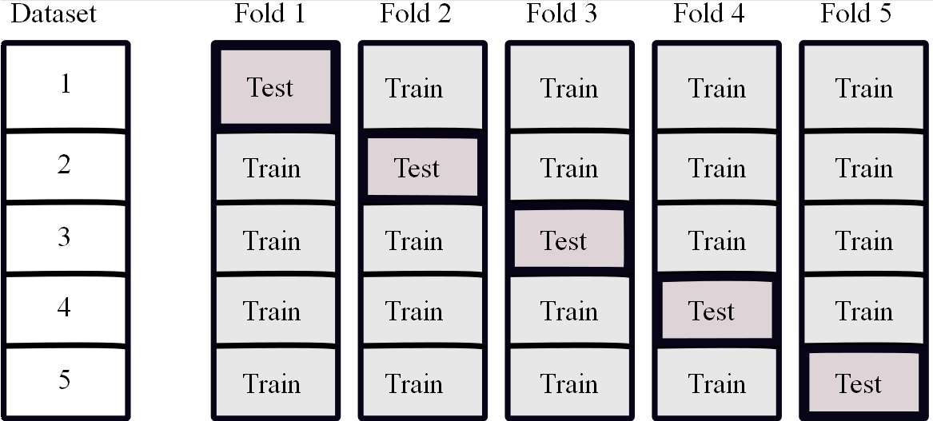
Example – 5 Fold Cross Validation

Slide 17
Bootstrap Validation
Based on the statistical procedure of sampling with replacement
data set of n instances is sampled n times (with replacement) to give another data set of n instances
since some elements will be repeated, there will be elements in the original data set that are not picked
these remaining instances are used as the test set
How many instances in the test set?
Probability of not getting picked in one sampling = 1 - 1/n
Pr(not getting picked in n samples) = (1 -1/n)^{n} = e⁻¹ = 0.368
so, for large data set, test set will contain about 36.8% of instances
to compensate for smaller training sample (63.2%), test set error rate is combined with the re-substitution error in training set:
e = (0.632 * e _{test instance}) + (0.368 * e _{training instance})

Slide 18
Measuring Effectiveness of Classification Models
When the output field is nominal (e.g., in two-class prediction), we use a confusion matrix to evaluate the resulting model
Example
Overall correct classification rate = (18 + 15) / 38 = 87%
Given T, correct classification rate = 18 / 20 = 90%
Given F, correct classification rate = 15 / 18 = 83%
Predicted Class
Actual Class

Slide 19
Confusion Matrix & Accuracy Metrics
Actual class\Predicted class | C₁ | ¬ C₁
C₁ | True Positives (TP) | False Negatives (FN)
¬ C₁ | False Positives (FP) | True Negatives (TN)
Classifier Accuracy, or recognition rate: percentage of test set instances that are correctly classified
Accuracy = (TP + TN)/All
Error rate: 1 – accuracy, or Error rate = (FP + FN)/All
Class Imbalance Problem: One class may be rare, e.g. fraud, or HIV-positive
Sensitivity: True Positive recognition rate = TP/P
Specificity: True Negative recognition rate = TN/N

Slide 20
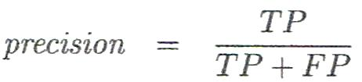
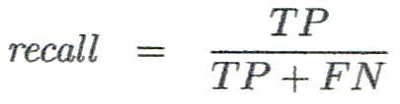
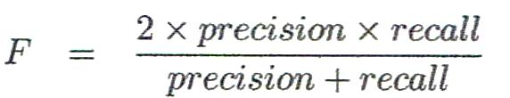
Other Classifier Evaluation Metrics
Precision
% of instances that the classifier predicted as positive that are actually positive
Recall
% of positive instances that the classifier predicted correctly as positive
a.k.a “Completeness”
Perfect score for both is 1.0, but there is often a trade-off between Precision and Recall
F measure (F₁ or F-score)
harmonic mean of precision and recall

Slide 21
What Is Prediction/Estimation?
(Numerical) prediction is similar to classification
construct a model
use model to predict continuous or ordered value for a given input
Prediction is different from classification
Classification refers to predict categorical class label
Prediction models continuous-valued functions
Major method for prediction: regression
model the relationship between one or more independent or predictor variables and a dependent or response variable
Regression analysis
Linear and multiple regression
Non-linear regression
Other regression methods: generalized linear model, Poisson regression, log-linear models, regression trees

Slide 22
Linear Regression
Linear regression: involves a response variable y and a single predictor variable x → y = w₀ + w₁ x
w₀ (y-intercept) and w₁ (slope) are regression coefficients
Method of least squares: estimates the best-fitting straight line
Multiple linear regression: involves more than one predictor variable
Training data is of the form (X₁, y₁), (X₂, y₂),…, (X_{|D|}, y_{|D|})
Ex. For 2-D data, we may have: y = w₀ + w₁ x₁+ w₂ x₂
Solvable by extension of least square method
Many nonlinear functions can be transformed into the above

Slide 23
Nonlinear Regression
Some nonlinear models can be modeled by a polynomial function
A polynomial regression model can be transformed into linear regression model. For example,
y = w₀ + w₁ x + w₂ x² + w₃ x³
is convertible to linear with new variables: x₂ = x², x₃= x³
y = w₀ + w₁ x + w₂ x₂ + w₃ x₃
Other functions, such as power function, can also be transformed to linear model
Some models are intractable nonlinear (e.g., sum of exponential terms)
possible to obtain least squares estimates through extensive computation on more complex functions

Slide 24
Other Regression-Based Models
Generalized linear models
Foundation on which linear regression can be applied to modeling categorical response variables
Variance of y is a function of the mean value of y, not a constant
Logistic regression: models the probability of some event occurring as a linear function of a set of predictor variables
Poisson regression: models the data that exhibit a Poisson distribution
Regression trees and model trees
Trees to predict continuous values rather than class labels

Slide 25
Regression Trees and Model Trees
Regression tree: proposed in CART system (Breiman et al. 1984)
CART: Classification And Regression Trees
Each leaf stores a continuous-valued prediction
It is the average value of the predicted attribute for the training instances that reach the leaf
Model tree: proposed by Quinlan (1992)
Each leaf holds a regression model—a multivariate linear equation for the predicted attribute
A more general case than regression tree
Regression and model trees tend to be more accurate than linear regression when instances are not represented well by simple linear models

Slide 26
Evaluating Numeric Prediction
Prediction Accuracy
Difference between predicted scores and the actual results (from evaluation set)
Typically the accuracy of the model is measured in terms of variance (i.e., average of the squared differences)
Common Metrics (p_{i} = predicted target value for test instance i, a_{i} = actual target value for instance i)
Mean Absolute Error: Average loss over the test set
Root Mean Squared Error: compute the standard deviation (i.e., square root of the co-variance between predicted and actual ratings)

Slide 27
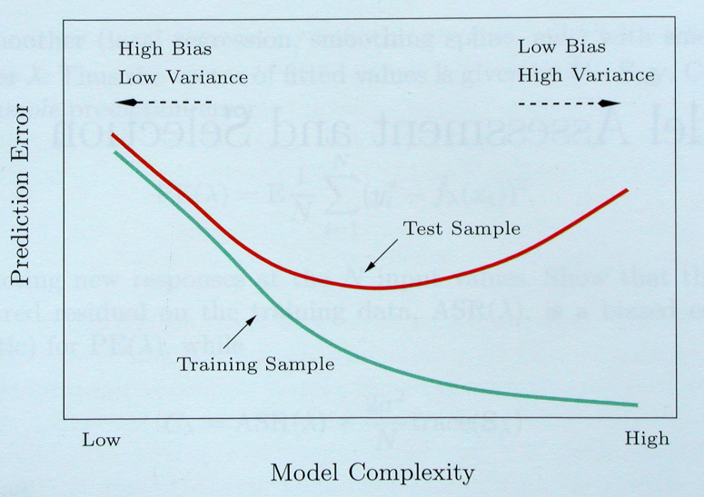
Bias-Variance Tradeoff

Slide 28
Bias-Variance Tradeoff
Possible ways of dealing with high bias
Get additional features
More complex model (e.g., adding polynomial terms such as x₁², x₂² , x₁.x₂, etc.)
Use smaller regularization coefficient (in regression models).
Note: getting more training data won’t necessarily help in this case
Possible ways dealing with high variance
Use more training instances
Reduce the number of features
Use simpler models
Use a larger regularization coefficient.

