Slide 1
Classification and Prediction: Regression Via Gradient Descent Optimization
Bamshad Mobasher
DePaul University

Slide 2
Linear Regression
Linear regression: involves a response variable y and a single predictor variable x → y = w₀ + w₁ x
The weights w₀ (y-intercept) and w₁ (slope) are regression coefficients
Method of least squares: estimates the best-fitting straight line
w₀ and w₁ are obtained by minimizing the sum of the squared errors (a.k.a. residuals)
w₁ can be obtained by setting the partial derivative of the SSE to 0 and solving for w₁, ultimately resulting in:

Slide 3
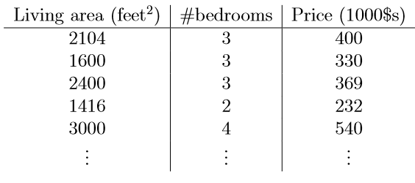
Multiple Linear Regression
Multiple linear regression: involves more than one predictor variable
Features represented as x₁, x₂, …, x_{d}
Training data is of the form (x¹, y¹), (x², y²),…, (x^{n}, y^{n}) (each x^{j} is a row vector in matrix X, i.e. a row in the data)
For a specific value of a feature x_{i} in data item x^{j} we use:
Ex. For 2-D data, the regression function is:
More generally:
x₁
x₂
y

Slide 4
Least Squares Generalization
Multiple dimensions
To simplify add a new feature x₀ = 1 to feature vector x:
x₀
x₁
x₂
y
1 1 1 1 1

Slide 5
Least Squares Generalization
Calculate the error function (SSE) and determine w:
Closed form solution to

Slide 6
Gradient Descent Optimization
Linear regression can also be solved using Gradient Decent optimization approach
GD can be used in a variety of settings to find the minimum value of functions (including non-linear functions) where a closed form solution is not available or not easily obtained
Basic idea:
Given an objective function J(w) (e.g., sum of squared errors), with w as a vector of variables w₀, w₁, …, w_{d}, iteratively minimize J(w) by finding the gradient of the function surface in the variable-space and adjusting the weights in the opposite direction
The gradient is a vector with each element representing the slope of the function in the direction of one of the variables
Each element is the partial derivative of function with respect to one of variables

Slide 7
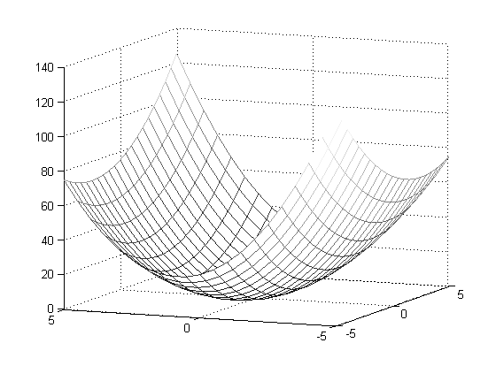
Optimization
An example - quadratic function in 2 variables:
f( x ) = f( x₁, x₂ ) = x₁² + x₁x₂ + 3x₂²
f( x ) is minimum where gradient of f( x ) is zero in all directions

Slide 8
Optimization
Gradient is a vector
Each element is the slope of function along direction of one of variables
Each element is the partial derivative of function with respect to one of variables
Example:

Slide 9
Optimization
Gradient vector points in direction of steepest ascent of function

Slide 10
Optimization
This two-variable example is still simple enough that we can find minimum directly
Set both elements of gradient to 0
Gives two linear equations in two variables
Solve for x₁, x₂

Slide 11
Optimization
Finding minimum directly by closed form analytical solution often difficult or impossible
Quadratic functions in many variables
system of equations for partial derivatives may be ill-conditioned
example: linear least squares fit where redundancy among features is high
Other convex functions
global minimum exists, but there is no closed form solution
example: maximum likelihood solution for logistic regression
Nonlinear functions
partial derivatives are not linear
example: f( x₁, x₂ ) = x₁( sin( x₁x₂ ) ) + x₂²
example: sum of transfer functions in neural networks

Slide 12
Gradient descent optimization
Given an objective (e.g., error) function E(w) = E(w₀, w₁, …, w_{d})
Process (follow the gradient downhill):
Pick an initial set of weights (random): w = (w₀, w₁, …, w_{d})
Determine the descent direction: -∇E(w^{t})
Choose a learning rate: η
Update your position: w^{t+1} = w^{t} - η ⋅∇E(w^{t})
Repeat from 2) until stopping criterion is satisfied
Typical stopping criteria
∇E( w^{t+1} ) ~ 0
some validation metric is optimized
Note: this step involves simultaneous updating of each weight w_{i}

Slide 13
Gradient descent optimization
In Least Squares Regression:
Process (follow the gradient downhill):
Select initial w = (w₀, w₁, …, w_{d})
Compute -∇E(w)
Set η
Update: w := w - η ⋅∇E(w)
Repeat until ∇E( w^{t+1} ) ~ 0

Slide 14
Illustration of Gradient Descent
E(w)
w₁
w₀

Slide 15
Illustration of Gradient Descent
E(w)
w₁
w₀

Slide 16
Illustration of Gradient Descent
E(w)
w₁
Direction of steepest
descent = direction of
negative gradient
w₀

Slide 17
Illustration of Gradient Descent
E(w)
w₁
Original point in
weight space
New point in
weight space
w₀

Slide 18
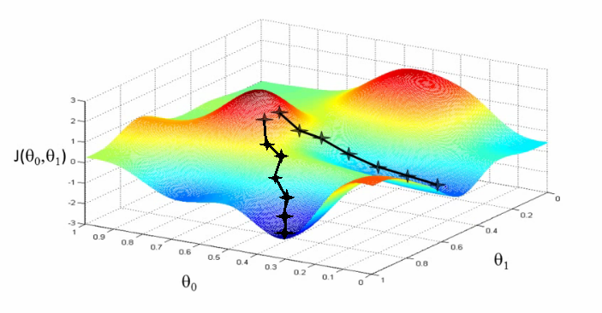
Gradient descent optimization
Problems:
Choosing step size (learning rate)
too small → convergence is slow and inefficient
too large → may not converge
Can get stuck on “flat” areas of function
Easily trapped in local minima

Slide 19
Stochastic gradient descent
Application to training a machine learning model:
Choose one sample from training set: x^{i}
Calculate objective function for that single sample:
Calculate gradient from objective function:
Update model parameters a single step based on gradient and learning rate:
Repeat from 1) until stopping criterion is satisfied
Typically entire training set is processed multiple times before stopping
Order in which samples are processed can be fixed or random.

