Slide 1
Matrix Factorization & Singular Value Decomposition
Bamshad Mobasher
DePaul University

Slide 2
Matrix Decomposition
Matrix D = m x n
e.g., Ratings matrix with m customers, n items
e.g., term-document matrix with m terms and n documents
Typically
D is sparse, e.g., less than 1% of entries have ratings
n is large, e.g., 18000 movies (Netflix), millions of docs, etc.
So finding matches to less popular items will be difficult
Basic Idea:
compress the columns (items) into a lower-dimensional representation
Credit: Based on lecture notes from Padhraic Smyth, University of California, Irvine

Slide 3
Singular Value Decomposition (SVD)
D = U Σ V^{t}
m x n
m x n
n x n
n x n
where: rows of V^{t} are eigenvectors of D^{t}D = basis functions
Σ is diagonal, with σ_{ii} = sqrt(λ_{i}) (ith eigenvalue)
rows of U are coefficients for basis functions in V
(here we assumed that m > n, and rank(D) = n)
Credit: Based on lecture notes from Padhraic Smyth, University of California, Irvine

Slide 4
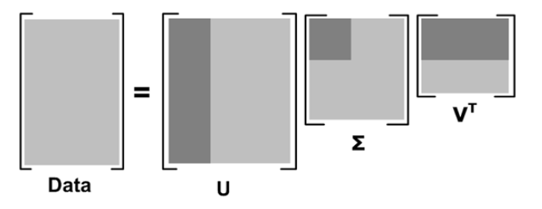
Singular Value Decomposition (SVD)
where: rows of V^{t} are eigenvectors of D^{t}D = basis functions
Σ is diagonal, with σ_{ii} = sqrt(λ_{i}) (ith eigenvalue)
rows of U are coefficients for basis functions in V
(here we assumed that m > n, and rank(D) = n)
Credit: Based on lecture notes from Padhraic Smyth, University of California, Irvine

Slide 5
SVD Example
Data D =
10 | 20 | 10
2 | 5 | 2
8 | 17 | 7
9 | 20 | 10
12 | 22 | 11
Credit: Based on lecture notes from Padhraic Smyth, University of California, Irvine

Slide 6
SVD Example
Data D =
10 | 20 | 10
2 | 5 | 2
8 | 17 | 7
9 | 20 | 10
12 | 22 | 11
Note the pattern in the data above: the center column
values are typically about twice the 1st and 3rd column values:
So there is redundancy in the columns, i.e., the column
values are correlated
Credit: Based on lecture notes from Padhraic Smyth, University of California, Irvine

Slide 7
SVD Example
D = U Σ V^{t}
where U = 0.50 0.14 -0.19
0.12 -0.35 0.07
0.41 -0.54 0.66
0.49 -0.35 -0.67
0.56 0.66 0.27
where Σ = 48.6 0 0
0 1.5 0
0 0 1.2
and V^{t} = 0.41 0.82 0.40
0.73 -0.56 0.41
0.55 0.12 -0.82
Data D =
10 | 20 | 10
2 | 5 | 2
8 | 17 | 7
9 | 20 | 10
12 | 22 | 11
Credit: Based on lecture notes from Padhraic Smyth, University of California, Irvine

Slide 8
SVD Example
D = U Σ V^{t}
where U = 0.50 0.14 -0.19
0.12 -0.35 0.07
0.41 -0.54 0.66
0.49 -0.35 -0.67
0.56 0.66 0.27
where Σ = 48.6 0 0
0 1.5 0
0 0 1.2
and V^{t} = 0.41 0.82 0.40
0.73 -0.56 0.41
0.55 0.12 -0.82
Data D =
10 | 20 | 10
2 | 5 | 2
8 | 17 | 7
9 | 20 | 10
12 | 22 | 11
Note that first singular value
is much larger than the others
Credit: Based on lecture notes from Padhraic Smyth, University of California, Irvine

Slide 9
SVD Example
D = U Σ V^{t}
where U = 0.50 0.14 -0.19
0.12 -0.35 0.07
0.41 -0.54 0.66
0.49 -0.35 -0.67
0.56 0.66 0.27
where Σ = 48.6 0 0
0 1.5 0
0 0 1.2
and V^{t} = 0.41 0.82 0.40
0.73 -0.56 0.41
0.55 0.12 -0.82
Data D =
10 | 20 | 10
2 | 5 | 2
8 | 17 | 7
9 | 20 | 10
12 | 22 | 11
Note that first singular value
is much larger than the others
First basis function (or eigenvector)
carries most of the information and it “discovers” the pattern of column dependence
Credit: Based on lecture notes from Padhraic Smyth, University of California, Irvine

Slide 10
Rows in D = weighted sums of basis vectors
1st row of D = [10 20 10]
Since D = U S V^{t} , then D[0,: ] = U[0,: ] * Σ * V^{t}
= [24.5 0.2 -0.22] * V^{t}
V^{t} = 0.41 0.82 0.40
0.73 -0.56 0.41
0.55 0.12 -0.82
D[0,: ] = 24.5 v₁ + 0.2 v₂ + -0.22 v₃
where v₁ , v₂ , v₃ are rows of V^{t} and are our basis vectors
Thus, [24.5, 0.2, 0.22] are the weights that characterize row 1 in D
In general, the ith row of U* Σ is the set of weights for the ith row in D
Credit: Based on lecture notes from Padhraic Smyth, University of California, Irvine

Slide 11
Summary of SVD Representation
D = U Σ V^{t}
Data matrix:
Rows = data vectors
V^{t} matrix:
Rows = our basis functions
U*Σ matrix:
Rows = weights
for the rows of D
Credit: Based on lecture notes from Padhraic Smyth, University of California, Irvine

Slide 12
How do we compute U, Σ, and V?
SVD decomposition is a standard eigenvector/value problem
The eigenvectors of D^{t} * D = the rows of V
The eigenvectors of D * D^{t} = the columns of U
The diagonal matrix elements in Σ are square roots of the eigenvalues of D^{t} * D
=> finding U,Σ,V is equivalent to finding eigenvectors of D^{t}D
Solving eigenvalue problems is equivalent to solving a set of linear equations – time complexity is O(m n² + n³)
Credit: Based on lecture notes from Padhraic Smyth, University of California, Irvine

Slide 13
Matrix Approximation with SVD
m x n
m x k
k x k
k x n
where: columns of V are first k eigenvectors
Σ is diagonal with k largest eigenvalues
rows of U are coefficients in reduced dimension V-space
This approximation gives the best rank-k approximation to matrix D
in a least squares sense (this is also known as principal components analysis)

Slide 14
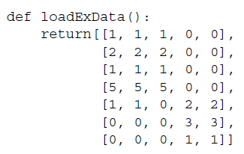
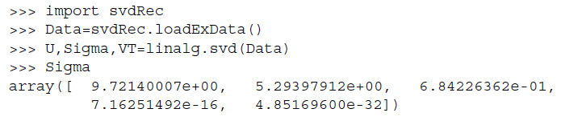
Ch. 14 – svdRec.py
First three values are much larger than the rest

Slide 15

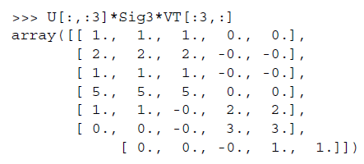
Ch. 14 – svdRec.py

Slide 16

Collaborative Filtering & Matrix Factorization
17,700 movies
The $1 Million Question
1 | 3 | 4
 | 3 | 5 |  |  | 5
 |  | 4 | 5 |  | 5
 |  | 3
 |  | 3
2 |  |  | 2 |  | 2
 |  |  |  | 5
 | 2 | 1 |  |  | 1
 | 3 |  |  | 3
1
480,000
users

Slide 17
User-Based Collaborative Filtering
 | Item1 | Item 2 | Item 3 | Item 4 | Item 5 | Item 6 | Correlation with Alice
Alice | 5 | 2 | 3 | 3 |  | ?
User 1 | 2 |  | 4 |  | 4 | 1 | -1.00
User 2 | 2 | 1 | 3 |  | 1 | 2 | 0.33
User 3 | 4 | 2 | 3 | 2 |  | 1 | .90
User 4 | 3 | 3 | 2 |  | 3 | 1 | 0.19
User 5 |  | 3 |  | 2 | 2 | 2 | -1.00
User 6 | 5 | 3 |  | 1 | 3 | 2 | 0.65
User 7 |  | 5 |  | 1 | 5 | 1 | -1.00
Prediction

Best match
Using k-nearest neighbor with k = 1

Slide 18
Item-Based Collaborative Filtering
Prediction

 | Item1 | Item 2 | Item 3 | Item 4 | Item 5 | Item 6
Alice | 5 | 2 | 3 | 3 |  | ?
User 1 | 2 |  | 4 |  | 4 | 1
User 2 | 2 | 1 | 3 |  | 1 | 2
User 3 | 4 | 2 | 3 | 2 |  | 1
User 4 | 3 | 3 | 2 |  | 3 | 1
User 5 |  | 3 |  | 2 | 2 | 2
User 6 | 5 | 3 |  | 1 | 3 | 2
User 7 |  | 5 |  | 1 | 5 | 1
Item similarity | 0.76 | 0.79 | 0.60 | 0.71 | 0.75
Best match
Item-Item similarities: usually computed using Cosine Similarity measure

Slide 19
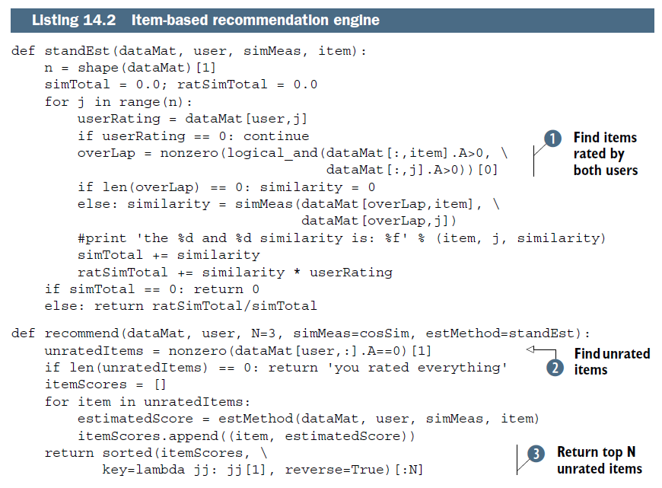

Slide 20

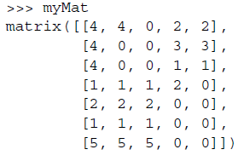
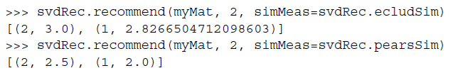
Item-Based Collaborative Filtering

Slide 21
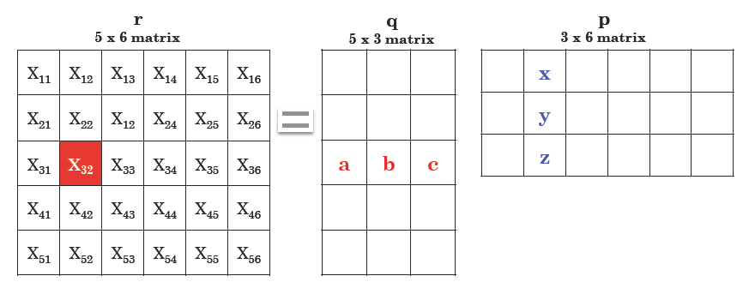
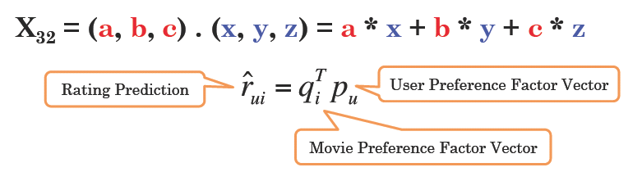
Matrix Factorization of Ratings Data
Credit: Alex Lin, Intelligent Mining

Slide 22
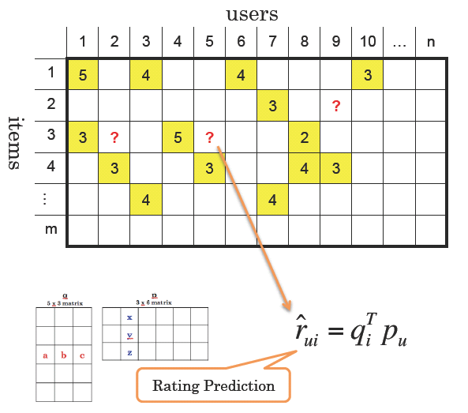
Predictions as Filling Missing Data
Credit: Alex Lin, Intelligent Mining

Slide 23
Matrix Factorization of Ratings Data
R
P
Q
n movies
f
n movies
x
f
~
~
m users
m users
r_{ui} p_{u} q^{T}_{i}
~
~
Based on the idea of Latent Factor Analysis
Identify latent (unobserved) factors that “explain” observations in the data
In this case, observations are user ratings of movies
The factors may represent combinations of features or characteristics of movies and users that result in the ratings

Slide 24
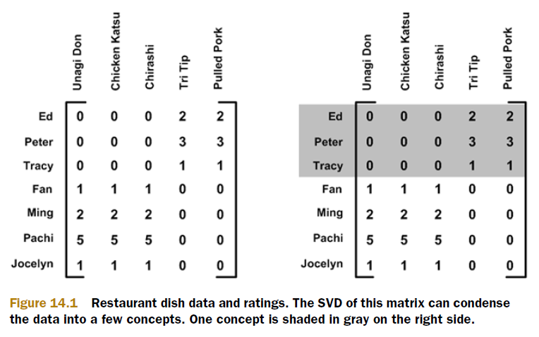
Matrix Factorization of Ratings Data

Slide 25





Matrix Factorization
P_{k} | Dim1 | Dim2
Alice | 0.47 | -0.30
Bob | -0.44 | 0.23
Mary | 0.70 | -0.06
Sue | 0.31 | 0.93
Q_{k}^{T}
Dim1 | -0.44 | -0.57 | 0.06 | 0.38 | 0.57
Dim2 | 0.58 | -0.66 | 0.26 | 0.18 | -0.36
Prediction:
Note: Can also do factorization via Singular Value Decomposition (SVD)
SVD:

Slide 26





Lower Dimensional Feature Space
Sue
Bob
Mary
Alice

Slide 27
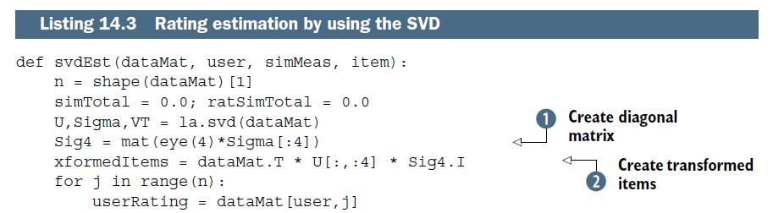
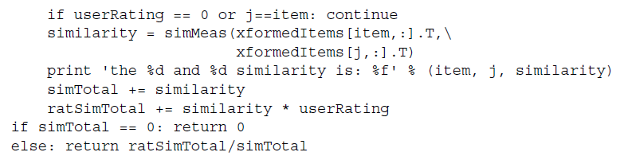

Slide 28
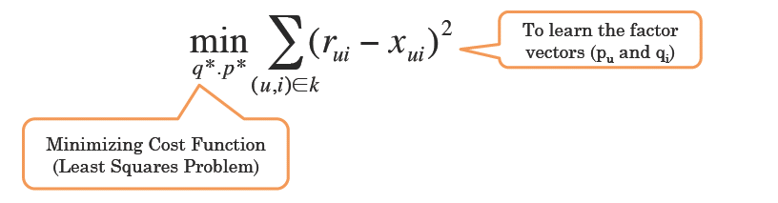
Learning the Factor Matrices
Need to learn the user and item feature vectors from training data
Approach: Minimize the errors on known ratings
Typically, regularization terms, user and item bias parameters are added
Done via Stochastic Gradient Descent or other optimization approaches

Slide 29
Learning Factor Matrices
~
~
r_{ui} q^{t}_{i} p_{u}
min_{q,p} Σ _{(u,i) ε R} ( r_{ui} - q^{t}_{i} p_{u} )²
Add regularization
min_{q,p} Σ _{(u,i) ε R} ( r_{ui} - q^{t}_{i} p_{u} )² + λ (|q_{i}|² + |p_{u}|² )

Slide 30
Stochastic Gradient Descent (SGD)
goodness of fit
regularization
min_{q,p} Σ _{(u,i) ε R} ( r_{ui} - q^{t}_{i} p_{u} )² + λ (|q_{i}|² + |p_{u}|² )
Online (“stochastic”) gradient update equations:
ε_{ui} = r_{ui} - q^{t}_{i} p_{u}
q_{i} ← q_{i} + γ ( ε_{ui} p_{u} - λ q_{i} )
p_{u} ← p_{u} + γ ( ε_{ui} q_{i} - λ p_{u} )

Slide 31
The $1 Million Question

Slide 32
Training Data
100 million ratings (matrix is 99% sparse)
Rating = [user, movie-id, time-stamp, rating value]
Generated by users between Oct 1998 and Dec 2005
Users randomly chosen among set with at least 20 ratings
Small perturbations to help with anonymity

Slide 33
Ratings Data
17,700 movies
1 | 3 | 4
 | 3 | 5 |  |  | 5
 |  | 4 | 5 |  | 5
 |  | 3
 |  | 3
2 |  |  | ? |  | ?
 |  |  |  | ?
 | 2 | 1 |  |  | ?
 | 3 |  |  | ?
1
480,000
users
Test Data Set
(most recent ratings)

Slide 34
Scoring
Minimize root mean square error
Does not necessarily correlate well with user satisfaction
But is a widely-used well-understood quantitative measure
RMSE Baseline Scores on Test Data
1.054 - just predict the mean user rating for each movie
0.953 - Netflix’s own system (Cinematch) as of 2006
0.941 - nearest-neighbor method using correlation
0.857 - required 10% reduction to win $1 million
Mean square error = 1/|R| Σ _{(u,i) e R} ( r_{ui} - r_{ui} )²
^

Slide 35
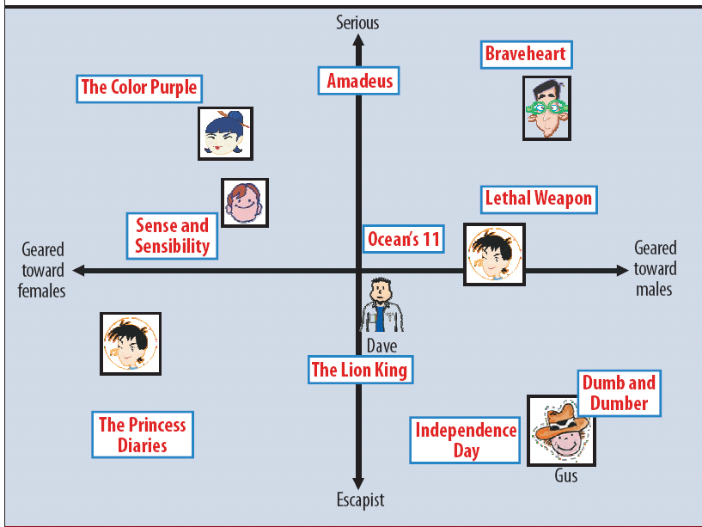
Matrix Factorization of Ratings Data
Figure from Koren, Bell, Volinksy, IEEE Computer, 2009

Slide 36
Modeling Systematic Biases
~
r_{ui} μ + b_{u} + b_{i} + user-movie interactions
~
overall
mean
rating
mean
rating
for user u
mean
rating
for
movie i
q^{t}_{i} p_{u}
Example:
Mean rating μ = 3.7
You are a critical reviewer: your ratings are 1 lower than the mean -> b_{u} = -1
Star Wars gets a mean rating of 0.5 higher than average movie: b_{i} = + 0.5
Predicted rating for you on Star Wars = 3.7 - 1 + 0.5 = 3.2
Credit: Padhraic Smyth, University of California, Irvine

Slide 37
Objective Function
goodness of fit
min_{q,p} { Σ _{(u,i) ε R} ( r_{ui} - (μ + b_{u} + b_{i} + q^{t}_{i} p_{u} ) )²
+ λ (|q_{i}|² + |p_{u}|² + |b_{u}|² + |b_{i}|² ) }
regularization
Typically selected via grid-search on a validation set
Credit: Padhraic Smyth, University of California, Irvine

Slide 38
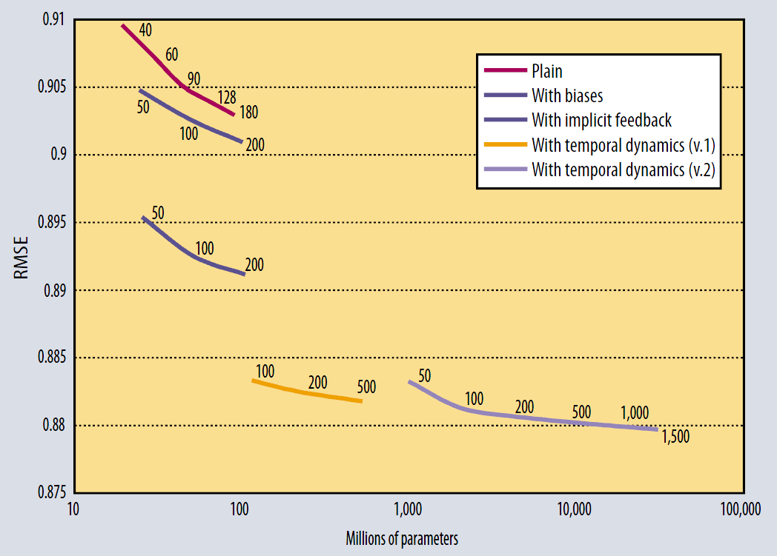
5%
8%
Figure from Koren, Bell, Volinksy, IEEE Computer, 2009

Slide 39
Adding Time Effects
~
r_{ui} μ + b_{u} + b_{i} + user-movie interactions
~
Add time dependence to biases
~
r_{ui} μ + b_{u}(t) + b_{i}(t) + user-movie interactions
~
Time-dependence parametrized by linear trends, binning, and other methods
For details see
Y. Koren, Collaborative filtering with temporal dynamics, ACM SIGKDD Conference 2009
Credit: Padhraic Smyth, University of California, Irvine

Slide 40
Adding Time Effects
~
r_{ui} μ + b_{u}(t) + b_{i}(t) + q^{t}_{i} p_{u}(t)
~
Add time dependence to user “factor weights”
Models the fact that user’s interests over “genres” (the q’s) may change over time

Slide 41
5%
8%
Figure from Koren, Bell, Volinksy, IEEE Computer, 2009

Slide 42
The Kitchen Sink Approach….
Many options for modeling
Variants of the ideas we have seen so far
Different numbers of factors
Different ways to model time
Different ways to handle implicit information
….
Other models (not described here)
Nearest-neighbor models
Restricted Boltzmann machines
Model averaging was useful….
Linear model combining
Neural network combining
Gradient boosted decision tree combining
Note: combining weights learned on validation set (“stacking”)
Credit: Padhraic Smyth, University of California, Irvine

Slide 44
Progress Prize 2008
Sept 2nd → Only 3 teams qualify for 1% improvement over previous year
Oct 2nd → Leading team has 9.4% overall improvement
Progress prize ($50,000) awarded to BellKor team of 3 AT&T researchers (same as before) plus 2 Austrian
graduate students, Andreas Toscher and Martin Jahrer
Key winning strategy: clever “blending” of predictions
from models used by both teams
Speculation that 10% would be attained by mid-2009

Slide 45
The Leading Team for the Final Prize
BellKorPragmaticChaos
BellKor:
Yehuda Koren (now Yahoo!), Bob Bell, Chris Volinsky, AT&T
BigChaos:
Michael Jahrer, Andreas Toscher, 2 grad students from Austria
Pragmatic Theory
Martin Chabert, Martin Piotte, 2 engineers from Montreal (Quebec)

Slide 47
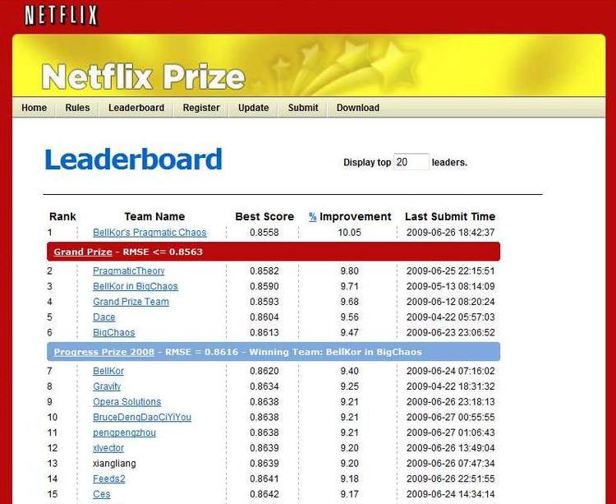
June 26th 2009: after 1000 days & nights…

Slide 48

Million Dollars Awarded Sept 21st 2009

