Slide 1
Principal Component Analysis
Bamshad Mobasher
DePaul University

Slide 2
Principal Component Analysis
PCA is a widely used data compression and dimensionality reduction technique
PCA takes a data matrix, A, of n objects by p variables, which may be correlated, and summarizes it by uncorrelated axes (principal components or principal axes) that are linear combinations of the original p variables
The first k components display most of the variance among objects
The remaining components can be discarded resulting in a lower dimensional representation of the data that still captures most of the relevant information
PCA is computed by determining the eigenvectors and eigenvalues of the covariance matrix
Recall: The covariance of two random variables is their tendency to vary together

Slide 3
Geometric Interpretation of PCA
The goal is to rotate the axes of the p-dimensional space to new positions (principal axes) that have the following properties:
ordered such that principal axis 1 has the highest variance, axis 2 has the next highest variance, .... , and axis p has the lowest variance
covariance among each pair of the principal axes is zero (the principal axes are uncorrelated).
PC 1
PC 2
Note: Each principal axis is a linear combination of the original two variables
Credit: Loretta Battaglia, Southern Illinois University

Slide 4
PCA: Coordinate Transformation
From p original variables: x₁,x₂,...,x_{p}:
Produce p new variables: y₁,y₂,...,y_{p}:
y₁ = a₁₁x₁ + a₁₂x₂ + ... + a_{1p}x_{p}
y₂ = a₂₁x₁ + a₂₂x₂ + ... + a_{2p}x_{p}
...
y_{p} = a_{p1}x₁ + a_{p2}x₂ + ... + a_{pp}x_{p}
y_{i}'s are
Principal Components
such that:
y_{i}'s are uncorrelated (orthogonal)
y₁ explains as much as possible of original variance in data set
y₂ explains as much as possible of remaining variance
etc.

Slide 5
Principal Components
2nd Principal
Component, y₂
1st Principal
Component, y₁

Slide 6
Principal Components: Scores
x_{i2}
y_{i,1}
y_{i,2}
x_{i1}

Slide 7
Principal Components: Eigenvalues
λ₂
λ₁
Eigenvalues represent variances of along the direction of each principle component

Slide 8
Principal Components: Eigenvectors
z₁ = [a₁₁,a₁₂,...,a_{1p}]: 1st Eigenvector of the covariance (or correlation) matrix, and coefficients of first principal component
z₂ =[a₂₁,a₂₂,...,a_{2p}]: 2nd Eigenvector of the covariance (or correlation) matrix, and coefficients of first principal component
…
z_{p} =[a_{p1},a_{p2},...,a_{pp}]: pth Eigenvector of the covariance (or correlation), matrix and coefficients of pth principal component
Dimensionality Reduction ➔ We can take only the top k principal components y₁,y₂,...,y_{k} effectively transforming the data into a lower dimensional space.

Slide 9
Covariance Matrix
Recall: PCA is computed by determining the eigenvectors and eigenvalues of the covariance matrix
Covariance of variables i and j
Value of variable i
in object m
Value of variable j
in object m
Sum over n objects
Mean of variable i
Mean of variable j
Notes:
For a variable x, cov(x,x) = var(x)
For independent variables x and y, cov(x,y ) = 0
The covariance matrix is a matrix C with elements C_{i,j} = cov(i,j)
The covariance matrix is square and symmetric
For independent variables, the covariance matrix will be a diagonal matrix with the variances along the diagonal and covariances in the non-diagonal elements
To calculate the covariance matrix from a dataset, ﬁrst center the data by subtracting the mean of each variable, then compute: 1/n (A^{T}.A)

Slide 10
Covariance Matrix - Example
Original Data
Centered Data
X =
A =
Cov(X) = 1/(n-1) A^{T}A =
Covariance Matrix

Slide 11
Summary: Eigenvalues and Eigenvectors
Finding the principal axes involves finding eigenvalues and eigenvectors of the covariance matrix (C = A^{T}A)
eigenvalues are values (λ) such that C.Z = λ.Z (Z are the eigenvectors)
this can be re-written as: (C - λI).Z = 0
eigenvalues can be found by solving the characteristic equation: det(C - λI) = 0
The eigenvalues, λ₁, λ₂, ... λ_{p} are the variances of the coordinates on each principal component axis
the sum of all p eigenvalues equals the trace of C (the sum of the variances of the original variables)
The eigenvectors of the covariance matrix are the axes of max variance
a good approximation of the full matrix can be computed using only a subset of the eigenvectors and eigenvalues
the eigenvalues are truncated below some threshold; then the data is reprojected onto the remaining r eigenvectors to get a rank-r approximation

Slide 12
Eigenvalues and Eigenvectors
λ₁ = 73.718 λ₂ = 0.384 λ₃ = 0.298
Eigenvalues
Covariance Matrix
Note: λ₁+λ₂ +λ₃ = 74.4
= trace of C (sum of variances in the diagonal)
Eigenvectors
Z =

Slide 13
Reduced Dimension Space
Coordinates of each object i on the kth principal axis, known as the scores on PC k, are computed as
where Y is the n x k matrix of PC scores, X is the n x p centered data matrix and Z is the p x k matrix of eigenvectors
Variance of the scores on each PC axis is equal to the corresponding eigenvalue for that axis
the eigenvalue represents the variance displayed (“explained” or “extracted”) by the kth axis
the sum of the first k eigenvalues is the variance explained by the k-dimensional reduced matrix

Slide 14
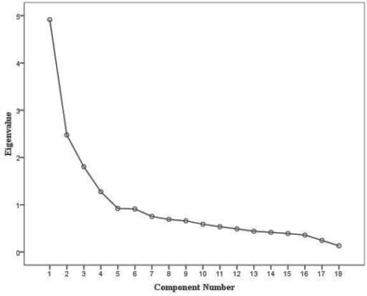
Reduced Dimension Space
Each eigenvalue represents the variance displayed (“explained”) by the a PC. The sum of the first k eigenvalues is the variance explained by the k-dimensional reduced matrix
A Scree Plot ➔

Slide 15
Reduced Dimension Space
So, to generate the data in the new space:
RowFeatureVector:
Matrix with the eigenvectors in the columns transposed so that the eigenvectors are now in the rows, with the most significant eigenvector at the top
RowZeroMeanData
The mean-adjusted data transposed, i.e. the data items are in each column, with each row holding a separate dimension
FinalData = RowFeatureVector x RowZeroMeanData

Slide 16
Example: Revisited
Centered Data
λ₁ = 73.718 λ₂ = 0.384 λ₃ = 0.298
A =
Eigenvalues
Eigenvectors
Z =

Slide 17
Reduced Dimension Space
U = Z^{T}.A^{T} =
Taking only the top k =1 principle component:
U = Z_{k}^{T}.A^{T} =

