Slide 1
Classification and Prediction: Regression Analysis
Bamshad Mobasher
DePaul University

Slide 2
What Is Numerical Prediction (a.k.a. Estimation, Forecasting)
(Numerical) prediction is similar to classification
construct a model
use model to predict continuous or ordered value for a given input
Prediction is different from classification
Classification refers to predicting categorical class label
Prediction models continuous-valued functions
Major method for prediction: regression
model the relationship between one or more independent or predictor variables and a dependent or response variable
Regression analysis
Linear and multiple regression
Non-linear regression
Other regression methods: generalized linear model, Poisson regression, log-linear models, regression trees

Slide 3
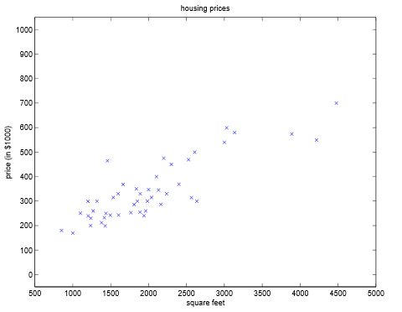
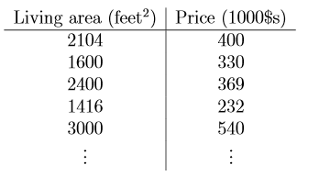
Linear Regression
Linear regression: involves a response variable y and a single predictor variable x → y = w₀ + w₁ x
x
y
Goal: Using the data estimate weights (parameters) w₀ and w₁ for the line such that the prediction error is minimized
The weights w₀ (y-intercept) and w₁ (slope) are regression coefficients

Slide 4
Linear Regression
y
Observed Value of y for x_{i}
e_{i}
Slope = w₁
Predicted Value of y for x_{i}
Error for this x value
Intercept = w₀
x_{i}
x

Slide 5
Linear Regression
Method of least squares:
Estimates the best-fitting straight line
w₀ and w₁ are obtained by minimizing the sum of the squared errors (a.k.a. residuals)
w₁ can be obtained by setting the partial derivative of the SSE to 0 and solving for w₁, ultimately resulting in:

Slide 6
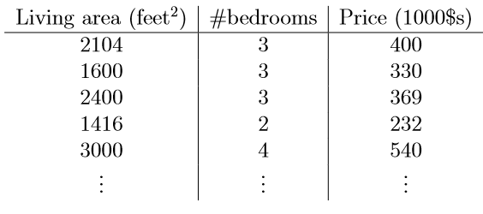
Multiple Linear Regression
Multiple linear regression: involves more than one predictor variable
Features represented as x₁, x₂, …, x_{d}
Training data is of the form (x¹, y¹), (x², y²),…, (x^{n}, y^{n}) (each x^{j} is a row vector in matrix X, i.e. a row in the data)
For a specific value of a feature x_{i} in data item x^{j} we use:
Ex. For 2-D data, the regression function is:
x₁
x₂
y

Slide 7
Least Squares Generalization
Multiple dimensions
To simplify add a new feature x₀ = 1 to feature vector x:
x₀
x₁
x₂
y
1 1 1 1 1

Slide 8
Least Squares Generalization
Calculate the error function (SSE) and determine w:
Closed form solution to

Slide 9
Extending Application of Linear Regression
The inputs X for linear regression can be:
Original quantitative inputs
Transformation of quantitative inputs, e.g. log, exp, square root, square, etc.
Polynomial transformation
example: y = w₀ + w₁⋅x + w₂⋅x² + w₃⋅x³
Dummy coding of categorical inputs
Interactions between variables
example: x₃ = x₁ ⋅ x₂
This allows use of linear regression techniques to fit much more complicated non-linear datasets.

Slide 10
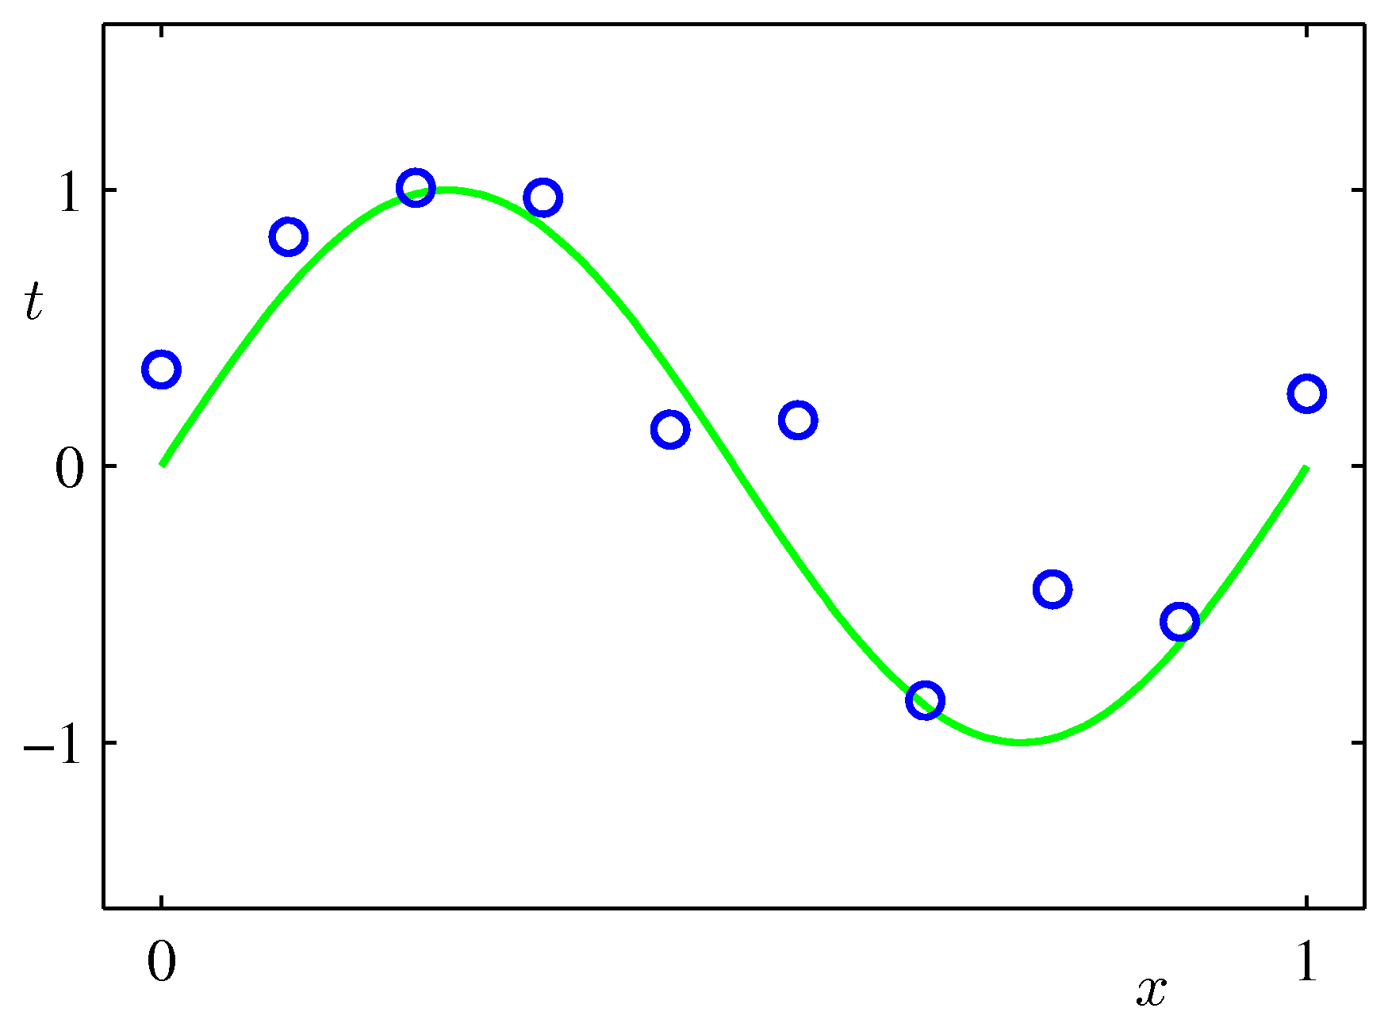
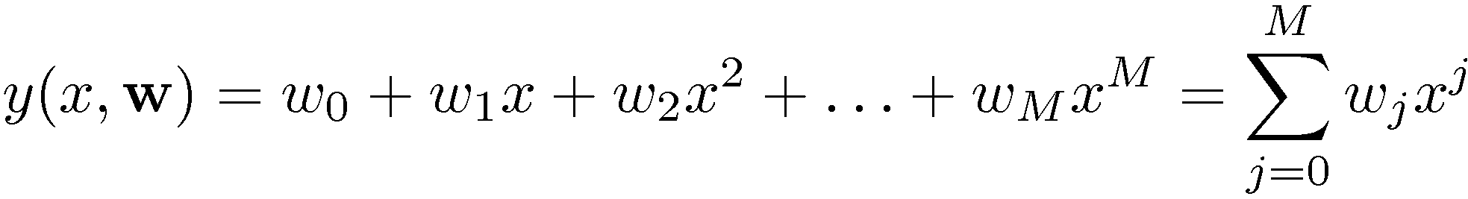
Example of fitting polynomial curve with linear model

Slide 11
Regularization
Complex models (lots of parameters) are often prone to overfitting
Overfitting can be reduced by imposing a constraint on the overall magnitude of the parameters (i.e., by including coefficients as part of the optimization process)
Two common types of regularization in linear regression:
L₂ regularization (a.k.a. ridge regression). Find w which minimizes:
λ is the regularization parameter: bigger λ imposes more constraint
L₁ regularization (a.k.a. lasso). Find w which minimizes:

Slide 12
Other Regression-Based Models
Generalized linear models
Foundation on which linear regression can be applied to modeling categorical response variables
Variance of y is a function of the mean value of y, not a constant
Logistic regression: models the probability of some event occurring as a linear function of a set of predictor variables
Poisson regression: models the data that exhibit a Poisson distribution
Log-linear models (for categorical data)
Approximate discrete multidimensional prob. distributions
Also useful for data compression and smoothing
Regression trees and model trees
Trees to predict continuous values rather than class labels

Slide 13
Regression Trees and Model Trees
Regression tree: proposed in CART system (Breiman et al. 1984)
CART: Classification And Regression Trees
Each leaf stores a continuous-valued prediction
It is the average value of the predicted attribute for the training instances that reach the leaf
Model tree: proposed by Quinlan (1992)
Each leaf holds a regression model—a multivariate linear equation for the predicted attribute
A more general case than regression tree
Regression and model trees tend to be more accurate than linear regression when instances are not represented well by simple linear models

Slide 14
Evaluating Numeric Prediction
Prediction Accuracy
Difference between predicted scores and the actual results (from evaluation set)
Typically the accuracy of the model is measured in terms of variance (i.e., average of the squared differences)
Common Metrics (p_{i} = predicted target value for test instance i, a_{i} = actual target value for instance i)
Mean Absolute Error: Average loss over the test set
Root Mean Squared Error: compute the standard deviation (i.e., square root of the co-variance between predicted and actual ratings)

Slide 15
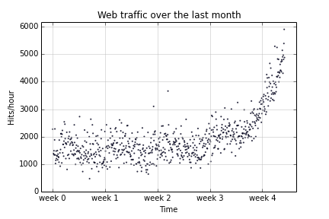
Example: Web Traffic Data

Slide 16
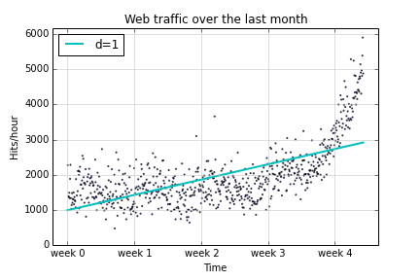
1D Poly Fit
Example of too much “bias” → underfitting

Slide 17
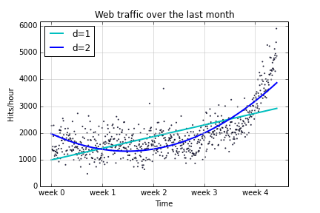
Example: 1D and 2D Poly Fit

Slide 18
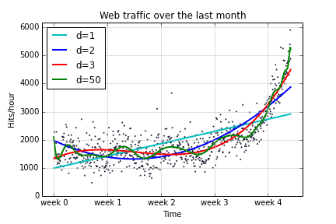
Example: 1D Ploy Fit
Example of too much “variance” → overfitting

Slide 19
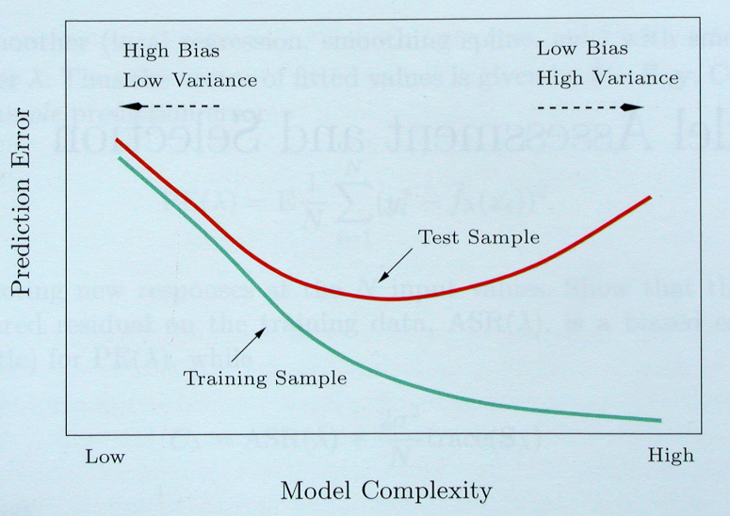
Bias-Variance Tradeoff

Slide 20
Bias-Variance Tradeoff
Possible ways of dealing with high bias
Get additional features
More complex model (e.g., adding polynomial terms such as x₁², x₂² , x₁.x₂, etc.)
Use smaller regularization coefficient λ.
Note: getting more training data won’t necessarily help in this case
Possible ways dealing with high variance
Use more training instances
Reduce the number of features
Use simpler models
Use a larger regularization coefficient λ.

