Slide 1
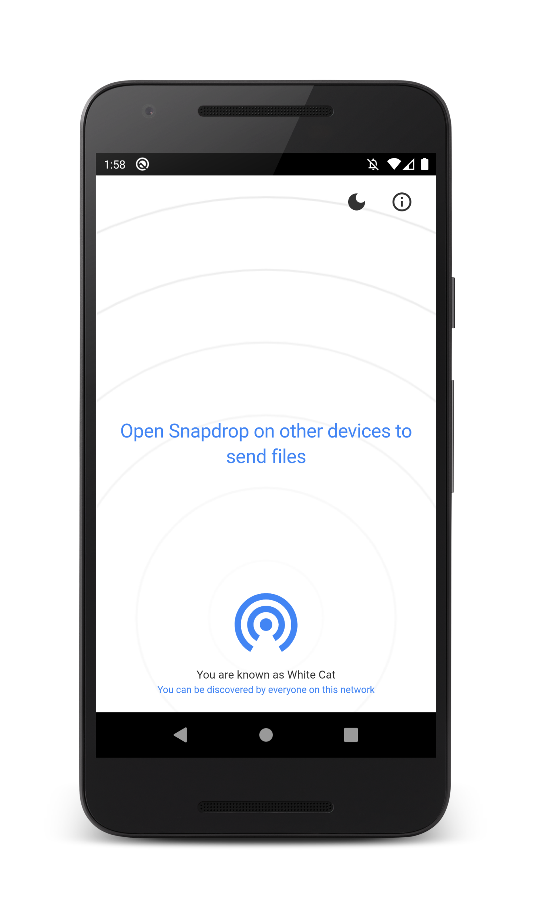
Filesharing
free and open source

Slide 2
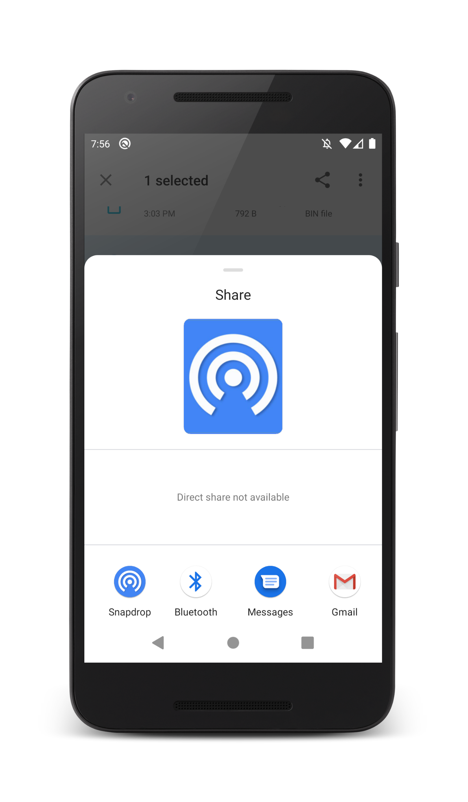
Easy sharing from within other apps

Slide 3
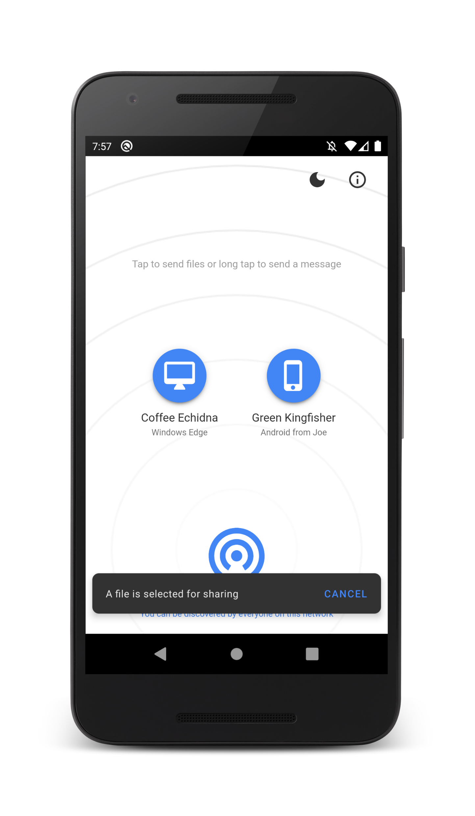
Send selected files
to multiple devices

Slide 4
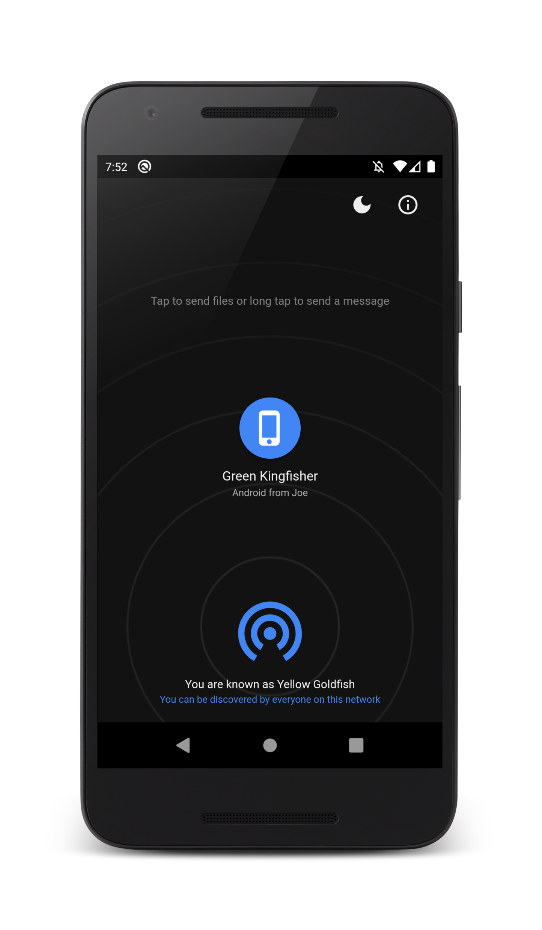
Turn it black
thanks to dark mode

Slide 5
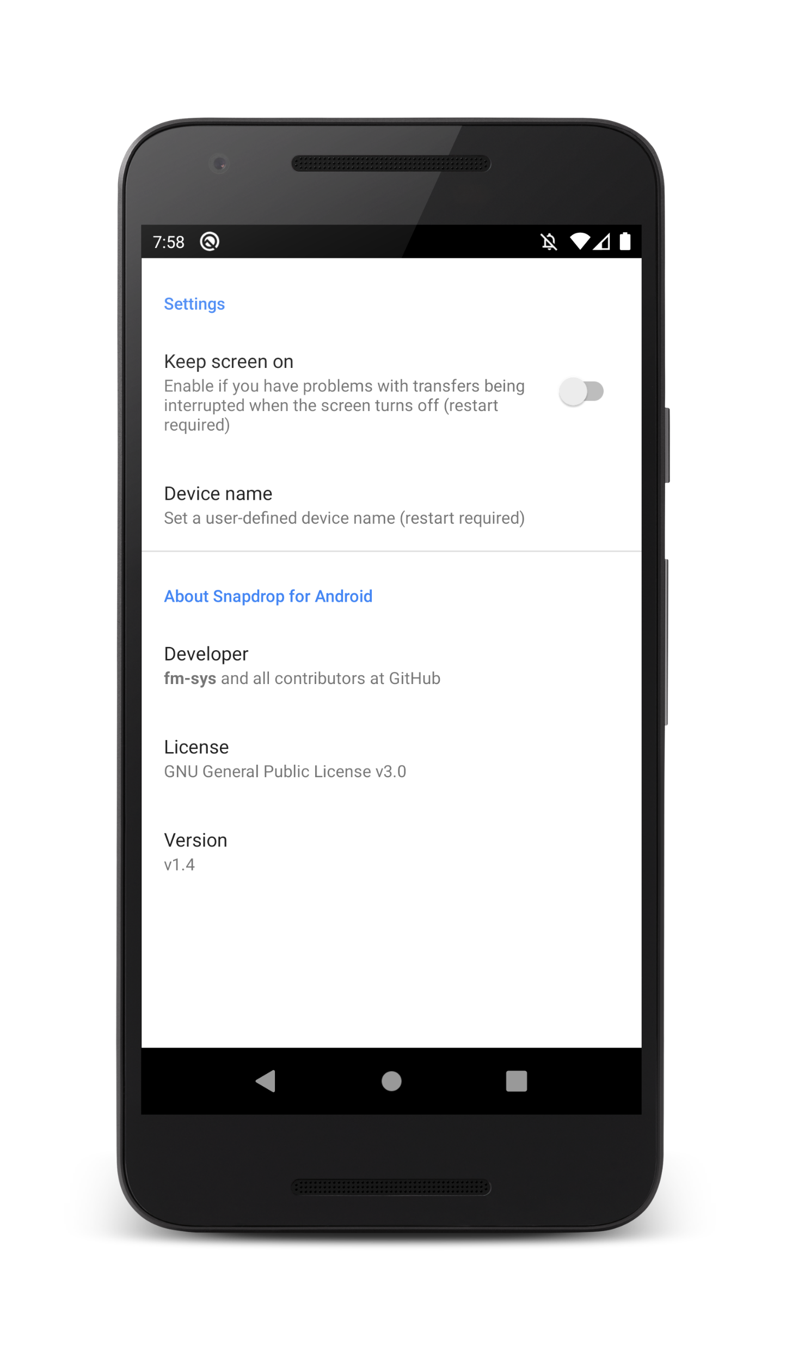
Personalize your
user experience

