Slide 1

FAKEBOOK
CREATED BY: SAMANTHA CAMERLENGO, JORDAN BETHUNE, OREST PANAS, STEEVEN SALONY AND JOSUE ARAGON

Slide 2







The New Networking App!
If you find yourself looking for a new way to create a profile, create posts on your profile to express yourself- Fakebook is the app for you!

Slide 3


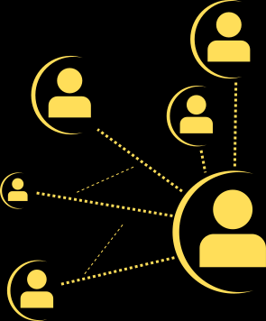

DESCRIPTION
MOTIVATION
USER STORY
Fakebook is a new full-stack application that allows users to create a profile. Once the profile is created, users can create posts to freely express themselves and share their thoughts.
The motivation behind this app was to create a new way for users to network and express themselves.
As a user I want to find an app where I can create a profile and create posts to share my thoughts.

Slide 4







Technologies Used: unique-username-generator
Challenges: We had a hard time getting our routes working and connected.
Successes: Getting posts to create and display
Tasks:
*HTML, CSS, JS: Jordan and Samantha
*Database and Heroku: Josue
*API's & Routes: Orest and Steeven

Slide 5

TIME FOR DEMO!

Slide 6





Directions for future use:
*Create like button on posts
*Edit profile after created account
*Be able to upload photos
*Be able to add other users as friends and view their posts
DIRECTIONS FOR FUTURE DEVELOPMENT

Slide 7





Links:
Heroku Link Here:
Github Repo:
https://github.com/Samantha131821/Fakebook.git

Slide 8
THANK YOU!!

