Slide 1
Book2
File created on: 2/10/2025 8:59:20 PM

Slide 2
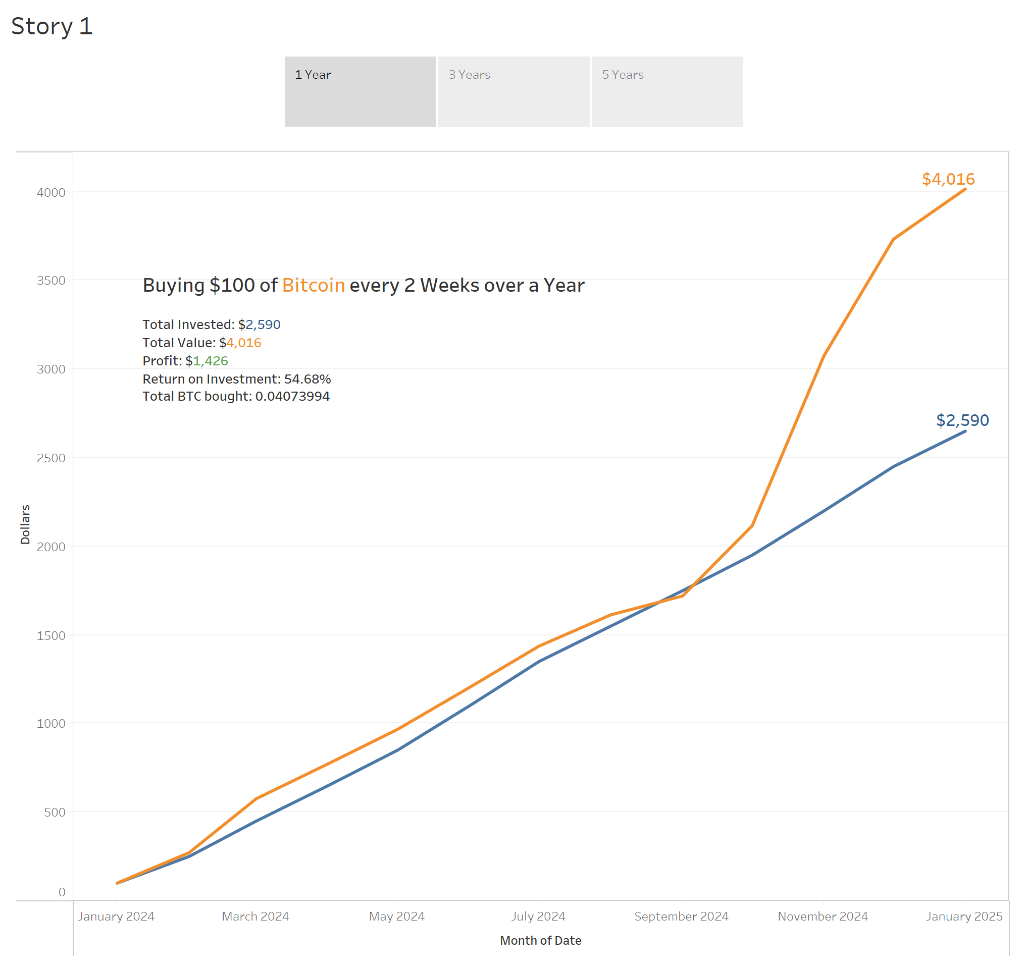

Slide 3
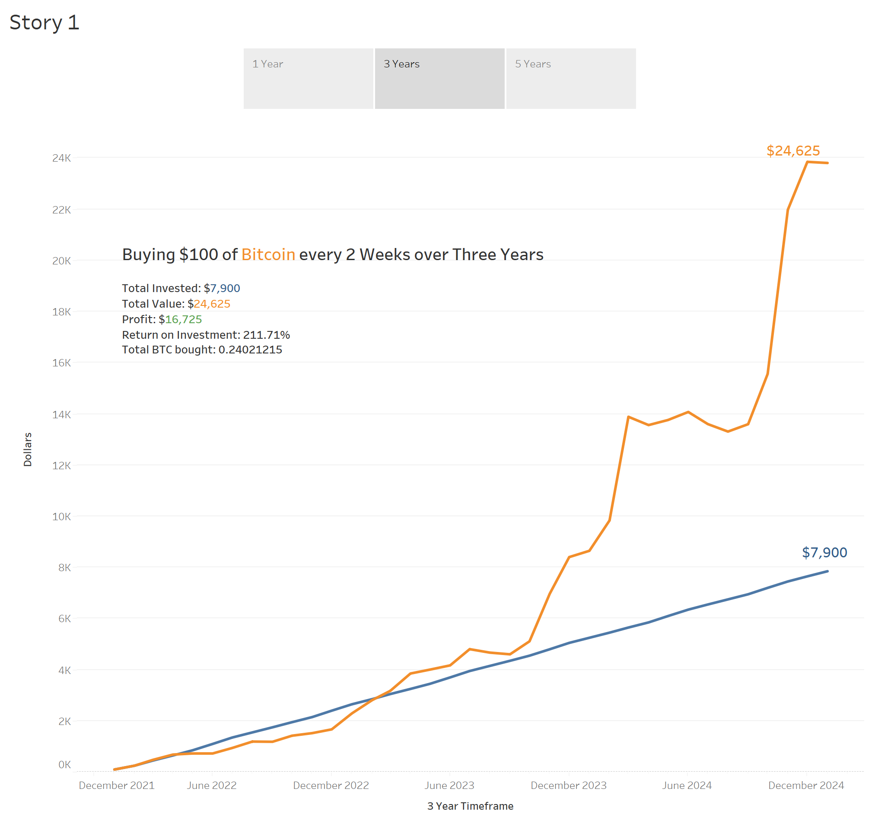

Slide 4
