Slide 1
The Power of Dollar Cost Averaging Bitcoin
Joseph Suckling

Slide 2
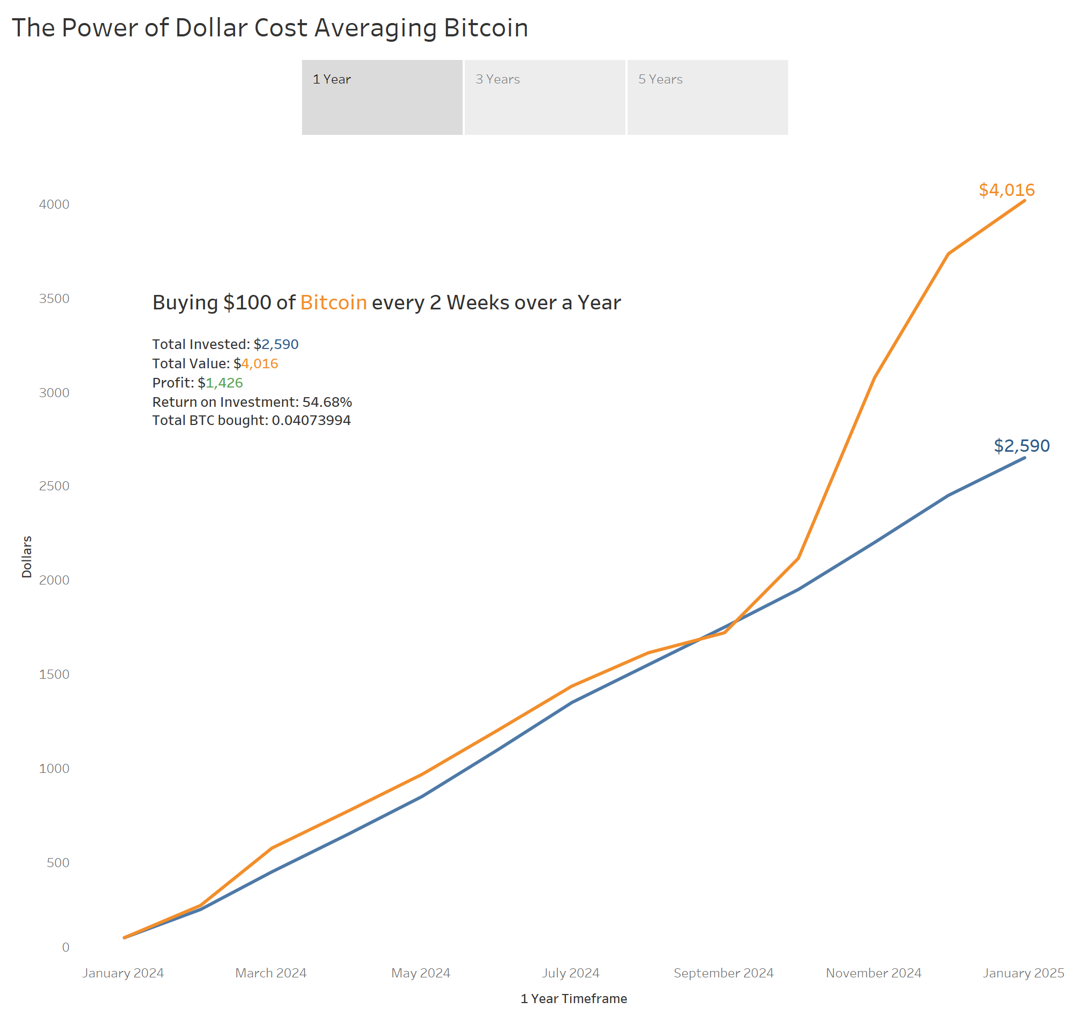

Slide 3
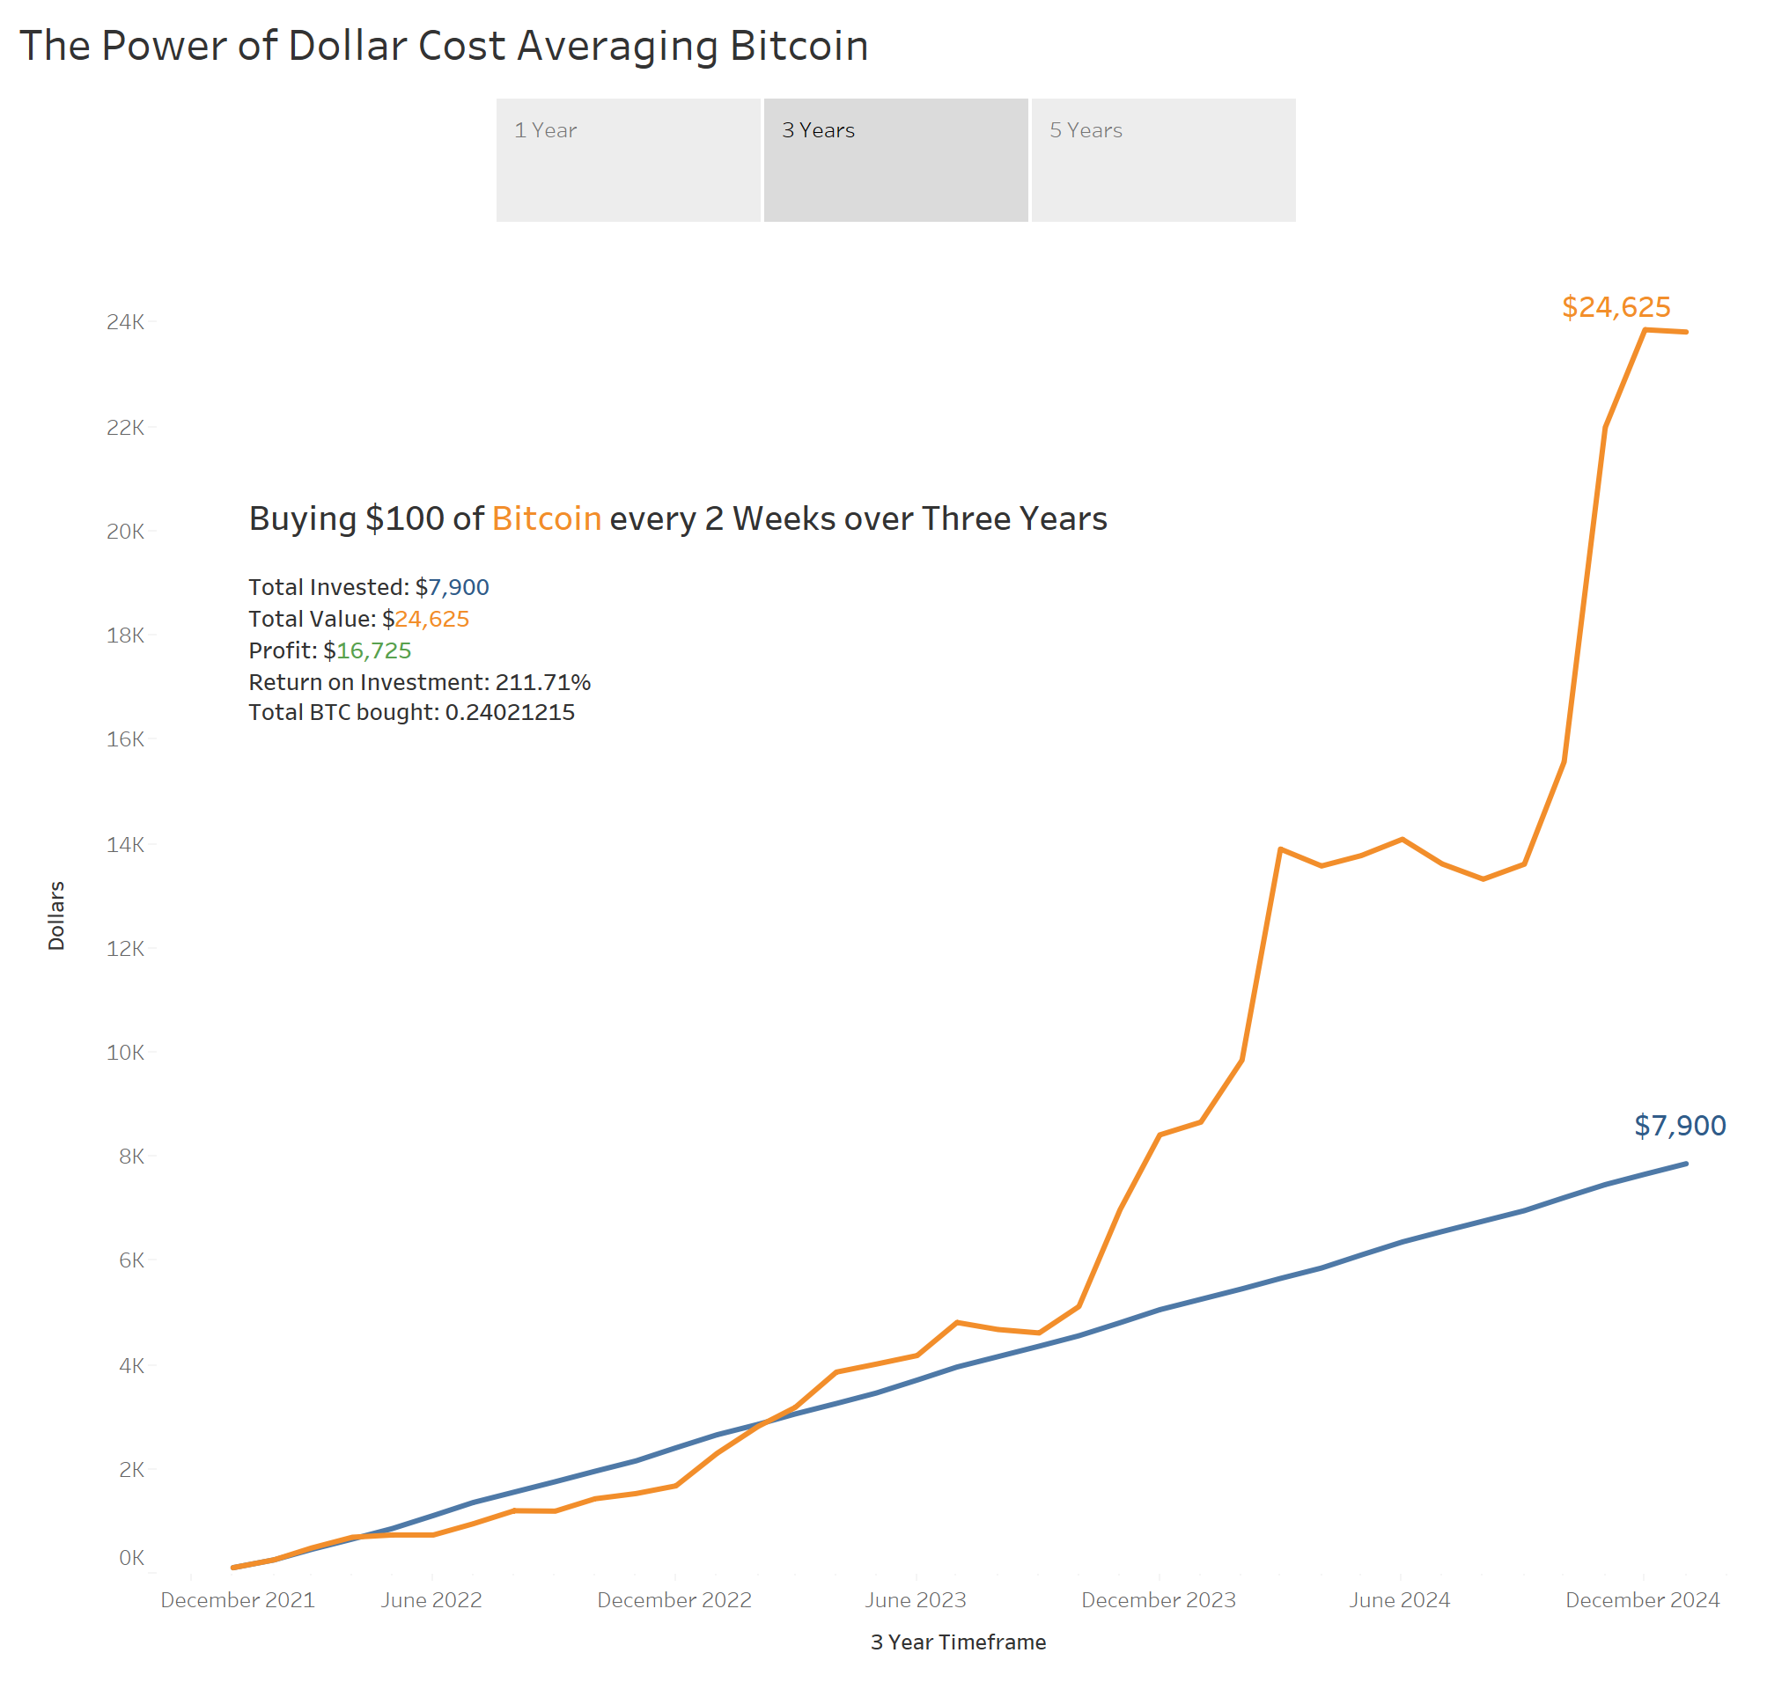

Slide 4
