Slide 1
h2h-analysis
File created on: 2/10/2025 1:47:52 PM

Slide 2
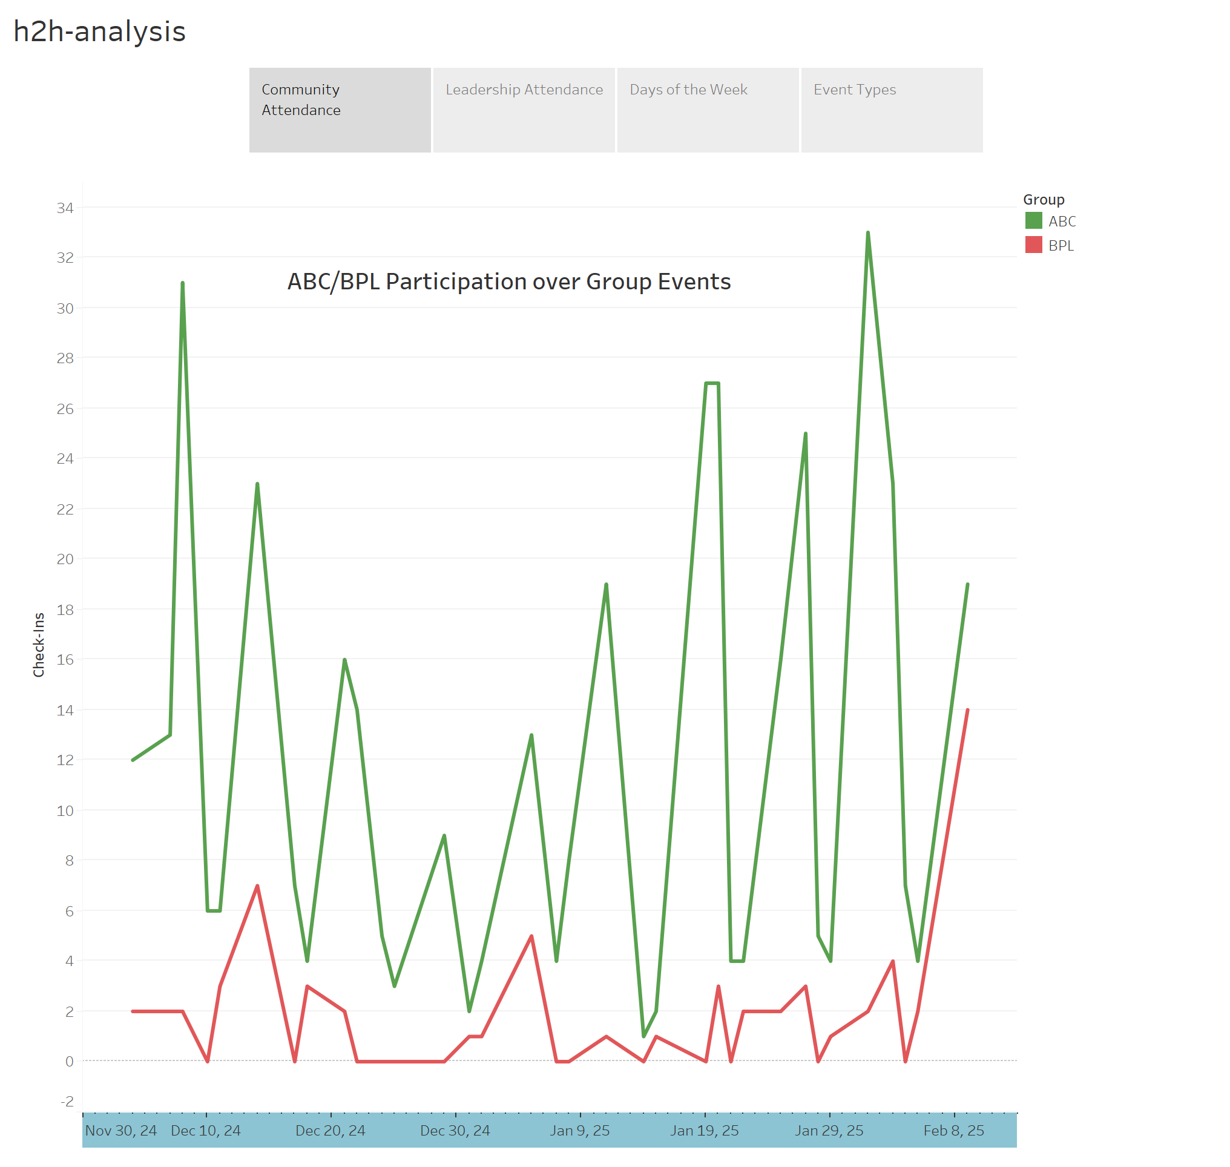

Slide 3
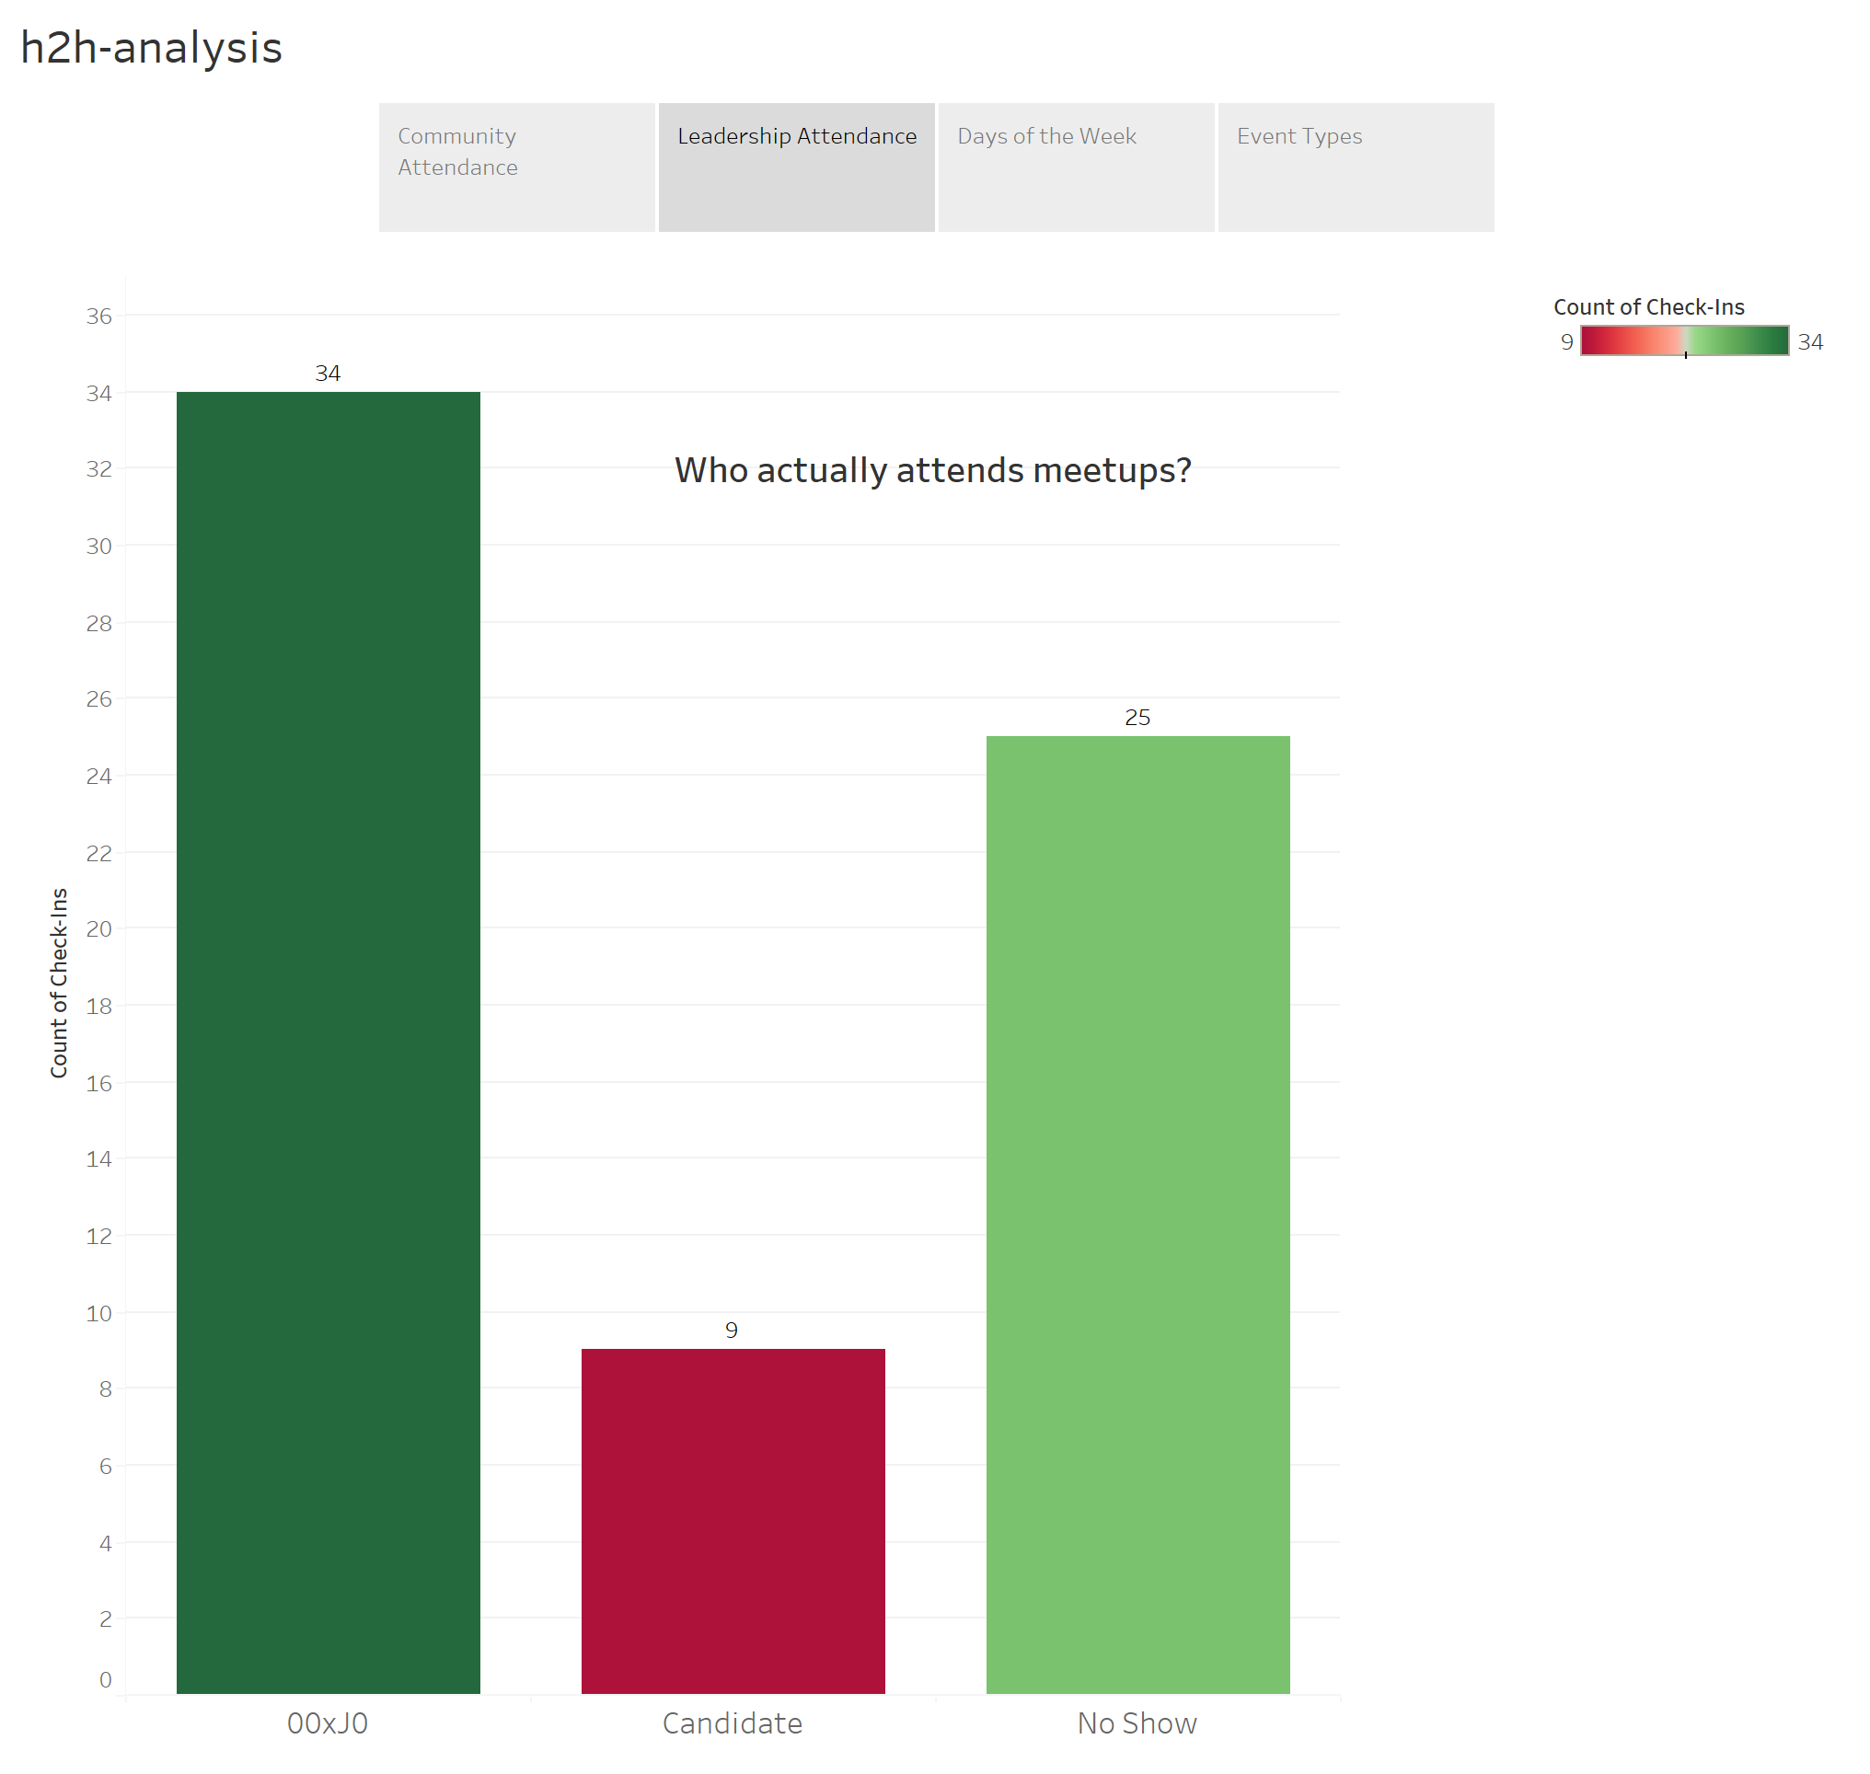

Slide 4
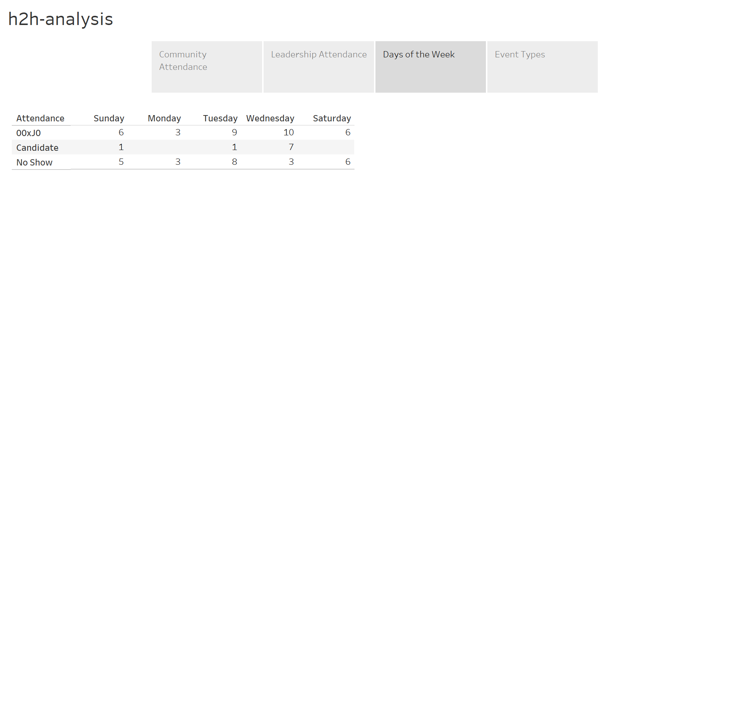

Slide 5
