Slide 1
Over 52,000 individuals are currently being detained in over 200 detention jails across the U.S.
Only 14% will be represented by an attorney when they plead their case in immigration court. Detainees without attorneys may be deported even if they have a valid case to remain here

Slide 2
The idea. . . Create a scalable solution to enable detained immigrants to efficiently contact legal service providers, and relay sensitive information to draft a legal case.

Slide 3
The Challenges
Cellphones are confiscated
Limited access to payphones
Cost-effective
Inter-operable

Slide 4
Current Scenario
Manual data entry to case files using phone banks
Legal services providers visit detention jails to provide in-person legal counsel for as many people as they can while there
The Executive Office for Immigration Review (EOIR) hosts an electronic phone system which gives court information for detained individuals, based on their alien registration number

Slide 5

hereToStay
Protecting the legal rights of all humans, regardless of immigration status

Slide 6

What we propose:
An intelligent voice system using natural language processing and machine learning for getting case information
A digital platform connecting lawyers to detainees
Effectively directing help where it is most needed

Slide 7
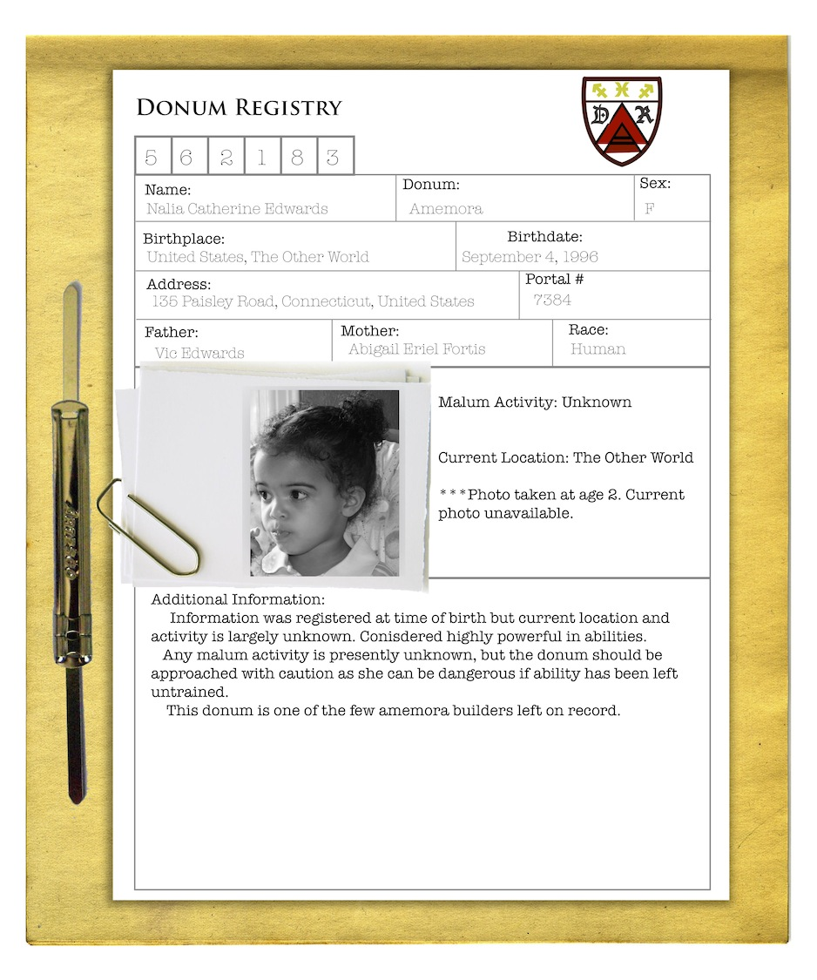
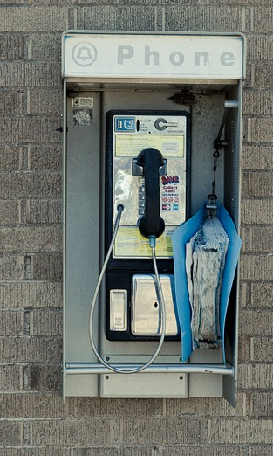


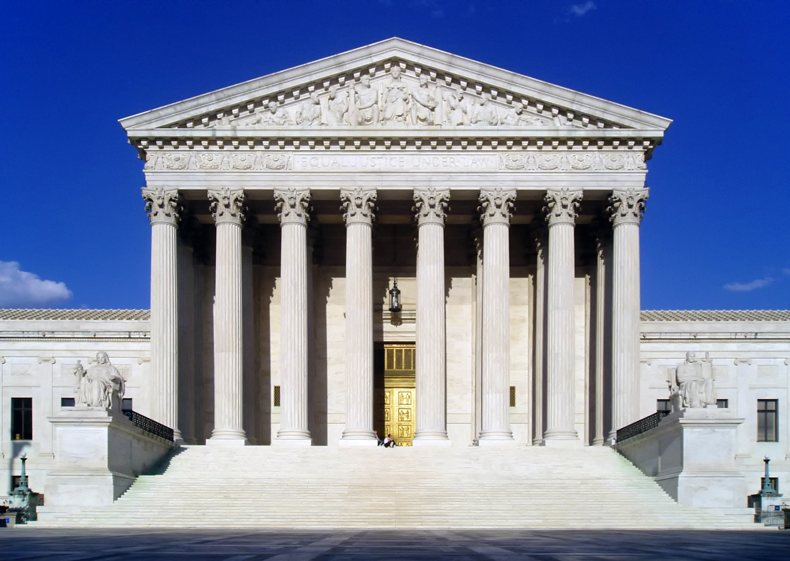
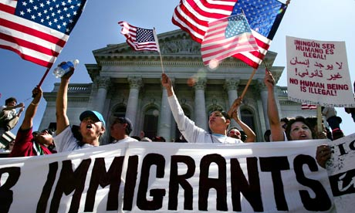
How it works

Slide 8
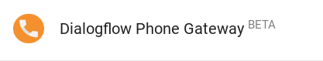




System components

Slide 9
Features:
Cost-effective
< $0.075 per call
Serverless architecture using cloud functions
No internet needed
Interoperable
Stored in firebase
Can be retrieved easily
Connecting lawyers to detainees:
Find the detention centers nearby
Prioritize cases according to earliest court date
Assign a score to each case as per facts of case
Make case files of potential clients ready

Slide 10
Future scope
grouping related cases together
Assigning a score-based system to lawyers for ensuring lawyer engagement
Providing multi-language support

