Slide 1
Zero-Shot Bot
Amogh Mannekote, Oluwapemisin Bandy-toyo, Vyom Pathak

Slide 2
Motivation
Designing a task-oriented dialogue system for a new domain can be data hungry
Schema-guided dialogue + zero-shot transfer approaches aim to transfer knowledge to a new task using just a concise description of the new task.
Research papers evaluate these models on test datasets.
We wanted to see for ourselves the first-hand challenges in using such a model for interactively chatting with an end-user.

Slide 3
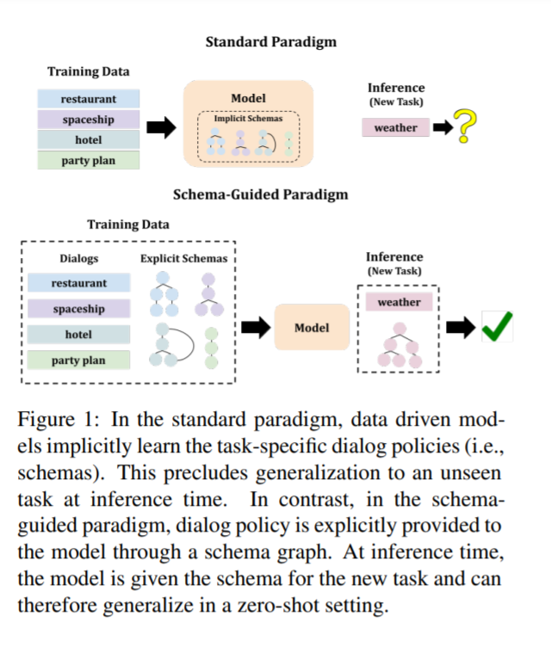
Motivation

Slide 4
System Overview

Slide 5
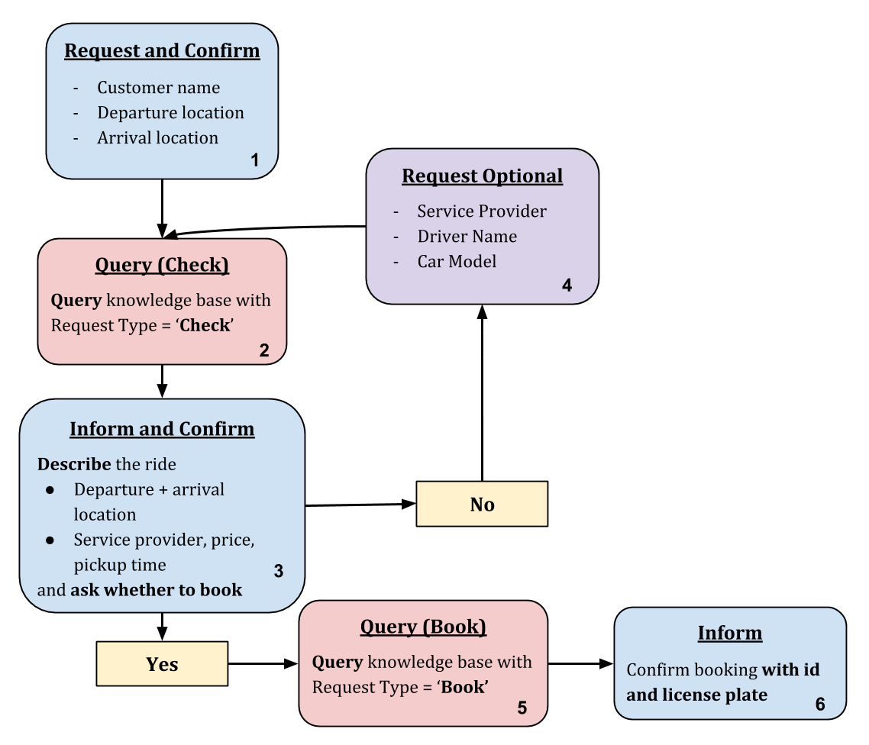
Domain and Task
We chose ride booking as the task for our agent, which helps users book a cab.
We trained the zero-shot model on dialogues from “sibling-domains” such as restaurant table booking, hotel booking, doctor appointment scheduling, etc., and transferred it to this unseen task.

Slide 6
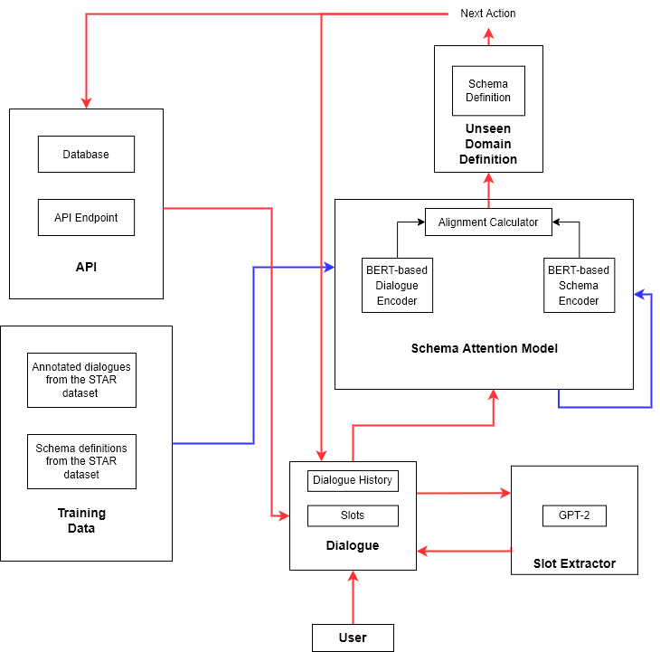
System Architecture

Slide 7
Dialogue Excerpt
USER: >> Can you give me a ride to TeaStory
SYS: >> May I have your name, please?
USER: >> Daniel
SYS: >> OK, and where are you departing from?
USER: >> University of Florida
SYS: >> Alright, where do you want to go?
USER: >> TeaStory
SYS: >> I found a Lyft ride for you from 'University of Florida' to 'teastory' for 33 credits
that could pick you up in 20 minutes. Should I book that for you?
USER: >> Sure
SYS: >> Ok, I have booked you a ride with licence plate '901 FSA'. Your booking ID is '987'.
USER: >> Thanks
SYS: >> Ok, I have booked you a ride with licence plate '901 FSA'. Your booking ID is '987'.
USER: >> goodbye
SYS: >> Goodbye. Enjoy your ride!

Slide 8
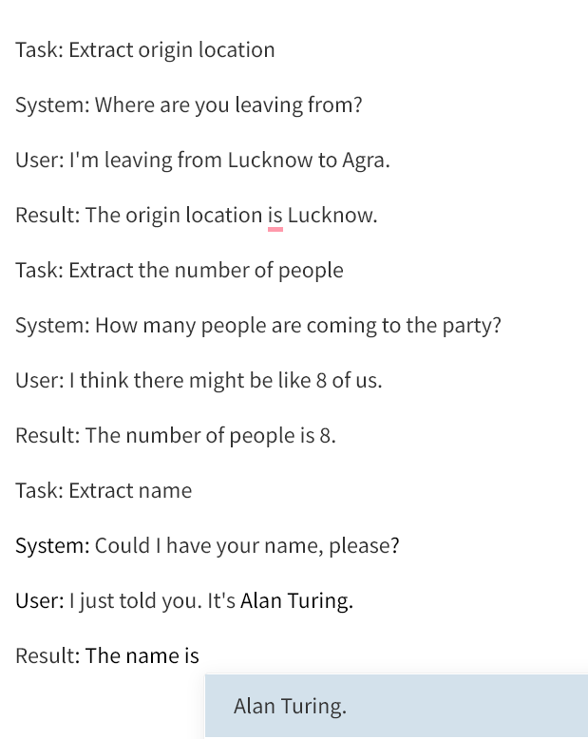
GPT-2 for Slot Extraction

Slide 9
Midterm and Final Evaluation Round Robins
Midterm State
Ability to interactively chat with the model
No persona
Inability to extract entities from input
Bugs in API querying
Improvements in Final State
Ability to extract entities from user utterances
Fixed API query bugs
Added persona to the system utterances to mimic the zero-shot bot’s objective

Slide 10
PARADISE Model and Analysis
Predictors
sys_ver
num_turns
is_happy_path
num_repeat
recog_errors
card_num
query_check_bug
code_error
short_mem
User task Completion Response to “Did the system help you complete your task?” on a scale of 1-10
Ordinal Regression Model

Slide 11
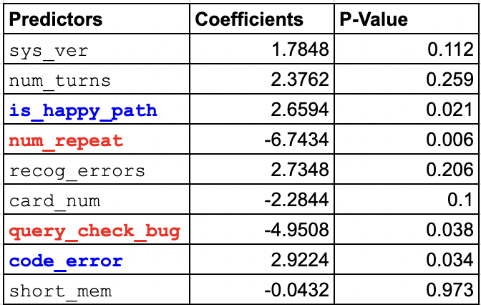
PARADISE Result and Analysis
Significant predictors:
Straying off the happy path is negatively correlated with task success rate
The number of times the system asks “I didn’t quite catch that. Could you please phrase that more explicitly?” is indicative of the dialogue not going as expected.
API Query Bugs in our system were correlated with lower task success rate.

Slide 12
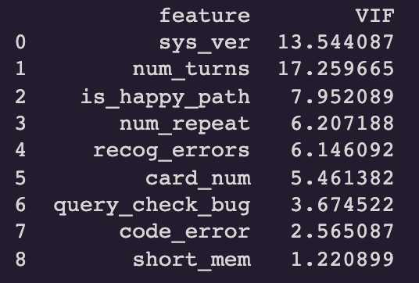
Predictor Collinearity

Slide 13
Goals Review
Minimal Goals:
Run the evaluation script for the Schema attention model.
A chat interface to talk to the ZS-bot.
Basic Goals:
Run the ZS-bot on a custom user-domain.
Bug fixes and improvements.
Stretch Goals:
Ability to process voice input
Answering some research questions

Slide 14
Collaboration Summary
Amogh Mannekote
Came up with the project idea. This involved identifying the research paper in question, understanding it, and brainstorming with Vyom Aasit Pathak and Oluwapemisin Bandy-toyo about ways to turn it into a usable system.
Set up the source code and bug tracking management systems.
Implemented a wrapper layer over the existing model to support chatting with the model.
Added support to the model for handling previously unseen schemas.
Co-worked on the entity extraction module based on GPT3-Neo for the mid-term round robin with Vyom Aasit Pathak
Co-developed the study protocol with Vyom Aasit Pathak for the mid-term round robin.
Helped identify areas of improvement for the system from the mid-term round-robin interactions.
Was actively involved in creating the reports and presentations.
Worked on developing the PARADISE model
Oluwapemisin Bandy-toyo
Creation of a React UI. This is something that we plan to incorporate in future iterations.
Creation of persona/scenario cards which allowed the user to personify someone attempting to complete specific tasks such as booking a ride somewhere.
Transcribing user interactions that occurred during the round robins.
Formulating different portions of the project reports i.e a portion of system architecture description.
Creating alternative schemas for user interactions. This allows for different variations in how the system responds to users .
Taking users through our bot’s testing and survey process during the round robins.
Worked on developing the PARADISE model
Vyom Aasit Pathak
Brainstormed with Amogh Mannekote about the idea on how to use the paper as a viable commercial system.
Co-worked on the entity extraction module based on GPT3-Neo for mid-term round robin with Amogh Mannekote.
Co-developed the protocols and the process to follow for the mid-term round robin with Amogh Mannekote.
Built a more robust GPT-2 entity extraction module with decent priming for final round robin which was a significant improvement.
Was actively partaking in developing the reports, and presentations.
Worked on developing the PARADISE for testing the usability of the dialogue system.

Slide 15
Thank you

