Slide 1
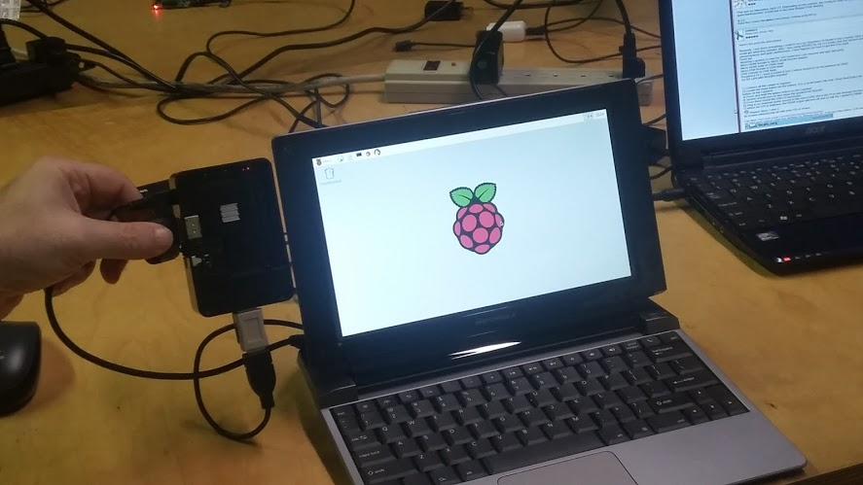

Slide 2


Slide 3


Slide 4
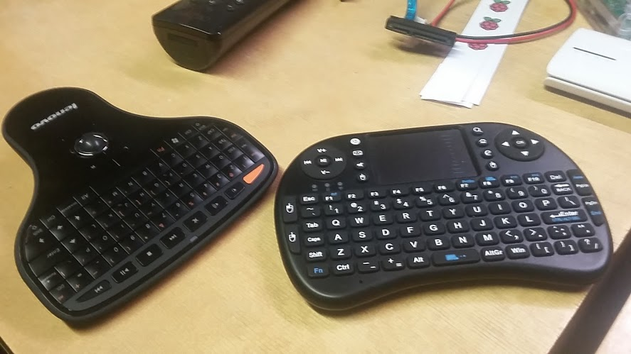

Slide 5
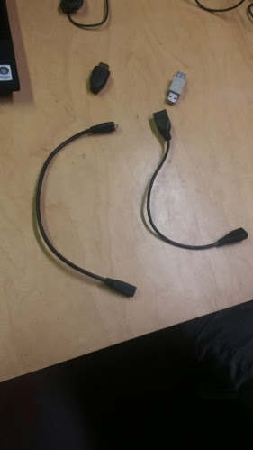

Slide 6
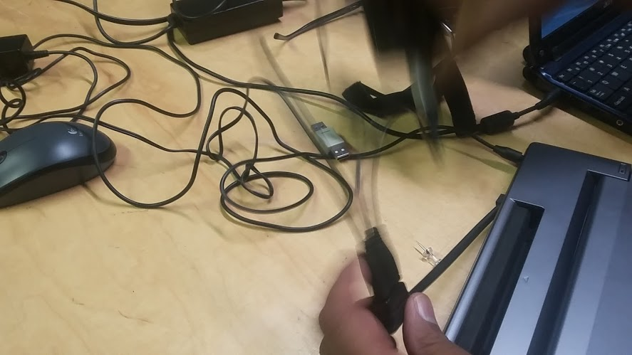

Slide 7
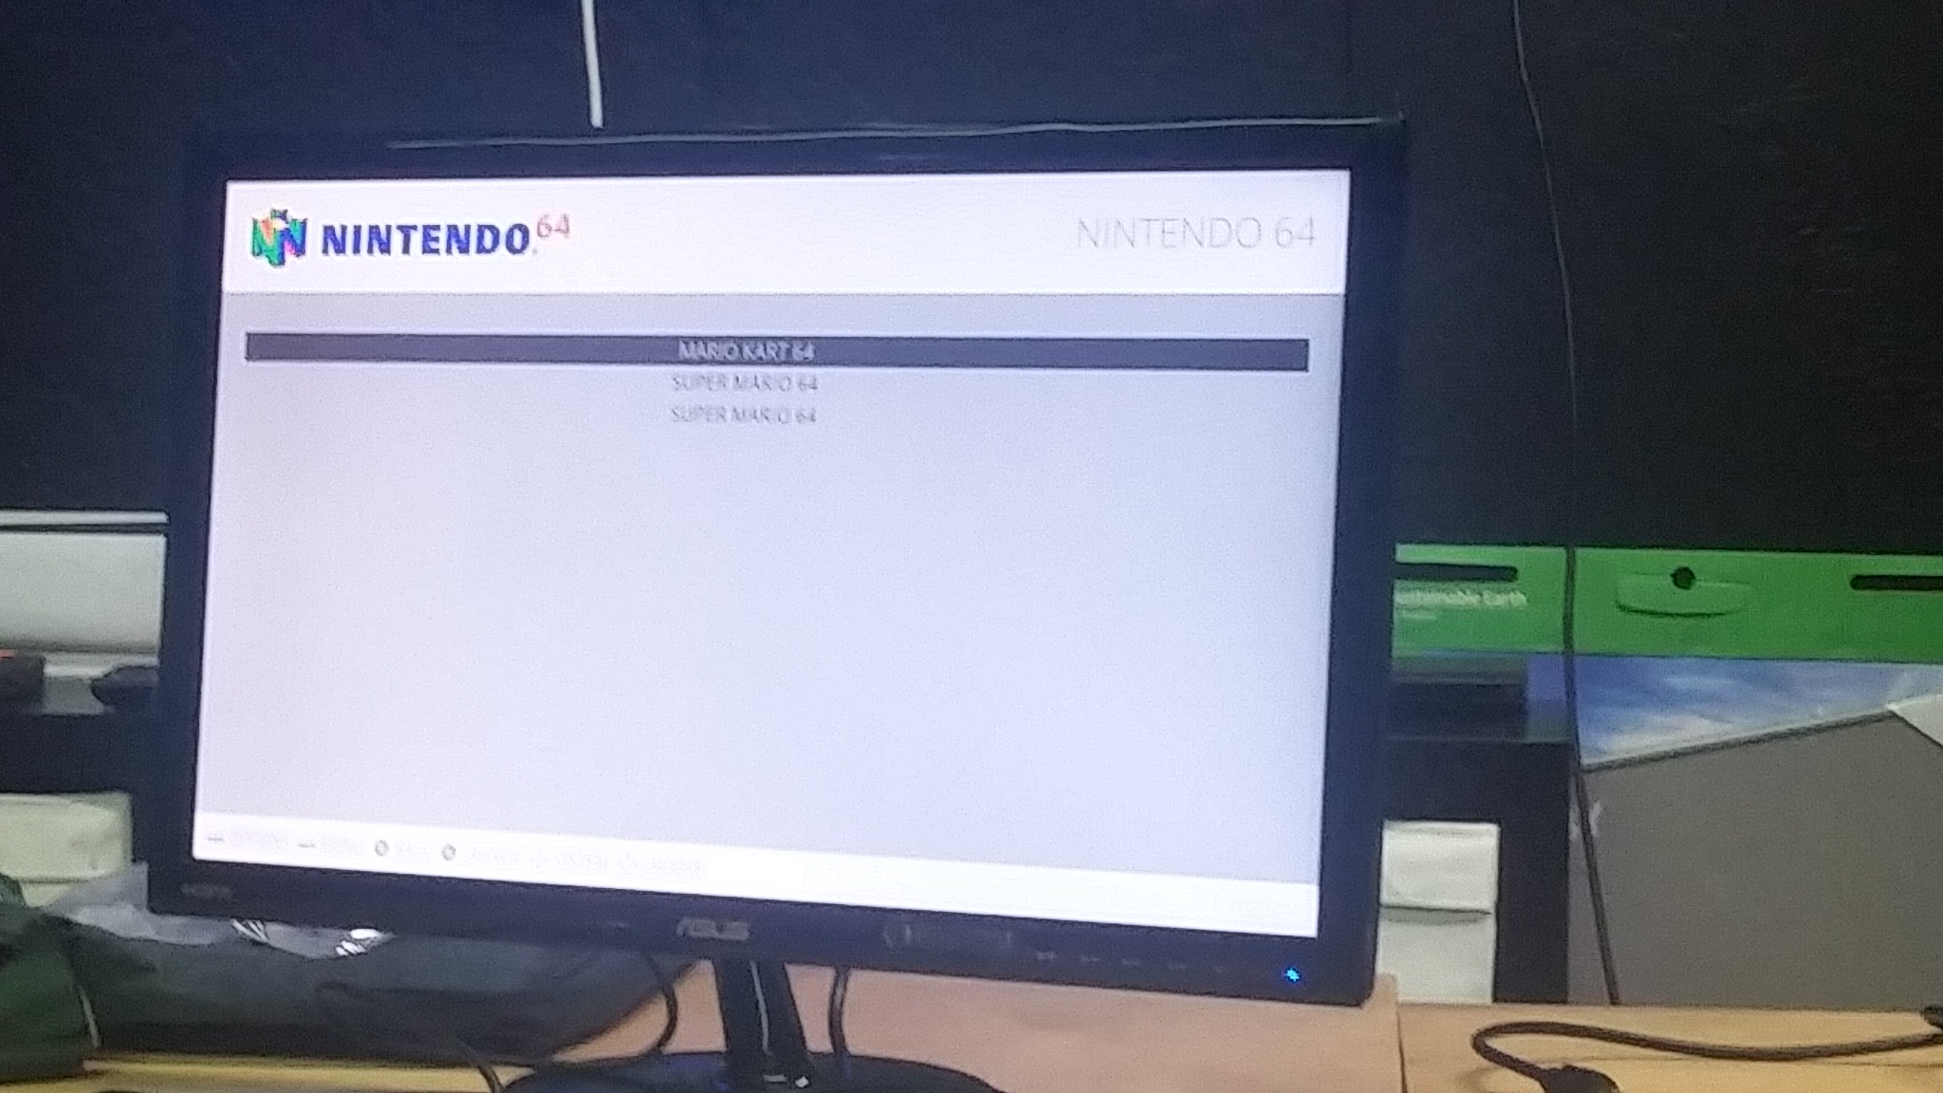

Slide 8
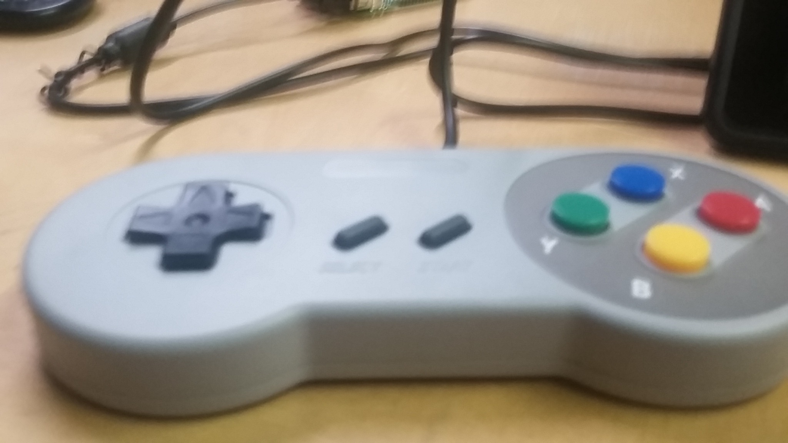

Slide 9
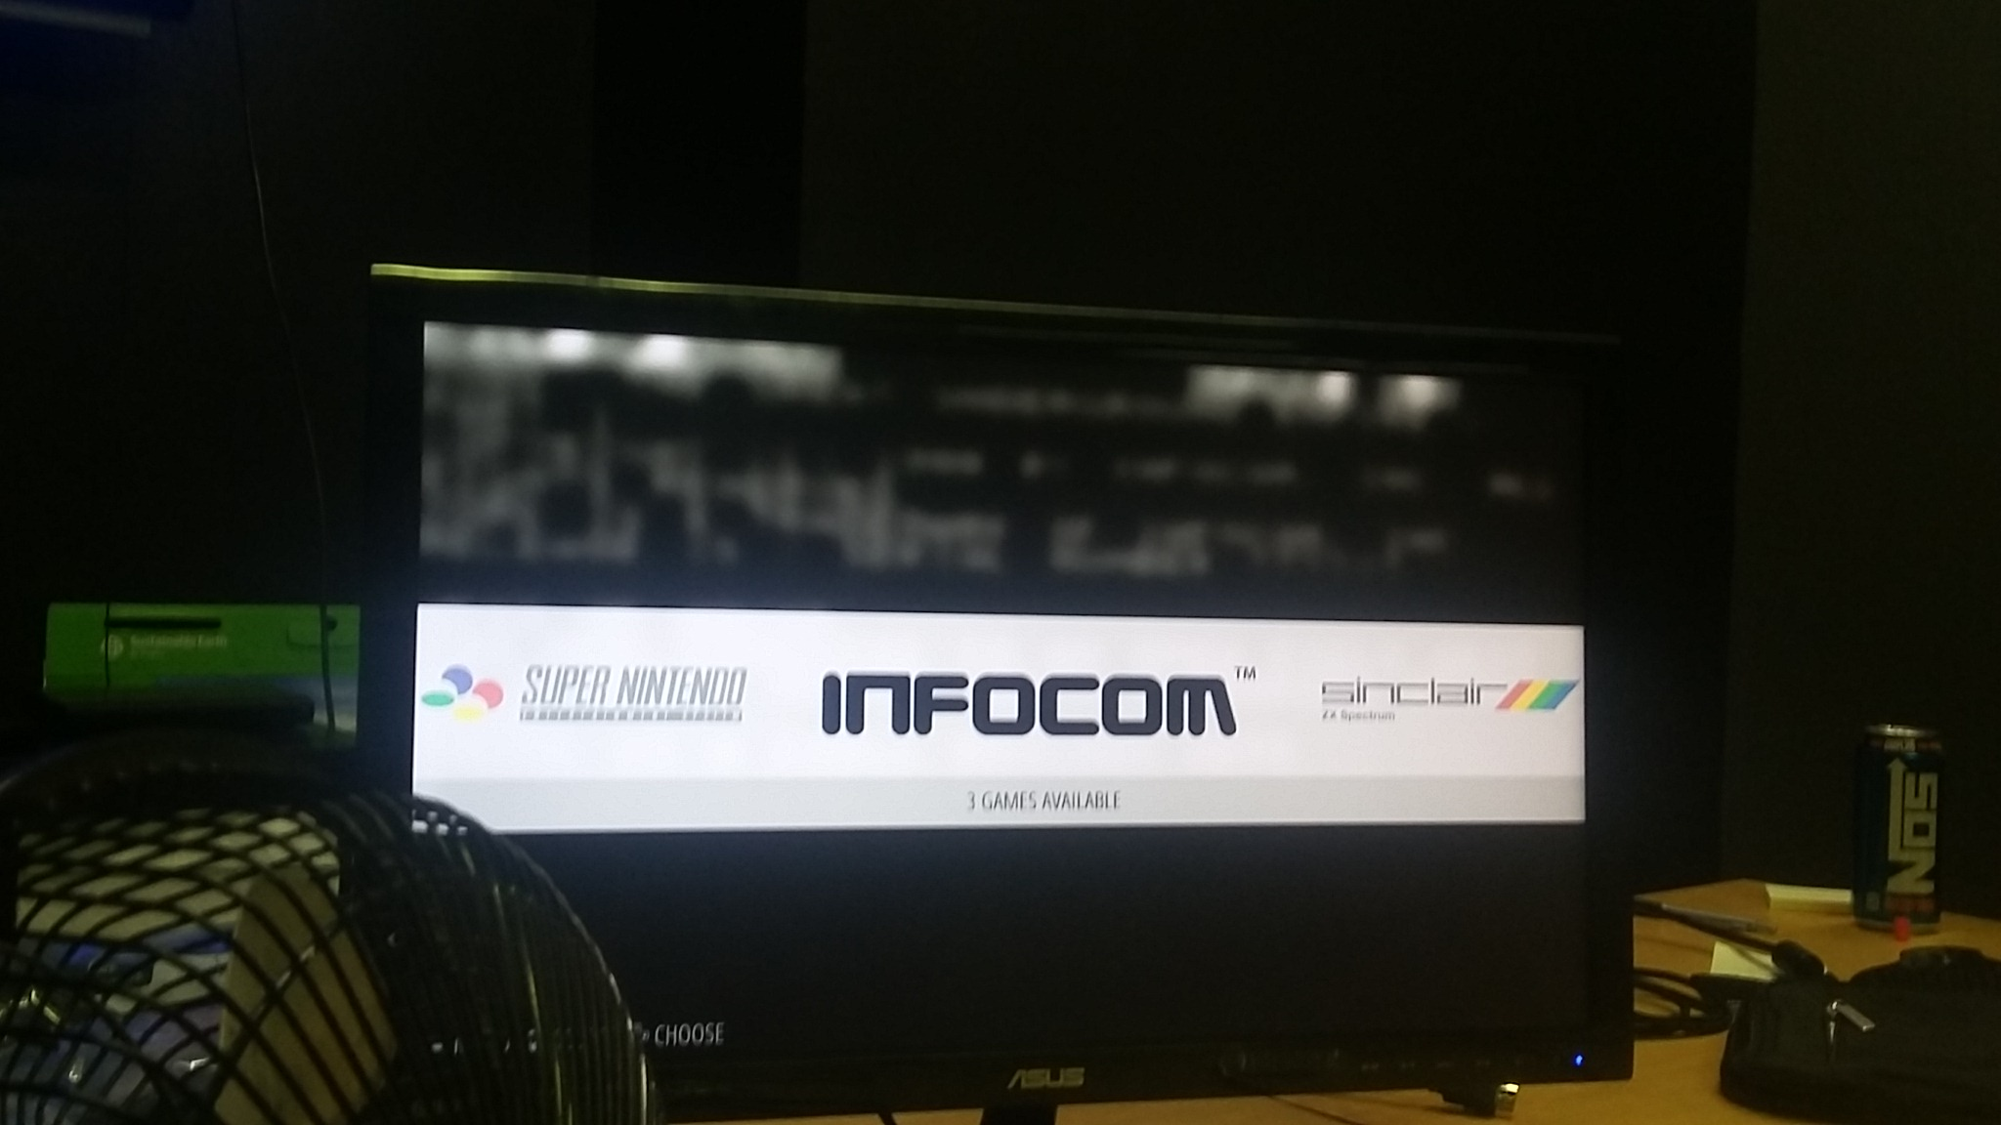

Slide 10
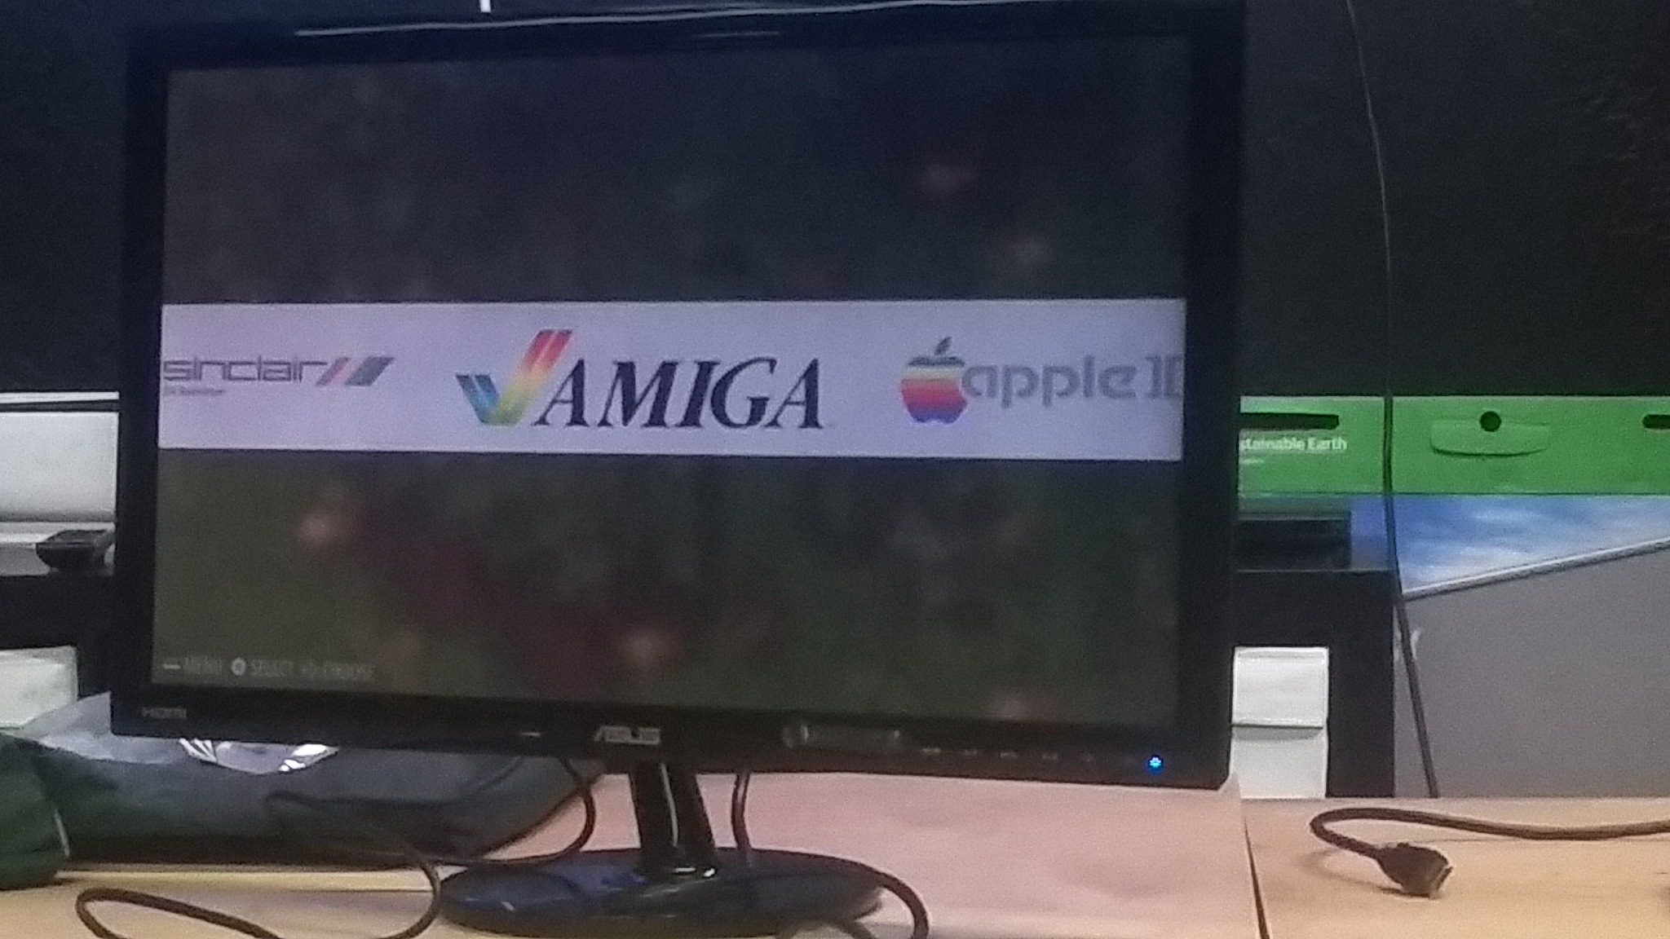

Slide 11
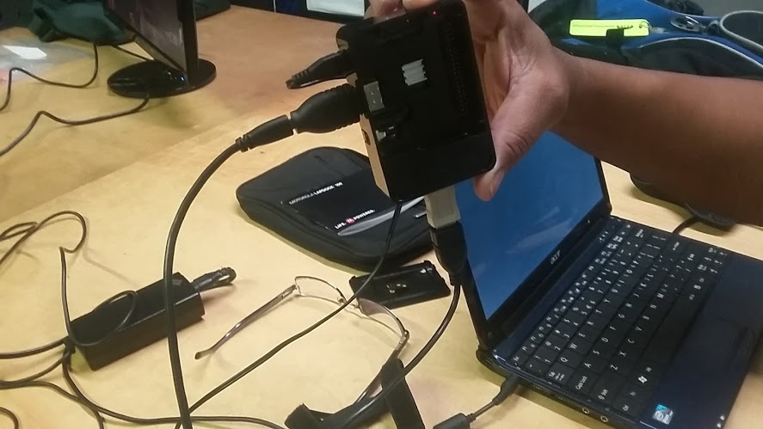

Slide 16
day we got Rudy’s Lapdock working!
At first, it seemed like the lapdock wouldn’t power on.
We checked the power cord with the multimeter and the power cord worked. So, Rudy did some research and tada!!!!
Then, he reset it. He did a reset and a power on at the same time to get it to work. He says you may need to do it a couple times.
15 - 2
We now have a few different keyboard options. One has a trackball that works. When we wanted to see if the trackball works, Alex said he’d give it a whirl.
HDMI Male to Micro HDMI Female Converter (Black)
CY HDMI 1.4 D type Micro HDMI Male to Micro HDMI Female M/F Extension Cable 30cmYCS Basics 9 Inch USB 2.0 A female to Micro B 5 Pin Female Extension Cable1 of SANOXY® USB Gender Changer, A Male To Male

Slide 17
https://www.youtube.com/watch?v=g-WUntsFLLw

