Slide 1
Handmade market section 2

Slide 2
■ Project team: Ahmed Ayman Abd El Aziz Osama Mohamed El Shamy Ahmed Essam Mohamed Ahmed Mohamed Mostafa Abd El Baky Ahmed Hesham Fathallah

Slide 3
Project charter: it is a short document that the project manager creates in the initiation phase of the project that describes the project stakeholders, purpose, deliverables, business case, milestones, assumptions, constraints, and risks.

Slide 4
Purpose of the project:
Handmade manufacturers have difficulty marketing their products and delivering them to consumers, so we've developed a program to make it easier for handmade manufacturers to show their products to the largest number of consumers and provide home delivery.

Slide 5
Business case for the project: Business case is the financial return that the company and the sponsor will get. For every product delivered to a consumer the company gets 5% of its price as benefit, and the sponsor will get 30% of the company’s earnings at the end of every year.

Slide 6
Key deliverables of the project: These are the primary products, services, or results the project should create. Facilitate the marketing and delivering of handmade products, thus reaching the largest number of consumers, and encourage handmade manufacturers to show their products on our platform and improve them.

Slide 7
Milestones: A milestone is an event in the project that shows progress. August: Create the application September: Test the functionalities of the application. October: Solve the problems of the application. November: Launch the application and make an advertisement about it on the social media. December: Get feedback on the program from users.

Slide 8
Project resources: Budget: $ 200,000. A rented server for two years duration. 500 motor cycles for delivery. IT consultant, software developer, UI designer, and marketing consultant.

Slide 9
High-level assumptions and constraints: An assumption is something that’s believed to be true but hasn’t necessarily been proven to be true, A constraint is anything that limits the project manager’s options. - The project must be completed by February 1. - The project must not exceed $ 250,000. - The product must be delivered to the user in three days maximum.

Slide 10
High-level risks: A risk is an uncertain event or condition that may have a positive or negative effect on the project. - Any error in the software or in the server could affect productivity and efficiency of the project. - Any damage done to the product during delivery could affect user satisfaction negatively.

Slide 11
■ Project scope statement: - Product scope description: The product scope is the thing the project will be creating. We will develop an application to help handmade manufacturers market their products thus reaching the largest number of consumers and we will provide delivery service.

Slide 12
Product acceptance criteria: The product acceptance criteria clearly define what the project must create in order for the project to be accepted by the customer and for the project to be considered completed. - The application must have a fast and secure delivery service that guarantees consumers and manufacturers their rights. - The application must have an online payment service. - Users can submit their feedback on the products so that manufacturers can consider their opinions.

Slide 13
Project deliverables: These are the primary products, services, or results the project should create. Facilitate the marketing and delivering of handmade products, thus reaching the largest number of consumers, and encourage handmade manufacturers to show their products on our platform and improve them.

Slide 14
Project exclusions: It’s important to define what’s excluded so that there’s no confusion when the project manager wants to close the project and the project customers are expecting more deliverables. - it’s not available to show products that are not handmade on our platform. - international shipping is not available. - dealing with foreign currency is not available.

Slide 15
Project constraints: A constraint is anything that limits the project manager’s options. - The project must be completed by February 1. - The project must not exceed $ 250,000. Project assumptions: An assumption is something that’s believed to be true but hasn’t necessarily been proven to be true. -The products must be delivered to the consumers without any damage. -The product must be delivered to the user in three days maximum.

Slide 16
Work breakdown structure (WBS) it’s breaking work into smaller tasks to make the work more manageable and approachable. 22.1. Initiating 22.1.1. Appoint the project manager and project team 22.1.2. Create the project charter 22.2. Planning 22.2.1. Scope management plan 22.2.2. Cost management plan 22.2.3. Risk management plan 22.2.4. Schedule management plan

Slide 17
22.3. Executing and controlling 22.3.1 Create the application 22.3.1.1 Software design 22.3.1.2 Building a software model 22.3.1.3 Constructing code 22.3.1.4 Testing 22.3.2 Design user interface 22.3.3 Launch the application 22.3.4 Market the application 22.3.5 Get feedback from users and improve the application performance 22.4. Closing 22.4.1 Conduct closeout meetings 22.4.3 Create project closeout documentation

Slide 18
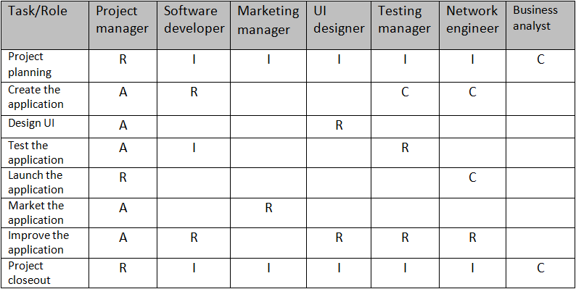
Roles and responsibilities matrix: it’s responsibility assignment chart that assigns tasks to the project team.

Slide 19
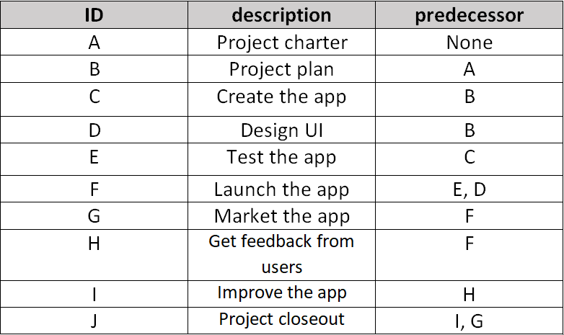
Project network: The project network is a visual flow diagram of the sequence, interrelationships, and dependencies of all activities that must be accomplished to complete the project.

Slide 20
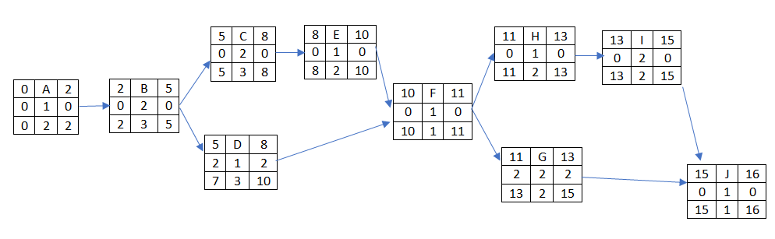
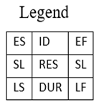

Slide 21
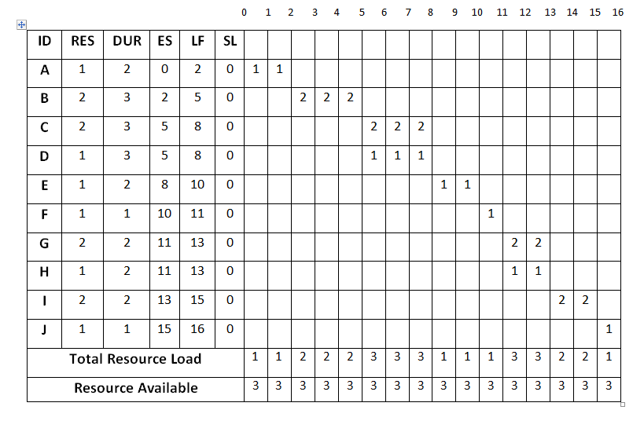
Resource constrained project:

Slide 22
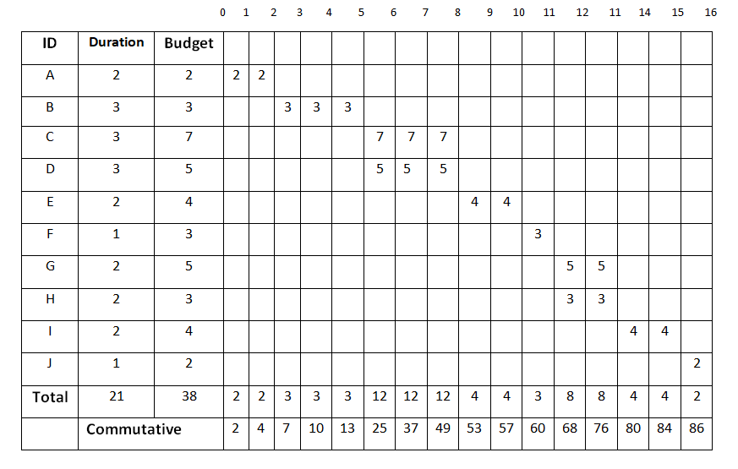
Time-Phased Budget Baseline:

Slide 23
Risks: - Any error in the software or in the server could affect productivity and efficiency of the project. We can handle this risk by constantly testing the software and the server for any error and fixing them if there any. - Any damage done to the product during delivery could affect user satisfaction negatively. We can handle this risk by providing a safe and secure delivery service. Monitoring: it’s simplified explanation of the tasks of the project

