Slide 1
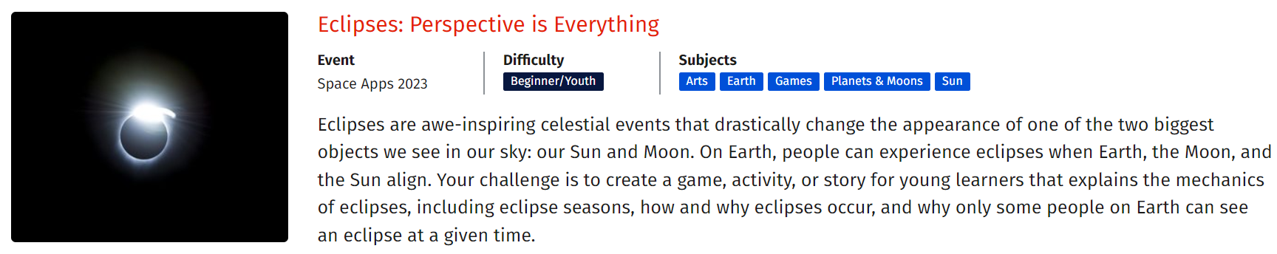
NASA Space Apps Challenge
By Team Lunavate

Slide 2
Eclipse is a beautiful Phenomenon
Eclipse occurs when celestial bodies align in such a way that one body partially or completely obscures the light from another.
This phenomenon creates moments of mesmerizing beauty as the world is temporarily cast into shadow or bathed in the soft glow.
Eclipses, whether they are solar or lunar, have fascinated people throughout history, reminding us of the stunning grandeur of our universe.

Slide 3
Solar Eclipse
Lunar Eclipse
A solar eclipse happens when the Moon moves directly between the Sun and the Earth, blocking out the Sun's light, and casting a shadow on a portion of the Earth's surface, creating moments of darkness during the day.
A lunar eclipse occurs when the Earth passes directly between the Sun and the Moon, causing the Earth's shadow to be cast on the Moon's surface, often resulting in the Moon taking on a reddish hue.

Slide 4
Our Approach
We are creating a Flutter application that offers a captivating visual experience to showcase the celestial beauty of Solar and Lunar Eclipses.
Our app provides users with a realistic representation of these astronomical events, including the dynamic interactions of the Sun, Earth, and Moon.
Through near to perfect and intricately calculated shadow rendering, users can explore and understand the intricate dynamics of these phenomena.
Additionally, we have incorporated an interactive feature, allowing users to engage with the Moon's revolution, making the learning experience both educational and visually engaging.

Slide 5
Our Design
Eclipse Demo
i
We aimed to capture the mesmerizing beauty of celestial events by creating a visually immersive experience.
Our app showcases the elegant choreography of the Sun, Earth, and Moon as they orbit the Earth continuously in an infinite cosmic space.

Slide 6
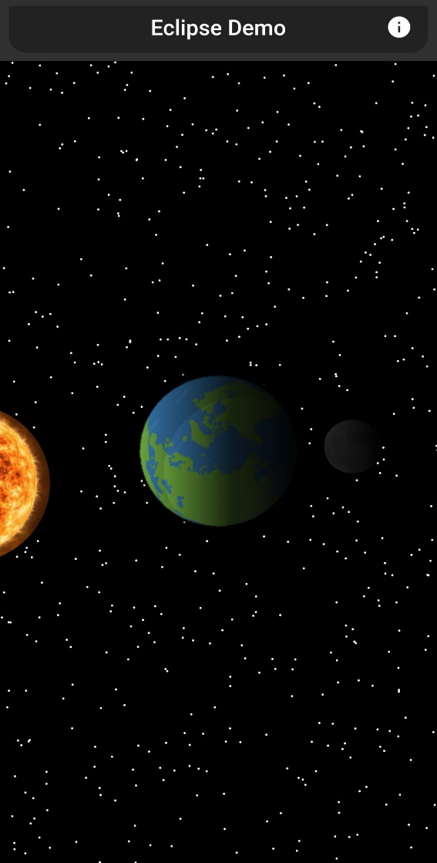
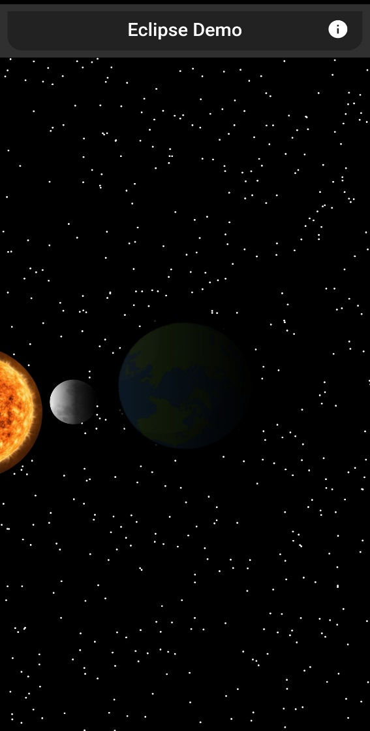
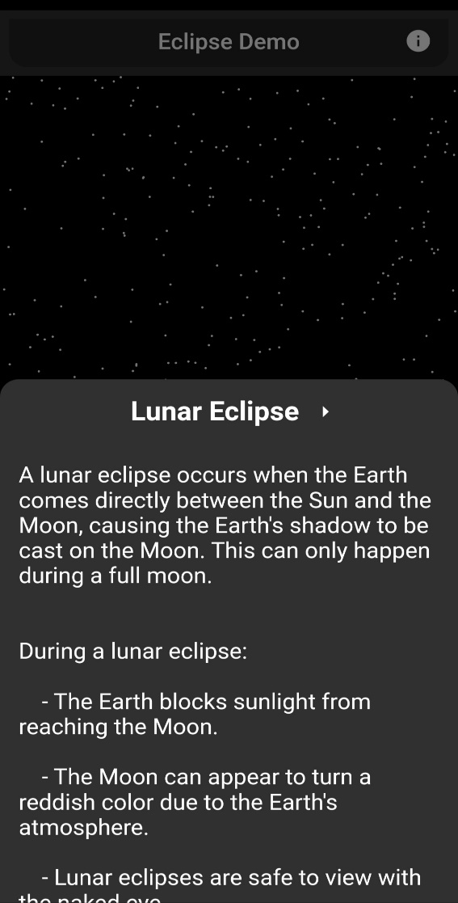
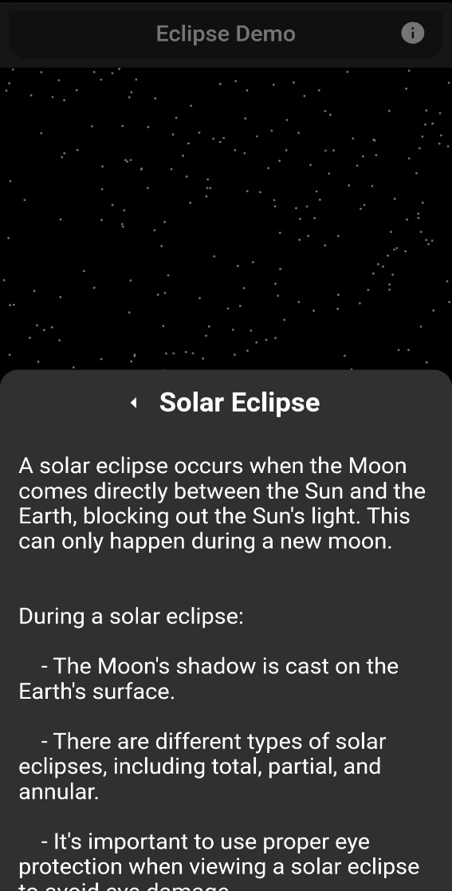
Our Resulting App

Slide 7
Thank You
NASA Space Apps Challenge
For this amazing opportunity,
- Team Lunavate

