Slide 1
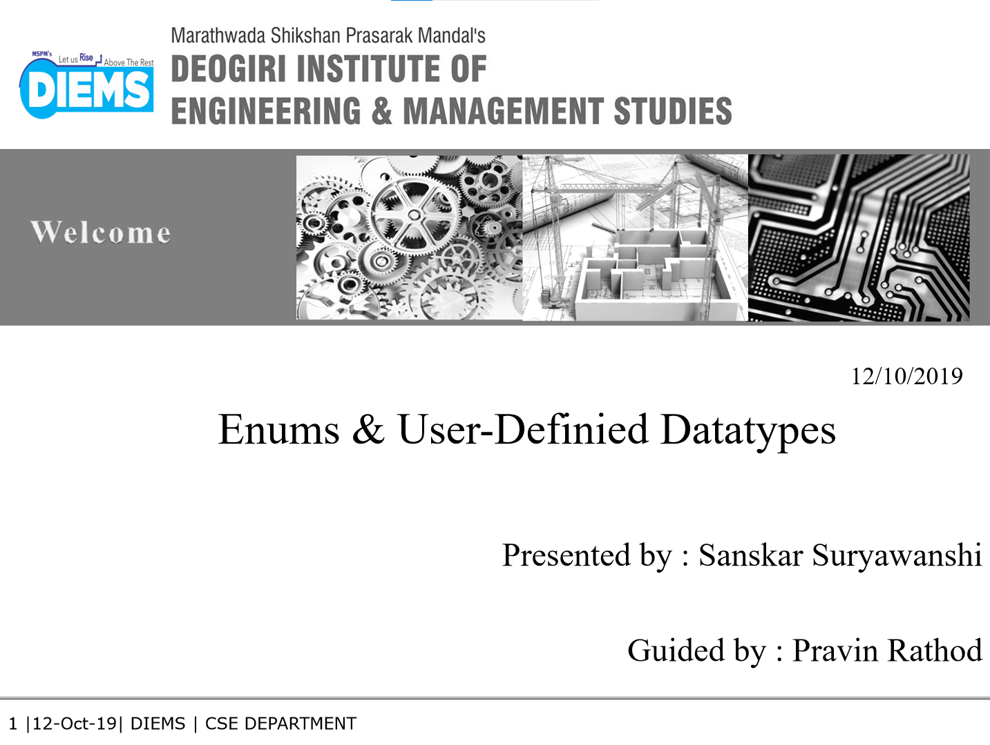

20/06/2023
DAA CA-II [PAC-MAN SAFE OPTIMAL PATH]
[26022]
Guided by : Prof. Ashwini Gaikwad
20/06/2023

Slide 2
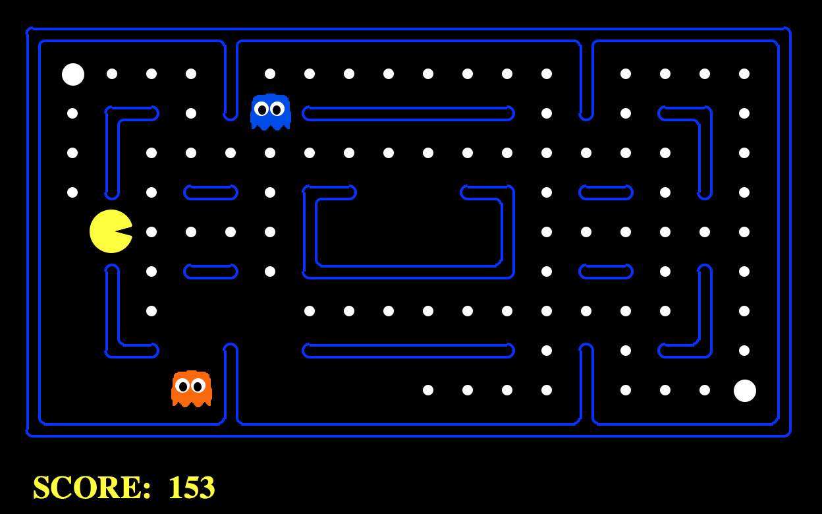
PAC-MAN
FOOD PELLET
GHOST
PAC-MAN
FOOD PELLET
GHOST

Slide 3
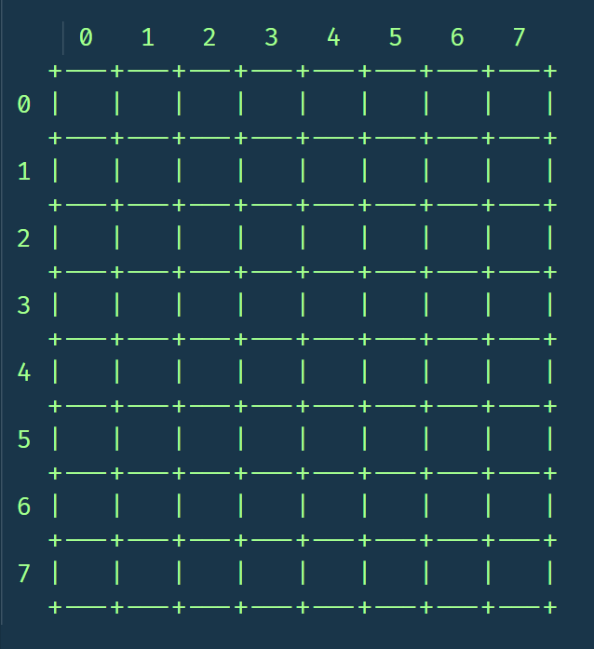
GAME STAGE

Slide 4
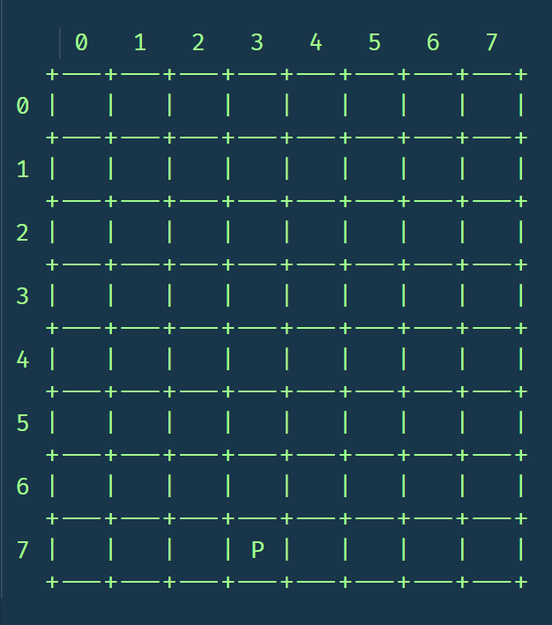
Place Pac-man at (7,3)

Slide 5

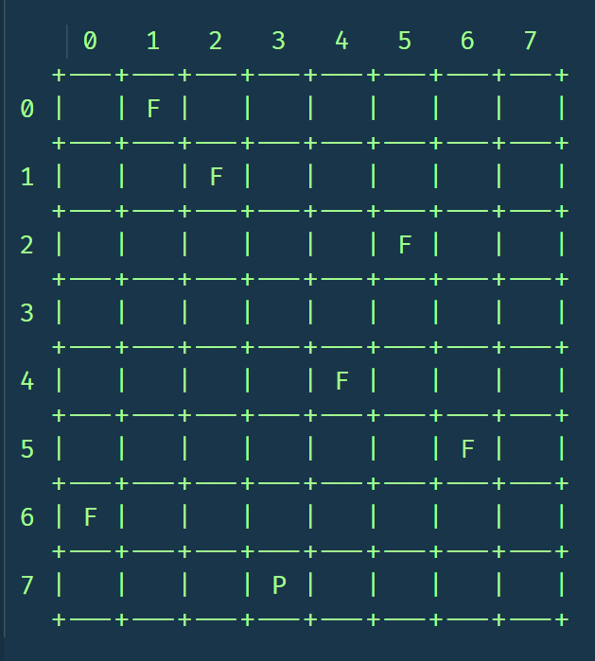

Place Food Item

Slide 6

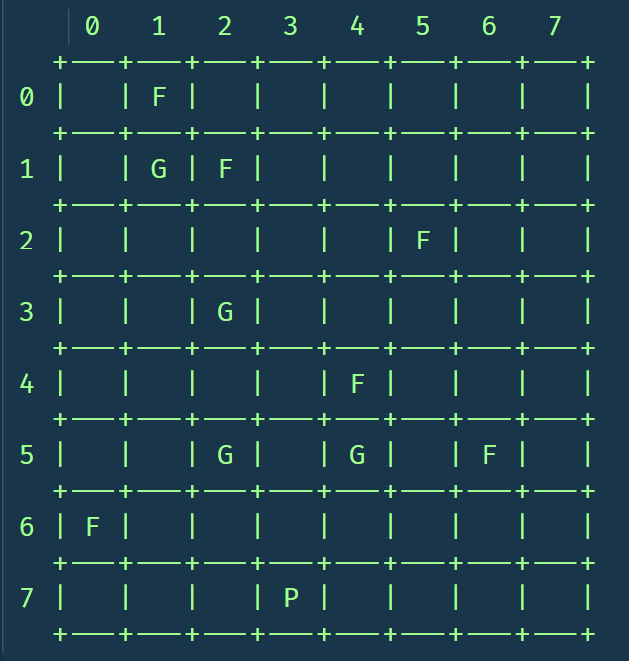
Place Ghosts

Slide 7
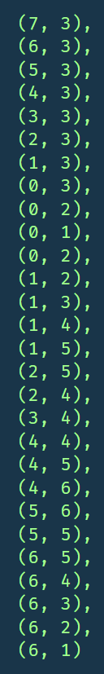
SOLUTION

Slide 8
ON TO THE CODE

Slide 9
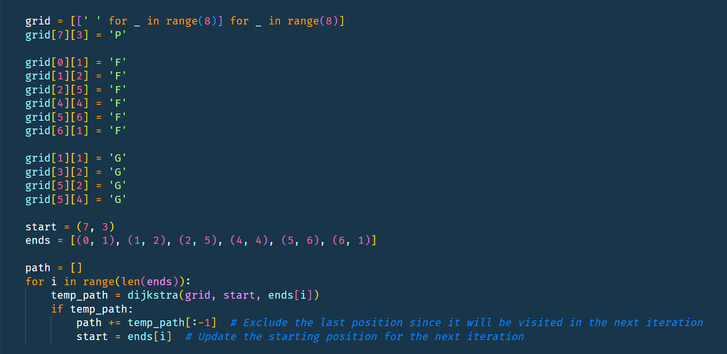

Slide 10
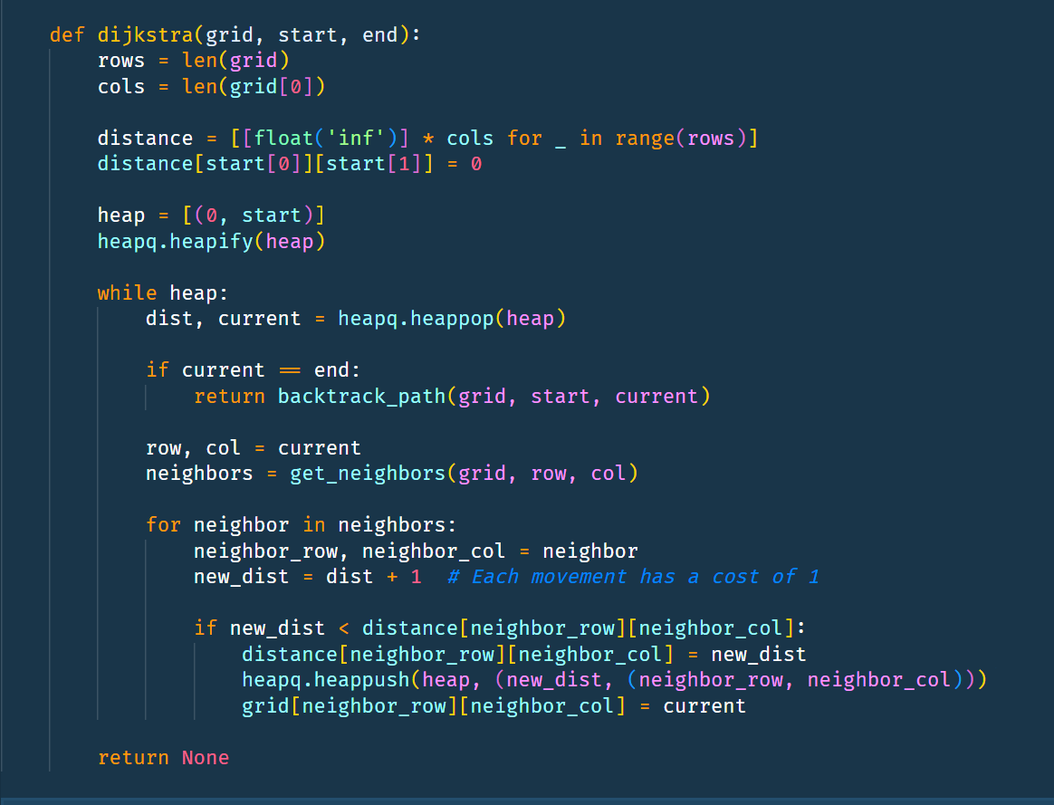

Slide 11
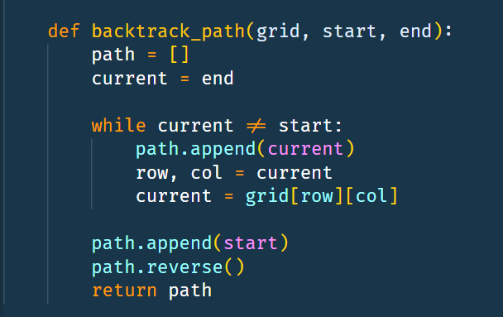
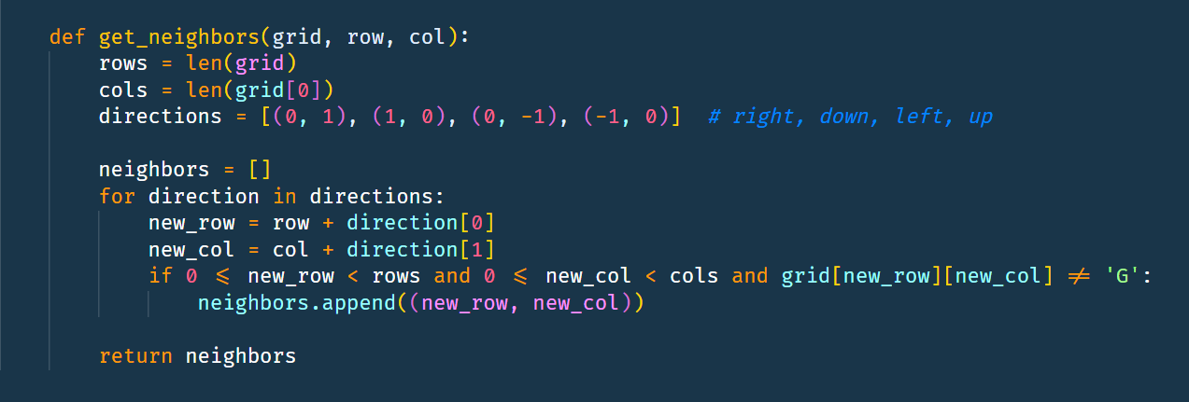

Slide 13
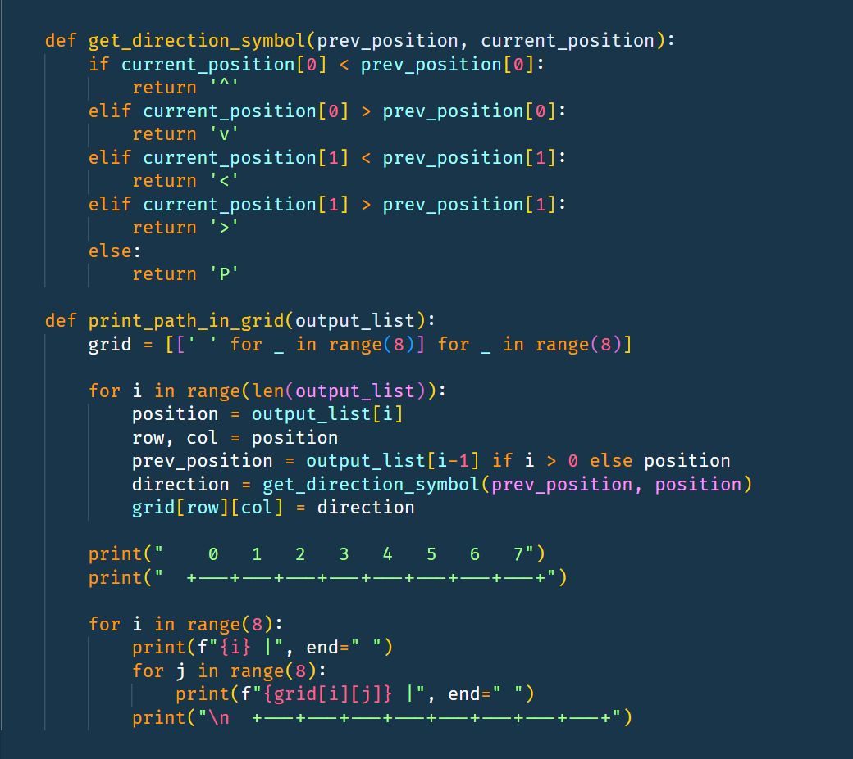

Slide 14
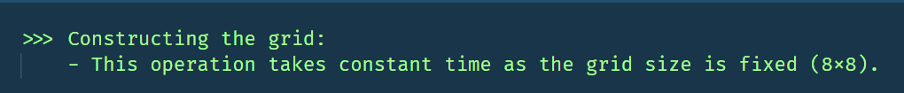
TIME COMPLEXITY

Slide 15

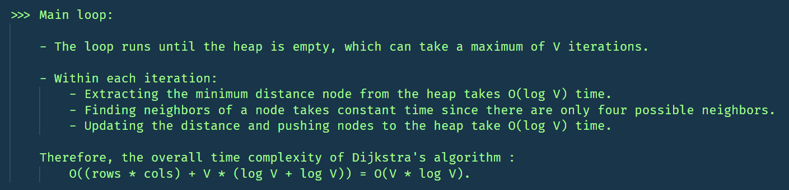

Slide 16
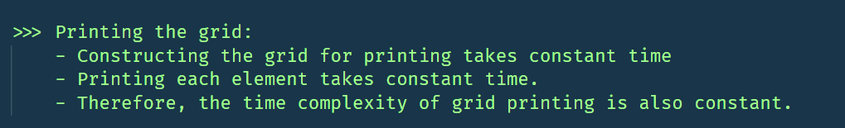
TIME COMPLEXITY : O(V*log(V))

Slide 17


