Slide 1
Project LED Playground
A LED matrix display designed using Configuration Logic Blocks to create animations and emojis
ISPACE
Date: 21/06/2026
v 0.1

Slide 2
Version History
Version | Date | Description | Remarks
0.1 | 21-06-2026 | Initial draft

Slide 3
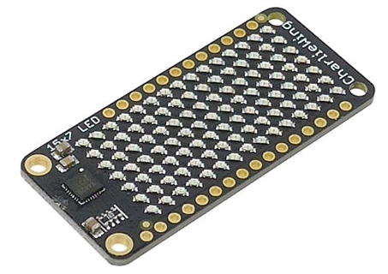
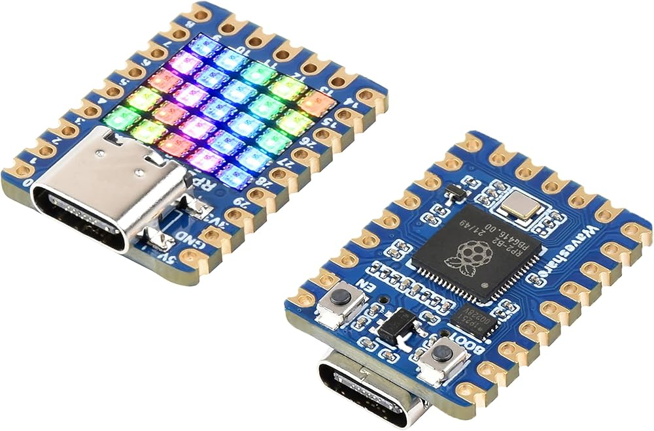
Introduction
There are many ready-made LED matrices available online that are simple to use and low-cost. However, the intention behind designing one from scratch is to understand the adaptation of CLB technology in generic applications for achieving lower cost and better battery performance.
The design will be based on Microchip’s latest CLB MCU (PIC18F26). Since CLB was introduced only recently, it is still relatively unknown to the wider engineering community, mainly because its adoption has been limited to niche application.
The CLB is a reconfigurable digital logic module, similar to a CPLD, that is integrated into the microcontroller (MCU) and performs hardware-based digital logic independent of the CPU. This results in fast and predictable response times for a diverse range of applications, such as automotive and industrial.
The CLB enables much larger hardware-based digital logic designs than previously possible on an MCU (up to 128 Basic Logic Elements, or BLEs) and is also capable of operating in sleep mode, allowing complex processing to occur with very low power consumption.
…
Image courtesy: Adafruit, Waveshare

Slide 4
V0.1

Slide 5
V0.1 Implementation
Front side / LED PCB
Back side / CTRL PCB
CLB
USBC
RTC
Row LEDs
LED,
BTN
XTAL
LP
MCU
TH
SNS
3V CELL
LP
PMIC
CLB: Configurable Logic Block
LP MCU: Low Power MCU
RTC: Real Time Clock
TH SNS: Temperature Sensor
LP PMIC: Low Power PMIC
XTAL: External Crystal
USBC: USB-C Connector
Column LEDs
*design may vary during implementation

Slide 6
High Level Block Diagram V0.1
LEDs + BTN
XTAL
BLE
ANT
Temperature
Sensor
(HDC3022)
Discrete LED matrix
Debug
Connector
+
UCB-C
LP MCU
(nRF52840)
Configurable Logic Block
(PIC18F26Q35)
USB
LED CTRL
3V Coin Cell
LP PMIC
(nPM2100)
RTC
(RV-8263-C7)
SDI/UART
GPIOs
SPI
I2C
3V
EXT/BATT_IN
*Part may be changed per availability

Slide 7
V0.1 working
*Implementation may vary during final release

