Slide 1
Project OAK
An approach in bringing Mechanical complications to Digital Timepiece
ISPACE
Date: 21/07/2024
V01

Slide 2
Version History
Version | Date | Description | Remarks
0.1 | 23-08-2023 | Initial draft
0.2 | 12-03-2024 | Added Layer details
0.3 | 21-07-2024 | Updated Button placement

Slide 3
INDEX
Introduction
AP collections
References
Implementation
Layer details
Initial PCB outputs
High Level Block Diagram V1
MCU pin utilization

Slide 4
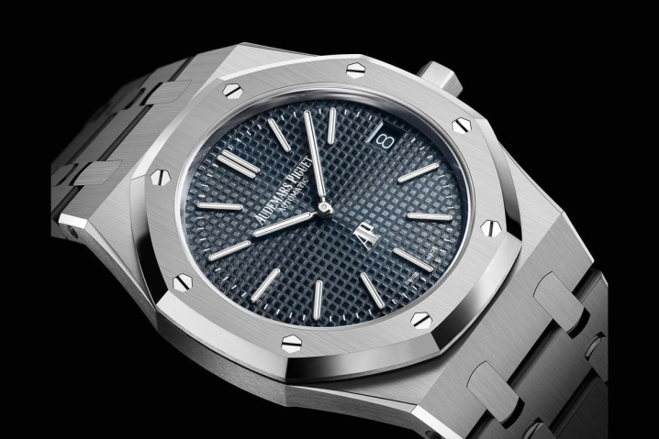
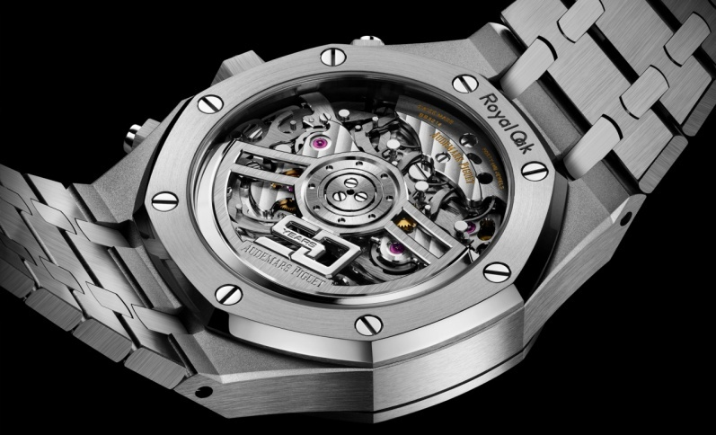
Introduction
Mechanical watches are still considered as symbol of craftsmanship even though the current world is fully in to smart watch.
Though smart watch does more than just displaying time, mechanical watches were pretty limited to displaying time, date & day, calendar.
But, there were few watches which were filled with complications like perpetual calendar, chronograph, GMT, split second, minute repeater etc.
With increase in complications, the value of the time piece also increases. One such example is Audemars Piguet (AP).
Image courtesy: Audemars Piguet

Slide 5
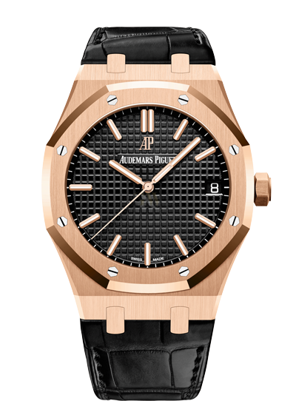
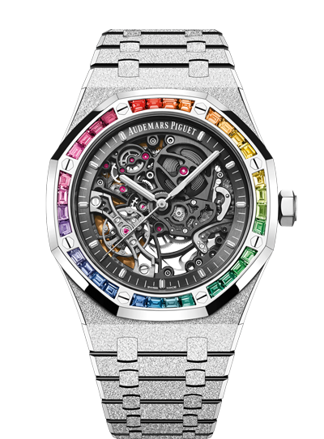
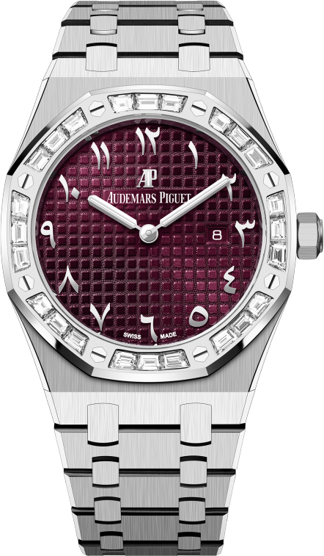
AP Royal OAK Collections (few)
Image courtesy: Audemars Piguet

Slide 6
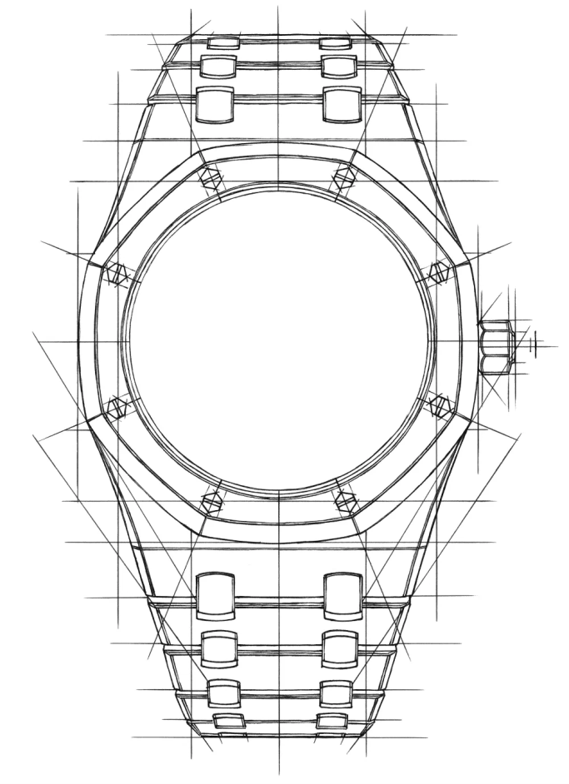
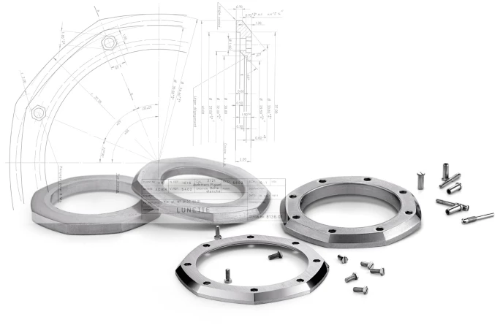
References
Image courtesy: Audemars Piguet

Slide 7
Implementation
Designing a normal analog watch with digital parts is basic but, recreating one of the mechanical complications into digital watch would be really interesting.
Mechanical complications like, Minute Repeater, GMT & moon-phase are considered few cool complications that ever designed in mechanical watches.
Minute Repeater is a complication where the watch indicates time through chimes.
GMT complication help you to track one more additional time zone along with current one.
Moon-phase complication helps you to keep track on full-moon.
Though these complications are already available in smart watch, recreating it locally with few hardware logic is really cool.
To make it more cooler, the whole watch body is going to be made from PCBs with suitable colour and finish to give the analog touch.
The very initial version will be just a simple watch features Time display functions. With further learning from initial version, GMT & Minute repeater complications are added in upcoming version.
Also, there will be some digital sensors to create some interaction with the user. (future use case)
The initial variant will be powered by 3V Coin cell. Later versions may opt for rechargeable battery.

Slide 8
Implementation Cont...
12
11
1
Hexagon PCB with cavity
1mm
10
2
Hexagon cavity for glass closing
1mm
.AI
Hexagon PCB for watch dial
1mm
LED cavity PCB
1.6 mm
9
3
Main PCB
1.6mm
Cavity PCB 1
1.6mm
8
O A K
4
Cavity PCB 2
1.6mm
7
5
Hexagon cavity for glass closing
1mm
6
Hexagon PCB with cavity
1mm
Total (estimation) : 11.4 mm
Final Finish
Cross section view
*design may vary during implementation

Slide 9
Layer details
TOP Layer
12
11
1
Hexagon PCB with cavity
1
45deg
Hexagon cavity for glass closing
1
10
.AI
2
ODxx
Hexagon PCB for watch dial
1
LED cavity PCB
1.6
9
3
Main PCB
1.6
Idxx + 0.5
Cavity PCB 1
1.6
8
O A K
4
Cavity PCB 2
1.6
7
5
Hexagon cavity for glass closing
1
6
Hexagon PCB with cavity
1
M2
(alias) inner
*design may vary during implementation

Slide 10
Cont...
Layer 2
12
11
1
Hexagon PCB with cavity
1
10
2
Hexagon cavity for glass closing
1
.AI
Hexagon PCB for watch dial
1
ODxx
LED cavity PCB
1.6
9
3
Main PCB
1.6
Idxx
Cavity PCB 1
1.6
8
O A K
4
Cavity PCB 2
1.6
7
5
Hexagon cavity for glass closing
1
6
Hexagon PCB with cavity
1
ID2.1 (TBD)
(alias) outer
*design may vary during implementation

Slide 11
Cont...
Layer 3
12
11
1
Hexagon PCB with cavity
1
Copper trace
Hexagon cavity for glass closing
1
10
.AI
2
No Copper region
Hexagon PCB for watch dial
1
ODxx
LED cavity PCB
1.6
9
3
Main PCB
1.6
IDxx
Cavity PCB 1
1.6
8
O A K
4
Cavity PCB 2
1.6
7
5
Hexagon cavity for glass closing
1
6
Mask opening + No copper
Hexagon PCB with cavity
1
*design may vary during implementation

Slide 12
Cont...
Layer 4 & 7
Hexagon PCB with cavity
1
Hexagon cavity for glass closing
1
Hexagon PCB for watch dial
1
LED cavity PCB
1.6
Main PCB
1.6
Cavity PCB 1
1.6
Cavity PCB 2
1.6
Hexagon cavity for glass closing
1
Slots for LED projection
Hexagon PCB with cavity
1
Slot (TBD)
*design may vary during implementation

Slide 13
Cont...
Layer 4
Hexagon PCB with cavity
1
Hexagon cavity for glass closing
1
Hexagon PCB for watch dial
1
LED cavity PCB
1.6
Slots for LED projection
Main PCB
1.6
Cavity PCB 1
1.6
Cavity PCB 2
1.6
Hexagon cavity for glass closing
1
Hexagon PCB with cavity
1
Slot (TBD)
*design may vary during implementation

Slide 14
Cont...
Layer 5
Hexagon PCB with cavity
1
Hexagon cavity for glass closing
1
Hexagon PCB for watch dial
1
Hour LEDs
LED cavity PCB
1.6
Main PCB
1.6
Minute LEDs
Cavity PCB 1
1.6
Cavity PCB 2
1.6
Low bat indicator LED
Hexagon cavity for glass closing
1
Hexagon PCB with cavity
1
ICs
Buttons
Slot (TBD)
*design may vary during implementation

Slide 15
Cont...
Layer 6 & 7
Hexagon PCB with cavity
1
Hexagon cavity for glass closing
1
Hexagon PCB for watch dial
1
LED cavity PCB
1.6
Slot (TBD)
Main PCB
1.6
Cavity PCB 1
1.6
Cavity PCB 2
1.6
Hexagon cavity for glass closing
1
Hexagon PCB with cavity
1
Slot (TBD)
*design may vary during implementation

Slide 16
Cont...
Layer 8
Hexagon PCB with cavity
1
Hexagon cavity for glass closing
1
Hexagon PCB for watch dial
1
LED cavity PCB
1.6
Slot (TBD)
Main PCB
1.6
Cavity PCB 1
1.6
Cavity PCB 2
1.6
Hexagon cavity for glass closing
1
Hexagon PCB with cavity
1
Same as Layer2
(alias) outer
*design may vary during implementation

Slide 17
Cont...
BOT Layer
Hexagon PCB with cavity
1
Hexagon cavity for glass closing
1
Hexagon PCB for watch dial
1
LED cavity PCB
1.6
Slot (TBD)
Main PCB
1.6
Cavity PCB 1
1.6
Cavity PCB 2
1.6
Hexagon cavity for glass closing
1
Hexagon PCB with cavity
1
Same as TOP layer
(alias) inner
*design may vary during implementation

Slide 18
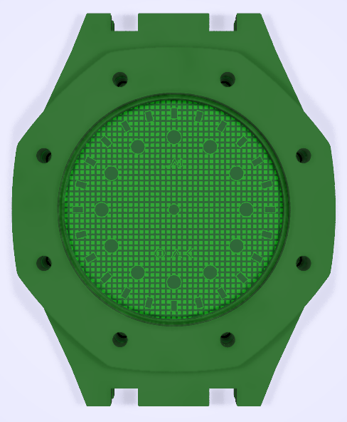
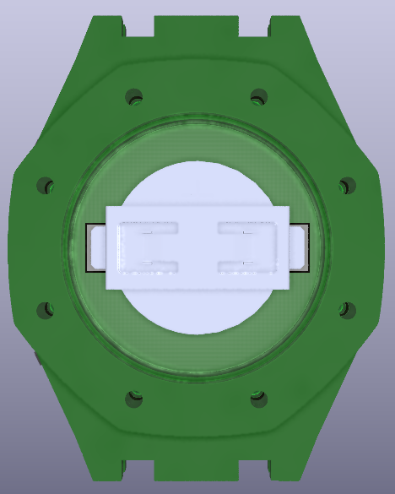
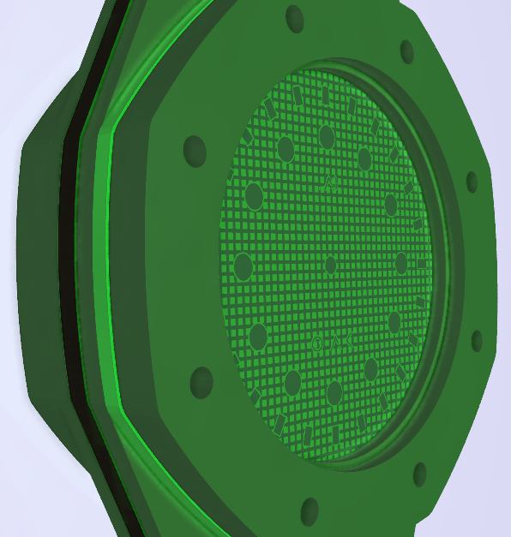
Initial PCB outputs
FRONT
BACK
SIDE
*design may vary during implementation

Slide 19

High Level Block Diagram V1
RTC
(RX8130CE)
12x Hour LEDs
I2C
+
GPIO
MCU
(ATMEGA328PB-MU)
(Internal Oscillator)
GPIO
24x Minute LEDs
GPIO
GPIO
X3 Push Button
(EVQP7A01P)
1x Bat Mon LED
3V
ADC
Cell connector
(BC-2003)

Slide 20
MCU pin utilization
12 Hour hand + 24 Minute hand LEDs (2.5min/LED): 12 GPIO (6x6 matrix configuration)
Low BATT indication LED: 1 GPIO
RTC I2C & control: 3 GPIO
Push button: 3 GPIO
Bat voltage monitor: 1 GPIO
ICSP programming: 4 GPIO
Debug: 2 GPIO
Total GPIOs (worst-case): 26 GPIOs
Available GPIOs in ATMega328P MCU: 27 GPIOs
Debug can be shared with other functions (i.e. -2GPIOs): 24 GPIOs

Slide 22
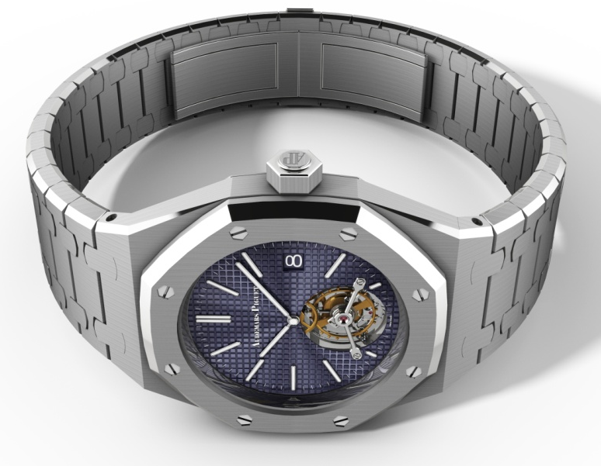
Major DXF (TBU)
Front View
Separate DXF without octagon part
Separate DXF (front view) without curved edges
DXF should cover till highlighted region
Scale: 1:1
Remove those hex screws in octagon DXF
No dimension markings required
Image courtesy: Audemars Piguet

Slide 23
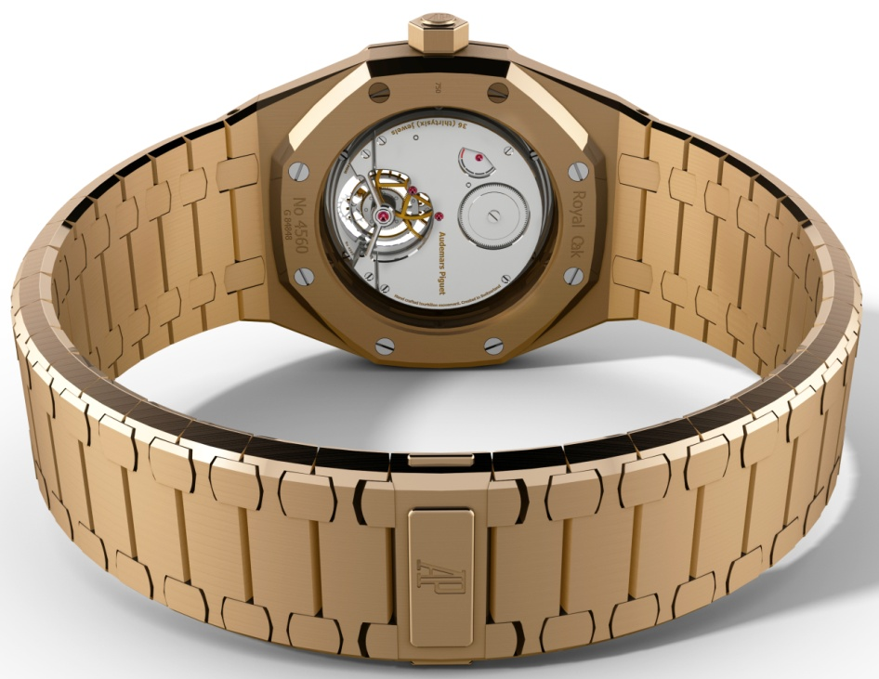
Major DXF (TBU)
Back View
Separate DXF (front view) without curved edges
DXF should cover till highlighted region
Scale: 1:1
Remove those hex screws in octagon DXF
No dimension markings required
Image courtesy: Audemars Piguet

Slide 24
3V
3V coin cell
3V
ATMEGA328PB
7 segment display
IO
RTC
I2C

