Slide 1

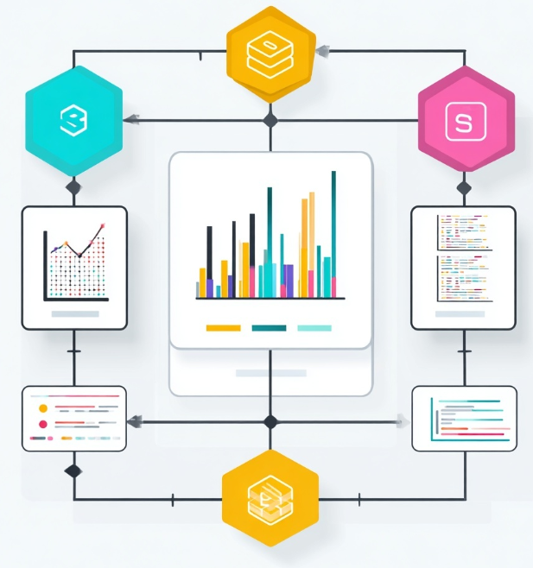
DSAI Module 2 Project end-to-end data pipeline & analysis workflow
1 - Executive Summary
2 - Business Value Proposition
3 - Technical Solution Overview
4 - Risk and Mitigation
5 - Q&A By: Cheung KH Tools: Meltano | BigQuery | dbt | Great Expectations | Dagster | Looker

Slide 2

1 – Executive Summary
Built an end-to-end data pipeline from raw CSV to BI dashboard
Designed scalable cloud data warehouse using BigQuery
Implemented ELT pipeline with dbt and data quality checks
Resolved real-world data issues (duplicates, encoding, schema mismatch)
Delivered actionable business insights via Looker dashboard

Slide 3

2 – Business Value Proposition
Business Problem
Raw data stored in multiple CSV files
No centralized data warehouse
Complex joins required for analysis
Data inconsistencies and duplicates
Difficult for business users to extract insights

Slide 4
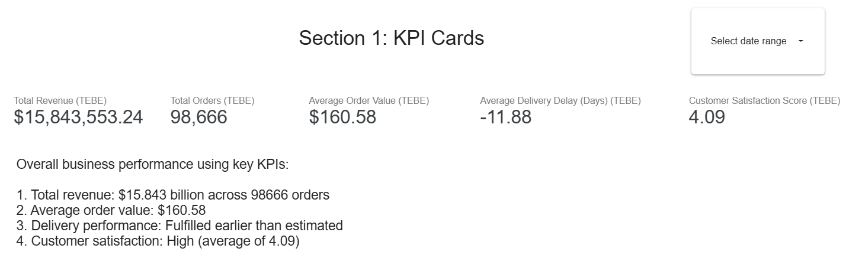
2 – Business Value Proposition
Insights (Looker)
Monthly revenue trends
Top product categories
Top sellers by revenue
Customer purchase patterns
Link: https://lookerstudio.google.com/reporting/5db17733-75bf-47d6-be43-3b62942b40be

Slide 5
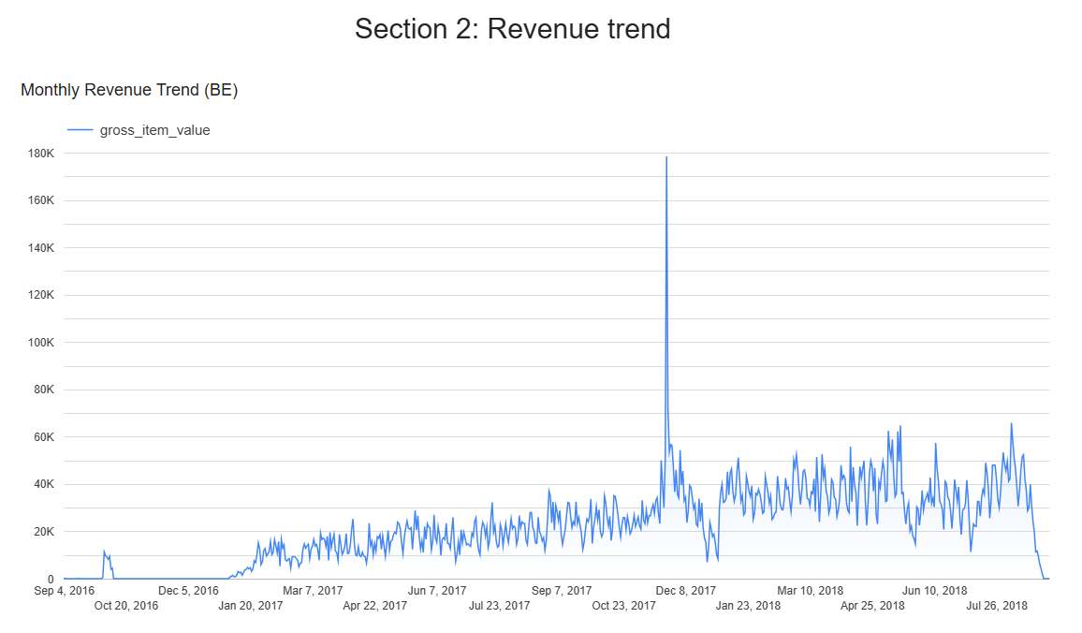
2 – Business Value Proposition
Insights (Looker)
Monthly revenue trends
Top product categories
Top sellers by revenue
Customer purchase patterns
Link: https://lookerstudio.google.com/reporting/5db17733-75bf-47d6-be43-3b62942b40be

Slide 6
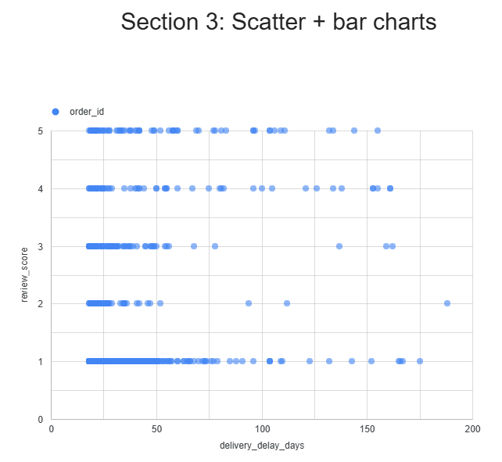
2 – Business Value Proposition
Insights (Looker)
Monthly revenue trends
Top product categories
Top sellers by revenue
Customer purchase patterns
Link: https://lookerstudio.google.com/reporting/5db17733-75bf-47d6-be43-3b62942b40be

Slide 7
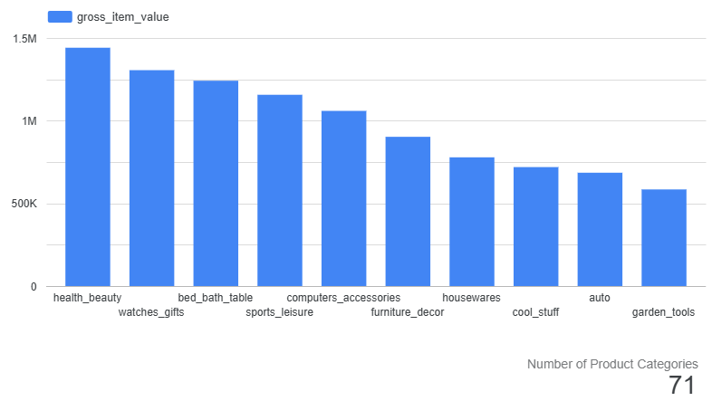
2 – Business Value Proposition
Insights (Looker)
Monthly revenue trends
Top product categories
Top sellers by revenue
Customer purchase patterns
Link: https://lookerstudio.google.com/reporting/5db17733-75bf-47d6-be43-3b62942b40be

Slide 8

2 – Business Value Proposition
Recommendations
Focus marketing on top-performing categories
Strengthen relationships with high-performing sellers
Optimize inventory for high-demand products
Monitor delivery delays to improve customer satisfaction

Slide 9
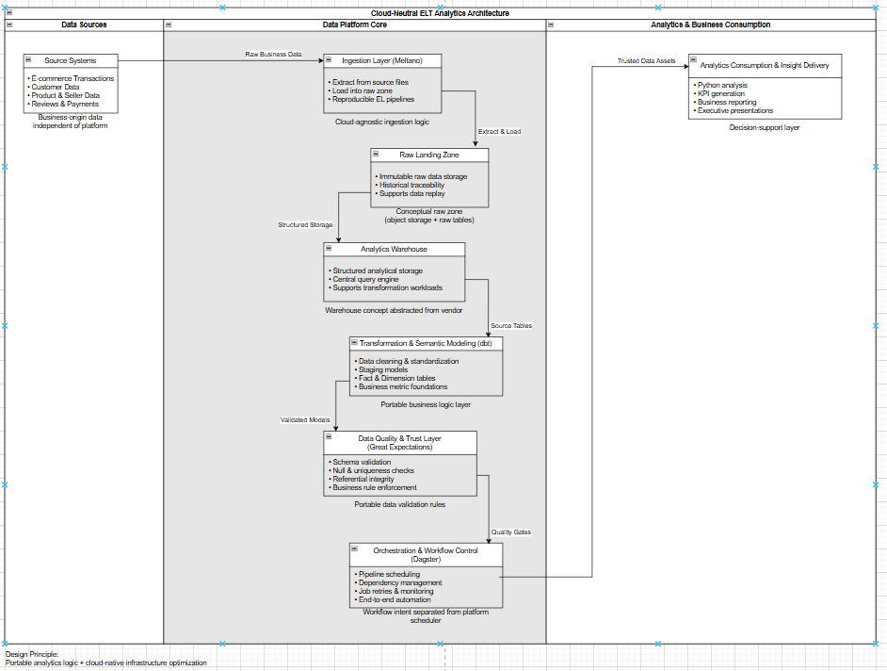
3 – Technical Solution Overview
Architecture
Cloud-based architecture (GCP)
ELT pipeline design
Modular and scalable system
Separation of concerns (raw / staging / marts)

Slide 10
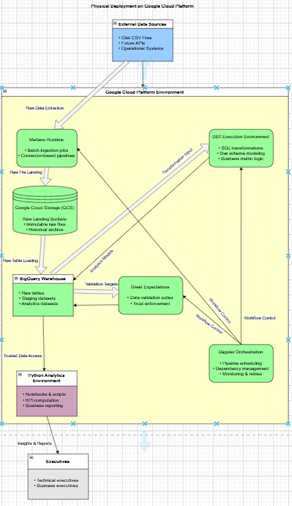
3 – Technical Solution Overview
Architecture
Cloud-based architecture (GCP)
ELT pipeline design
Modular and scalable system
Separation of concerns (raw / staging / marts)

Slide 11

3 – Technical Solution Overview
Pipeline Flow
Ingestion → Meltano loads CSV into BigQuery
Transformation → dbt staging + marts
Validation → Great Expectations
Orchestration → Dagster (optional layer)
Analytics → Python + Looker

Slide 12
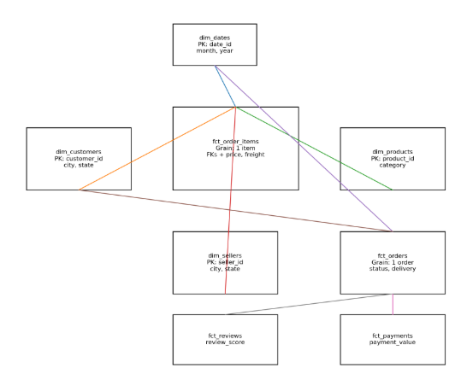
3 – Technical Solution Overview
Star Schema
Fact Tables:
fct_order_items (core revenue table)
fct_orders
Dimension Tables:
dim_customers
dim_products
dim_sellers
dim_dates
Grain definition:
1 row = 1 product in an order

Slide 13

4 – Risk & Mitigation
Data Challenges
Duplicate records due to re-ingestion → Solved using ROW_NUMBER( ) deduplication
JSON parsing from raw data column → Extracted fields using json_value( )
Encoding issues (hidden characters) → Cleaned during transformation
Multiline CSV causing row mismatch → Validated using Python + SQL
Null key values → Applied filtering and data quality rules

Slide 14

4 – Risk & Mitigation
Data Quality
Implemented Great Expectations
Tests included:
Null checks
Uniqueness checks
Referential integrity
Achieved:
✅ 100% test pass rate

Slide 15

Q & A

