Slide 1

汇报人：王鸣泽

Slide 2
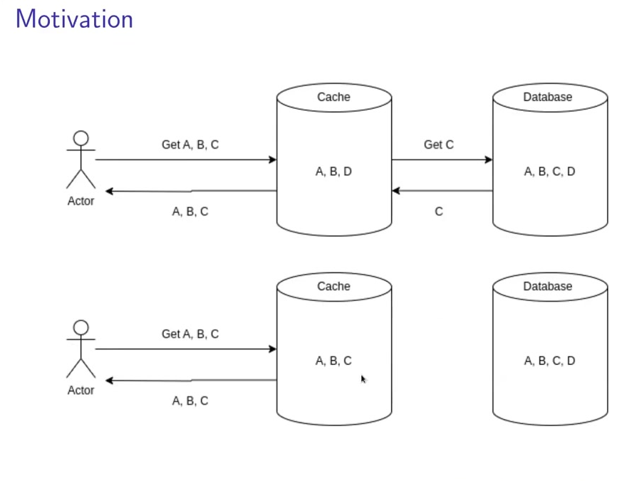

Slide 3
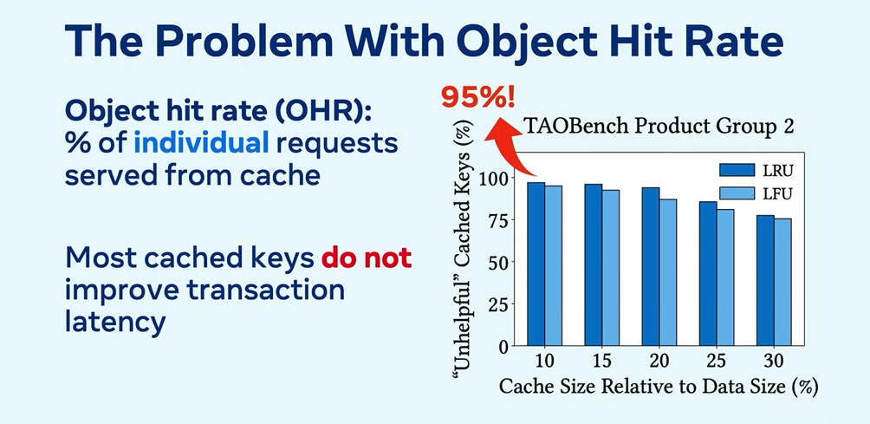

Slide 4
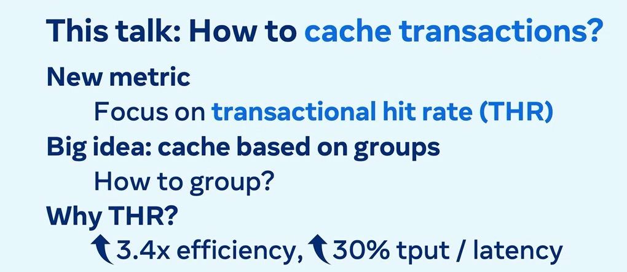
score?

Slide 5
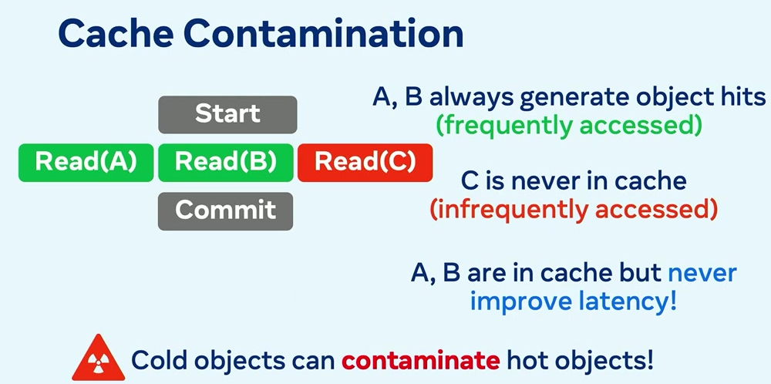

Slide 6
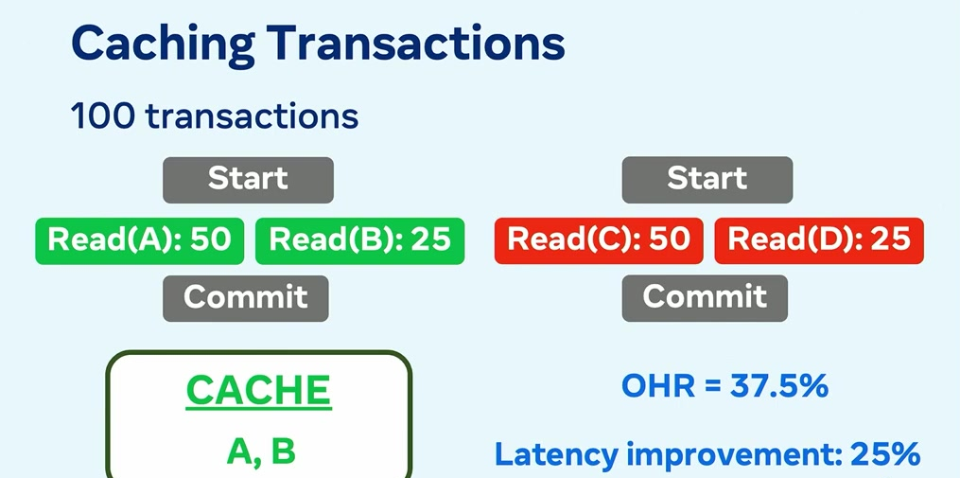

Slide 7
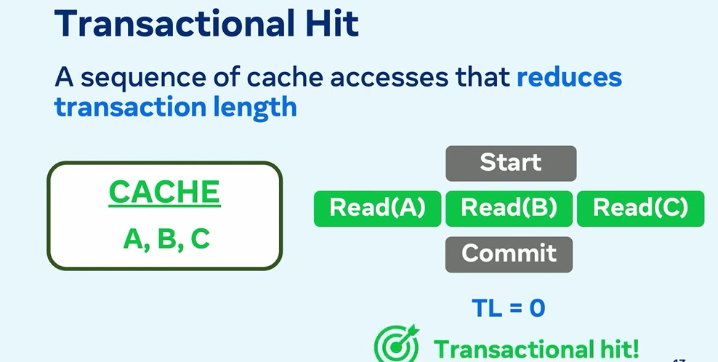

Slide 8
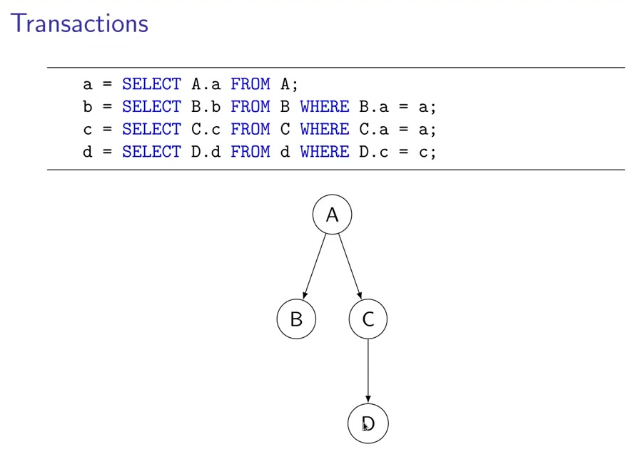

Slide 9
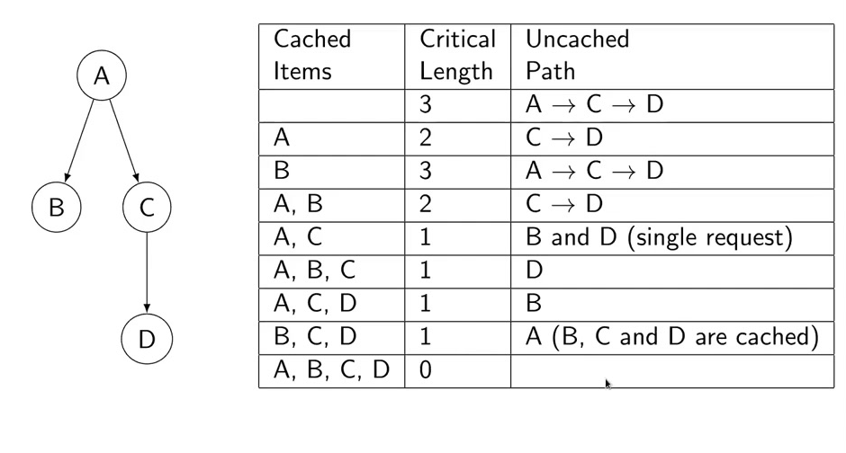

Slide 10
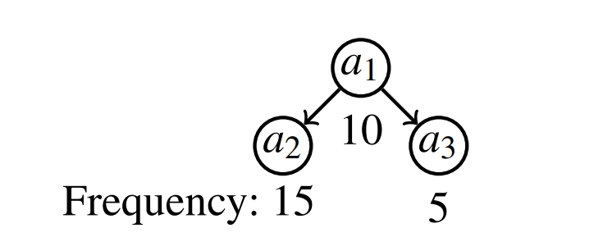


Cache state

Slide 11

Transactional hit rate

Slide 12
NP-hard
1. Cache size limit
2. Different sizes of objects
3. The uncertainty of access patterns
4. Replace Decision

Slide 13

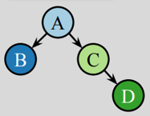
Group
{c,d}
{a,b}

Slide 14

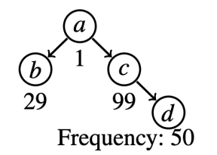

Scoring

Slide 15

Scoring

Slide 16




Scoring

Slide 17
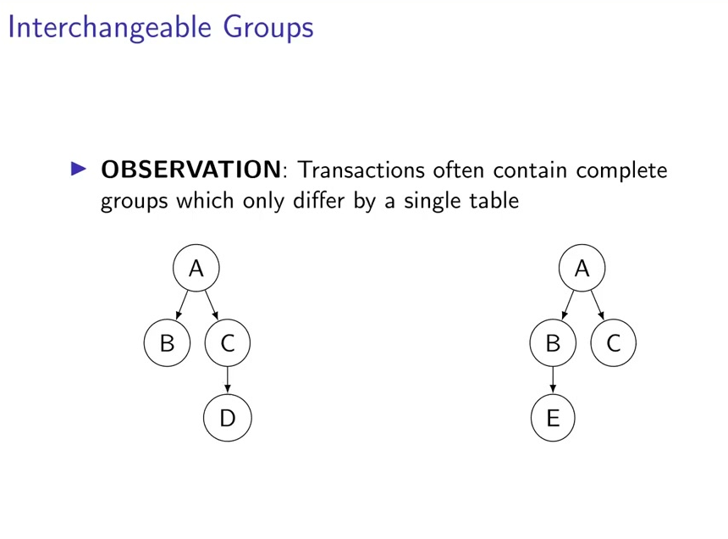

Slide 18
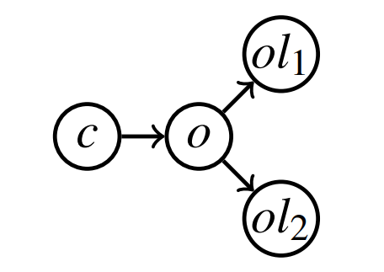
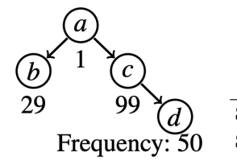

Interchangeability and levels

Slide 19
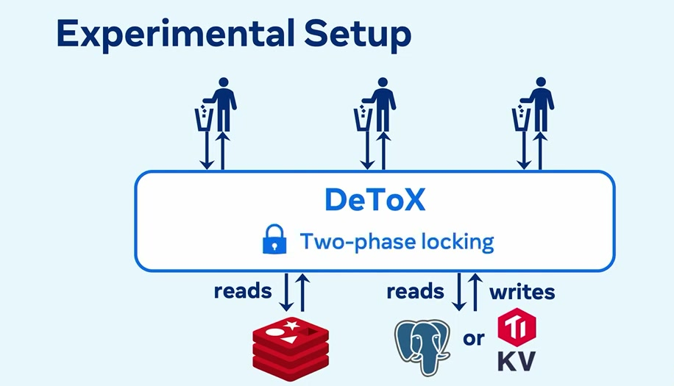

Slide 20
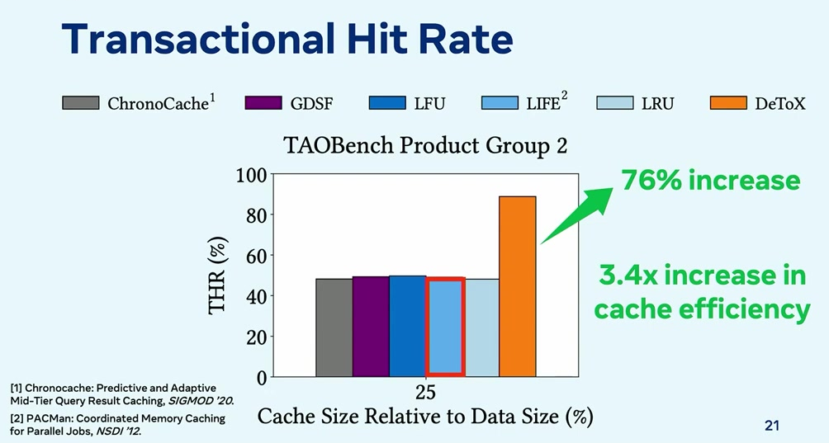

Slide 21
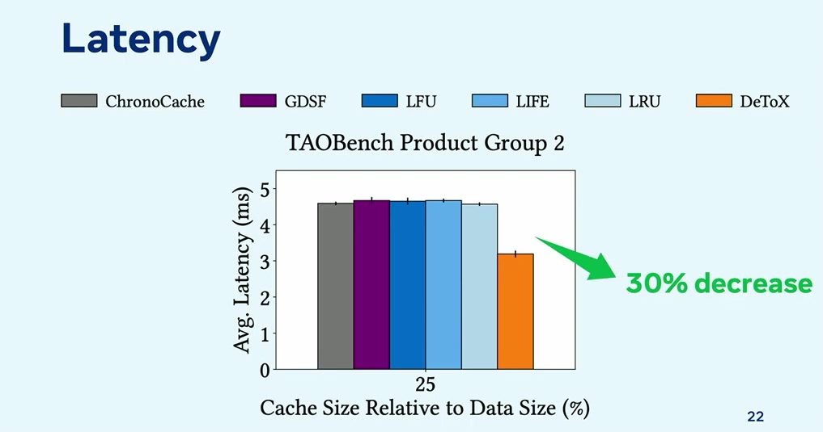

Slide 22
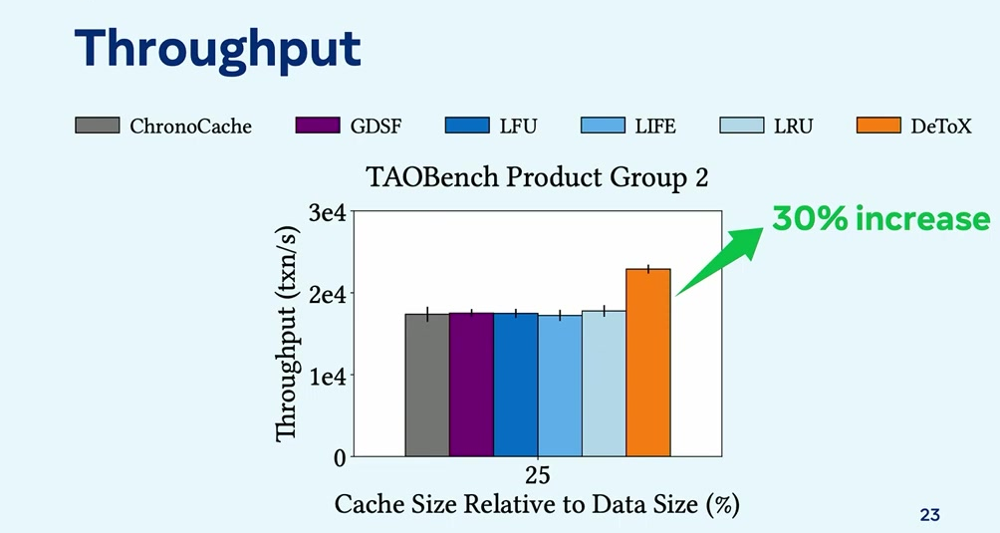

Slide 23
score?

Slide 24
汇报完毕
欢迎指正

