Slide 1
Study Timer Final Project
01057030-羅啟軒
01057057-蔡金保

Slide 2
Table of contents
01
02
To do list
Study Timer
List of tasks you need to complete or things that you want to do
Every 25 minute break 5 minute, Every 4 x 25 minute break 15 minute

Slide 3
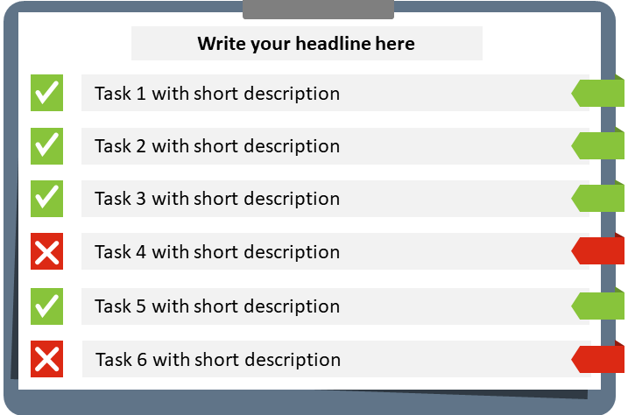
Project 01
To do list is a List of tasks you need to complete or things that you want to do and list of tasks you need to complete in a certain period of time. It’s a very simple, efficient and extremely popular productivity tool.

Slide 4
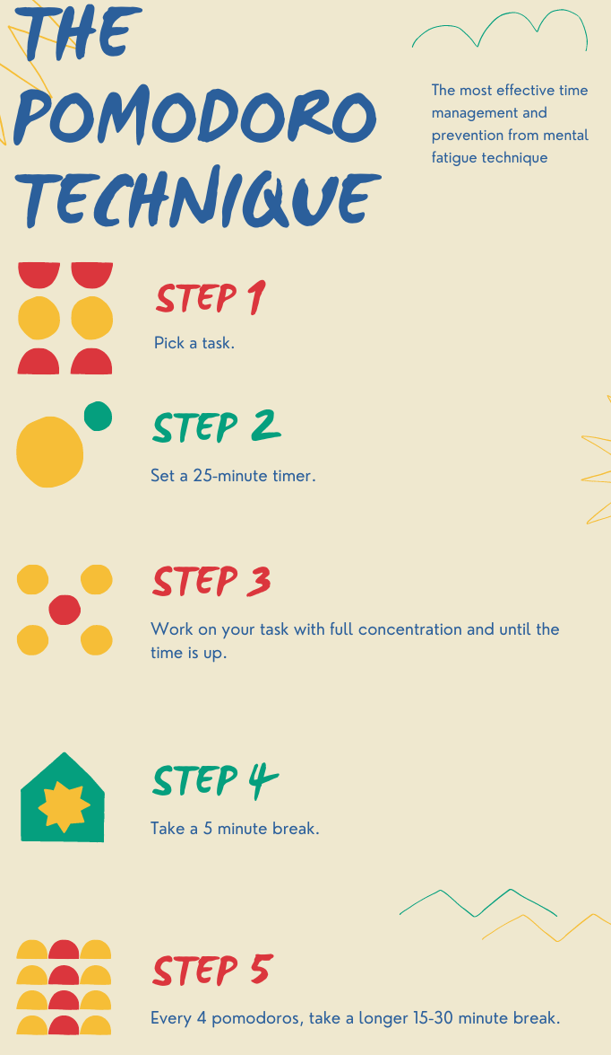
Project 02
The timer technique we use is Pomodoro Technique is a time management method based on 25-minute stretches of focused work broken by five-minute breaks. Longer breaks, typically 15 to 30 minutes, are taken after four consecutive work intervals.

Slide 5
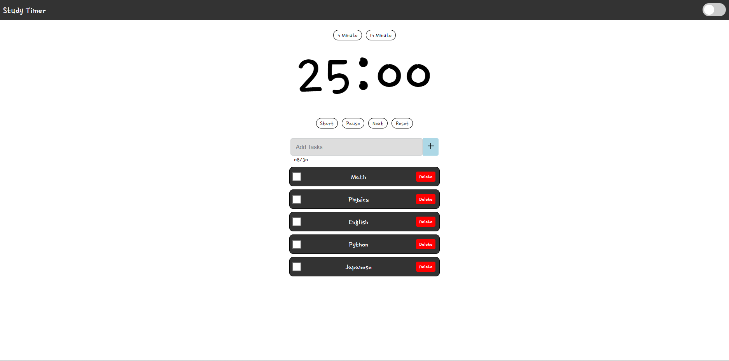
Initial Page
Study Timer
Todo List

Slide 6
Why did we create this website?
Because a lot of people get distracted when studying, such as seeing a notice on their phone, so we created this website for those people who get easily distracted.
So the idea is that by using a timer, you can focus on one activity for a specific length of time and then take a short rest before moving to the next one.
There are several benefits use this website for studying:
-Improved focus: Working in short duration allows you to stay focused on the subject at hand and avoiding distractions from other tasks or notifications.
-Increased productivity: helps you in make the most of your time by breaking down your task into smaller parts and having regular breaks to recharge.
-Reduced stress: You can avoid feeling overwhelmed and reduce stress by reducing your task into smaller pieces and taking regular breaks.

Slide 7
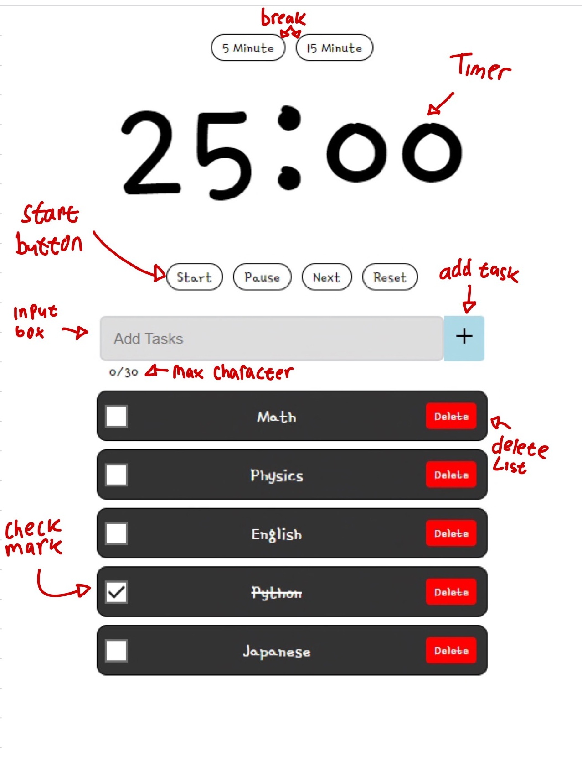
How it Works
Click Start, or write tasks and activities you wish to complete before clicking Start. After clicking start 25 minute concentration study, it will change to 5 minute break and every 50 minute study will receive 15 minute long break if you finished your tasks you can checkmark the checkbox or delete and if you close the website the list will still seem just as before.
If you prefer a longer break, you can select a 5 or 15-minute break. Once it is completed, I will switch to a 25-minute again.

Slide 8
Website Characteristic
To Do list
If you reload the page, the To Do List will be saved in local storage.
Light and Dark mode
Light mode can display information in a clearer and more visual way.
Dark mode can be used to keep your partner sleeping without disturbing him or light mode is too bright for you.

Slide 9
Work Distribution
01057030-羅啟軒
Study Timer
01057057-蔡金保
To do List
Light and Dark mode
Initial page
Power Point
Node.js
Link Website : https://01057057kim.github.io/Final-Project/Index.html

Slide 10

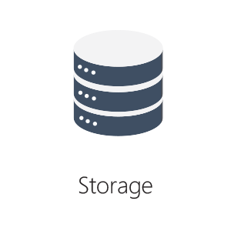

Modules Used
HTML
CSS
Java Script
Local Storage
Node.js

Slide 11
Thank
You

