Slide 1



JAVA
PROJECT
01057059（康維成）01057057（蔡金保）

Slide 2


CONTENT
01
SYSTEM OVERVIEW
02
SYSTEM FEATURES
03
SYSTEM REQUIREMENTS AND ACHIEVEMENT
04
SYSTEM DESIGN (STRUCTURE DIAGRAM)
05
USER INTERFACE
06
WORK DIVISION
07
PROBLEMS AND SOLUTIONS

Slide 3

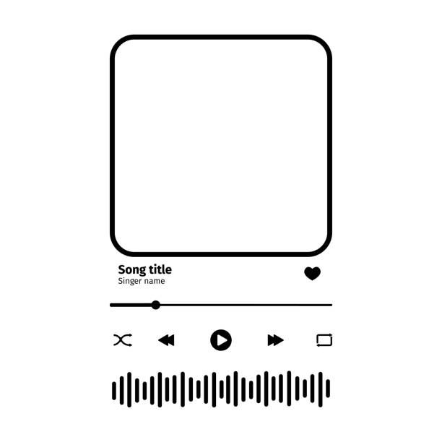




SYSTEM OVERVIEW
Let the users upload their songs from their own library
Make a playlist of songs according to the users choices

Slide 4





SYSTEM FEATURES
seek bar and time indicators that display the current position within the playing song. Users are be able to drag the seek bar to seek forward or backward within the song
allow users to open specific MP3 files or entire folders containing music
allows users to start or pause the playback of the selected song
FILE UPLOAD
PLAY AND PAUSE
TIME CONTROL

Slide 5








LIBRARY
Java.io
Java.util
JavaFX.util
JavaFX.stage
JavaFX.beans
JavaFX.scene
JavaFX.applications

Slide 6









REQUIREMENTS AND ACHIEVEMENTS
Upload File
Song Adjustment
User-Friendly UI
We accomplished this features and applied it to our systems
We are able to let the users to adjust the volume, songs playback time, allowing users to navigate through their music playlist effortlessly
We make sure that the UI of the program to prioritize simplicity and intuitive interaction with visually appealing layout

Slide 7















STRUCTURE DIAGRAM
EQUALIZER
SHUFFLE
START MENU
shuffle(playList)
setVolume()
openEqualizer()
REPEAT
repeatEnable
updateSongList()
VOLUME
SEARCH
filterSongList()
UPLOAD
remove(selectedIndex)
fileList.clear()
currentSongIndex + 1
currentSongIndex - 1
REMOVE
CLEAR
play() pause()
NEXT
PREVIOUS
PLAY/PAUSE
getFormattedSongName()
updateRemainingTime()
SONG
NAME
TIME ELAPSED

Slide 8

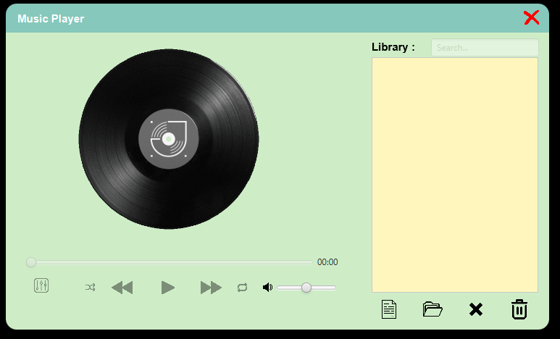
USER INTERFACE

Slide 9



WORK DIVISION
康維成
Main Program
Button Functionality
Time Adjustment
Song List Function
蔡金保
Main UI
File / Folder Upload Functionality
Volume Adjustment
Shuffle, Repeat, Search, and Equalizer

Slide 10




PROBLEMS AND SOLUTION
Problems
Seek Slider for song duration
File Uploading for (MP3 Files)
JavaFX UI
Solution
For seek slider, we have to first make a function getTotalDuration function and updateRemainingTime so that every time the media is playing the remaining time is updated every seconds
We must use javaFx FileChooser and FolderChooser to be able to choose mp3 files.
We are a little bit struggling while making the ui because we are still new to javaFX

Slide 11
DEMO
Youtube
https://youtu.be/22MVv1zyI9U
Alternative https://drive.google.com/file/d/1cJ_5tRXyHRmAqIewNIRBE-YFSTd9aZfs/view?usp=sharing

Slide 12

THANK YOU
GITHUB LINK: https://github.com/01057057kim/MusicPlayer

