Slide 1
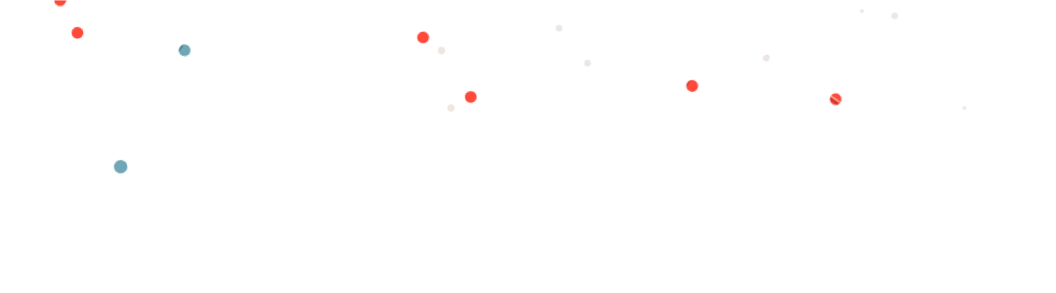






MUSIC PLAYER
康維成 01057059
蔡⾦保 01057057

Slide 2




OUTLINE
Why Music Player?
Features System Requirements
Basic Structure Framework Expected UI Work Distribution Schedule

Slide 3
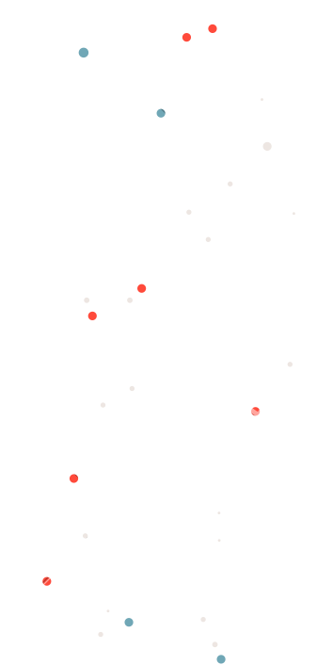

WHY MUSIC PLAYER
MAIN IDEA
Many people nowdays like to listen to music, so we want to make a music player that can play all of the users favourite song.
GOAL
Make a music player that is easy to use and available for everyone to use.
OUR MISSION
Make a project that we can personally use in our daily basis.

Slide 4

PLAYBACK CONTROL
Allow users to play, pause, skip, and repeat tracks, as well as adjust the volume.
FEATURES
MUSIC LIBRARY MANAGEMENT
Create and manage playlists, as well as search for and add new songs to their library.
AUDIO QUALITY SETTINGS
Adjust the audio quality settings to their preference
PLAYLIST MANAGEMENT
Allow users to create and manage playlists

Slide 5
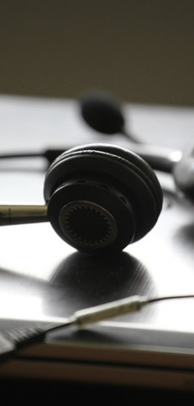
BASIC STRUCTURE
User Interface
Music Player Desktop App
Music Library & Playback
Audio Files

Slide 6



FRAMEWORK

Slide 7
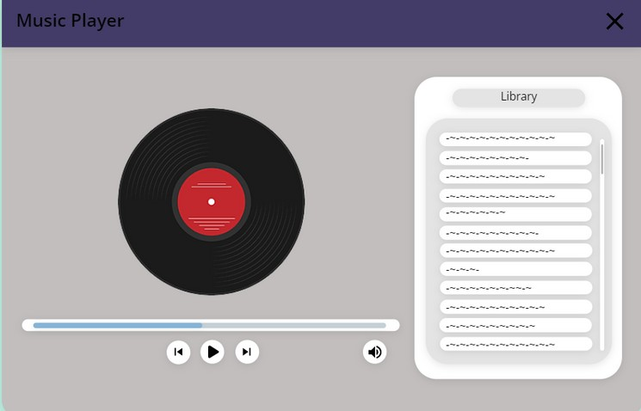
EXPECTED APPEARANCE

Slide 8



康維成 01057059
Main Program UI Construction
WORK DISTRIBUTION
蔡⾦保 01057057
Main Program UI Construction
AAI | Pro X

Slide 9

APRIL 1 ST
Idea Brainstorming
APRIL 10 TH
Power Point Creation
SCHEDULE
MAY 1 ST
Main Program Done (Expected)
MAY 15 TH
User Interface Done (Expected)
MAY 31 ST
Demo Day

Slide 10


THANK YOU
Music is the movement of sound to reach the soul for the education of its virtue.
PLATO

