Slide 1
Password generator
01057059 康維成
01057157 林洧毅

Slide 2
Outline
1
INTRODUCTION
2
TECHNOLOGY USED
3
HOW IT WORKS?
4
WORK DISTRIBUTION

Slide 3
INTRODUCTION
We made a free password generator website that gives a user many choices, so the generator is really flexible and generate a password according to what the users need.
Our main goals is to make a user-friendly Password Generator that can be used anytime we need.

Slide 4

Why password generator?
Passwords are a real security threat. Over 80% of hacking-related breaches are due to weak or stolen passwords, a recent report shows . So if you want to safeguard your personal info and assets, creating secure passwords is a big first step. And that’s where our Password Generator can help.

Slide 5
UNIQUENESS
Save Password Feature, in our website you can save the generated password
History Feature, if you save any password after generating, you can later see it again whenever you want

Slide 6
Technology used
HTML5
provides the basic structure of sites
CSS
used to control presentation, formatting, and layout
used to control the behavior of different elements and to save key-value pairs in a web browser (local storage)
JS
jQuery
used as a test for every element in the set

Slide 7

WEBSITE INITIAL PAGE

Slide 8
How it works?

Slide 9
01
How it works?
Choose between pin
or password

Slide 10
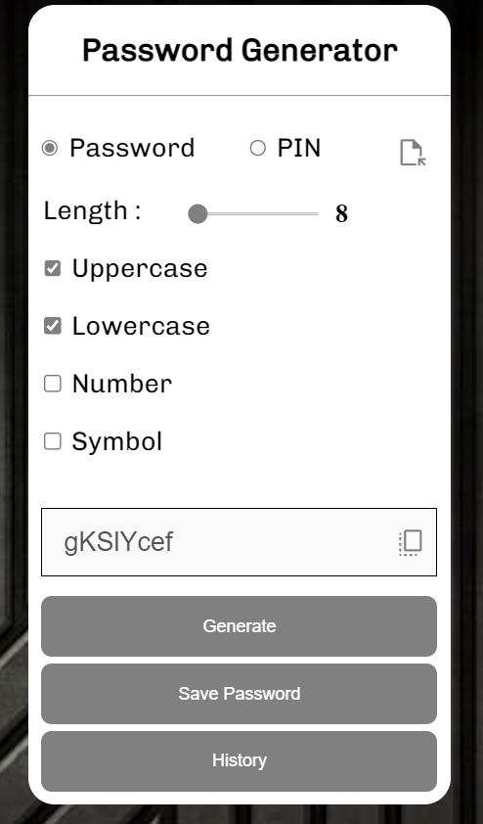
02
How it works?
Select Your customization as you wish

Slide 11
03
How it works?
Click the copy button to automatically copy the password to your clipboard
This is the generated password
Click the generate button

Slide 12
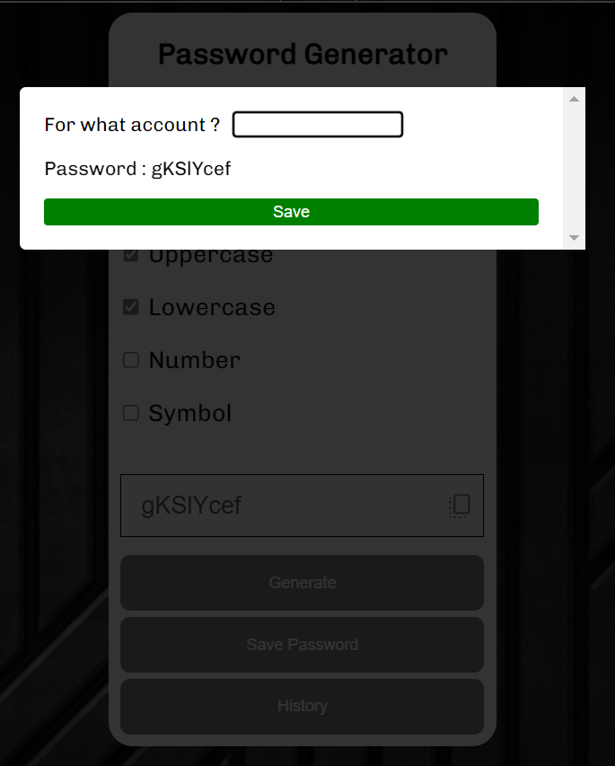
04
How it works?
Click the save button if you want to save the password
After click save button, you can type what account is used that password

Slide 13
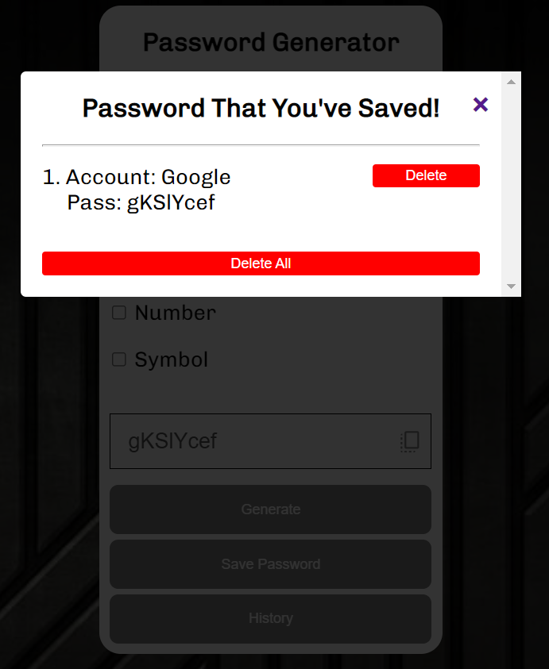
05
How it works?
Click the history button to see your saved password

Slide 14

Website url
https://01057157.github.io/Final-Project/01057157-01057059-FinalProject.html

Slide 15
Work distribution
康維成 | 林洧毅
Home Page UI | Home Page UI
JS Local Storage | CSS
jQuery interaction | Generator Logic​
PPT | JS

Slide 16
Q&A
We receive any critics and suggestion nicholas.khang04@gmail.com bryank2717@gmail.com

Slide 17
THANK YOU!

