Slide 1

Project 4: Status Report
Stanley Zheng
Lookmai Rattana

Slide 2
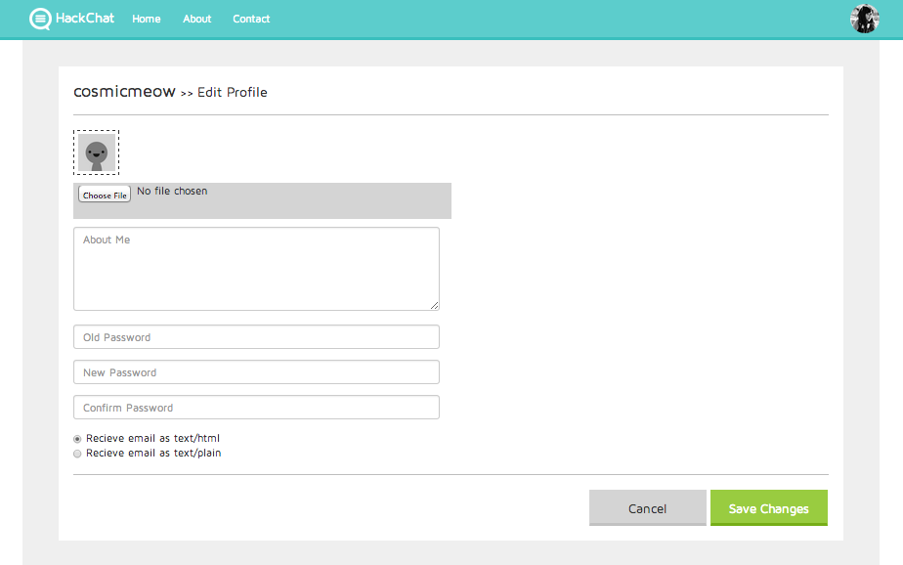
User Profile Management
User can change his/her password here
User can change notification preference
User can change their avatar
User can edit their description

Slide 3
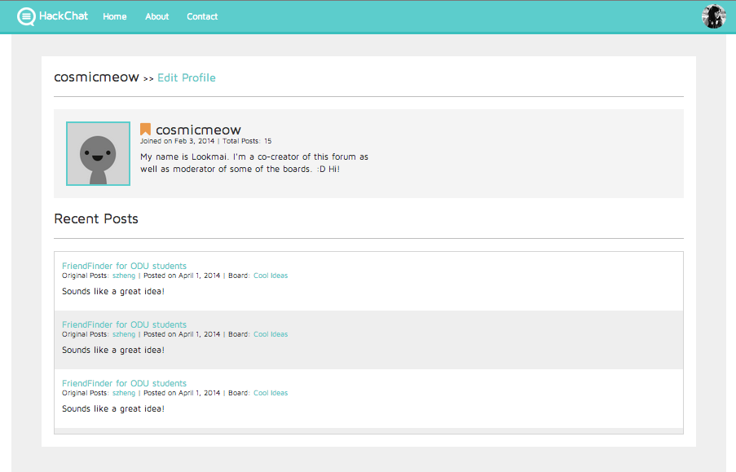
User Profile Page
If this is the user’s own profile, displays Edit Profile option
Other users can see user’s recent posts

Slide 4
Unimplemented Features
CAPTCHA
Post Picture Upload
Searching
Full Functionality Check
Populate Forum

