Slide 1

Project 3: Status Report
Stanley Zheng
Lookmai Rattana

Slide 2
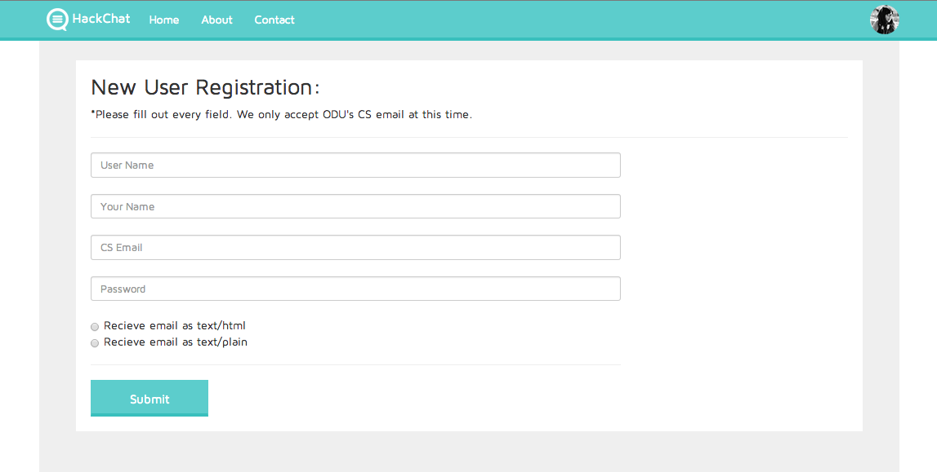
USER REGISTRATION
User can pick out his or her username
JS script to check if the email is valid (CS email and generally valid form)
Options for email

Slide 3
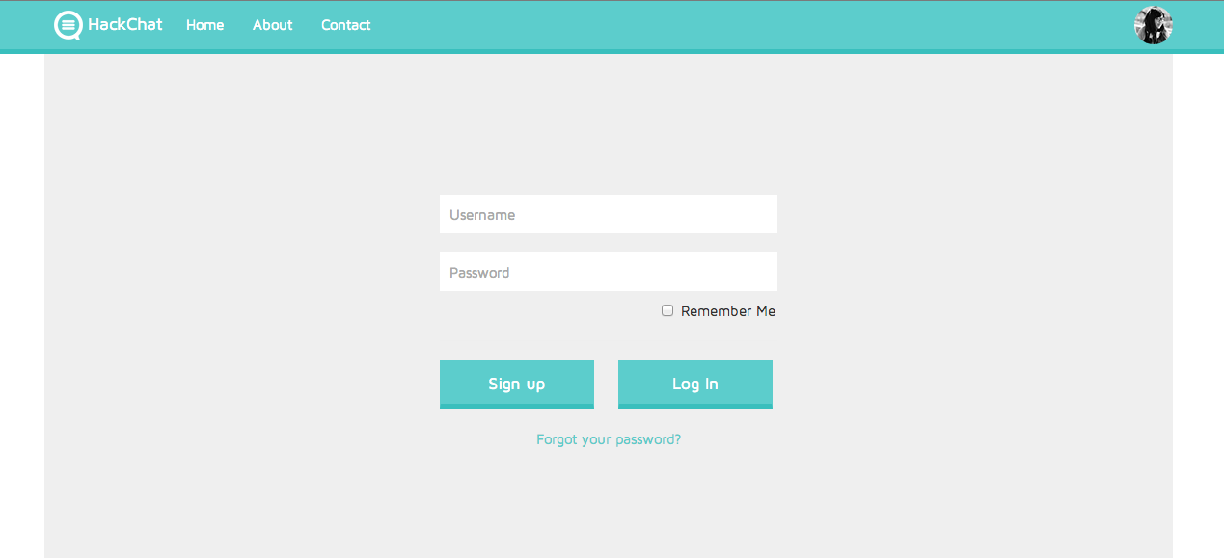
FORGOT PASSWORD
When a user forgets his/her password, the server send out an email to the user with a link to set new password

Slide 4
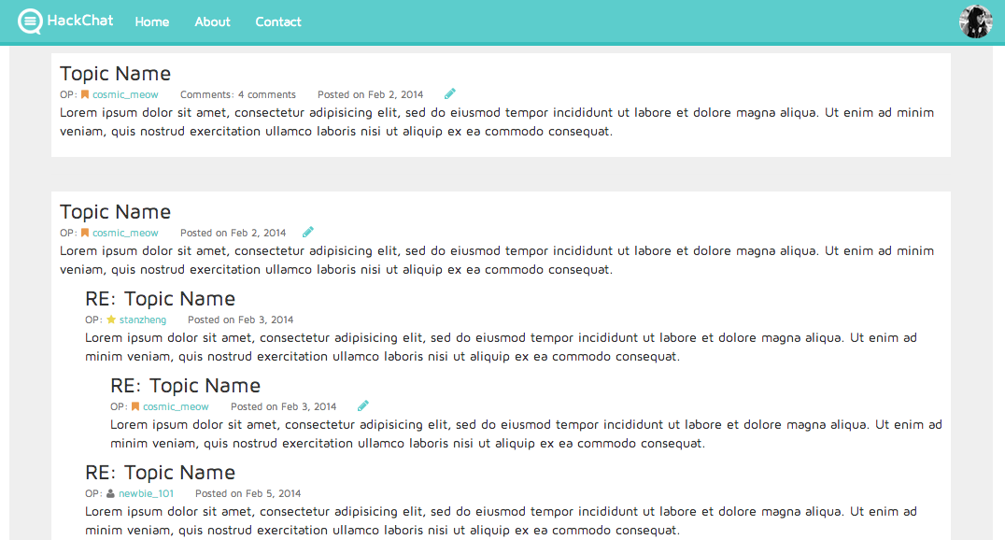
EDIT POST

Slide 5
USER LEVELS
Since HackChat is not a traditional forum model, we didn’t have much room to display user level. The idea of small icons that can indicate user’s level become one of the plausible implementation for this feature.

Slide 6





USER LEVELS
Special Users
Normal Users
Orange Banner: Admin
Person: New User (< 10 posts)
Yellow Star: Moderator
Coffee: Average User (> 10 posts)
Check Mark: Pro User (> 100 posts)
Icons in front of the username indicate their user level. The icons with special colors indicate that the user may be an admin or a moderator.
Color, shapes, and the level’s calculation may be change later on.

Slide 7
Unimplemented Features
Admin/Mod: Freeze Board
Admin/Mod: Edit Posts
Admin/Mod: Suspend and Unsuspend Users
Admin: Overview of Users’ Stats
Admin: Delete Users
SQL: Prevent SQL injection attack

