Slide 1

Project 2: Status Report
Stanley Zheng
Lookmai Rattana

Slide 2
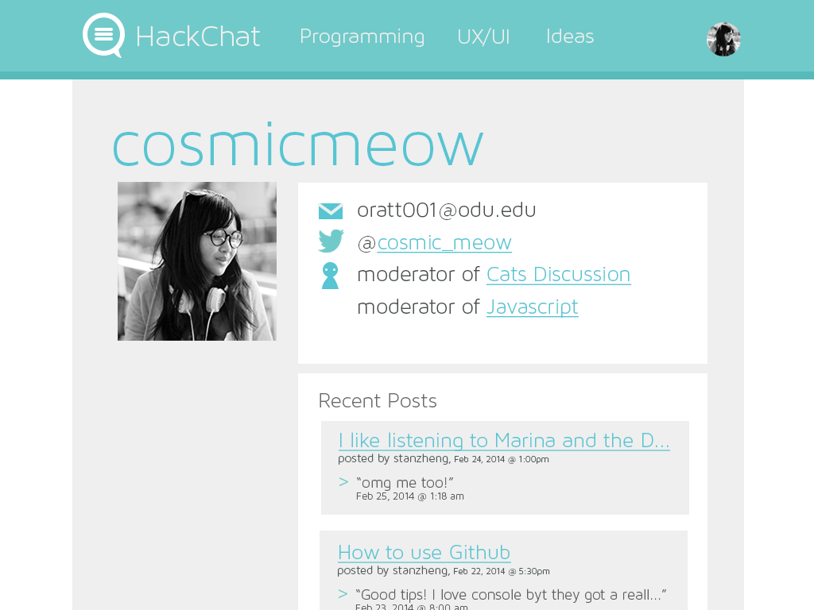
ROLES

Slide 3
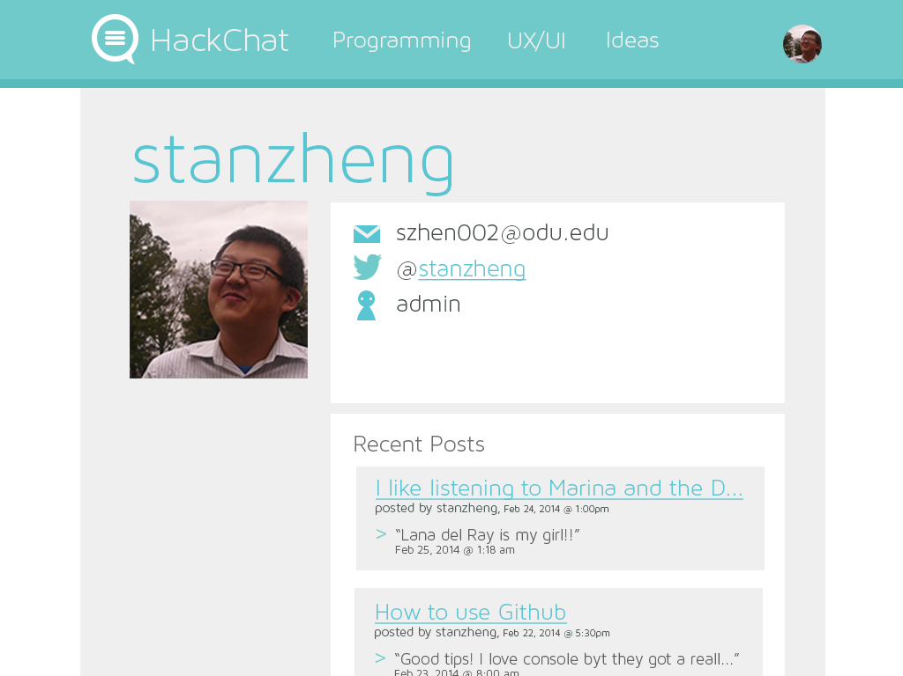

Slide 4
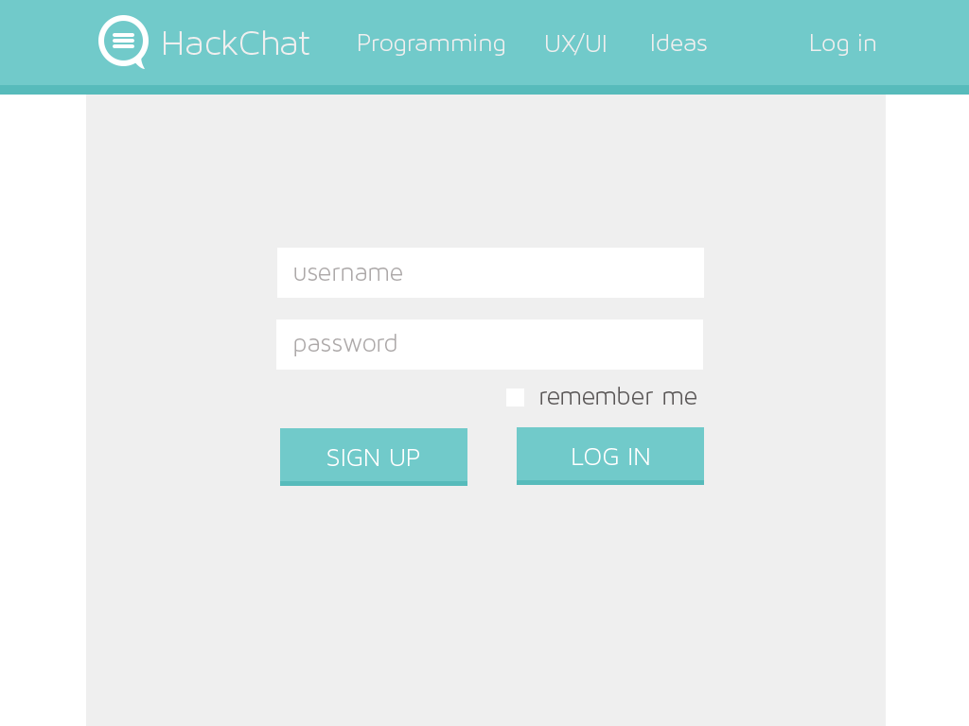
USER LOGIN

Slide 5
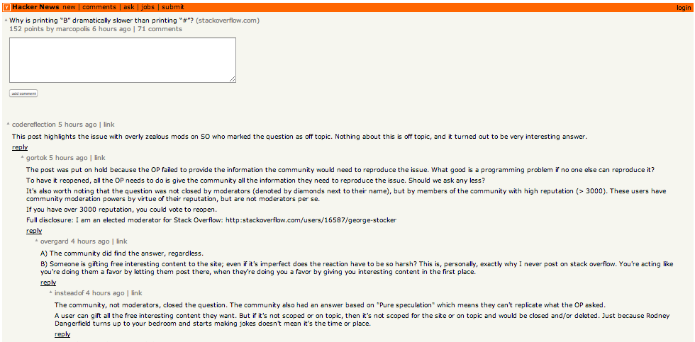
Thread Support (Ideal look)

Slide 6
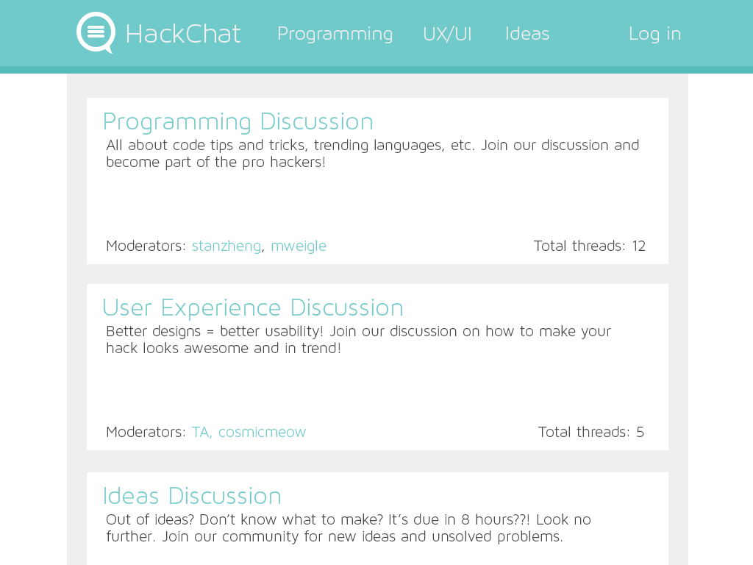
MULTIPLE FORUMS

Slide 7
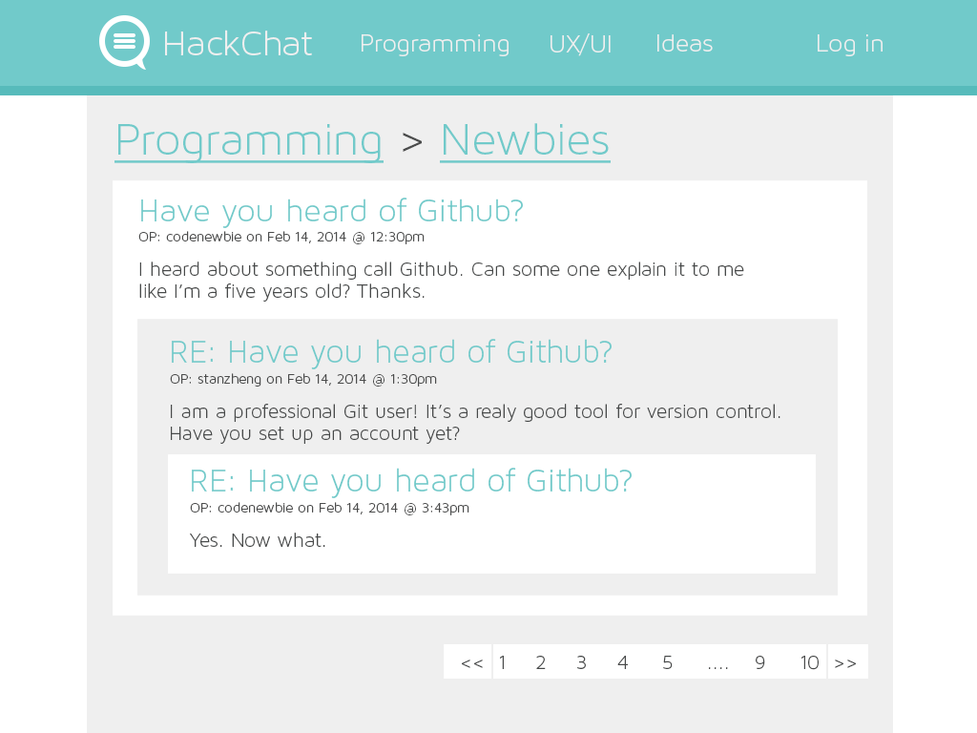
PAGINATION

