Slide 1
SI 614
Finding communities in networks
Lecture 18

Slide 2
Outline
Review:
  identifying motifs
  k-cores
  max-flow/min-cut
Hierarchical clustering
Block models
Community finding based on removal of high betweenness edges (slow)
Clustering based on modularity, spectral methods
Bridges, brokers, bi-cliques and structural holes
If there’s time: Mark Newman’s spectral clustering methods (extra slides)

Slide 3
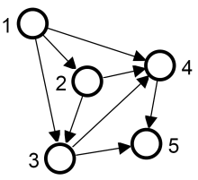
Motifs
Given a particular structure, search for it in the network, e.g. complete triads
advantage: motifs an correspond to particular functions, e.g. in biological networks
disadvantage: don’t know if motif is part of a larger cohesive community

Slide 4
k-cores
Each node within a group is connected to k other nodes in the group
4 core
3 core
but even this is too stringent of a requirement for identifying natural communities
4 core
2 core

Slide 5
Min cut – max flow
The maximum flow between vertices A and B in a graph is exactly the weight of the smallest set of edges to partition the graph in two with A and B in different components
Advantage: works on directed graphs
Disadvantage, need to know how to pick source and sink in two different communities or reformulate the problem
Don’t know the number of partitions desired ahead of time
2
3
1
3
3
1
1
1
3
1
A
1
B
4
3
2
2
1
1
1
2
4
4
2

Slide 6
Community finding vs. other approaches
Social and other networks have a natural community structure
We want to discover this structure rather than impose a certain size of community or fix the number of communities
Without “looking”, can we discover community structure in an automated way?

Slide 7
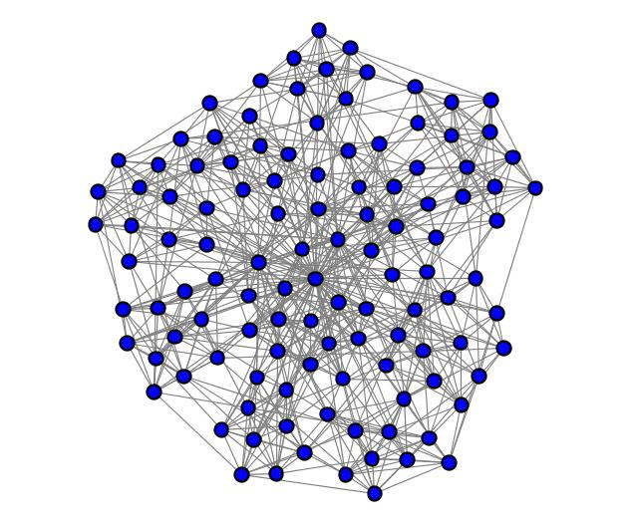
Especially where the community structure isn’t apparent or the networks are large
is there community structure?

Slide 8
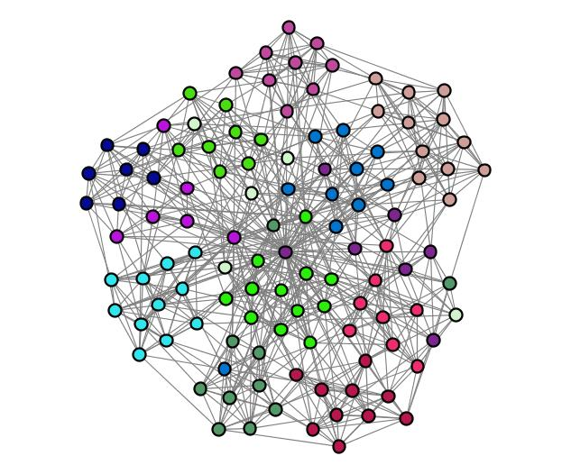
Football conferences
Edges: teams that played each other

Slide 9
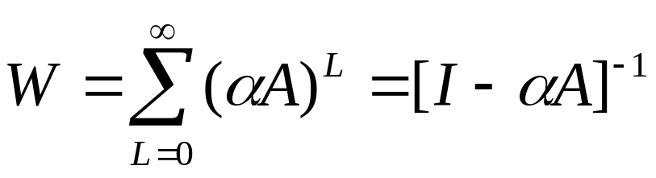
Traditional methods: hierarchical clustering
Compute weights W_{ij} for each pair of vertices
  choices
    # of node independent paths between vertices
      equal to the minimum number of vertices that must be removed from the graph to disconnect i and j from one another
W_{ij} = 2
    # all paths between vertices (weighted by length of path, α^{L}, α<1)

Slide 10
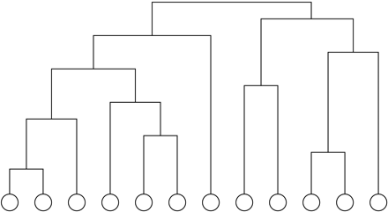
Hierarchical clustering
Process:
  after calculating the weights W for all pairs of vertices
  start with all n vertices disconnected
  add edges between pairs one by one in order of decreasing weight
  result: nested components, where one can take a ‘slice’ at any level of the tree

Slide 11
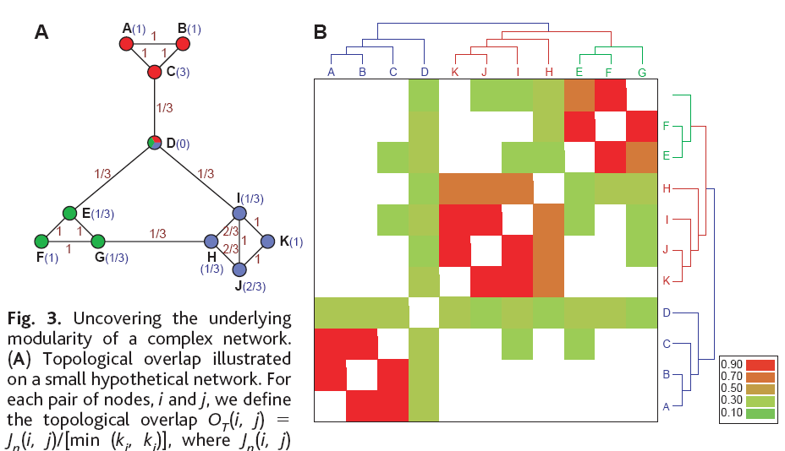
An example we’ve seen already
Razvasz et al: Hierarchical modularity
W_{ij} = topological overlap
Wij = J_{n}(i,j)/[min(k_{i},k_{j})
where
  J_{n}(i,j) = # of nodes that both i and j link to (+1 for linking to each other)
  k_{i} is the degree of node i
Topological overlap -> regular equivalence (more on this and block modeling in a bit)

Slide 12
Hierarchical clustering in Pajek
Procedure
  generate a complete cluster using Cluster->Create Complete Cluster
  compute the dissimilarity matrix
    run Operations->Dissimilarity
      select “d1/All” to consider network as a binary matrix
      select “Corrected Euclidean” or “Corrected Manhattan” distance for valued networks
  the above will use the dissimilarity matrix to hierarchically cluster nodes and output
    a dissimilarity matrix
    EPS picture of the dendrogram
    permutation of vertices according to the dendrogram
    hierarchy representing hierarchical clustering
      to visualize:
        Edit->Show Subtree
        Select nodes (Edit->Change Type or Ctrl+T)
        transform the hierarchy into a partition (Hierarchy->Make Partition)

Slide 13
Blockmodeling
Identify clusters of nodes that share structural characteristics
Partition nodes and their relations into blocks
Goal: reduce a large network to a smaller number of comprehensible units
Disadvantage – need to know number of classes (which may correspond to core & periphery, age, gender, ethnicity, etc…)

Slide 14
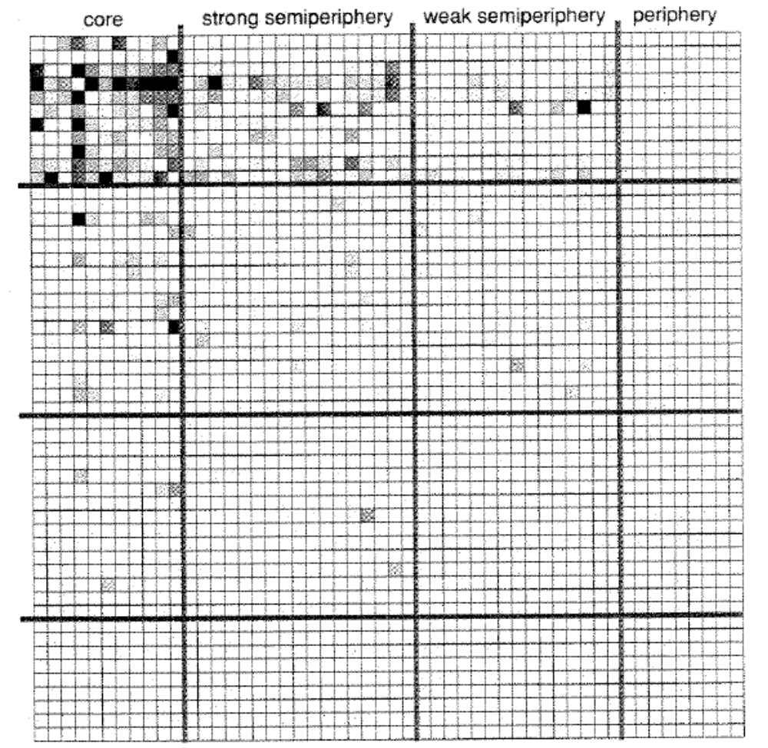
Example of core-periphery structure
metal trade by country

Slide 15
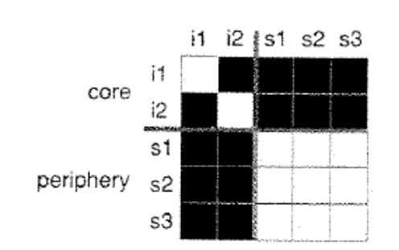
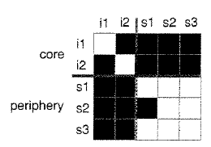
Equivalence
Structural equivalence:
  equivalent nodes have the same connection pattern to the same neighbors
  blocks are completely full or empty
Regular equivalence:
  equivalent nodes have the same or similar connection patterns to (possibly different neighbors)
    e.g. teachers at different universities fulfill the same role
ideal core-periphery
structure
imperfect core-periphery
structure

Slide 16
Hierarchical clustering: issues
using path counts as weights tends to separate out peripheral nodes whose path counts are always low
  but leaf nodes should belong to the community of their neighbor

Slide 17
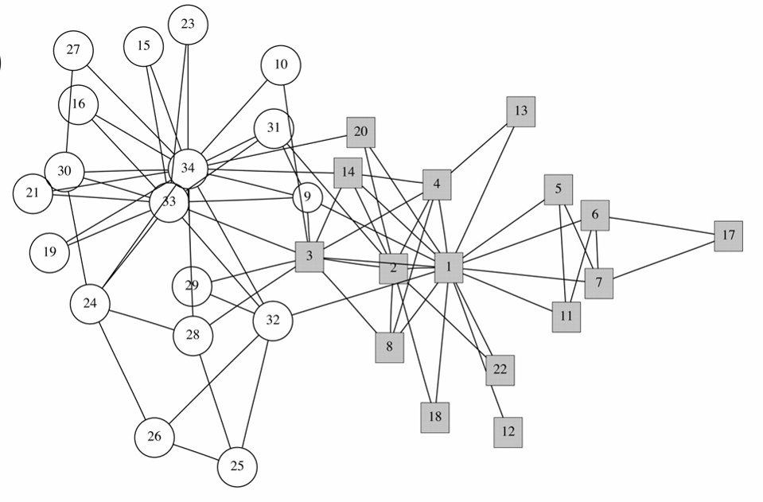
Example: Zachary Karate Club

Slide 18
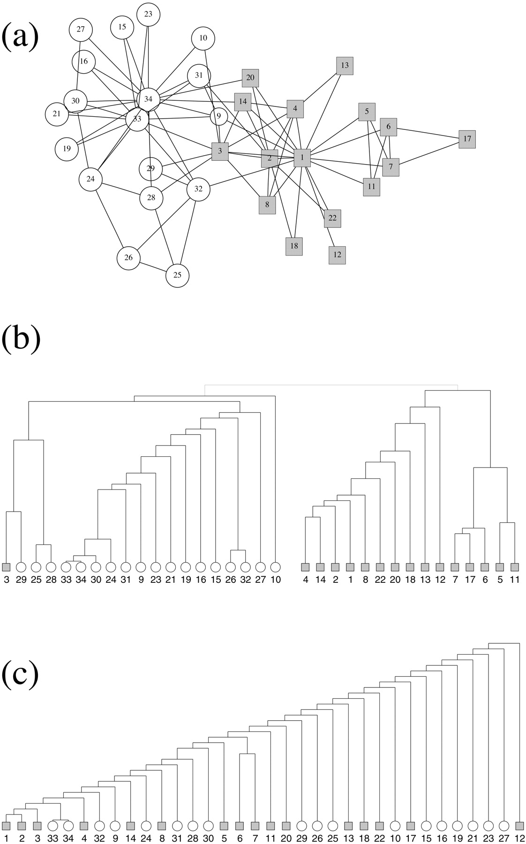
Example: Zachary karate club data
Cores of communities (vertices 1, 2 & 3) and (33 & 34) are correctly identified, but the divisive structure is not captured
Zachary karate club data hierarchical clustering tree using edge-independent path counts

Slide 19
Girvan & Newman: betweenness clustering
Algorithm
  compute the betweenness of all edges
  while (betweenness of any edge < threshold):
    remove edge with lowest betweenness
    recalculate betweenness
Betweenness needs to be recalculated at each step
  removal of an edge can impact the betweenness of another edge
  very expensive: all pairs shortest path – O(N³)
  may need to repeat up to N times
  does not scale to more than a few hundred nodes, even with the fastest algorithms

Slide 20
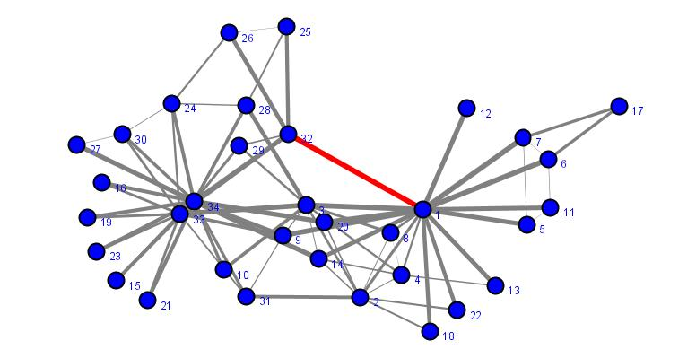
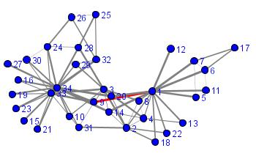
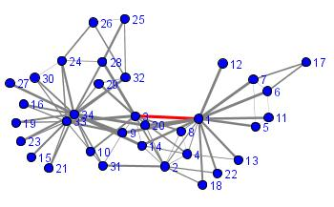
illustration of the algorithm

Slide 21
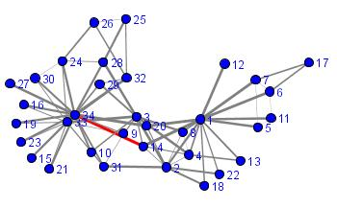
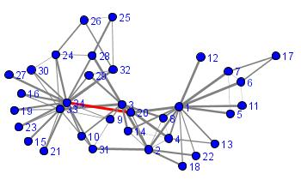
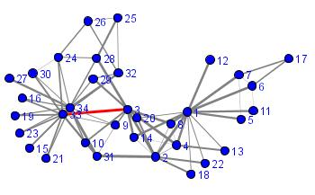
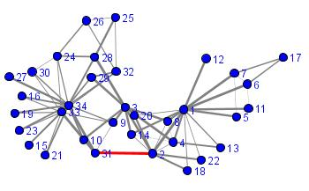
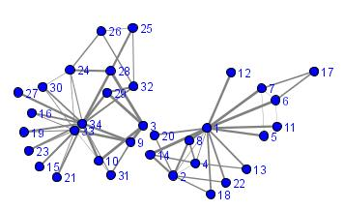
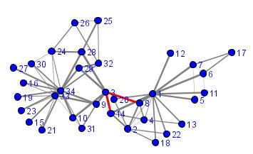
+ deletion of the edge 2-3
separation complete

Slide 22
betweenness clustering algorithm & the karate club data set

Slide 23
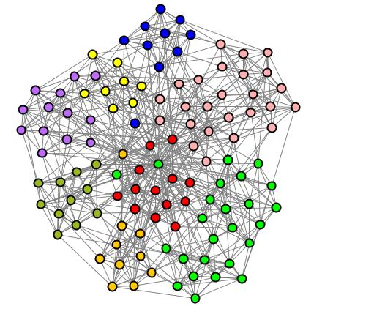
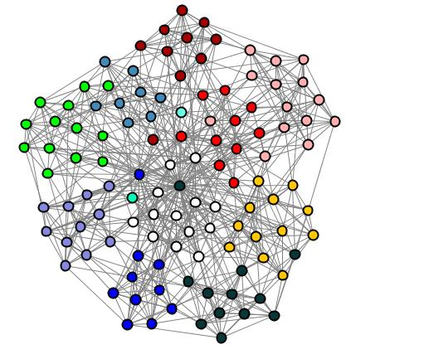
betweenness clustering and the karate club data
8 clusters
12 clusters
better partitioning, but also create some isolates

Slide 24
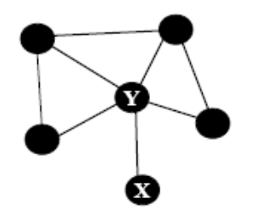
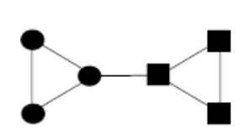
Email as Spectroscopy: Automated Discovery of Community Structure within Organizations
Joshua R. Tyler, Dennis M. Wilkinson, Bernardo A. Huberman
Communities and technologies (2003)
Modifications of Girvan-Newman betweenness clustering algorithm
  stopping criterion: stop removing edges before disconnecting a leaf node
cut is not made
smallest graph w/ 2 viable communities
  randomness is introduced by calculating shortest paths from only a subset of nodes and running the entire algorithm several times
    nodes that border several communities fall in different communities on different runs
    distinguishes between brokers and single-community nodes

Slide 25
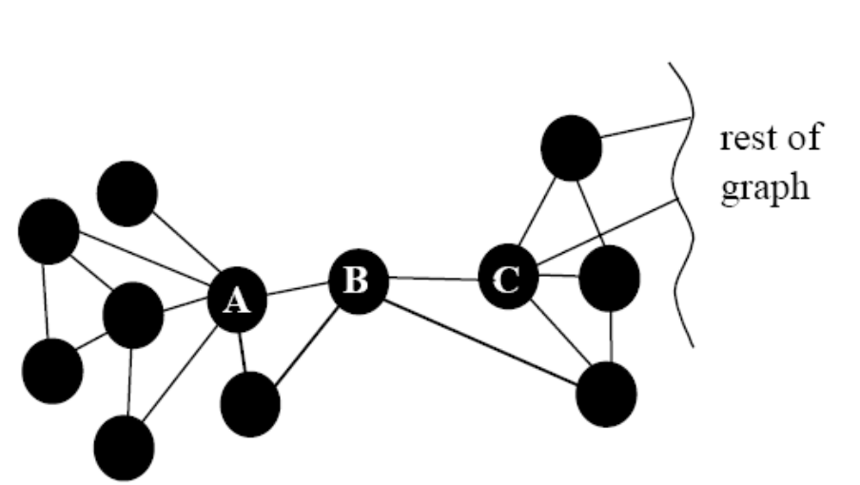
inter-community nodes
Example of network structure, where one node B, could arguably belong to either community
With “noisy” algorithm, can keep track of % of time B ends up in A’s community or C’s community

Slide 26
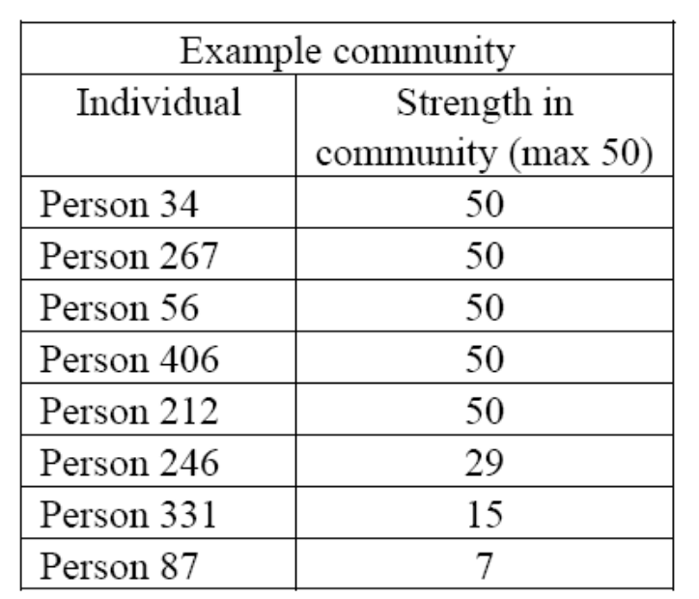
email spectroscopy: results
data: HP labs email network (~ 400 nodes, 3 months, mass mailings removed, 30 message threshold)
giant component of 434 nodes
66 communities, 49 correspond exactly to organizational units
other 17 contain individuals from 2 or more organizational units within the company
Field interviews confirmed accuracy of algorithm: individuals identified their communities, divisions in formal groups, and overlaps in interest on joint projects

Slide 27
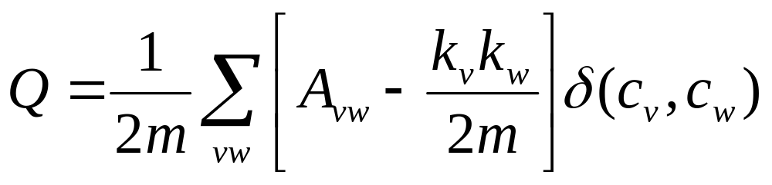
Finding community structure in very large networks
Authors: Aaron Clauset, M. E. J. Newman, Cristopher Moore
2004
Consider edges that fall within a community or between a community and the rest of the network
Define modularity:
if vertices are in the same community
probability of an edge between
two vertices is proportional to their degrees
adjacency matrix
For a random network, Q = 0
  the number of edges within a community is no different from what you would expect

Slide 28
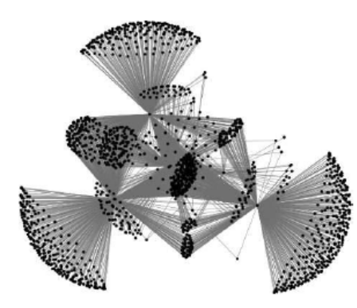
Finding community structure in very large networks
Authors: Aaron Clauset, M. E. J. Newman, Cristopher Moore
2004
Algorithm
  start with all vertices as isolates
  follow a greedy strategy:
    successively join clusters with the greatest increase ΔQ in modularity
    stop when the maximum possible ΔQ <= 0 from joining any two
  successfully used to find community structure in a graph with > 400,000 nodes with > 2 million edges
    Amazon’s people who bought this also bought that…
  alternatives to achieving optimum ΔQ:
    simulated annealing rather than greedy search

Slide 29
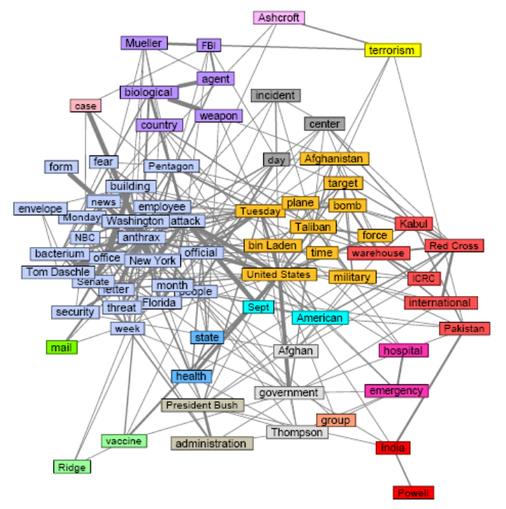
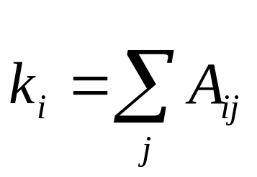
Extensions to weighted networks
Betweenness clustering?
  Will not work – strong ties will have a disproportionate number of short paths, and those are the ones we want to keep
  Modularity (Analysis of weighted networks, M. E. J. Newman)
weighted edge
reuters new articles keywords

Slide 30
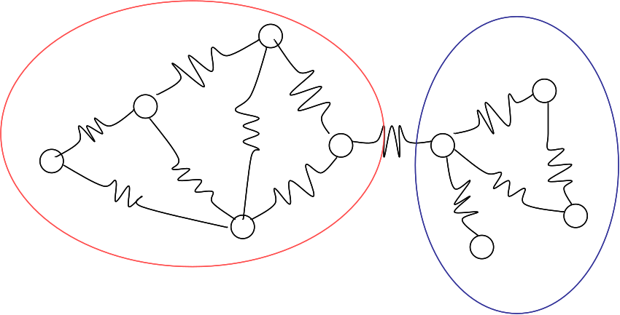
Extensions to weighted networks
Voltage clustering
A physics approach to finding
communities in linear time
Fang Wu and Bernardo Huberman
apply voltages to different parts of the network
largest voltage drops occur between communities
related to spectral partitioning

Slide 31
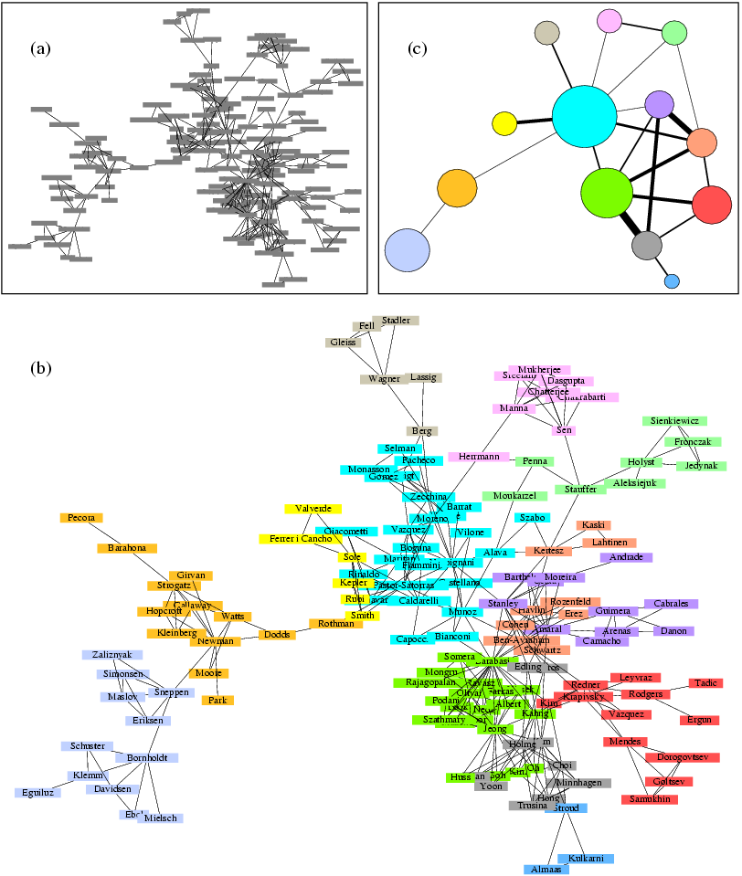
Reminder of how modularity can help us visualize large networks

Slide 32
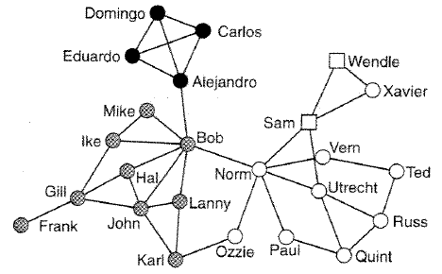
Bridges
Bridge – an edge, that when removed, splits off a community
Bridges can act as bottlenecks for information flow
younger & Spanish speaking
bridges
younger & English speaking
older & English speaking
union negotiators
network of striking employees

Slide 33
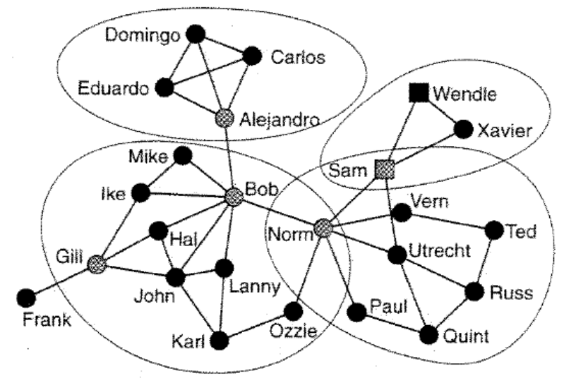
Cut-vertices and bi-components
Removing a cut-vertex creates a separate component
bi-component: component of minimum size 3 that does contain a cut-vertex (vertex that would split the component)
bi-component
cut-vertex
Pajek: Net>Components>Bi-Components (treats the network as undirected) see chapter 7
  identifies vertices belonging to exactly one component and isolates
  identifies # of bridges or bi-components to which a vertex belongs
  identifies bridges (components of size 2)

Slide 34
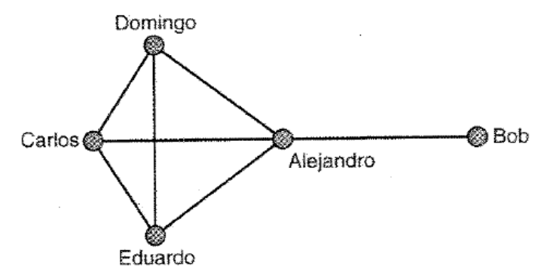
Ego-networks and constraint
ego-network: a vertex, all its neighbors, and connections among the neighbors
Alejandro’s ego-centered network
Alejandro is a broker between contacts who are not directly connected
Constraint: # of complete triads involving two people
Low-constraint – many structural holes that may be exploited
High-constraint – removing a tie to any one of the vertices means that others will act as brokers for that contact

Slide 35
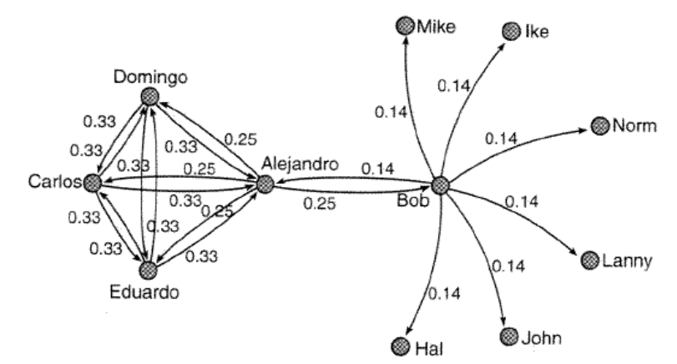
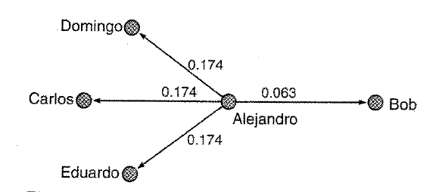
Proportional strength of ties
Strength of tie ~ 1/(# connections for the person)
asymmetrical
dyadic constraint: measure of strength of direct and indirect ties to a person

Slide 36
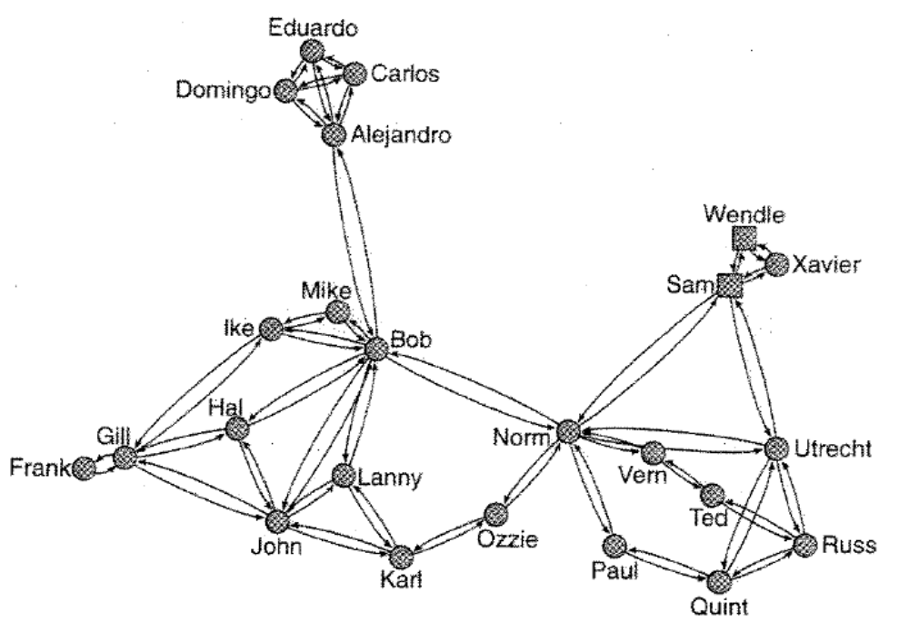
Structural holes with Pajek
Net>Vector>Structural Holes computes the dyadic constraint for all edges and for the network in aggregate
To visualize
  Options>Values of Lines>Similarities (in the Draw screen)
  Use an energy layout – high dyadic constraint vertices will be closer together

Slide 37
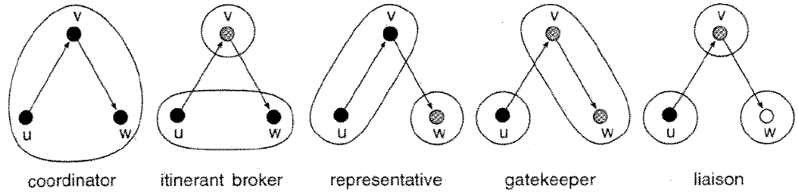
Brokerage roles in and between groups

Slide 38
Available tools:
Pajek: hierarchical clustering, bi-components, and block models
Guess: weak component clustering (need to threshold first) and betweenness clustering (slow)
Jung: betweenness, voltage, blockmodels, bi-components
Mark Newman’s homepage – fast clustering for very large graphs using modularity

Slide 39
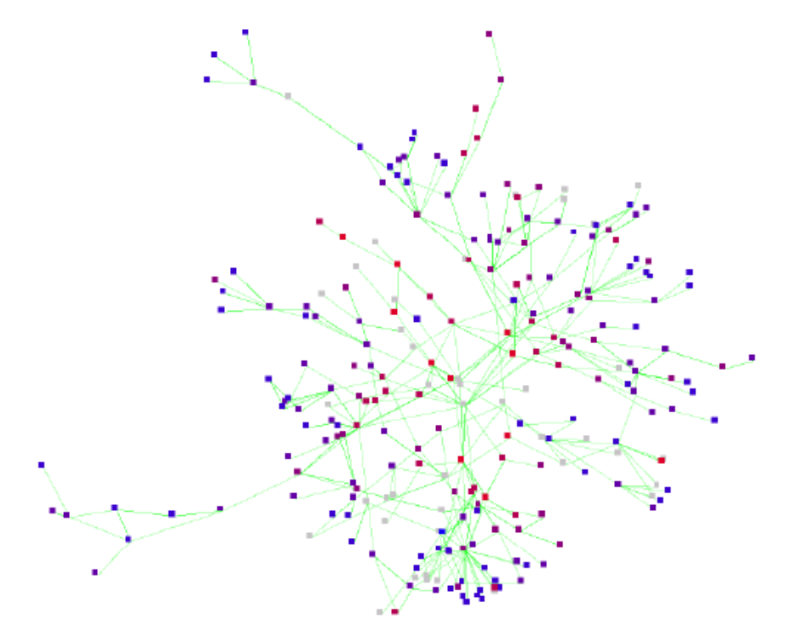
An aside
email spectroscopy: email network centrality corresponds to position in the organizational hierarchy

