Slide 1

Travis Douce, Stacey Kerr, Ankur Vashi, Scott Shamp, Henry Oddi, Doug Brewer

Slide 2


Travis Douce, Stacey Kerr, Ankur Vashi, Scott Shamp, Henry Oddi, Doug Brewer

Slide 3
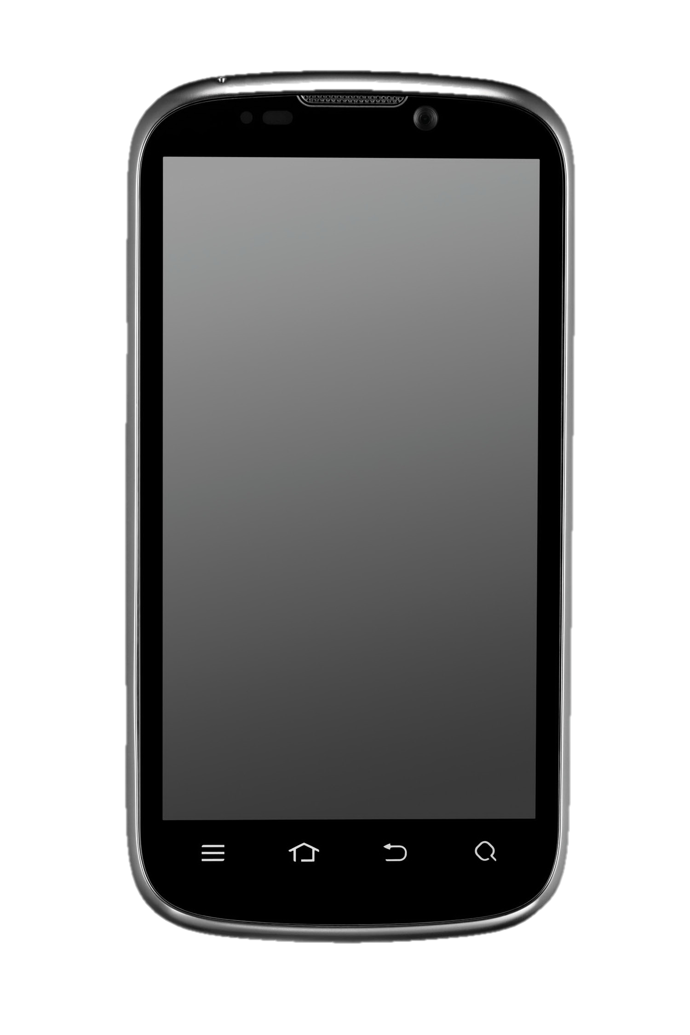

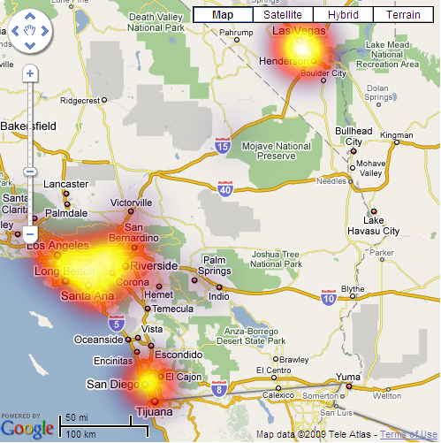
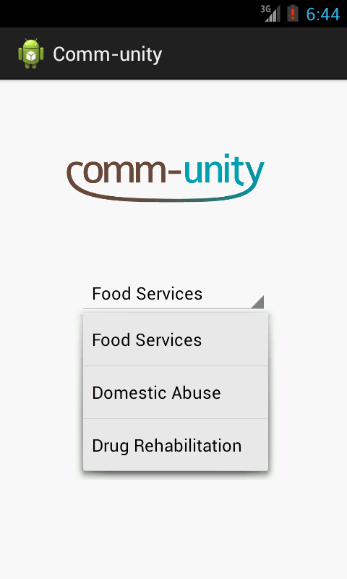
Travis Douce, Stacey Kerr, Ankur Vashi, Scott Shamp, Henry Oddi, Doug Brewer

Slide 4


Travis Douce, Stacey Kerr, Ankur Vashi, Scott Shamp, Henry Oddi, Doug Brewer

Slide 5
Advantages
Reaches those in need
Addresses organizational challenges
Generates “small” data
Scalable on existing infrastructure
Scalable on existing infrastructure
Generates “small” data
Reaches those in need
Addresses organizational challenges
Travis Douce, Stacey Kerr, Ankur Vashi, Scott Shamp, Henry Oddi, Doug Brewer
Notes:
1 - Smart Phones Prevalent
2--Engages Community, Maximizes Resources
3--Precise Geographic Information in Real Time
4--Low Cost / Maintenance, Scalable

