Slide 1


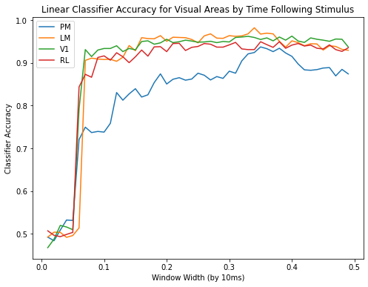
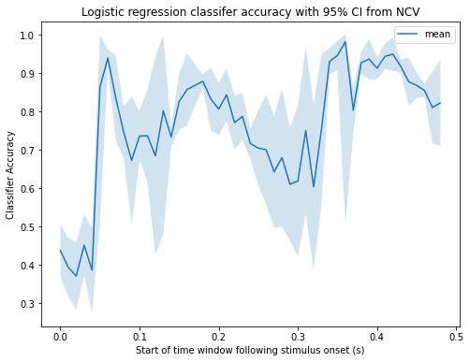
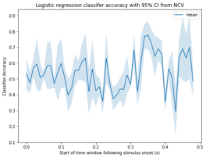
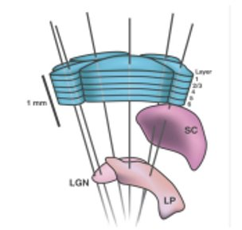
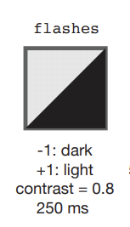
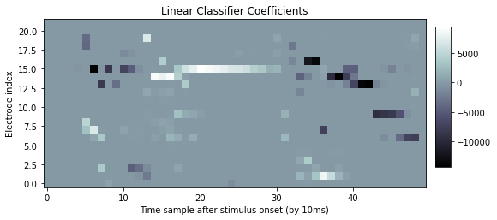
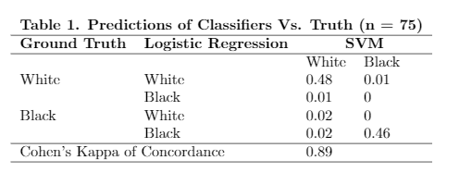


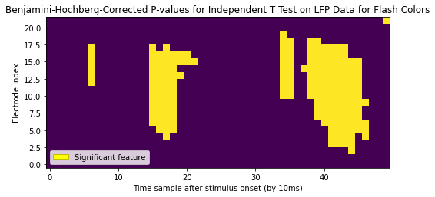
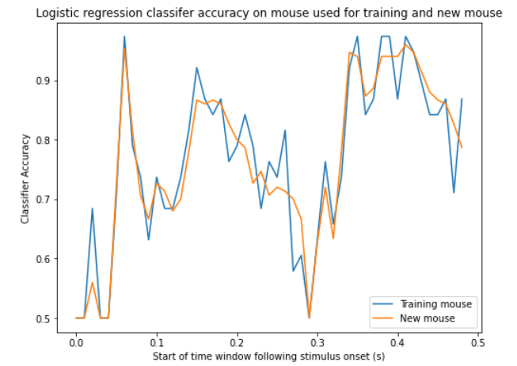
Decoding Stimuli from Local Field Potentials in the Mouse Visual System
Clayton Washington¹, William Cole², Konrad Urban³, Robert E. Kass³
¹The Ohio State University; ²University of Massachusetts Amherst; ³Carnegie Mellon University
Introduction
Results and Analysis
Discussion
We decode stimuli from Local Field Potential data in the mouse visual system using multiple common classifiers. We investigate the relative efficacy of data from several brain regions and time intervals
We aim to answer the following questions:
How well can classifiers discriminate between two stimuli using raw LFP data from different brain regions?
Are models trained on data from one mouse effective when applied to another mouse?
Classification Performances by Cortical Area
Classifier Performance Over Time: V1 Vs. Thalamus
Two different visual stimuli can be discriminated using a common interpretable classification technique with high accuracy.
Features of greatest interest appear after stimulus offset within the thalamic region and the visual cortex . Thus, the absence of the previous stimulus following a flash is related to the strongest synchronized synaptic responses in these areas.
The good performance on data from a second mouse of the model trained on data from the first mouse confirms the strong ability of LFP activity in visual areas to discriminate between contrasting stimuli.
We observe a response latency relative to stimulus onset. This is consistent with the appearance of our significant features in V1 (see Figure 4B).
Classification on PM data lags in performance and does not always reach the efficacy of classification on data from other regions until about 350 ms, where accuracy peaks for all cortical areas.
Accuracy of classifiers trained on data from V1 (Figure 5A) increases sharply in the time windows in which our significant features exist in V1 (see Figure 4B).
Accuracy of classifiers trained on data from thalamic regions LGN and LP (Figure 5B) remains close to chance while the stimulus is presented (0 ms to 250 ms).
Around 350 ms, data from V1 and thalamus produce similarly large increases in classifier accuracy.
At 400 ms, accuracy of the classifier trained on data from V1 remains high while accuracy of the classifier trained on data from thalamus falls to chance.
A
Data and Experiment
Figure 3: Expanding window classifier accuracy. Logistic regression classifiers were trained/tested on data from V1, LM, RL, and PM from expanding time windows.
Future Plans
An adult mouse was exposed to a sequence of visual stimuli. Neural activity was measured using six of the Neuropixels Probes (Figure 1)^{3,4} inserted through multiple brain regions including the Primary Visual Cortex (V1), the Lateromedial Area (LM), the Rostrolateral Area (RL), the Posteromedial Area (PM), the Lateral Geniculate Nucleus (LGN), and the Lateral Posterior Nucleus (LP)⁴.
Features of Stimulus Conditions in V1
B
Analyze systematically misclassified trials to identify consistent features.
Apply dimensionality reduction techniques to visually interpret LFP response to different stimuli.
Investigate further the strong differences in LFP response after stimulus offset.
The plots have common time axes to elucidate regions of interest at 70 ms, 150 ms, and 350 ms. Classifier accuracy per time window is displayed in Figure 5A.
The dominant features shown in Figure 4B occur simultaneously with transitions between dominant stimulus condition favored by regression coefficients, especially between electrodes 10 and 20.
The sharp increase in classifier performance around 70 ms following stimulus onset is less prolonged than the increase in performance at 320 ms (Figure 5A).
A series of 75 light and 75 dark flashes was shown for 250 ms with 2 seconds between each display (Figure 2)⁴. We concentrate our analysis on the first 500 ms following stimulus onset.
Figure 5: Logistic regression classifier accuracy for LFP data with 95% confidence interval derived from NCV. Classifiers were trained/tested on data from 10 ms sliding time windows. (A) LFP data from V1. (B) LFP data from LGN and LP.
Inter-rater Reliability
References
Figure 1: Six Neuropixels probes passing through cortical and thalamic regions of mouse visual system.
Figure 2: The two stimulus conditions.
We trained an SVM classifier and a Logistic Regression classifier and compared their performance.
The models exhibit a near-perfect level of concordance (Kappa = 0.89)
The contingency table expresses high accuracy of both models and lacks obvious trends in incorrect classifications
1. Allen Institute for Brain Science: Understanding the brain.
(n.d.). Retrieved from https://alleninstitute.org/what-we-
do/brain-science/
2. Kass, R., Brown, E., & Eden, U. (2014). Analysis of neural
data. New York, NY ;: Springer.
3. Atlas, A. B. (2021). Visual Coding – Neuropixels¶. Visual
Coding – Neuropixels - Allen SDK dev documentation.
Retrieved from https://allensdk.readthedocs.io/en/latest
/visual_coding_neuropixels.html.
4. de Vries, S.E.J., Lecoq, J.A., Buice, M.A. et al. A large-scale
standardized physiological survey reveals functional
organization of the mouse visual cortex. Nat
Neurosci 23, 138–151 (2020). https://doi.org/10.1038
/s41593-019-0550-9
5. Bates, Stephen, et al. “Cross-Validation: What Does
It Estimate and How Well Does It Do It?”
arXiv, 14 Apr. 2021. arXiv:2104.00673v2
Methods
A
Classification Task | Distinguish LFP as a light flash or dark flash based on neural data
Classifiers | Logistic Regression, Support Vector Machine
Inputs | Labeled raw LFP data sampled at 100Hz for 500 ms following stimulus onset
Model Transferability
To estimate prediction error and provide confidence intervals, we use leave-one-out Nested Cross-Validation as described by Bates, Hastie, and Tibshirani in [5]. We performed classifications using sliding windows and expanding windows.
Sliding windows: A new classifier is trained and tested on each 10 ms increment of the overall data.
Expanding windows: A collection of classifiers is trained and tested with each classifier using 10 ms more data than the last.
B
The Logistic Regression classifiers were trained across sliding time windows on 75% of the data from mouse_{train} and tested on the remainder of the data from mouse_{train} along with all of the data from a new mouse.
Across all time windows, the model performed similarly well on data from both mice.
Figure 4: (A)Logistic regression coefficients from classifier trained/tested on data from 10 ms sliding time windows. (B) Benjamini-Hochberg-corrected p-values from independent t-test on trial-averaged LFP data from each flash color. Features declared significant by the false discovery rate of 5 * 10⁻¹⁵ are shown in yellow.
We acknowledge the NIH along with Undergraduate Program for Neural Computation at CMU for making this project possible.
Figure 6: Test accuracy across sliding windows for data from the mouse used for training and a new mouse.

