Slide 1



ONEPILOT · DIGITAL CO-WORKER
Digital Co-Worker
An AI co-worker for every person on your team. It does the busywork across your systems, in plain chat or in the background.
Ask in plain language
Digital Co-Worker
Done in your systems

Slide 2


THE PROBLEM
Real work is a dozen small steps across a dozen systems.
A request comes in
The manual middle
Your systems
an email, a message, a form
read it, check the balance, open the system, key in the record, write back
SAP, email, files
The co-worker does the steps in the middle, so a request turns into a done task on its own.
Brisken Digital Co-Worker, part of OnePilot
02 / 11

Slide 3



WHO DOES THE WORK
A digital co-worker for every kind of task.
Domain specialists
Personal assistants
Analysts
Clerks
Deep in one area: treasury, payments, market data. They know your rules and your systems.
One per person. They handle the small, constant tasks that fill a day.
Pull the numbers together, summarize, and suggest the next move.
The steady, repetitive work: entries, records, reconciliations, done without tiring.
Brisken Digital Co-Worker, part of OnePilot
03 / 11

Slide 4

HOW YOU USE IT
You ask in plain language. It does the steps.
STEP 01 You ask
›
STEP 02 It works
›
STEP 03 It confirms
A message in chat, or a request that lands by email. Plain language, the way you would ask a colleague.
It reads the request, pulls what it needs from your systems, and carries out each step.
It tells you what it did in chat, shows the result, and suggests the next action.
Every step is checked and logged, and you can put a person in the loop wherever you want one.
Brisken Digital Co-Worker, part of OnePilot
04 / 11

Slide 5

A REAL EXAMPLE
A bank transfer, from an email, on its own.
01
›
02
›
03
›
04
›
05
Email arrives
Reads & summarizes
Checks cash
Creates the record
Confirms in chat
a transfer request lands in the inbox
the co-worker reads it and suggests the action
pulls the cash position from S/4HANA
books the memo record for the payment
reports success, suggests what is next
You stayed in the chat the whole time. The co-worker did the five steps across email and SAP.
Brisken Digital Co-Worker, part of OnePilot
05 / 11

Slide 6
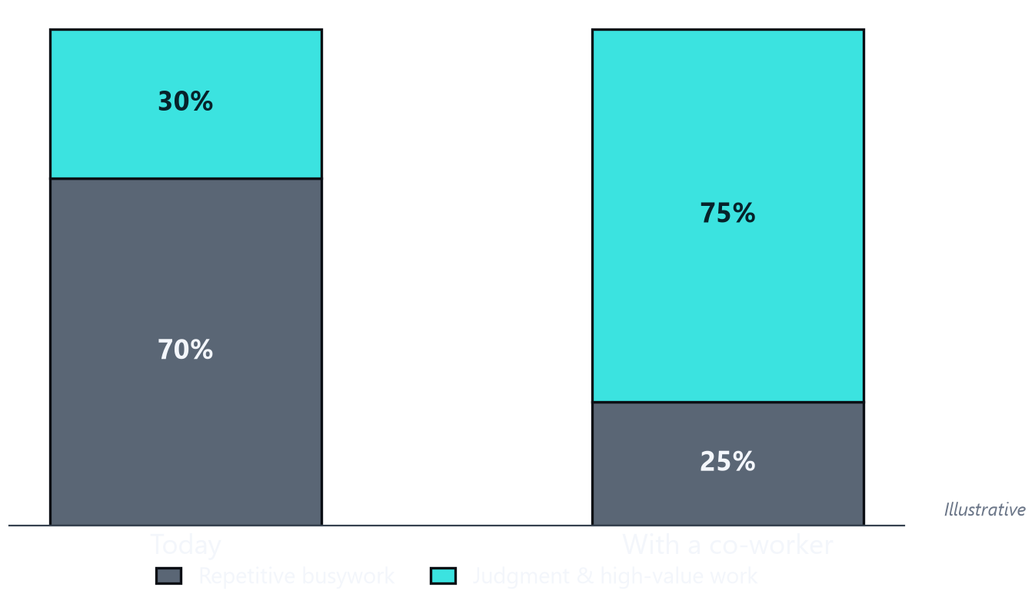

WHAT YOUR TEAM GETS BACK
Less busywork. More judgment.
The co-worker takes the busywork
The repetitive steps, the entries, the chasing, all done in the background.
Your people move up
They spend the day on the work that needs judgment, not on re-keying.
BUILT ON SAP
Brisken Digital Co-Worker, part of OnePilot
06 / 11

Slide 7


HOW IT FITS TOGETHER
One AI layer between your people and your systems.
Your team, in chat
Your systems
Requests in plain
language, by chat
or by email
Digital Co-Worker
SAP S/4HANA, treasury,
email, files,
non-SAP apps
one app on OnePilot
runs inside your SAP landscape,
checks and logs every step
Every action is checked, approved where you want it, and logged: a full audit trail, segregation of duty, ISO 27001 and SOC 1.
Brisken Digital Co-Worker, part of OnePilot
07 / 11

Slide 8




WHY IT IS SAFE TO LET IT RUN
The controls are built in, not bolted on.
A full audit trail
Approvals where you want them
Every action the co-worker takes is recorded, end to end.
The moves that matter wait for a person to sign off.
Automatic checks
Alerts on exceptions
Odd or bad data is caught before it reaches a system.
You hear about the odd one out; the rest just runs.
No code to change it
ISO 27001 and SOC 1
Your rules, changed by your team, no IT project.
The security controls your auditors already expect.
Brisken OnePilot
08 / 11

Slide 9


WHAT IT RUNS ON
Digital Co-Worker is one app on OnePilot.
OnePilot is the layer underneath. It moves your data cleanly between systems, both ways, across SAP and everything else, with the checks and the AI built in. One way to connect to all of it:
SAP systems
Spreadsheets & files
Email
Web & APIs
AI
It reads and writes to each of them, so the work lands where it needs to with nothing re-typed.
Brisken OnePilot
09 / 11

Slide 10
WHO WE ARE
We run the data and AI layer for SAP treasury.
Built into SAP
AI you can talk to
Yours to shape
An SAP co-innovation partner. The co-worker runs on SAP's own cloud, so it sits inside your landscape, not beside it.
Large language models do the reading, drafting and judgment. You work with it the way you already message a colleague.
No code. Role-based co-workers your team sets up. Customer teams already build on the platform.
1
co-worker per person
0
code to set it up
24/7
tireless, never off
Brisken OnePilot
10 / 11

Slide 11
Built to stay done.
Give us twenty minutes on the busywork your team repeats every day, and we will show you a co-worker doing it.
Dirk Neumann · dirk.neumann@brisken.com
brisken.com · Houston, TX

