Slide 1



ONEPILOT · MARKET DATA HUB
Market Data Hub
Every rate and reference you rely on, from any source to every system. Curated once, governed end to end.
Your data sources
Market Data Hub
Every system, SAP and beyond

Slide 2
THE SHORT VERSION
Every rate, through one governed feed. Here is what that looks like.
01
What this is
One managed feed on OnePilot: every provider ingested once, one governed rate delivered into SAP and beyond.
02
What it replaces
The Datafeed RFC and per-vendor scripts, in ABAP, that break when a provider changes a field.
03
What you get
One governed number in every system, checked for anomalies, audited on every change, no code to run it.
04
Who it is for
Treasury and IT teams feeding rates into SAP ECC or S/4HANA, and the systems beyond it.
The next page is where you are today. Then the machine itself: one pipeline, six real screens.
Brisken Market Data Hub, part of OnePilot
02 / 12

Slide 3

THE WAY IT WORKS TODAY
Every feed into SAP is a Datafeed RFC or a script. Built in ABAP, and it breaks when a field changes.
Your sources
The manual middle
Your systems
Bloomberg, LSEG, 360T, OANDA, central banks, websites, anywhere
re-keying rates, fixing formats, chasing bad values, reconciling by hand, fearing month-end
SAP, analytics, non-SAP apps, everywhere
71% of US SAP-treasury roles describe building or hand-running integrations into SAP, or manual data work (29 of 41). Source: Brisken Shadow Integration Report, N=41 US SAP-treasury job ads. Market research, not a Market Data Hub performance metric.
Brisken Market Data Hub, part of OnePilot
03 / 12

Slide 4




WHAT IT IS
One managed pipeline, provider to SAP.
Connect a provider once, and every rate is normalized, validated, governed and delivered into SAP the same way.
EVERY PROVIDER IN
Bloomberg · LSEG · ICE · CME · 360T · central banks
Ingest
›
Validate
›
Govern
›
Distribute
›
Audit
INTO EVERY SYSTEM
SAP ECC and S/4HANA · non-SAP apps, databases and analytics
Each of the next six pages is a real screen of this pipeline, in order.
Brisken Market Data Hub, part of OnePilot
04 / 12

Slide 5
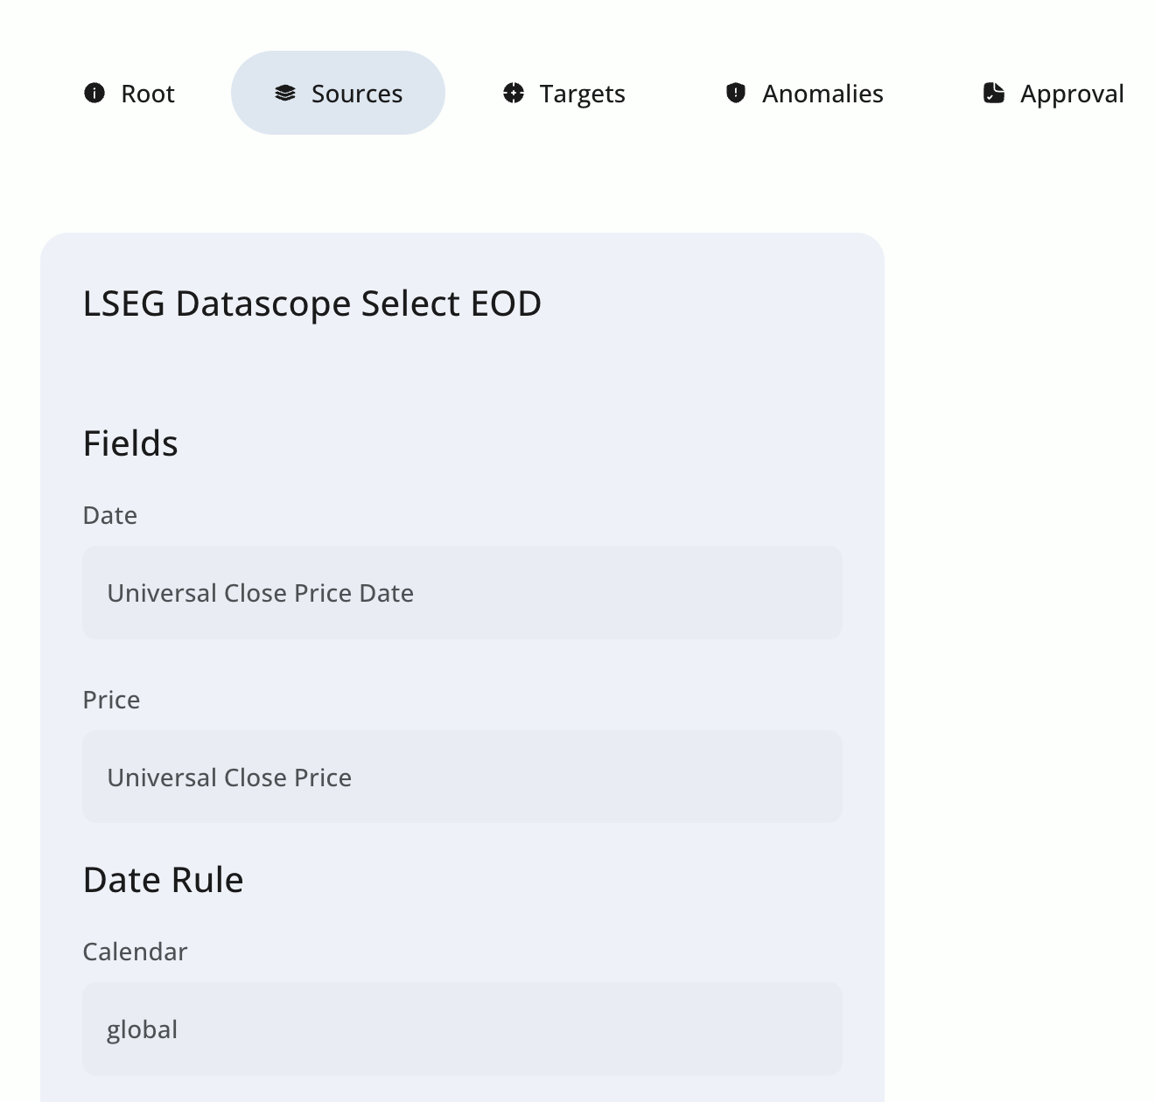
SHOW THE MACHINE · 1 / 6 · INGEST
Connect a provider once.
One provider configured in the product: LSEG Datascope Select. No per-vendor script.
Configured once
Remap, not rewrite
One screen deep
Set up in the product, not in ABAP.
A renamed field is a mapping change here.
Sources, targets, anomalies, approval, together.
Brisken Market Data Hub, part of OnePilot
05 / 12

Slide 6
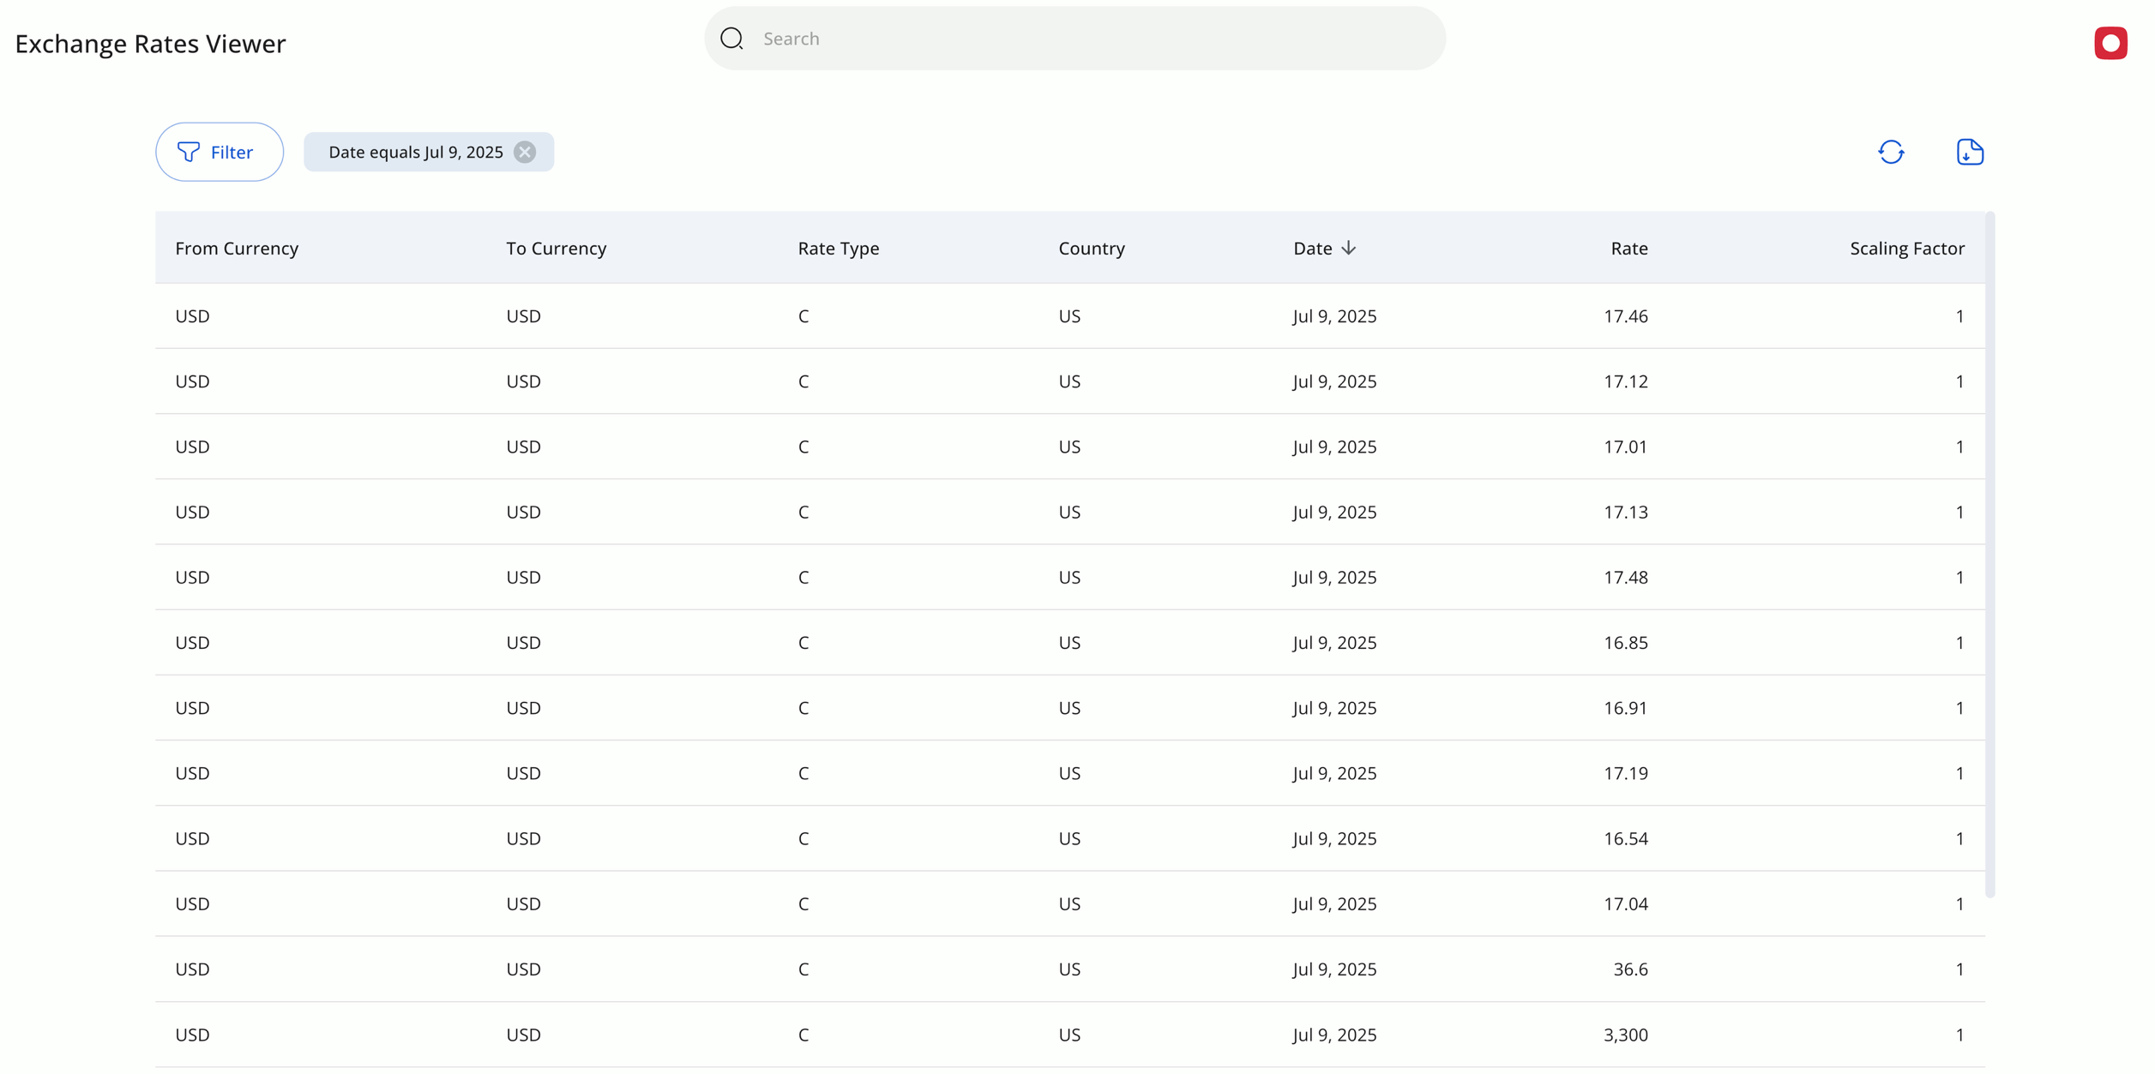
SHOW THE MACHINE · 2 / 6 · INGEST
The data lands, SAP-ready.
Every provider normalized to one shape, in the fields SAP already reads.
One shape
SAP fields
On a schedule
From, to, rate type, rate, scaling factor.
Rate type and scaling are what SAP reads.
Pulled by a routine on a calendar, not by hand.
Brisken Market Data Hub, part of OnePilot
06 / 12

Slide 7
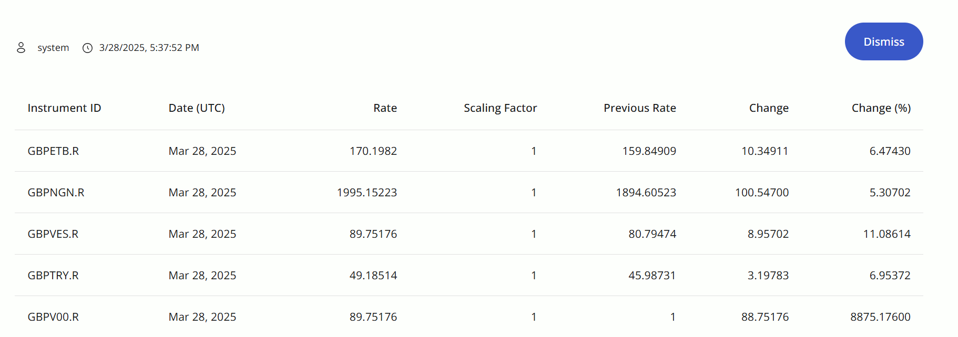
SHOW THE MACHINE · 3 / 6 · VALIDATE
A bad rate, caught before it reaches SAP.
A live anomaly notification from the product. The user is system, not a person.
Flagged automatically
User: system
Caught before SAP
The hub marks the outlier rates itself.
No person keyed or approved this.
The bad value is stopped at the gate.
Brisken Market Data Hub, part of OnePilot
07 / 12

Slide 8
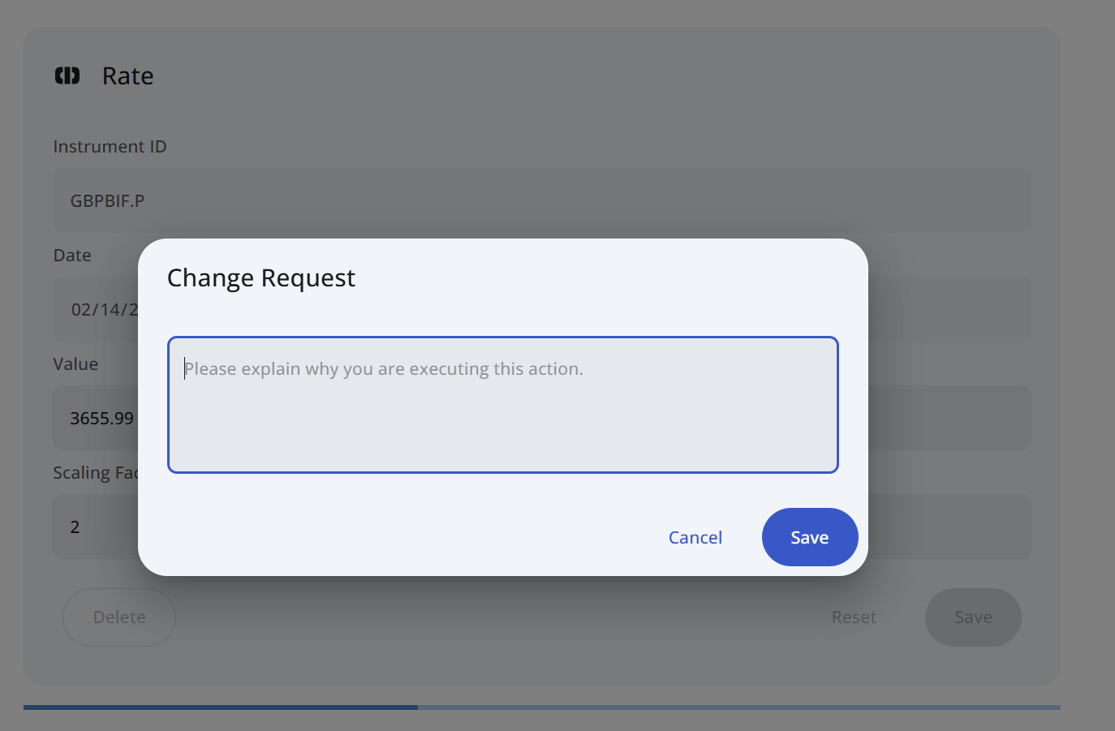
SHOW THE MACHINE · 4 / 6 · GOVERN
Nothing changes without a reason.
Editing a rate opens a change request: explain why, before it saves.
A reason, required
Four-eyes
On the record
Nothing saves without one.
The change is reviewed on the value itself.
The exact instrument and value are logged.
Brisken Market Data Hub, part of OnePilot
08 / 12

Slide 9
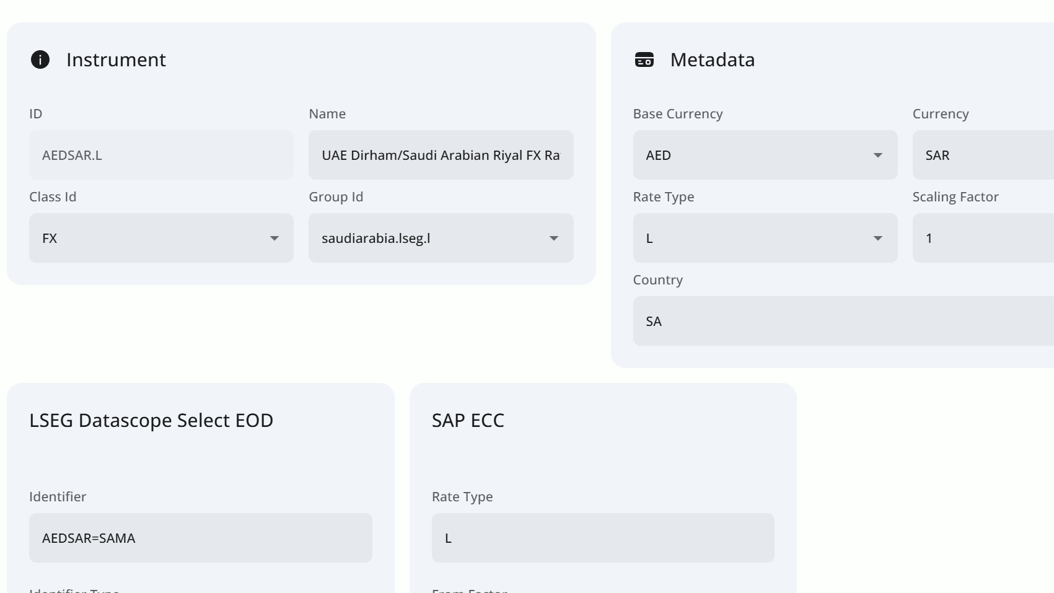
SHOW THE MACHINE · 5 / 6 · DISTRIBUTE
Mapped straight to your SAP.
One instrument, its provider source and its SAP ECC target, side by side.
Source to SAP
The rate your team reads
Changed here
The LSEG source mapped to the SAP ECC target.
The same value, in SAP, no re-keying.
SAP is never touched by hand.
Brisken Market Data Hub, part of OnePilot
09 / 12

Slide 10
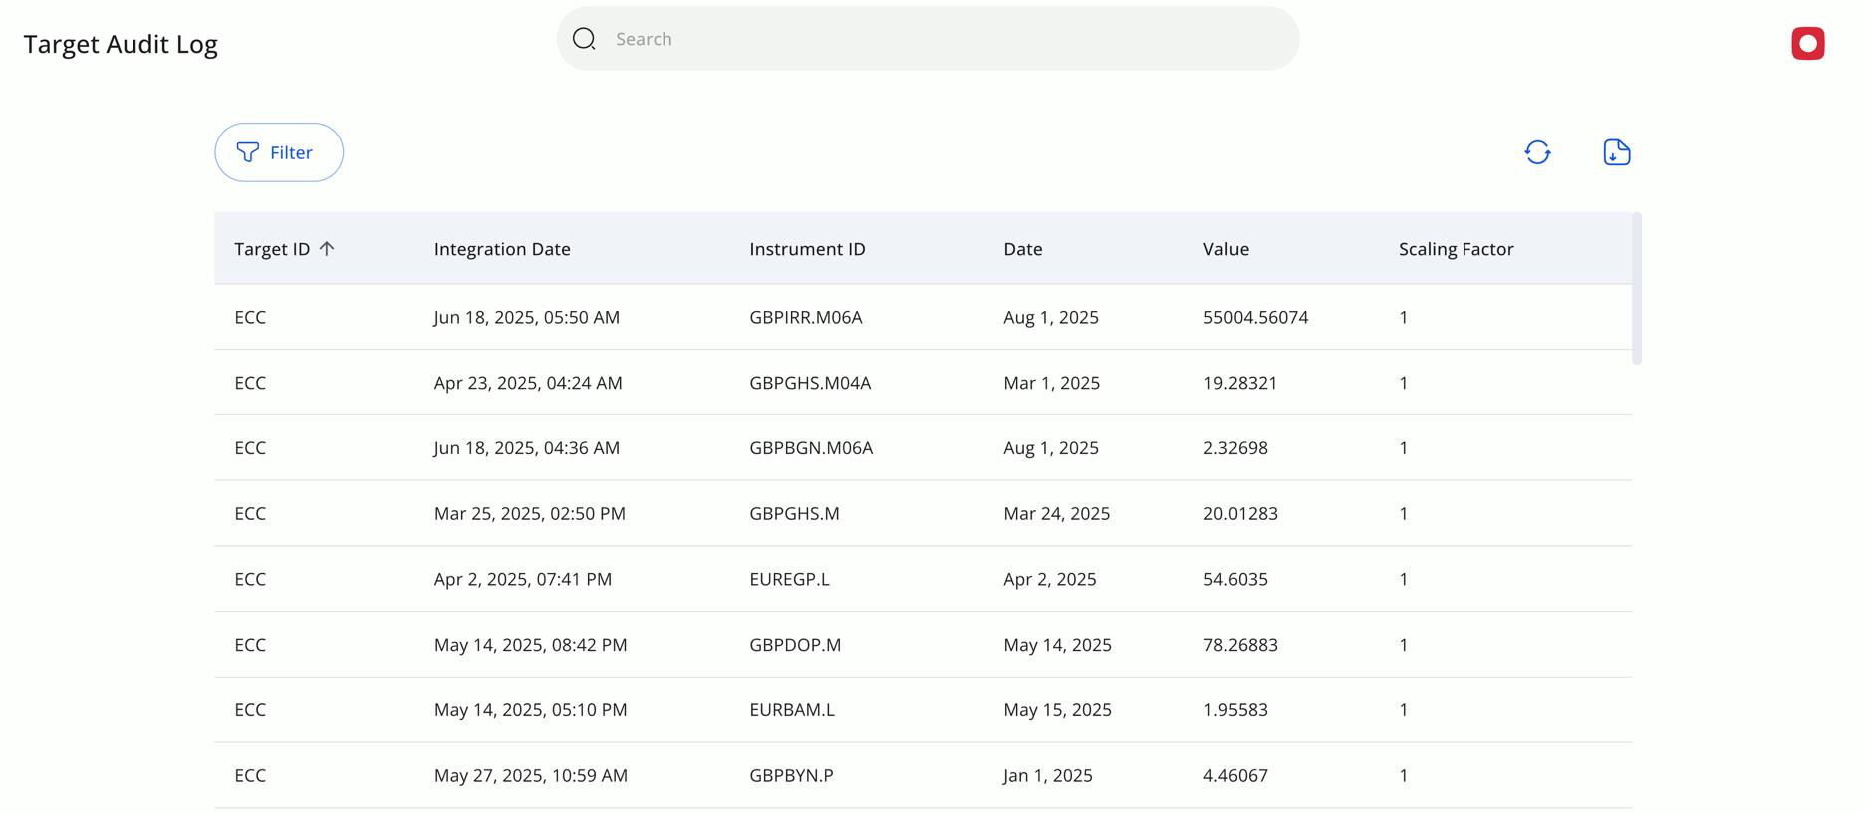
SHOW THE MACHINE · 6 / 6 · AUDIT
Audited to the target.
Every value that reached SAP, with its integration timestamp.
Both values kept
Per instrument
One click
The source rate and the SAP value together.
Reconciled one row at a time.
Where a rate came from is not a project.
Brisken Market Data Hub, part of OnePilot
10 / 12

Slide 11






WHY IT IS SAFE TO AUTOMATE
The controls are built in, not bolted on.
A full audit trail
Five anomaly checks
Every value and every change is recorded, end to end.
Standard deviation, variation, missing, stale and custom, before a rate moves.
Change requests with a reason
Audited to the target
Every rate edit is captured, routed for approval, and logged.
What you saw on the last page: every rate sent, logged with both values.
No code to change it
ISO 27001 and SOC 1
Your rules, changed by your team, no IT project.
The security controls your auditors already expect.
Brisken Market Data Hub, part of OnePilot
11 / 12

Slide 12

WHY IT FITS
What “one governed layer” looks like in practice.
Every feed, in
Every system, out
Connect any provider or feed, with nothing to swap out. Bloomberg, Refinitiv, 360T, OANDA, central banks, exchanges, government agencies, websites, your own internal data. Add or drop a source any time.
Push the curated data into SAP ECC and S/4HANA, or any non-SAP system, database, website or analytics tool. Any protocol you use: API, ODATA, SFTP, email, Excel add-in. Push it or let them pull it.
Brisken Market Data Hub, part of OnePilot
04 / 12

Slide 13










PARTNERS AND CUSTOMERS
The data, the platform, and the teams behind it.
TECHNOLOGY PARTNER
TRUSTED BY TEAMS AT
MARKET DATA PROVIDERS
Brisken Market Data Hub, part of OnePilot
11 / 12

Slide 14

One governed feed.
Give us twenty minutes on where your market data comes from, and we will show you one governed source feeding every system.
Or start with the Quick Assessment.
Dirk Neumann · dirk.neumann@brisken.com
brisken.com · Houston, TX

