Slide 1



ONEPILOT · MARKET DATA HUB
Market Data Hub
for Commodities
A commodities case study, in technology and concepts, from many sources to one governed price.
Your sources
Market Data Hub
Risk and trading

Slide 2

THE PROBLEM
Every commodity price has a dozen moving parts. Someone builds the curve by hand.
Components & sources
The manual middle
Risk & trading
Freight, storage, quality, local taxes, provider feeds
collecting components, adjusting by port and tenor, reconciling by hand
Prices that differ desk to desk
The Market Data Hub is the middle, so one governed curve reaches every desk on its own.
Brisken Market Data Hub for Commodities, part of OnePilot
02 / 9

Slide 3


HOW IT FITS TOGETHER
One governed hub, from source to system.
Sources & feeds
Risk & trading
PULL
Market Data Hub
PUSH
Provider feeds, central
banks, forward views, and
components from the ground
Risk management, the
trading desk, SAP Treasury,
any downstream system
one app on OnePilot
assembles and governs
every price curve
Every price is validated, checked for anomalies and logged: a full audit trail, segregation of duty, no-code rules, ISO 27001 and SOC 1.
Brisken Market Data Hub for Commodities, part of OnePilot
03 / 9

Slide 4
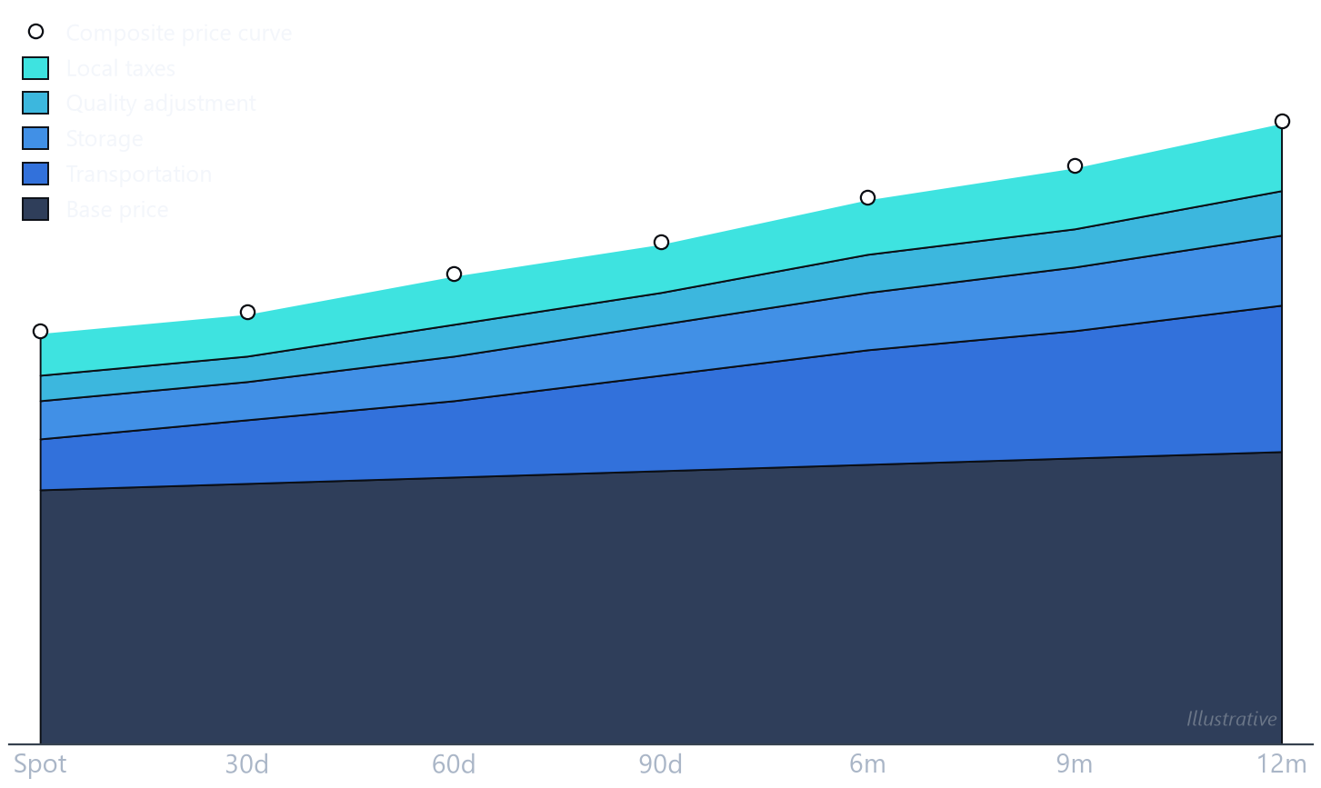


A WORKED EXAMPLE
Commodity price curves.
A curve on a timeline
Today's spot price, then 30, 60 and 90 days, out to a year.
Composite by design
Transportation, storage, quality and local taxes, combined into one price per tenor.
Location matters
The same commodity differs by delivery point, as storage, port fees and the local market differ.
Brisken Market Data Hub for Commodities, part of OnePilot
04 / 9

Slide 5



HOW IT WORKS
Many sources, one governed process.
01
02
03
04
›
›
›
Collect
Validate
Assemble
Distribute
Feeds, forward views, and components from the ground
Every rate checked; anomalies flagged for approval
Components combined into one curve per tenor
Sent to each system in the format it needs
Every change is versioned, approved, and audited, end to end.
Brisken Market Data Hub for Commodities, part of OnePilot
05 / 9

Slide 6

WHERE THE PRICE GOES
One curve, feeding risk and trading.
Risk management
Exposure on one consistent price
The payoff
One governed
Better information means lower buying cost and stronger selling margins than peers who line prices up by hand.
price curve
Trading desk
Prices buys and sells off the same curve
Brisken Market Data Hub for Commodities, part of OnePilot
06 / 9

Slide 7


WHO WE ARE
The data and AI layer for SAP treasury and trading.
Built on SAP
Provider and target agnostic
Governed end to end
An SAP co-innovation partner. The hub runs on SAP's own cloud, so it sits inside your landscape, not beside it.
Pull from any market data feed, push to any system, SAP or not, and change your sources at any time.
Every rate is validated on the way in and every change is audited, before anything reaches a downstream system.
Co-innovation partner SAP Certified, built on SAP's own cloud ISO 27001 and SOC 1 Type II
Brisken Market Data Hub for Commodities, part of OnePilot
07 / 9

Slide 8









PARTNERS AND CUSTOMERS
The data, the platform, and the teams behind it.
TECHNOLOGY PARTNER
TRUSTED BY TEAMS AT
MARKET DATA PROVIDERS
Brisken Market Data Hub for Commodities, part of OnePilot
08 / 9

Slide 9
Built to stay done.
Give us twenty minutes on your commodity price data, and we will show you one governed curve feeding every desk.
Dirk Neumann · dirk.neumann@brisken.com
brisken.com · Houston, TX

