Slide 1
Beer Mash Extraction

Slide 2
Problem Statement
The data that has been provided contains submissions of beer recipes. Some of the information contained are Beer Name, Beer Style, Original Gravity, Brew Method, etc.
Based off of what has been provided, I would be interested to see if one can predict the “Efficiency”.

Slide 3
Features of Dataset
o Size(L): Amount brewed for recipe listed
o OG: Specific gravity of wort before fermentation
o FG: Specific gravity of wort after fermentation
o ABV: Alcohol By Volume
o IBU: International Bittering Units
o Color: Standard Reference Method. Light to dark. Ex. 40 = black
o BoilSize: Fluid at beginning of boil
o BoilTime: Time wort is boiled
o BoilGravity: Specific gravity of wort before the boil
o MashThickness: Amount of water per pound of grain
o PrimaryTemp: Temperature at the fermenting stage
o PitchRate: Yeast added to the fermentor per gravity unit - M cells/ml/deg P
o SugarScale: Scale to determine the concentration of dissolved solids in wort
o BrewMethod: Various techniques for brewing
o Style: Type of brew.

Slide 4
Categorical and Numerical Features in Dataset
Categorical Features are :
SugarScale
Brewmethod
Style
Numerical Features are:
Id, Size(L), OG, FG, ABV, Color, BoilSize, BoilTime, BoilGravity, Efficiency, MeshThickness, PitchRate, PrimaryTemp

Slide 5
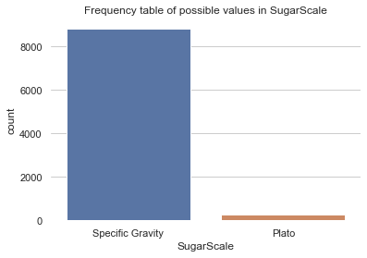
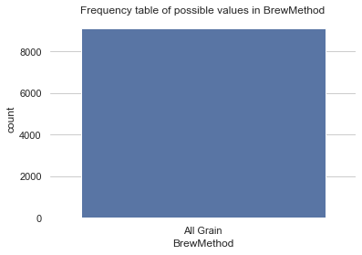
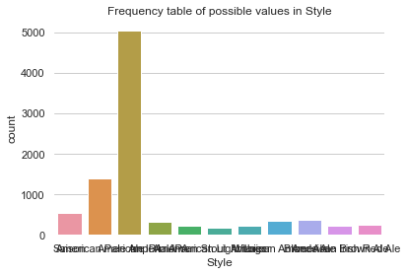
Graph of Categorical Features
Sugarscale , BrewMethod and Style

Slide 6
Statistics Report of Numerical Features
 | count | mean | std | min | 25% | 50% | 75% | max
Size(L) | 9099.0 | 52.409094 | 197.934651 | 1.89 | 20.500 | 20.820 | 30.000 | 5850.000
OG_sg | 9099.0 | 1.059861 | 0.013090 | 1.00 | 1.052 | 1.058 | 1.066 | 1.500
FG_sg | 9099.0 | 1.013343 | 0.004332 | 1.00 | 1.011 | 1.013 | 1.016 | 1.119
ABV | 9099.0 | 6.112086 | 1.361060 | 0.00 | 5.270 | 5.970 | 6.780 | 49.960
IBU | 9099.0 | 54.944371 | 40.279746 | 0.00 | 30.360 | 45.020 | 67.880 | 671.670
Color | 9099.0 | 9.923881 | 8.360675 | 0.03 | 5.240 | 7.100 | 10.870 | 50.000
BoilSize | 9099.0 | 60.975811 | 211.880396 | 3.03 | 26.500 | 28.390 | 35.980 | 5850.000
BoilTime | 9099.0 | 66.049896 | 12.598966 | 0.00 | 60.000 | 60.000 | 60.000 | 180.000
BoilGravity_sg | 9099.0 | 1.047471 | 0.013119 | 1.00 | 1.040 | 1.046 | 1.053 | 1.500
Efficiency | 9099.0 | 71.015397 | 7.620112 | 0.80 | 70.000 | 70.000 | 75.000 | 100.000
MashThickness | 9099.0 | 2.064355 | 1.635604 | 0.00 | 1.400 | 1.500 | 2.900 | 50.000
PitchRate | 9099.0 | 0.696186 | 0.312178 | 0.00 | 0.350 | 0.750 | 1.000 | 2.000
PrimaryTemp | 9099.0 | 19.689260 | 3.610124 | -17.78 | 18.330 | 20.000 | 20.000 | 85.000
With just this table, we can see the following:
# The numerical features in this dataset are on different scales (OG and FG have low std, but other fields like Size or BoilSize have very high std). This means that some sort of scaling is absolutely necessary
# Every numerical feature will have some important outliers (the only by exception being PitchRate) because the max value is always very far away from the 75 percentile.
# That third point is pretty important, we should have a look at boxplots for these features.

Slide 7
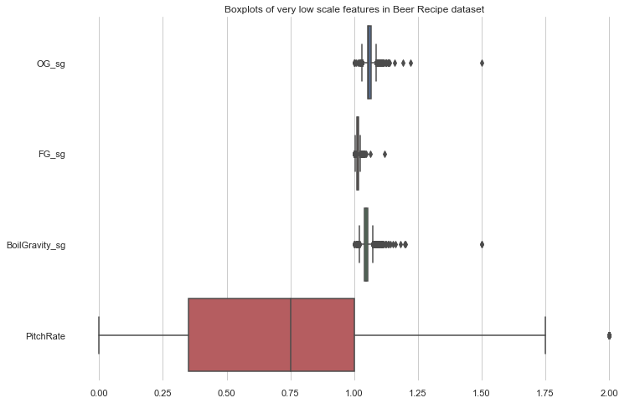
Cateogrize features for Outliers
Vlow_scale_feats = ['OG_sg', 'FG_sg', 'BoilGravity_sg', 'PitchRate’]

Slide 8
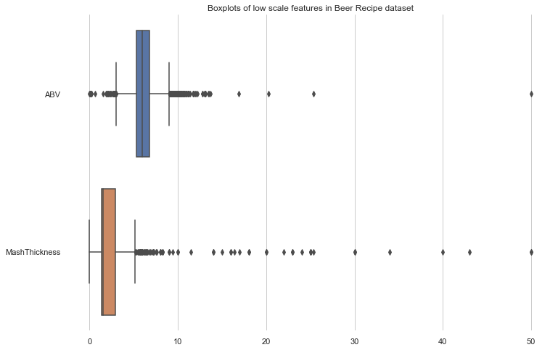
Outlier for Low Scale Feats
low_scale_feats = ['ABV', 'MashThickness’]

Slide 9
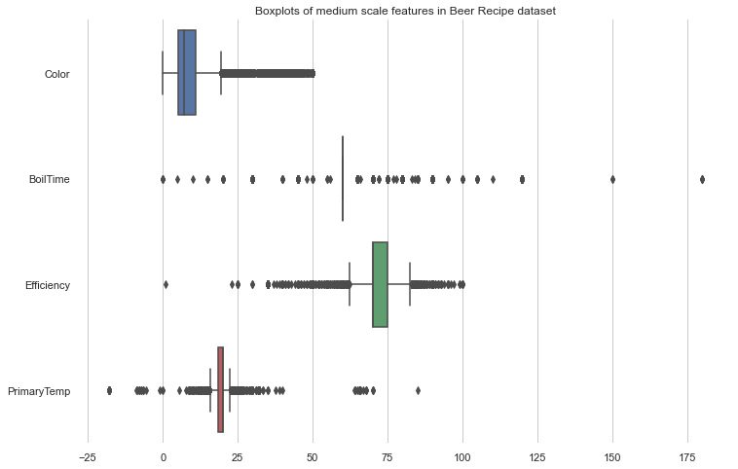
Outlier for Mid Scale Feats
mid_scale_feats = ['Color', 'BoilTime', 'Efficiency', 'PrimaryTemp’]

Slide 10
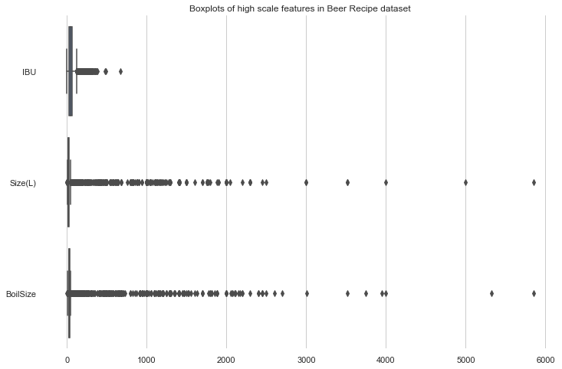
Outlier for High Scale Feats
high_scale_feats = ['IBU', 'Size(L)', 'BoilSize’]

Slide 11
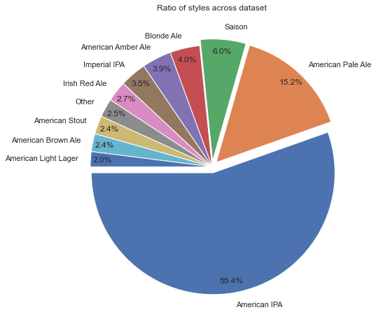
Pie Chart Distribution for Style Category

Slide 12
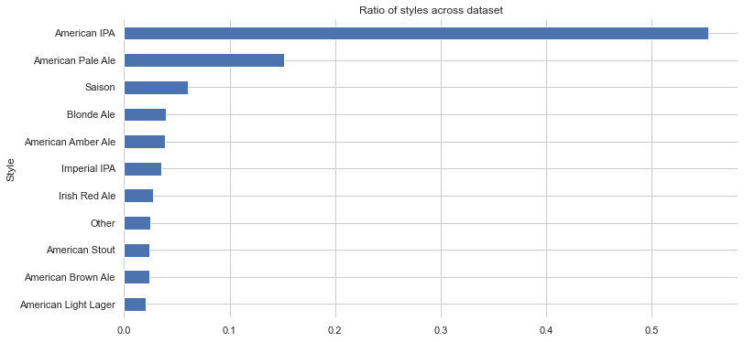
Bar Chart Distribution

Slide 13
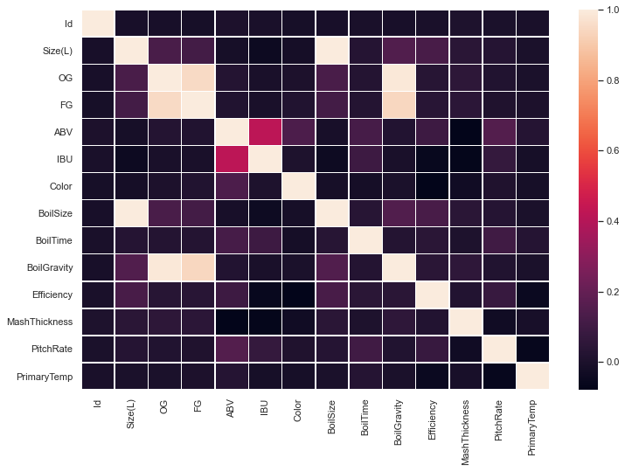
Heat Map to check Correlation

Slide 14
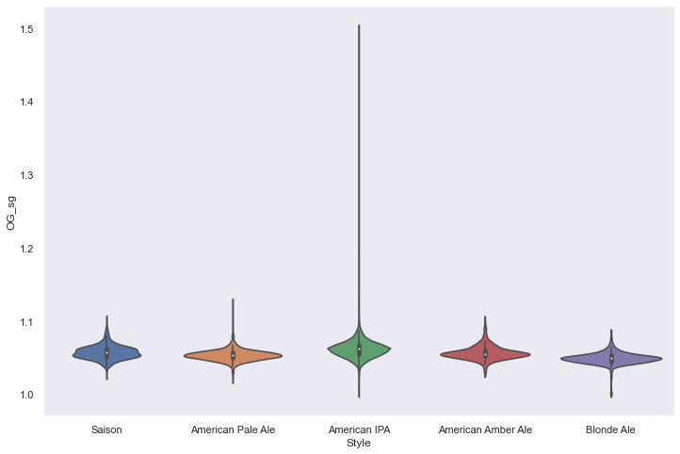
Outliers under Style Column

Slide 15
Split the Data Train and Test
Preprocessing the data
But before we can start looking at the Regressor, we'll have to preprocess our data to be able to use it to train our model.
The steps I'll need to go through are:
Label-encoding the categorical features I'll use
Fill null values in some of the numerical features (if I decide to use them)
Separate Target Classes from the Features(Here Efficiency is Target Column)
Perform a Train-Test Split so we can evaluate the Regressor on part of the data

Slide 16
Predicted Values and Accuracy
Based on Random Forest Regressor the Predicted Values for Efficiency we got
And the accuracy we got with the cross validation around 0.22654 approx. We need to retrain the model and try to implement some other regressor model. To get the best accuracy

