Slide 1
Load Balancing in SDN Controller
Shailesh Kumar
14CS01038

Slide 2
Introduction (SDN)
Software Defined Networking is a layered network architecture that provides programmability, automation, and network control by decoupling the control plane and the data plane of the network.
Increased control granularity in SDN allows a per flow definition with a high granularity policy level.
SDN infrastructure can adjust to the specific user application running on it via the control plane.

Slide 3
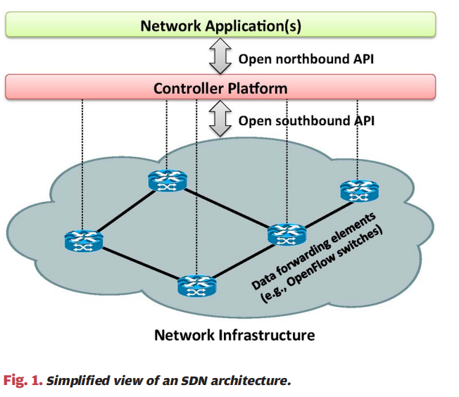
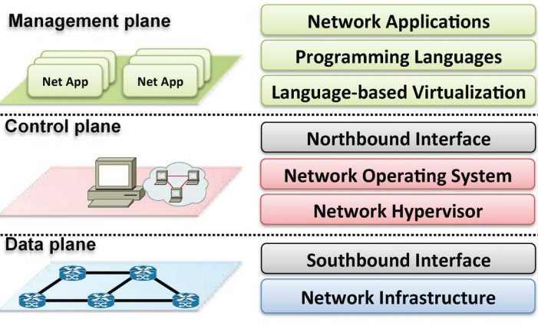
Introduction Cont.

Slide 4
Problem Definition
Balancing the loads of distributed controllers in SDN

Slide 5
Motivation
To increase scalability and availability of controller in SDN, distributed controllers are placed in the Network.
Each controlling its domain of network.
Loads on controller may be high and low and thus need to be balanced.

Slide 6
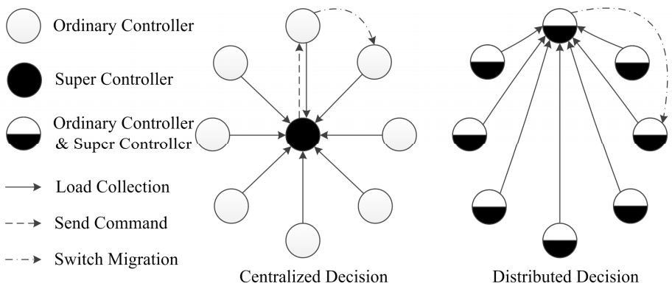
Proposed Work
Centralized Load Balancing
Distributed Load Balancing

Slide 7
Centralized Load Balancing
A master controller is responsibe for balancing the load of all controllers.
Periodically requests load from all other controllers.
Send a command message to high-load controller to migrate its load to low-load controller.

Slide 8
Centralized Load Balancing
Solving Node Failure
If the master node fails, load balacing fails.
Frequent Inter-controller communication with control messages will cause performance reduction.
Selection of new master controller.
Predefine the next master controller based on present master controller.
Handling Node Failure in Centralized approach
Assign each node a node id.
For n nodes having ids 0,1,2,... n-1
If M is current Master Controller then next Master Controller will be
M = (M+1)%n

Slide 9
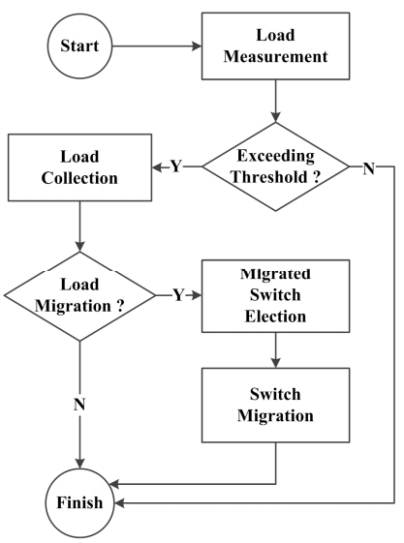
Distributed Load Balancing

Slide 10
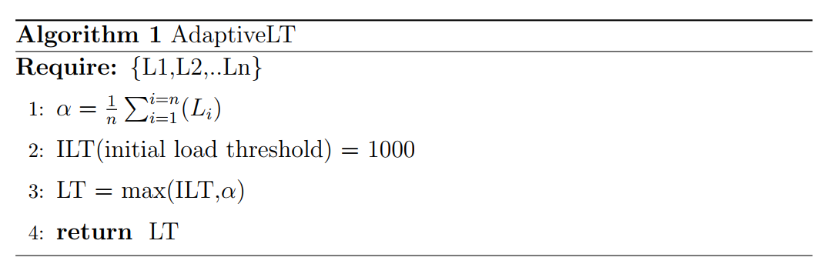
Load Measurement
Adaptive Load Threshold(LT)
Load on a controller can be view as average packet arrival rate.
In case of increase in overall load on the whole network new threshold is calculated as average of all loads

Slide 11

Decision Making
Define a load balacing rate as.
If load balancing rate is < 0.7 then go to load balancing.
Should go for load balancing if controller’s load is maximum of all.

Slide 12

Switch Election
Finding a switch such that following condition is satisfied.
Load threshold reduction when network goes down form high load to low load.
Update the LT, by collecting network load once again, value whenever L_{t} – L_{c} > L_{g}(load-gap).

Slide 13
Comparasion
Distributed Load Balancing technique will perform better than Centralized Load Balancing in case of low load, because it not go for load collection.
In case of high load in network, both are degrading the network performance.
Operational cost of Distribute Load Balancing is more.
Distribute better in low load, Centralized better in high load.

Slide 14
Conclusion and Future Work
Theroy suggest that centralized load balacing technique will outperform distributed load balancing under high-load in network.
Future work include validation of above proposed theory by adding load balancing module in Opendaylight controller.
Evaluating the optimal value of ILT, load balancing rate, and load-gap.

Slide 15
Current Work
Thank You
Prerequisites for implementaion.
Python and Java.
Python Completed.
Java learning.

