Slide 1
Sorting

Slide 2
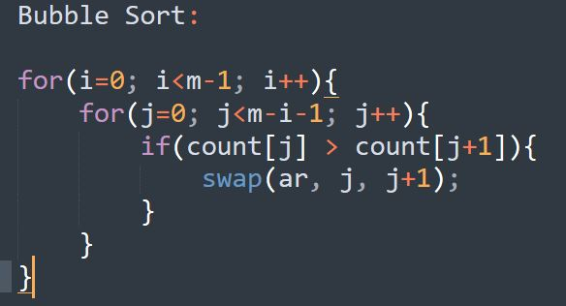
Bubble Sort

Slide 3
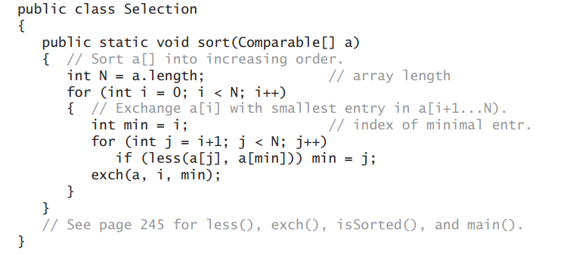
Selection Sort

Slide 4
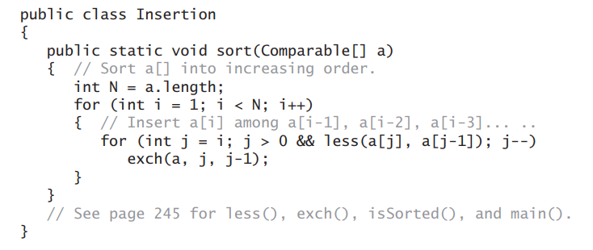
Insertion Sort:

Slide 5
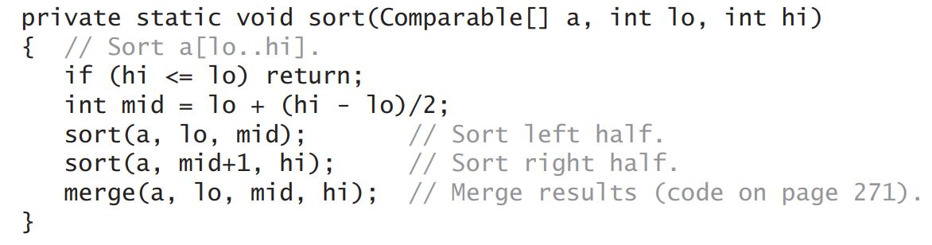
Merge Sort: (Sort Procedure)

Slide 6
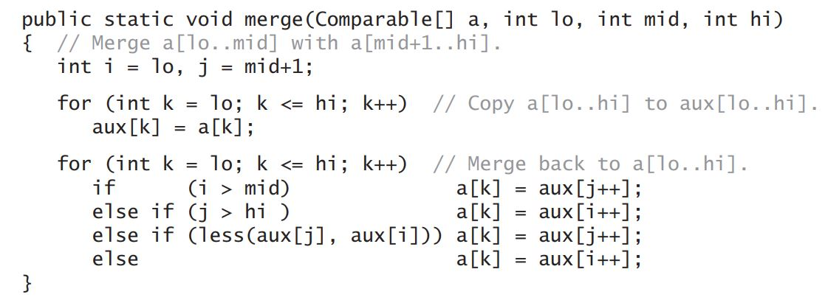
Merge Sort: (Merge Procedure)

