Slide 1
Segmentation of jawbone image (include teeth), ultrasound image
RULE-BASED LEARNING

Slide 2
Tutorial
Article: Computer-Assisted Detection of Cemento-Enamel Junction in Intraoral Ultrasonographs
Researched and built:
+ Homomorphic Filtering
+ Contrast Enhancement
+ Adaptive Median Filter
+ K-means clustering and CEJ Selection

Slide 3
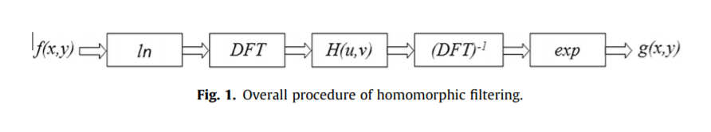
Homomorphic Filtering
Homomorphic Filtering – HF: a general technique for signal and image processing, which involves a nonlinear mapping to another domain, where linear filtering is applied, followed by a mapping back to the original domain. In a nutshell, HF is a technique to enhance low-light pixels.
The process below perform the HF technique:

Slide 4
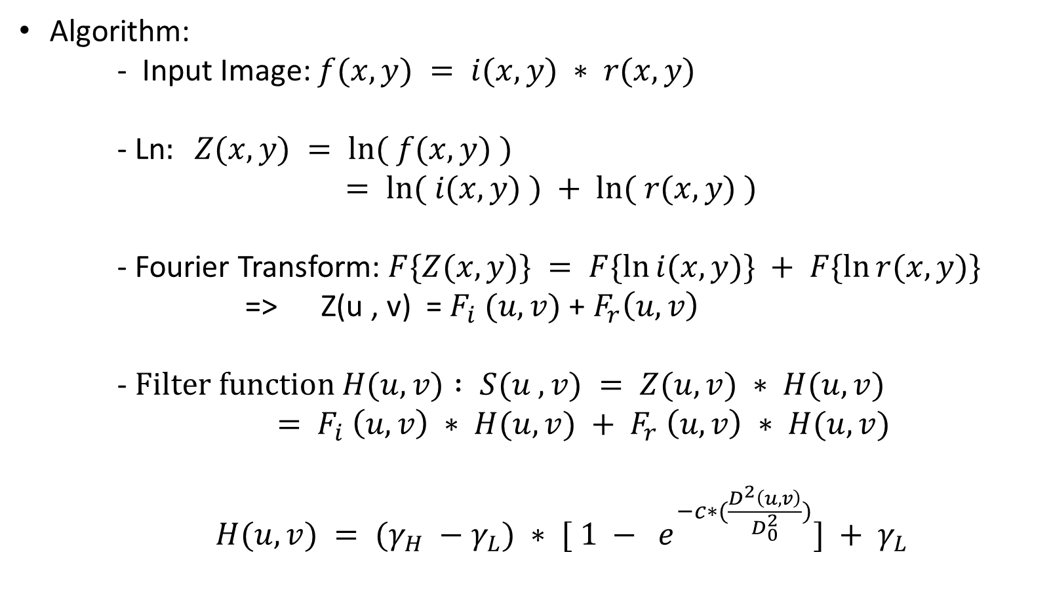
Homomorphic Filtering
Algorithm:
- Input Image: $f(x, y) = i(x, y) ∗ r(x, y)$
- Ln$: Z(x, y) = ln⁡( f(x, y) )$
$$= ln⁡( i(x, y) ) + ln⁡( r(x, y) )$$
- Fourier Transform: $F\{Z(x, y)\} = F\{ln⁡i(x, y)\} + F\{ln⁡r(x, y)\}$
=> Z(u , v) = $F_{i} (u, v)$ + $F_{r}\left(u, v\right)$
- $Filter function H(u, v) : S(u , v) = Z(u, v) ∗ H(u, v)$
$$= F_{i} \left(u, v\right) ∗ H(u, v) + F_{r} \left(u, v\right) ∗ H(u, v)$$
$H(u, v) = (γ_{H} −γ_{L}) ∗ [ 1 − e^{−c∗(\frac{D^{2}\left(u, v\right)}{D_{0}^{2}})}] + γ_{L}$

Slide 5
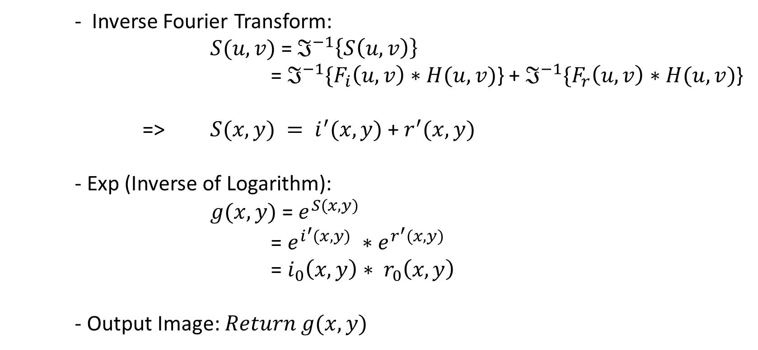
Homomorphic Filtering
- Inverse Fourier Transform:
$S(u, v)$= $ℑ^{−1}\left\{S\left(u,v\right)\right\}$
= $ℑ^{−1}\{F_{i}\left(u, v\right)∗H(u, v)$} + $ℑ^{−1}\{F_{r}\left(u, v\right)∗H(u, v)$}
=> $S(x, y) = i^{′}(x, y)$ + $r^{′}(x, y)$
- Exp (Inverse of Logarithm):
$g(x, y)$= $e^{S(x, y)}$
= $e^{i^{′}(x, y)} ∗e^{r^{′}(x, y)}$
= $i_{0}\left(x, y\right)∗ r_{0}\left(x, y\right)$
- Output Image: $Return g(x, y)$

Slide 6
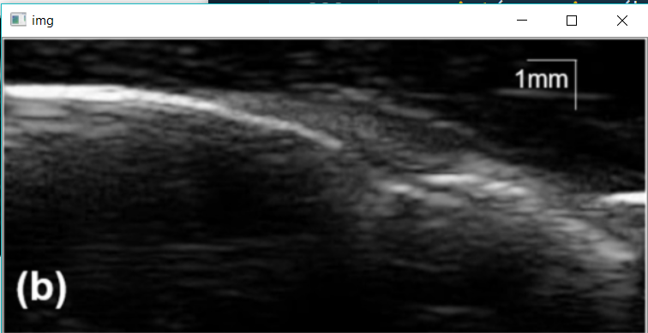
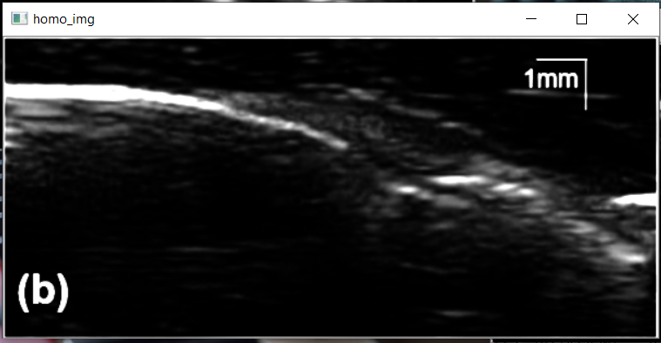
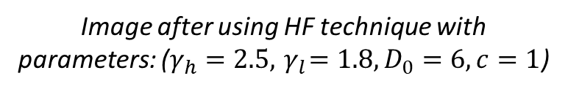
Homomorphic Filtering
Result:
Original image
Image after using HF technique with parameters: ($γ_{h}=2.5,{ γ}_{l}=1.8, D_{0}=6, c=1$)

Slide 7
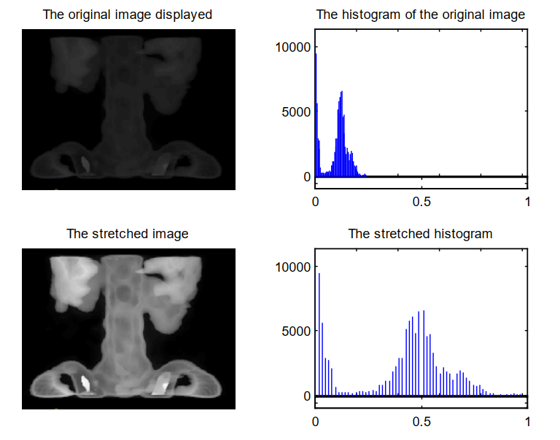
Contrast Enhancement - CE
It is a technique to optimize the difference between pixels. CE can be done through a variety of ways, but there are two common methods that are universally applicable:
1. Contrast Stretching
2. Contrast Equalization
Contrast Stretching: A technique for stretching the range of values of the histogram.
Includes the following types: Min-Max , Percentage, Piecewise.
Example:

Slide 8
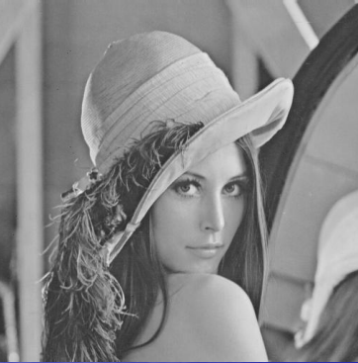
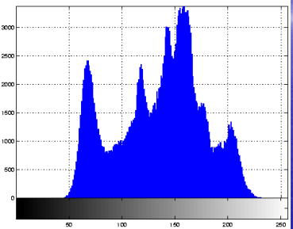
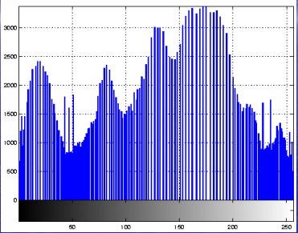
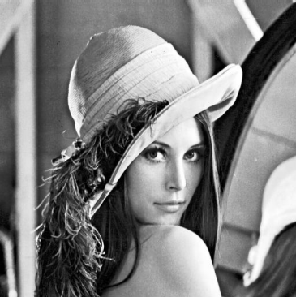
Contrast Enhancement - CE
2. Histogram Equalization: an image processing technique that adjusts image intensity to improve contrast. Histogram equalization is one of the simplest and commonly used methods to enhance low-level images using histograms.

Slide 9
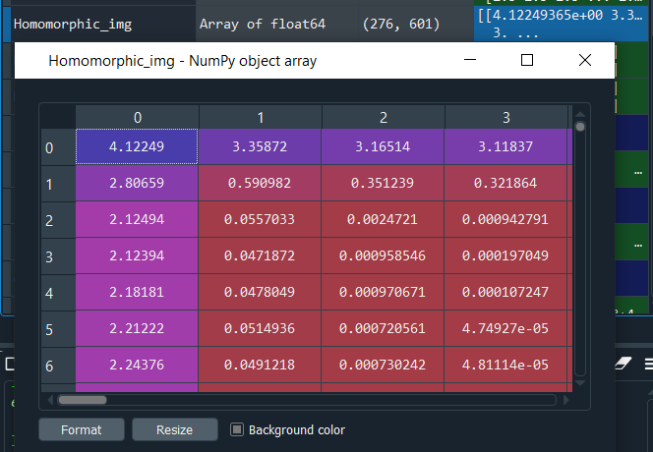
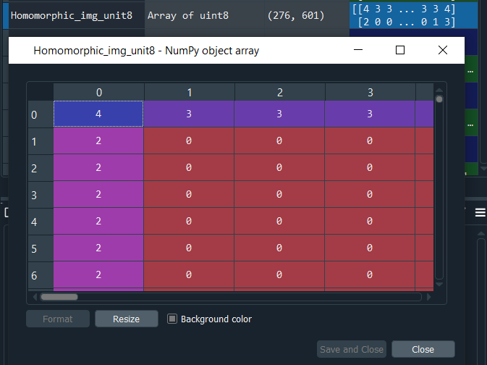
Contrast Enhancement - CE
Implement:
Contrast Enhancement:
Input: Image after using HF technique.
Output: Error. Because Image after using HF has dtype of float64 but the required dtype of image for function (CLAHE) and (equalizeHist) is uint8 or uint16
HF: float64 dtype
HF: uint8 dtype

Slide 10
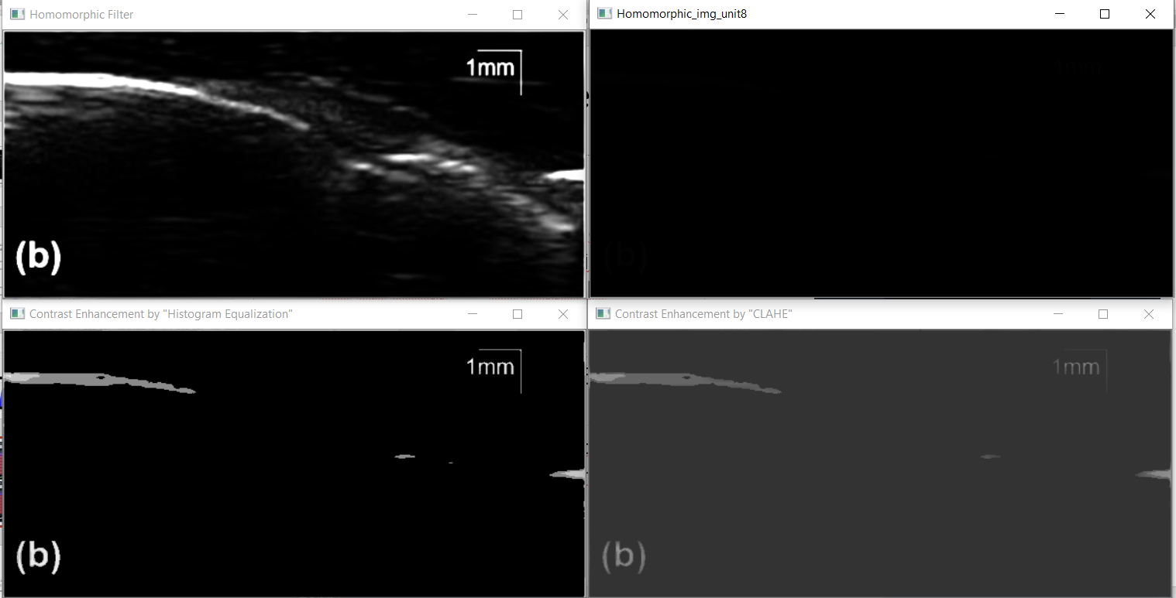
Contrast Enhancement - CE

Slide 11
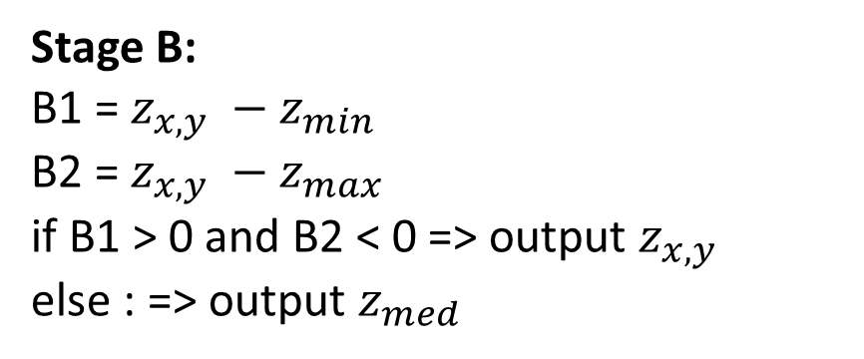
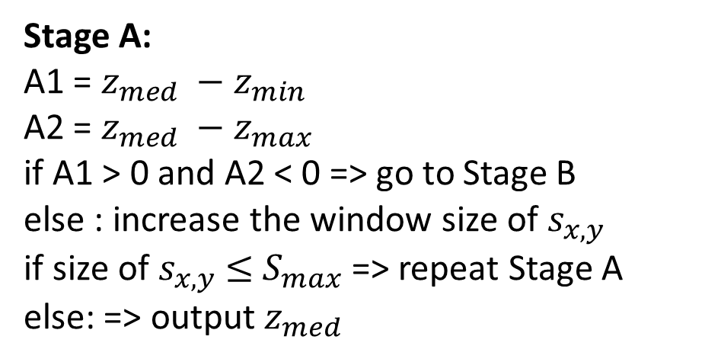
Adaptive Median Filter – AMF
Stage A:
A1 = $z_{med} −z_{min}$
A2 = $z_{med} −z_{max}$
if A1 > 0 and A2 < 0 => go to Stage B
else : increase the window size of $s_{x,y}$
if size of $s_{x,y}$ $≤$ $S_{max}$=> repeat Stage A
else: => output $z_{med}$
AMF can handle impulse noise that appears dense in space and also perform some smoothing operations on other types of noise.
AMF has 3 goals:
+ Remove impulse noise
+ Smooth other types of noise
+ Reduce distortion (thinner or thicker the contours of the object)
Algorithm:
Stage B:
B1 = $z_{x, y} −z_{min}$
B2 = $z_{x,y} −z_{max}$
if B1 > 0 and B2 < 0 => output $z_{x, y}$
else : => output $z_{med}$

Slide 12
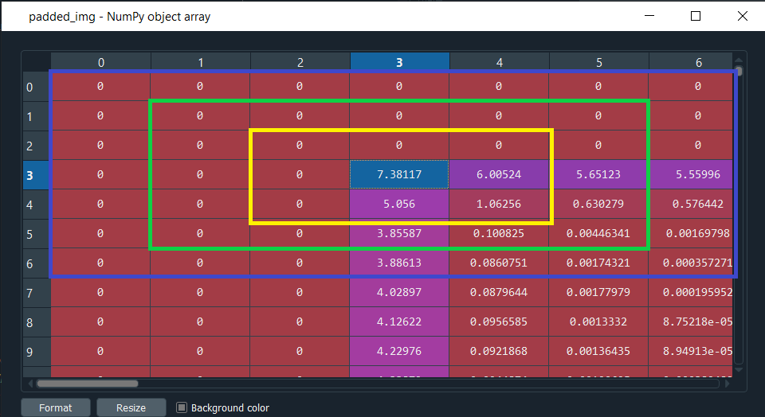

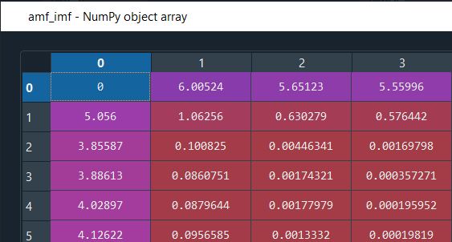

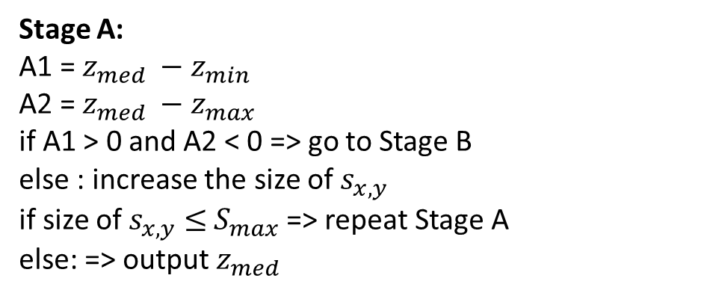
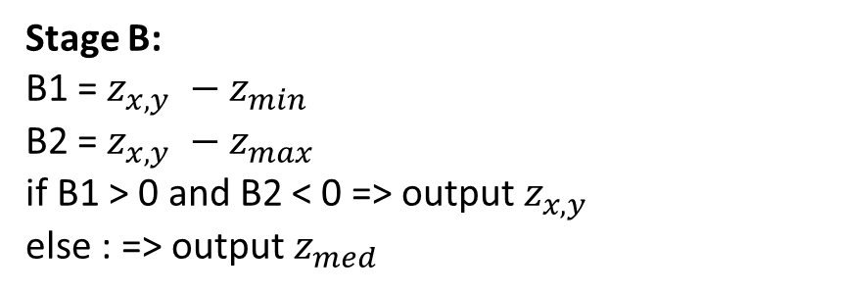
Stage A:
A1 = $z_{med} −z_{min}$
A2 = $z_{med} −z_{max}$
if A1 > 0 and A2 < 0 => go to Stage B
else : increase the size of $s_{x,y}$
if size of $s_{x,y}$ $≤$ $S_{max}$=> repeat Stage A
else: => output $z_{med}$
Stage B:
B1 = $z_{x, y} −z_{min}$
B2 = $z_{x,y} −z_{max}$
if B1 > 0 and B2 < 0 => output $z_{x, y}$
else : => output $z_{med}$

Slide 13
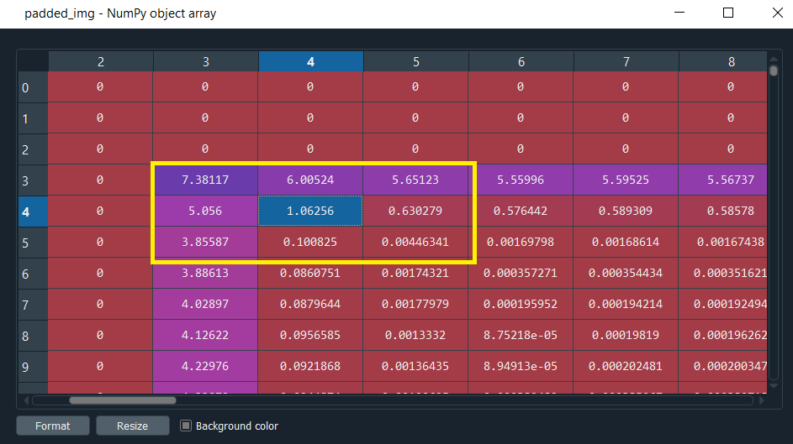
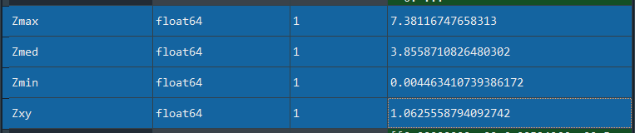
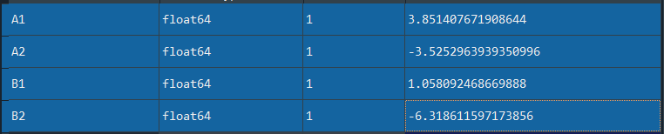
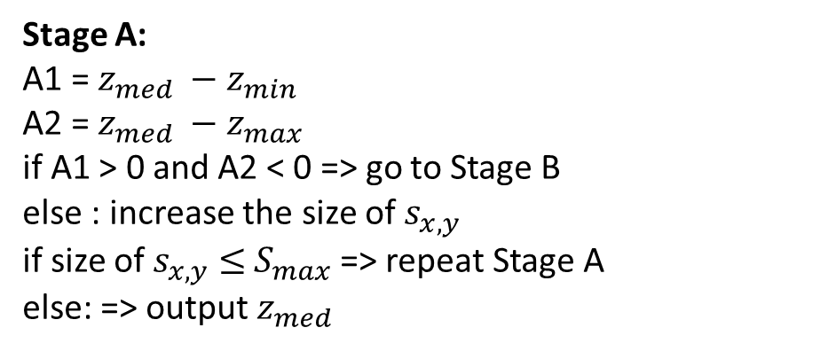
Stage A:
A1 = $z_{med} −z_{min}$
A2 = $z_{med} −z_{max}$
if A1 > 0 and A2 < 0 => go to Stage B
else : increase the size of $s_{x,y}$
if size of $s_{x,y}$ $≤$ $S_{max}$=> repeat Stage A
else: => output $z_{med}$
Stage B:
B1 = $z_{x, y} −z_{min}$
B2 = $z_{x,y} −z_{max}$
if B1 > 0 and B2 < 0 => output $z_{x, y}$
else : => output $z_{med}$

Slide 14
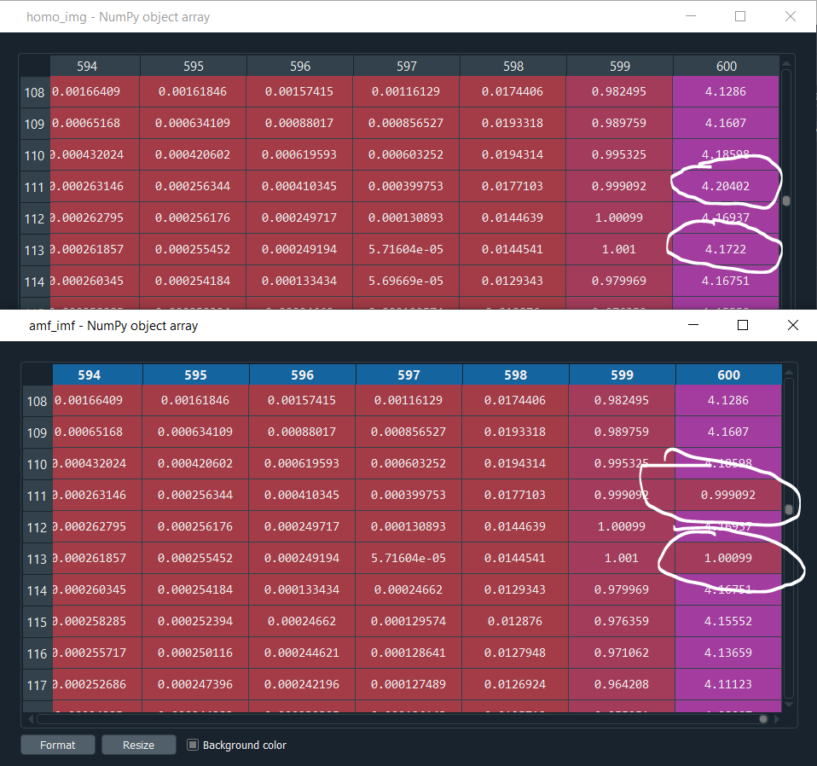
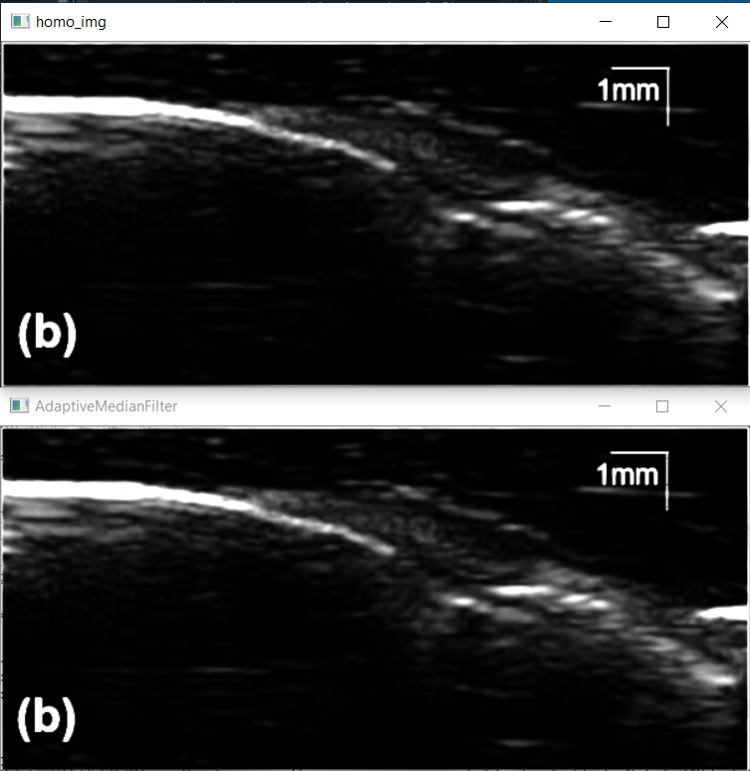
Adaptive Median Filter - AMF

Slide 15
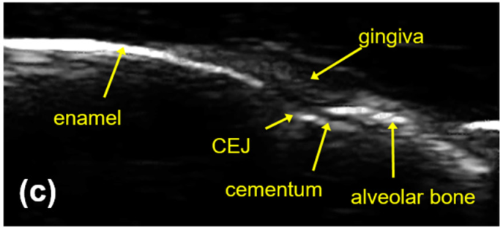
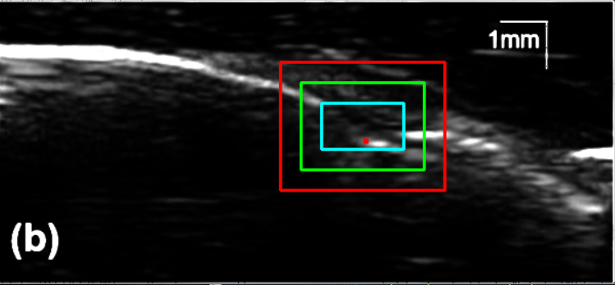
K-means clustering and CEJ Selection
K-means clustering: select the ROI (the region of interest) region that contains the CEJ position and exclude the enamel and gingiva regions as much as possible. Here, we use 3 rectangular boxes surrounding the CEJ area to compare the accuracy of CEJ selection with k = 2

Slide 16
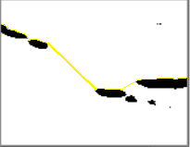
K-means clustering and CEJ Selection
CEJ Selection: After the bounding box is selected and clustered, the edge detection algorithm will be used to find the corresponding edges. Where the two points of contact between enamel and cementum are, the CEJ is at the bottom with the greatest distance between enamel and cementum

Slide 17
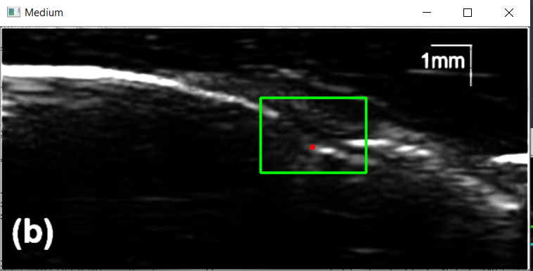
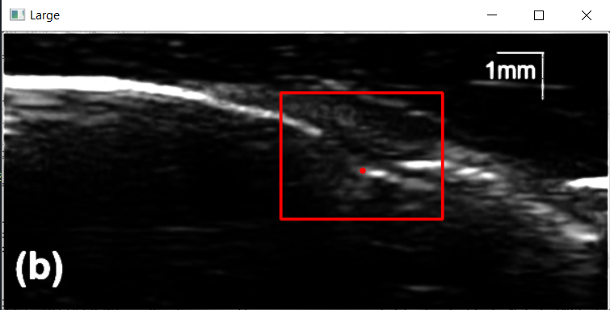
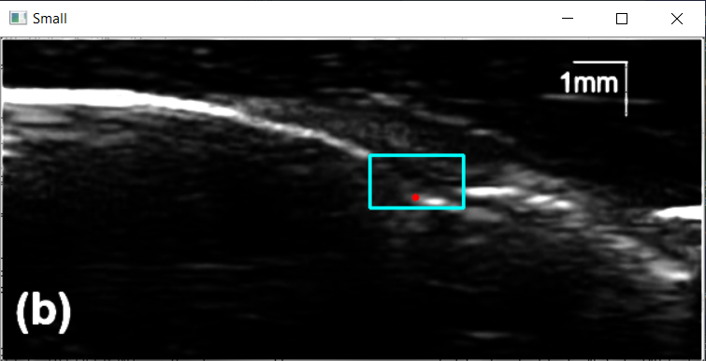
K-means clustering and CEJ Selection
Compare between box boundaries: Large, Medium, Small
Medium box boundary in Image
Large box boundary in Image
Small box boundary in Image

Slide 18
THE END. Thank you!!!

