Slide 1
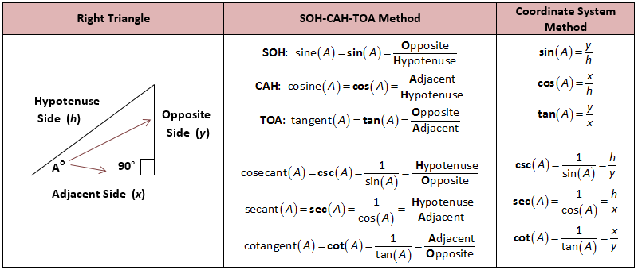
Testing1
Testing2

Slide 2
Testing3
Testing4

