Slide 1
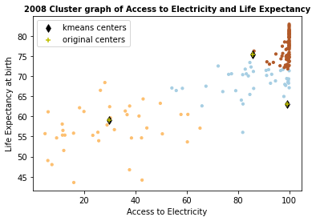
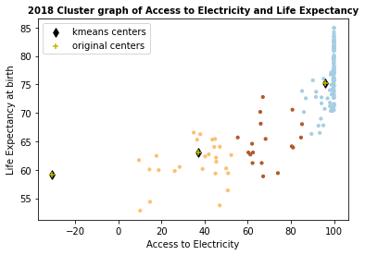
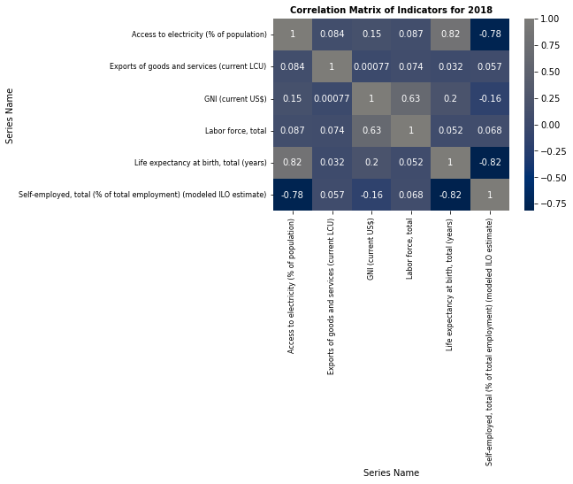
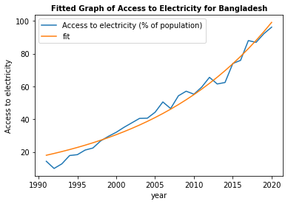
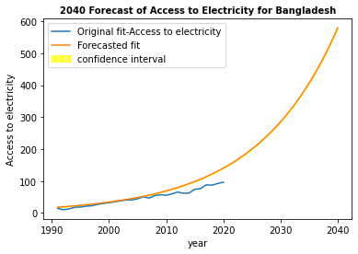
Effects of Economic Indicators on National Income Dorothy E. Sarpong Kumankoma
Abstract
We explore the relationship between economic indicators and national income of countries. Focusing on key indicators such as Access to Electricity, Gross National Income (GNI), Self-Employment, Life Expectancy, Labor force, and Exports of Goods and Services, the study aims to uncover patterns and clusters amongst the countries that shed light on the economic landscape of the nations.
Github link: https://github.com/01DorSarpong/Assignment_3_Clustering_Fitting
Data Source: https://databank.worldbank.org/source/world-development-indicators#
Introduction
Due to global interdependence and complex economic dynamics, the exploration of the interplay between economic indicators and national income stands as a crucial endeavor. The study explored clusters amongst the Access to Electricity and Life Expectancy at Birth indicators for 2008 and 2018. Cluster 0 which had countries with the highest values were further explored with a focus on Algeria, Bangladesh and China. Further investigations were made on Bangladesh to understand the distribution and forecasting of the values for the next 20 years.
The cluster graphs show a 10-year span analyses between 2008 and 2018. We see a decline in the access to electricity over the years. This could be due to economic crises, prevalence of natural disasters , increase in population etc. Life expectancy at birth also increased slightly in the new years and this could be associated with the introduction of new technologies in health care that seeks to ride on advanced scientific research and studies.
From the graphs we can see that life expectancy and access to electricity both have a positive correlation with the Gross National Income of a country. A 10-year span analyses between 2008 and 2018 shows that access to electricity for the countries in cluster 1 have declined over be associated with the introduction of new technologies in health care that seeks to ride on advanced scientific research and studies.
Conclusion
In assessing the overall prosperity of countries, Gross national income, a comprehensive measure of a country's economic performance, has been crucial. Valuable insights and correlations have been provided by the analysis of these macroeconomic indicators. Labor force has been a pivotal factor, showcasing the importance of human capital in economic growth. Access to electricity has surfaced as a key contributor to economic prosperity, as it directly influences productivity and development. The positive correlation between life expectancy at birth and national income underscores the interconnectedness of healthcare and economic well-being. Two thirds of the over 150 countries analysed proved that for a country can increase it’s National Income with a keen focus on their Labour Force, Access to Electricity and the factors that influence their Life Expectancy at Birth such as the Health Sector.

