Slide 1
Basics of Dublin Core Metadata
Tutorial
Dublin Core – Building blocks for interoperability
17 December 2009
Thomas Baker

Slide 2
Basics of Dublin Core metadata
Dublin Core in historical context
Core metadata on a new World-Wide Web
Towards a Web of Data
Structured Data and search engines
Interoperability options in a Web of Data
Levels of Interoperability
Data Integration and Structured Search
Metadata Records and DCMI Abstract Model
Web-enabled controlled vocabularies
Linking legacy data to the Web of Data

Slide 3
1994: The Need
Web had arrived: WWW conference, Chicago
Clear: librarians would not “scale” to what was coming…
“We need a simple template for describing Web pages”
Librarians and computer people met in Dublin, Ohio…

Slide 4
1995: the “Dublin Core”
Elements
Identifier
Title
Creator
Contributor
Publisher
Subject
Description
Coverage
Format
Type
Date
Relation
Source
Rights
Language
Simple enough for non-experts to understand
A “library catalog card” for Web objects

Slide 5
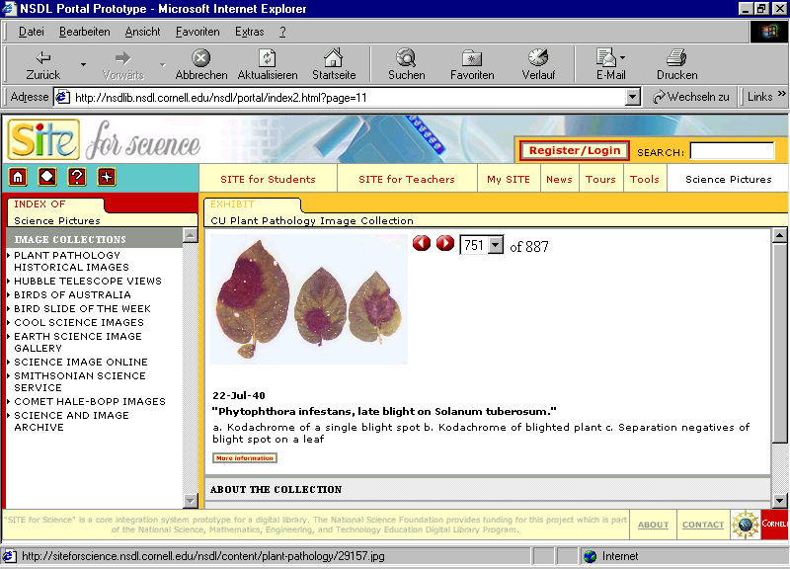

Slide 6
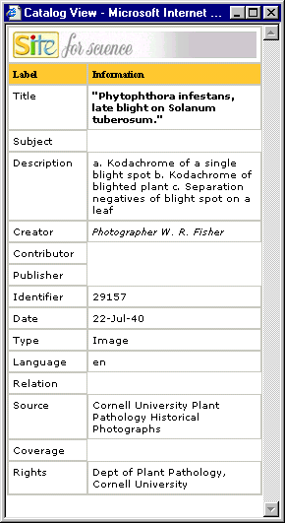

Slide 7
1996: Modular metadata
Not: “One size fits all”.
Different ways may be needed to describe one object:
MARC records for library catalogs
Dublin Core for simpler descriptions
Specialized metadata for terms and conditions of use
Recognized need for a general framework for different types of metadata

Slide 8
1996: “Warwick Framework”
Metadata “Packages” associated with a resource
Container
Package
Dublin Core
Package
MARC record
Package
Indirect Reference
URI
Package
Terms and Conditions
Work starts on general framework for metadata:
Resource Description Framework (RDF), Semantic Web

Slide 9
1997: Qualification to add precision
Not just any Date, but a Date Created
Not just any Subject, but a Library of Congress Subject Heading
Dumb-down: ignore extra details to see just a “core” description

Slide 10
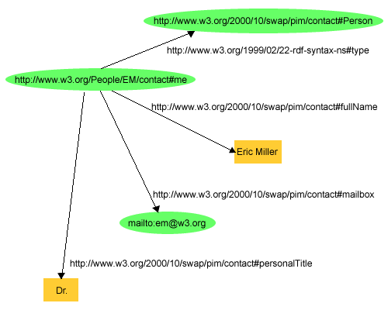
1997: W3C starts work on Resource Description Framework (RDF)
Source: http://www.w3.org/TR/rdf-primer/

Slide 11
1998: DC elements get URIs
http://purl.org/dc/elements/1.1/title: identifiers rooted in Web infrastructure
New assumptions
How can machines and software process this automatically?
Work on the underlying data model…

Slide 12
2000: Idea of “Application Profiles”
Customized implementations
Use “the Dublin Core” with other vocabularies
Local rules and guidelines
Application profile provides documentation so that others can follow
Not “take it or leave it”, but “take what you want, create what you need”

Slide 13
2000: Growing the vocabulary
Elements
Refinements
Encodings
Types
Identifier
Title
Creator
Contributor
Publisher
Subject
Description
Coverage
Format
Type
Date
Relation
Source
Rights
Language
Abstract
Access rights
Alternative
Audience
Available
Bibliographic citation
Conforms to
Created
Date accepted
Date copyrighted
Date submitted
Education level
Extent
Has format
Has part
Has version
Is format of
Is part of
Is referenced by
Is replaced by
Is required by
Issued
Is version of
License
Mediator
Medium
Modified
Provenance
References
Replaces
Requires
Rights holder
Spatial
Table of contents
Temporal
Valid
Box
DCMIType
DDC
IMT
ISO3166
ISO639-2
LCC
LCSH
MESH
Period
Point
RFC1766
RFC3066
TGN
UDC
URI
W3CTDF
Collection
Dataset
Event
Image
Interactive
Resource
Moving Image
Physical Object
Service
Software
Sound
Still Image
Text

Slide 14
2003-2007: DCMI Abstract Model
Moving the informal model of Dublin Core early years onto a solid RDF foundation
Value URI
dcam:memberOf
VES URI
Value URI
“literal”
@lang
rdf:value
“literal”
^^SES URI
“literal”
@lang
“literal”
^^SES URI

Slide 15
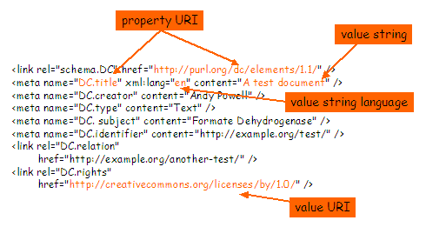
Motivation: One model – many syntax options
Example of Simple Dublin Core in XHTML

Slide 16
DCMI Model today
Core semantics
The Dublin Core and related vocabularies
Data model
RDF (and related DCMI Abstract Model)
Application Profiles
Use mixed vocabularies
Based on underlying data model
Customized for specific purposes

Slide 17
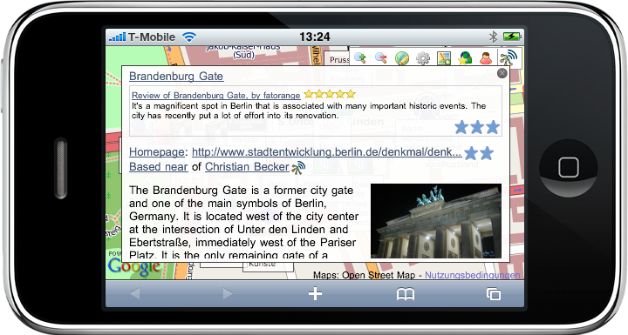
Today: Dublin Core and Structured Search
Source: Chris Bizer and Christian Becker, Freie Universität, Berlin

Slide 18
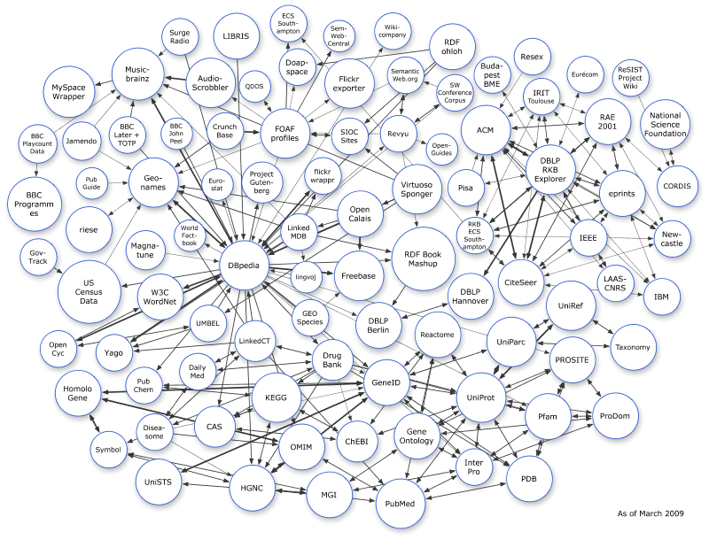
Today: Dublin Core in the Linked Data Cloud

Slide 19
Levels of Interoperability

Slide 20
Interoperability Levels for Dublin Core metadata
Shared validatable constraints
4: Description Set Profile Interoperability
Shared formal vocabularies and constraints in records
Shared model for “records”
3: Description Set syntactic interoperability
Shared formal vocabularies in exchangeable records
Shared formal-semantic model
2: Semantic interoperability
Shared vocabularies based on formal semantics
Shared (natural-language) definitions
1: Informal interoperability
Shared vocabularies defined in natural language
http://dublincore.org/documents/interoperability-levels/

Slide 21
Open- and closed-world
Shared constraints
Open-world data optimized for specific environments.
Shared model for “records”
Open-world data captured in manageable records.
Shared formal-semantic model
“Open-world” data.
Shared (natural-language) definitions
Data in silos. “Intra-operability” within silos.

Slide 22
Supporting technologies
Shared constraints
DCMI Description Set Profile.
SPARQL Query Patterns.
Shared model for “records”
DCMI Abstract Model. DC-DS-XML.
SPARQL Named Graphs.
Shared formal-semantic model
Linked data. RDF data. Extracted triples.
DC-RDF. DC-HTML. RDFa!
Shared (natural-language) definitions
Closed systems. Proprietary systems. Web of APIs.
DC-XML/2003 and other early DCMI specs.

Slide 23
Deployed base
Shared constraints
Shared “records”
Shared formal-semantic model
Shared (natural-language) definitions

Slide 24
Rate of growth
Shared constraints
Shared “records”
Shared formal-semantic model
Shared (natural-language) definitions

Slide 25
Which level do you require?
Shared constraints
Pro: Validation. Quality.
Contra: It is “constraining”…
Shared model for “records”
Pro: Provenance. Trust.
Contra: Lack of mature, deployed models.
Shared formal-semantic model
Pro: Easier to integrate and migrate data.
Contra: Harder to design, less tools.
Shared (natural-language) definitions
Pro: Easier to deploy. Validatable records.
Contra: Closed-world. Interoperability by (thousands of) ad-hoc agreements.

Slide 26
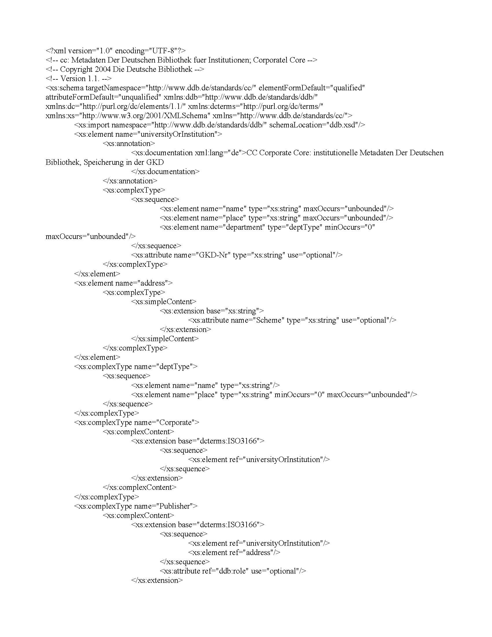
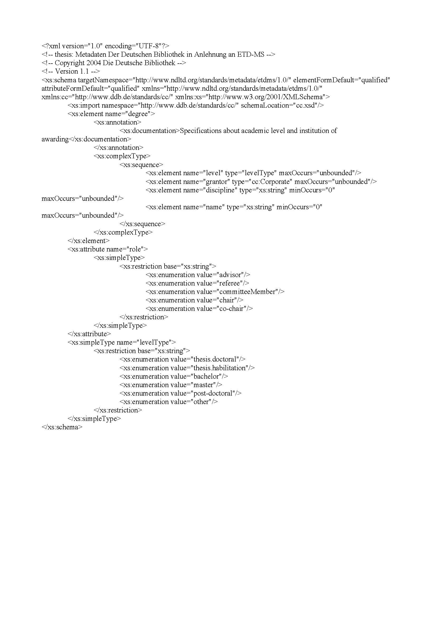
Level-1 applications s interoperate with shared or mapped schemas
Schema A
Schema B
Schema C
same
as
mapped
to

Slide 27
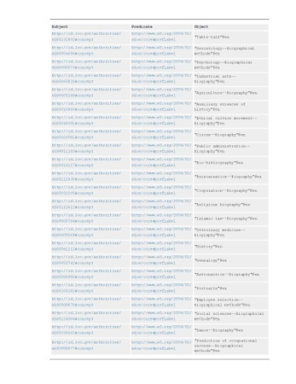
Good level-2 Application Profiles create good triples
Profile A
Profile B
Profile C

Slide 28
Good triples can be merged coherently
Profile A
Profile B
Profile C

Slide 29
Applications come and go…
Profile A
Profile B
Profile C

Slide 30
The data remains

Slide 31
Data quality is independent of profiles used to create it
SPARQL Endpoint
Queries

