Slide 1
The “metadata record” and DCMI Abstract Model

Slide 2
Property URI
Value URI
Resource URI
dcam:memberOf
VES URI
Value URI
“literal”
@lang
Property URI
rdf:value
“literal”
^^SES URI
Resource URI
Property URI
“literal”
@lang
Property URI
“literal”
^^SES URI

Slide 3
Property URI
Value URI
Resource URI
dcam:memberOf
VES URI
Value URI
“literal”
@lang
Property URI
rdf:value
“literal”
^^SES URI
Resource URI
Property URI
“literal”
@lang
Property URI
“literal”
^^SES URI

Slide 4
DCAM Description Set Model
The structure of “DC metadata”
Uses URIs to refer to resources described & to metadata terms
a description set is made up of one or more descriptions, each of which describes one resource
a description is made up of
zero or one described resource URI
identifies described resource
one or more statements
a statement is made up of
exactly one property URI
identifies property
exactly one value surrogate
a value surrogate is either a literal value surrogate or a non-literal value surrogate
e.g. http://dublincore.org/documents/ 2007/06/04/abstract-model/
e.g. http://purl.org/dc/terms/subject

Slide 5
Description Set
Description
Resource URI
Statement
Non-Literal Value Surrogate
Property URI
Statement
Non-Literal Value Surrogate
Property URI
Description
Resource URI
Statement
Literal Value Surrogate
Property URI
Statement
Literal Value Surrogate
Property URI

Slide 6
DCAM Description Set Model
a literal value surrogate is made up of
exactly one value string
encodes value
a non-literal value surrogate is made up of
zero or one value URIs
identifies value
zero or one vocabulary encoding scheme URI
identifies a set of which the value is a member
zero or more value strings
represents value
a value string is either a plain value string or a typed value string
a plain value string may have an associated value string language
a typed value string is associated with a syntax encoding scheme URI
Vocabulary Encoding Scheme
A named set to which a “Thing” belongs
Syntax Encoding Scheme
A named set of rules for the “interpretation” of a set of “Strings”
e.g. “DCMI Abstract Model”
e.g. http://www.w3.org/TR/2004/ REC-rdf-concepts-20040210/
e.g. http://purl.org/dc/terms/LCSH
e.g. “metadata”
e.g. “métadonnées”

Slide 7
Description Set
Description
Resource URI
Statement
Non-Literal Value Surrogate
Property URI
Value URI
Statement
Non-Literal Value Surrogate
Property URI
Value URI
Vocab Enc Scheme URI
Value string
Language
Value string
Syntax Enc Scheme URI
Description
Resource URI
Statement
Literal Value Surrogate
Property URI
Value string
Language
Statement
Literal Value Surrogate
Property URI
Value string
Syntax Enc Scheme URI

Slide 8
Description Set
Description
Resource URI
Statement
Non-Literal Value Surrogate
Property URI
Value URI
Statement
Non-Literal Value Surrogate
Property URI
Value URI
Vocab Enc Scheme URI
Value string
Language
Value string
Syntax Enc Scheme URI
Description
Resource URI
Statement
Literal Value Surrogate
Property URI
Value string
Language
Statement
Literal Value Surrogate
Property URI
Value string
Syntax Enc Scheme URI

Slide 9
Example: Description of document, description of publisher
Description Set
Description
<http://dublincore.org/documents/2007/06/04/abstract-model/>
Statement
<http://purl.org/dc/terms/publisher>
Non-Literal Value Surrogate
Property URI
<http://example.org/org/DCMI>
Value URI
Statement
Non-Literal Value Surrogate
<http:/purl.org/dc/terms/subject>
<http://example.org/mySH/h123>
Value URI
Property URI
<http://example.org/terms/mySH>
Vocab Enc Scheme URI
“Metadata”
en
Value String
"Métadonnées"
fr
Value String
Description
<http://example.org/org/DCMI>
Statement
Literal Value Surrogate
<http://xmlns.com/foaf/ 0.1/name>
“Dublin Core Metadata Initiative”
en
Value String
Property URI
Statement
Literal Value Surrogate
<http://purl.org/dc/ terms/created>
“1995”
^^xsd:gyear
Value String
Property URI

Slide 10
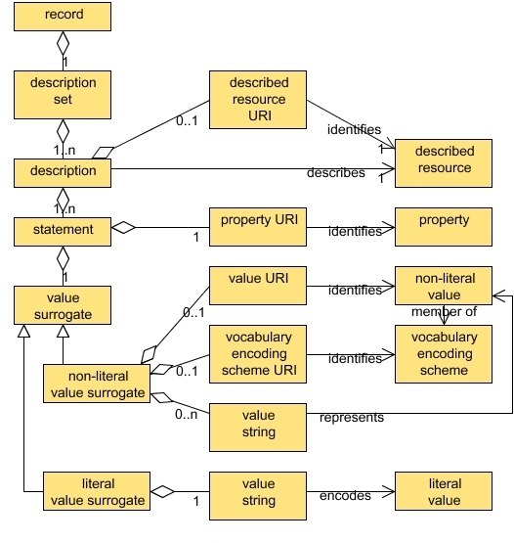
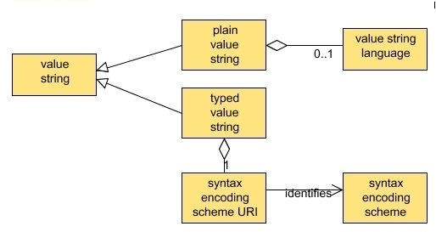
DCAM Description Set Model

Slide 11
Encoding guidelines based on DCMI Abstract Model

Slide 12
DC-RDF
Any concrete syntax for RDF can be used for Dublin Core metadata
Available syntaxes include RDF/XML, N3, Turtle, RDFa
“Expressing DC metadata using RDF” (2008)
http://dublincore.org/documents/2008/01/14/dc-rdf/
Uses RDF abstract syntax
Supports full DCAM description model

Slide 13
<?xml version="1.0" encoding="UTF-8" ?>
<rdf:RDF xmlns:rdf="http://www.w3.org/1999/02/22-rdf-syntax-ns#"
xmlns:dcterms="http://purl.org/dc/terms/"
xmlns:dcam="http://purl.org/dc/dcam/"
xmlns:foaf="http://xmlns.com/foaf/0.1/" >
<rdf:Description
rdf:about="http://dublincore.org/documents/2007/06/04/abstract-model/">
<dcterms:publisher rdf:resource="http://example.org/org/DCMI" />
<dcterms:subject>
<rdf:Description rdf:about="http://example.org/mySH/h123" >
<dcam:memberOf rdf:resource="http://example.org/terms/mySH" />
<rdf:value xml:lang= "en">Metadata</rdf:value>
<rdf:value xml:lang= "fr">Métadonnées</rdf:value>
</rdf:Description>
</dcterms:subject>
</rdf:Description>
<rdf:Description rdf:about="http://example.org/org/DCMI">
<foaf:name xml:lang= "en">Dublin Core Metadata Initiative</foaf:name>
<dcterms:created
rdf:datatype="http://www.w3.org/2001/XMLSchema#gyear">1995</dcterms:created >
</rdf:Description>
</rdf:RDF>

Slide 14
DC-Text
“Expressing DC metadata using DC-Text”, DCMI Recommended Resource, 2007-12-03
http://dublincore.org/documents/2007/12/03/dc-text/
Supports full DCAM description model
Intended for human-readability rather than machine-processing

Slide 15
@prefix page: <http://dublincore.org/pages/> .
@prefix dcterms: <http://purl.org/dc/terms/> .
@prefix exterms: <http://example.org/terms/> .
@prefix exsh: <http://example.org/sh/> .
DescriptionSet (
Description (
ResourceURI ( page:home )
Statement (
PropertyURI ( dcterms:subject )
ValueURI ( exsh:metadata )
VocabularyEncodingSchemeURI ( exterms:EXSH )
ValueString ( "Metadata"
Language ( en )
)
ValueString ( "Métadonnées"
Language ( fr )
)
)
)
)

Slide 16
DC-HTML
RDFa is an excellent option for embedding Dublin Core descriptions in HTML documents
“Expressing DC metadata using HTML/XHTML meta and link elements”
http://dublincore.org/documents/2008/08/04/dc-html/
Supports subset of DCAM description model
DC metadata in HTML document describes that document
or at least document of which HTML page is representation
An HTML meta-data profile
GRDDL Profile Transformation to generate RDF/XML

Slide 17
<?xml version="1.0" encoding="UTF-8" ?>
<!DOCTYPE html PUBLIC "-//W3C//DTD XHTML 1.0 Strict//EN"
"http://www.w3.org/TR/xhtml1/DTD/xhtml1-strict.dtd">
<html xmlns="http://www.w3.org/1999/xhtml">
<head profile="http://dublincore.org/documents/2008/08/04/dc-html/">
<title>DCMI Abstract Model</title>
<base href="http://dublincore.org/documents/2007/06/04/abstract-model/” />
<link rel="schema.DCTERMS" href="http://purl.org/dc/terms/" />
<link rel="DCTERMS.subject" href="http://example.org/terms/mySH/h123"
xml:lang=“en” title=“Metadata” />
<link rel="DCTERMS.publisher" href="http://example.org/org/DCMI" />
</head>
<body>
</body>
</html>

Slide 18
Dublin Core metadata in XML
“Expressing DC Description Sets using XML (DC-DS-XML)”
http://dublincore.org/documents/2008/09/01/dc-ds-xml/
Supports full DCAM description model
Verbose, but easily processable
GRDDL Namespace Transformation to generate RDF/XML

Slide 19
<?xml version="1.0" encoding="UTF-8" ?>
<dcds:descriptionSet xmlns:dcds="http://purl.org/dc/xmlns/2008/09/01/dc-ds-xml/">
<dcds:description
dcds:resourceURI="http://dublincore.org/pages/home">
<dcds:statement
dcds:propertyURI="http://purl.org/dc/terms/publisher“
dcds:valueURI="http://example.org/org/DCMI" />
<dcds:statement
dcds:propertyURI="http://purl.org/dc/terms/subject"
dcds:vesURI="http://example.org/terms/mySH"
dcds:valueURI="http://example.org/mySH/h123">
<dcds:valueString xml:lang= "en">Metadata</dcds:valueString>
<dcds:valueString xml:lang= "fr">Métadonnées</dcds:valueString>
</dcds:statement>
</dcds:description>
<dcds:description
dcds:resourceURI="http://example.org/org/DCMI">
<dcds:statement dcds:propertyURI="http://xmlns.com/foaf/0.1/name">
<dcds:literalValueString xml:lang=“en”>Dublin Core Metadata Initiative</dcds:literalValueString>
</dcds:statement>
<dcds:statement dcds:propertyURI="http://purl.org/dc/terms/created">
<dcds:literalValueString
dcds:sesURI="http://www.w3.org/2001/XMLSchema#gyear">1995</dcds:literalValueString>
</dcds:statement>
</dcds:description>
</dcds:descriptionSet>

Slide 20
Metadata Records and RDF
Dublin Core terms can be used in RDF without using DC-AM
In using the DC-AM, you are also using RDF
DC-AM adds the notion of a bounded “record” (description set)
Other RDF-based “record” formats under development using SPARQL Named Graphs

Slide 21
Singapore framework

Slide 22
Dublin Core Application Profile
Specification of how to construct description sets (descriptions, statements) to serve some purpose
At core, a profile of a “description set”
a set of constraints on the description set
based on E-R model of problem space
Enables
structural validation
predictability for processing, querying etc

Slide 23
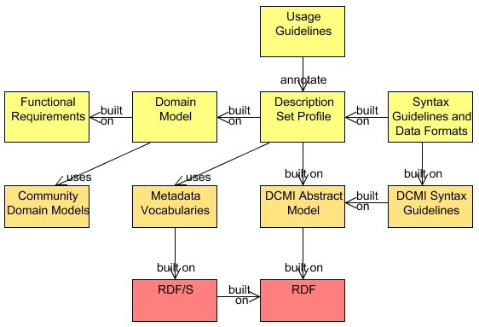
Singapore Framework
Application Profile
Domain standards
Foundation standards

Slide 24
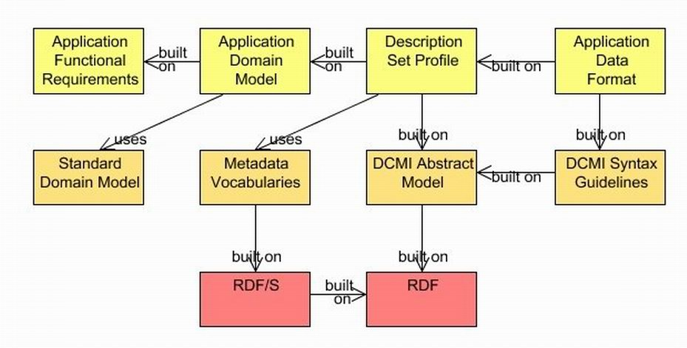
Getting from Requirements...

Slide 25
...to a Data Format

Slide 26
...based on Community Standards

Slide 27
...on the basis of Foundation Standards (RDF)‏

Slide 28
What does your application need to do?

Slide 29
Functional Requirements
What activities must the application support?
Who are the users? How expert are they?
Scholarly Works Application Profile examples:
“Facilitate identification of open access materials.”
“Be compatible with preservation metadata approaches.”
“Enable identification of research funder and project code.”
“Support navigation between different 'versions' of the same eprint.”
DC Collections Application Profile examples:
“Enable searching on the entity that owns the collection”
“Enable selection of a collection based on a textual description”

Slide 30
What things are being described?

Slide 31
The simplest domain model...!
Resource

Slide 32

A slightly more complicated domain model

Slide 33
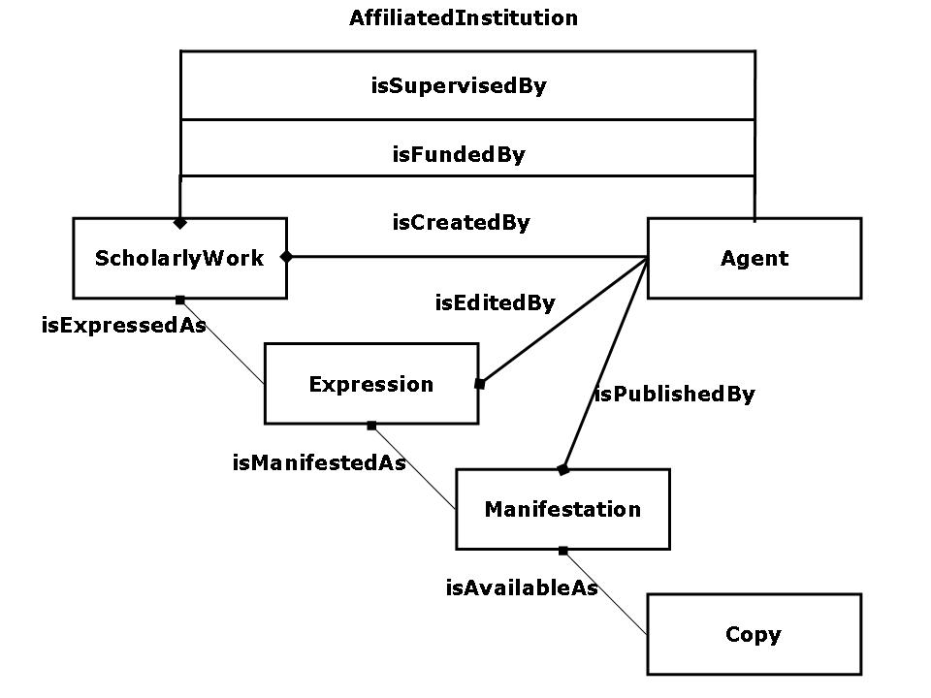
Domain Model for Scholarly Works Application Profile

Slide 34
Description Set Profile, based on DCMI Abstract Model‏

Slide 35
DCMI Description Set Profile (DSP)
A way of describing structural constraints on a description set
the resources that may be described by descriptions in the description set
the properties that may be referenced in statements
the ways a value surrogate may be given
Description templates, statement templates
Model & XML Syntax for DSP
Working draft by Mikael Nilsson (Royal Institute of Technology, Sweden)
http://dublincore.org/documents/2008/03/31/dc-dsp/

Slide 36
Description Set Profile
Description Set
Description
<http://dublincore.org/documents/2007/06/04/abstract-model/>
Statement
<http://purl.org/dc/terms/publisher>
Non-Literal Value Surrogate
Property URI
<http://example.org/org/DCMI>
Value URI
Statement
Non-Literal Value Surrogate
<http:/purl.org/dc/terms/subject>
<http://example.org/mySH/h123>
Value URI
Property URI
<http://example.org/terms/mySH>
Vocab Enc Scheme URI
“Metadata”
en
Value String
"Métadonnées"
fr
Value String
Description
<http://example.org/org/DCMI>
Statement
Literal Value Surrogate
<http://xmlns.com/foaf/ 0.1/name>
“Dublin Core Metadata Initiative”
en
Value String
Property URI
Statement
Literal Value Surrogate
<http://purl.org/dc/ terms/created>
“1995”
^^xsd:gyear
Value String
Property URI

Slide 37
Example: Description Set Profile of a Book
A book:
a literal title
a creator, described separately
A creator
a literal name

Slide 38
Templates and constraints
Statement template: literal title
Description Template: Book
Property:
dcterms:title
Literal value
Language
SES
Statement template: creator
Property:
dcterms:creator
Description reference: Creator
Value URI
Vocabulary Encoding Scheme
Value string
Language
SES
Statement template: literal name
Description Template: Creator
Property:
foaf:name
standalone:no
Literal value
Language
SES

Slide 39
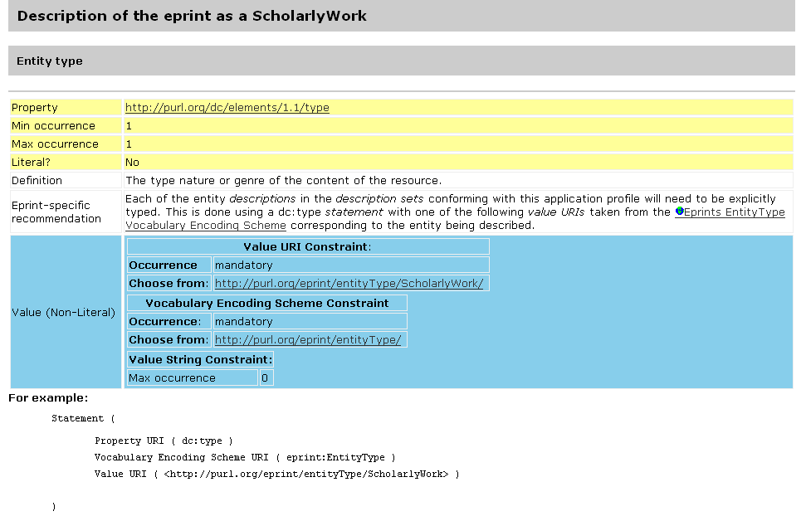
Documentation of templates and constraints

Slide 40
Metadata vocabularies, built on RDF

Slide 41
Free choice of (model-based) syntax

