Slide 1
Web-enabled vocabularies

Slide 2
Value Vocabularies
Simple lists...
“Animal”, “Vegetable”, “Mineral”
“Yes”, “No”, “Maybe”
Controlled vocabularies...
Subject headings (“China – History”)‏

Slide 3
Moving from string-based metadata...
<http://openlibrary.org/6/0L7983950M>
a bibo:Book
dc:title 'Weaving the Web';
dc:creator 'Tim Berners-Lee' ;
dc:subject 'World Wide Web' ;
dc:publisher 'Texere Publishing';
dc:identifier '0752820907'.

Slide 4
...to Linked Metadata
<http://openlibrary.org/6/0L7983950M>
a bibo:Book
dc:title 'Weaving the Web';
dc:creator 'Tim Berners-Lee' ;
dc:subject <http://id.loc.gov/authorities/sh95000541#concept> ;
dc:publisher 'Texere Publishing';
dc:identifier '0752820907'.

Slide 5
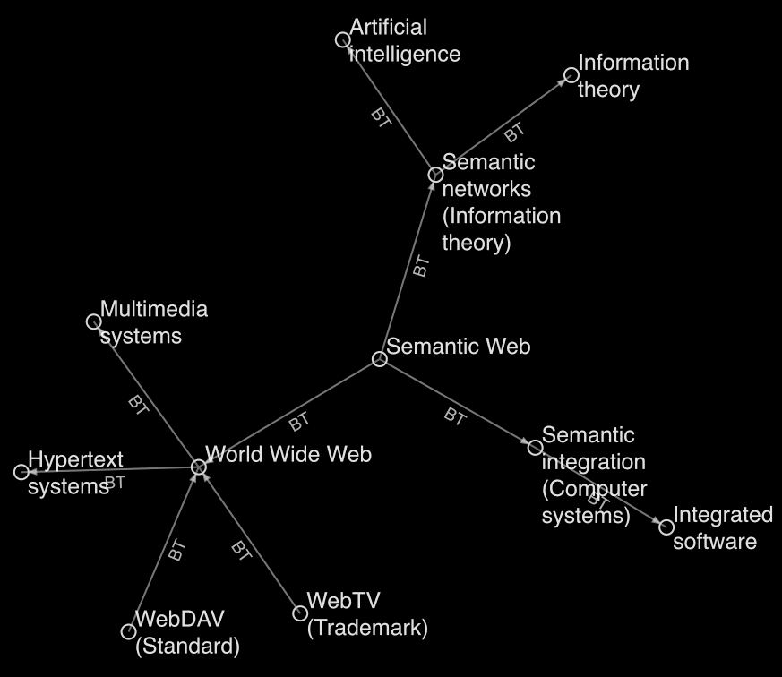
A Web of Broader and
Narrower Concepts
http://inkdroid.org/bzr/lcsh/docs/slides/

Slide 6
SKOS Example UK Archival Thesaurus
Term: Economic cooperation
Used For: Economic co-operation
Broader terms: Economic policy
Narrower terms: Economic integration, European economic cooperation, European industrial cooperation, Industrial cooperation
Related terms: Interdependence
Scope Note: Includes cooperative measures in banking, trade, industry etc., between and among countries.

Slide 7
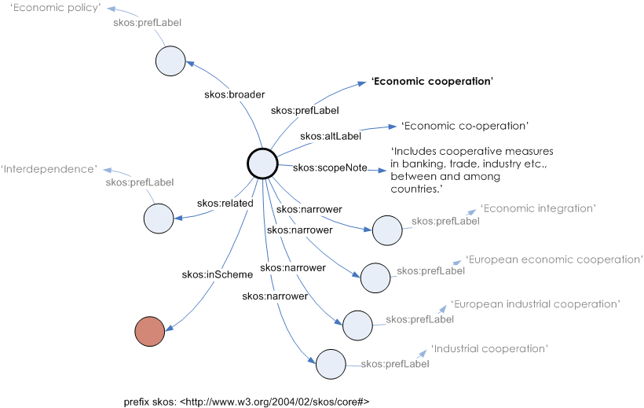
Expressing a thesaurus as linked data

Slide 8
SKOS
Simple Knowledge Organisation System
RDF-based model for simple knowledge structures such as thesauri
Porting (“Webifying”) thesauri: representing and sharing classifications, glossaries, thesauri developed in the Print World
Examples of existing knowledge structures:
In the Print World: Dewey Decimal Classification, Art and Architecture Thesaurus
In the Web World: DMOZ categories

Slide 9
SKOS in a Nutshell
Using SKOS:
concepts can be identified using URIs,
labeled with lexical strings in one or more natural languages,
assigned notations (lexical codes),
documented with various types of note,
linked to other concepts and
organized into informal hierarchies and association networks,
aggregated into concept schemes,
grouped into labeled and/or ordered collections, and
mapped to concepts in other schemes.

Slide 10

SKOS Properties
RDF properties for links to Broader, Narrower, Related Concepts
RDF properties and classes for defining a knowledge system
Basic description (Concept, Concept Scheme)‏
Labeling (Preferred Label, Alternative Label)‏
Documentation (Definition, History Note)‏
Mapping (Broader Match, etc)‏
As of August 2009 a W3C Recommendation
http://www.w3.org/TR/skos-reference

Slide 11
SKOS Philosophy
The aim of SKOS is not to replace original conceptual vocabularies in their initial context of use,
…but to allow them to be ported to a shared space,
…based on a simplified model,
…enabling wider re-use and better interoperability.

Slide 12
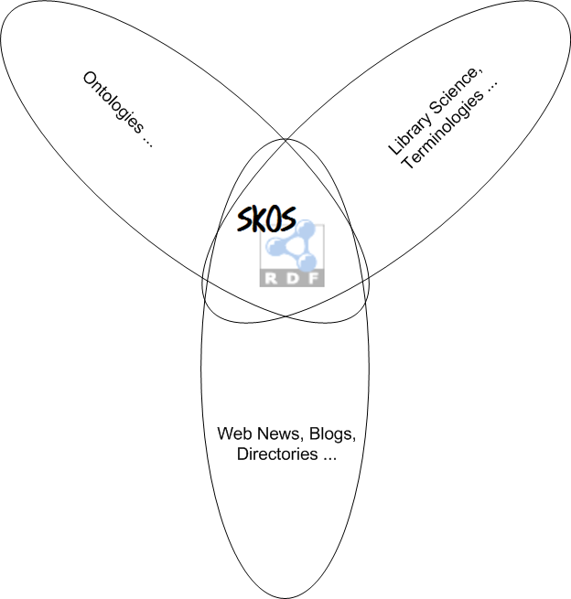
SKOS Position

Slide 13
Extensibility of SKOS
Not “take it or leave it”, but “take what you want, create what you need”
Extension “by refinement”
Sub-properties or sub-classes of SKOS Core properties or classes
Extensions are backwards-compatible via RDFS inference
Extension “by combination”

Slide 14
Ontology engineering – OWL
Web Ontology Language for defining complex conceptual structures
Class-oriented, logically precise modeling
Demanding in terms of expertise, effort, cost

Slide 15
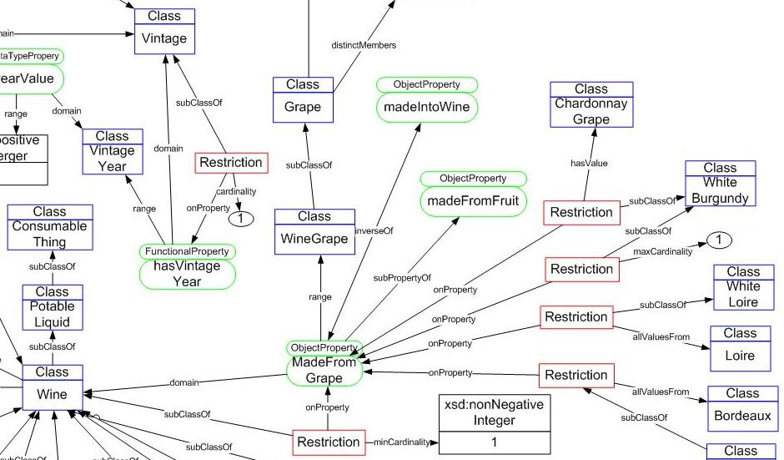
OWL Wine Ontology

Slide 16
Knowledge Organization Systems versus Formal Ontologies
Knowledge Organization Systems (KOS)
Concepts may be linked pragmatically
Semi-formal, intuitive “maps” of domains
Aid in finding related objects
Port to Semantic Web without re-engineering using SKOS
Formal Ontologies
Provide an interpretation of reality
Assert axioms or facts about things in the world
Inference using logical entailments
Re-engineering a KOS as formal ontology is hard

Slide 17
Role of Knowledge Organization Systems
KOS are magnets for attracting links
Hubs for resources indexed according to a given subject or topic URI
Concepts embedded in a KOS can be used to expand or narrow queries
KOS provide pathways for navigating to related resources

Slide 18
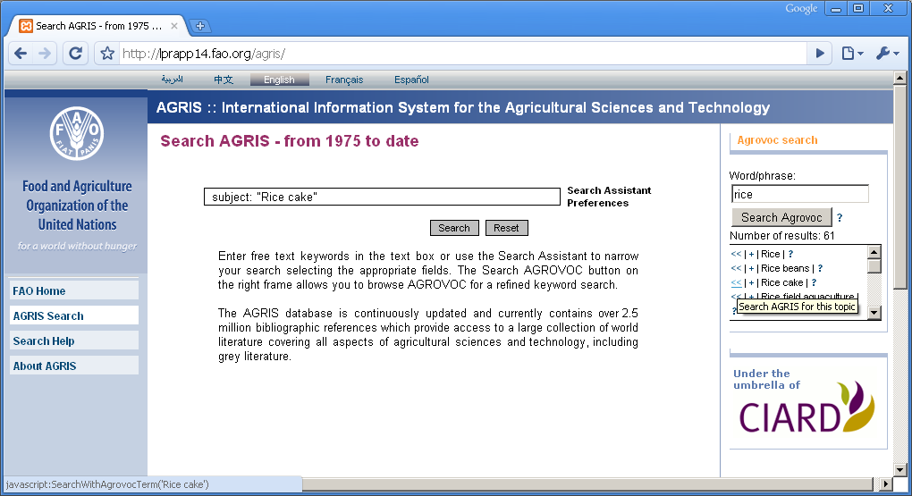
Narrowing a search by topic

