Slide 1
Linking legacy data

Slide 2
Creating shared RDF vocabularies
Vocabularies “born RDF”
Simple Knowledge Organization System (SKOS)‏
Web Ontology Language (OWL)‏
DCMI Metadata Terms
Translation of pre-Web vocabularies into RDF
MARC Relators (roles of agents with respect to resources) - Done!
RDA (successor to Anglo-American Cataloging Rules)‏
Library of Congress value vocabularies in SKOS
FRBR (Func. Requirements for Bibliographic Records)‏
CIDOC CRM

Slide 3
Core and extension vocabularies
Core-like RDF vocabularies
SKOS Core: about knowledge systems
Dublin Core: about information resources
FOAF: about people and organizations
Shared underlying (RDF) model
Shared mechanisms for extensibility
Extension-like vocabularies
Web as context for community creation of vocabularies

Slide 4
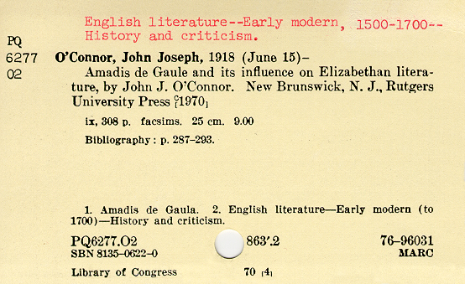
Library catalog card – subject headings
4
Notes:
4

Slide 5
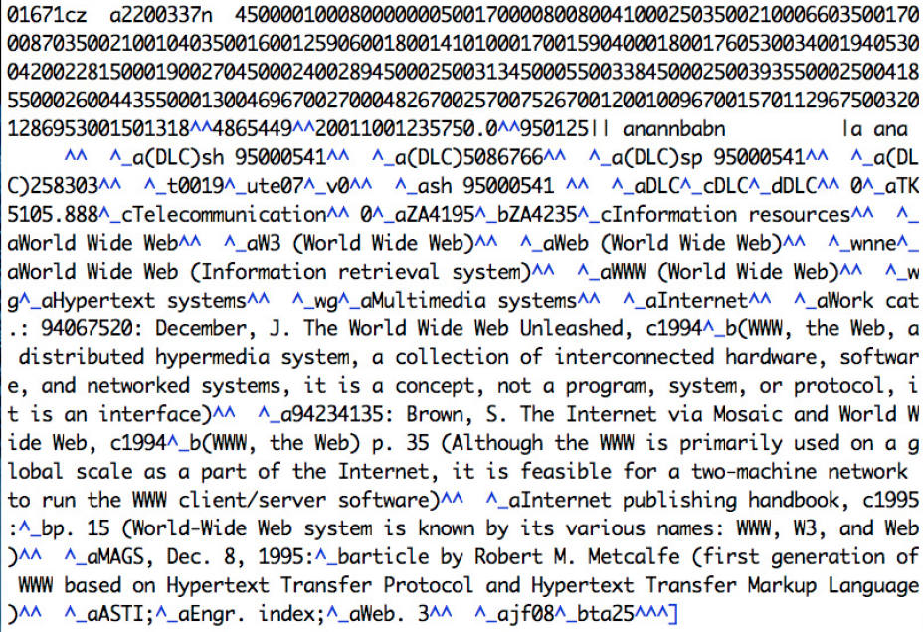
Converting Library of Congress Subject Headings...

Slide 6
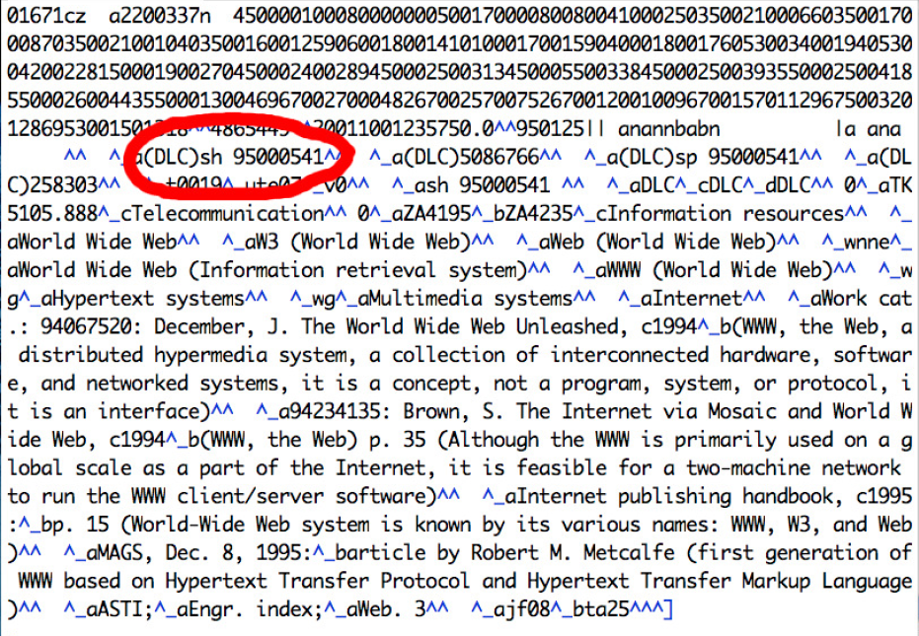
Using existing identifiers as basis for URIs...

Slide 7
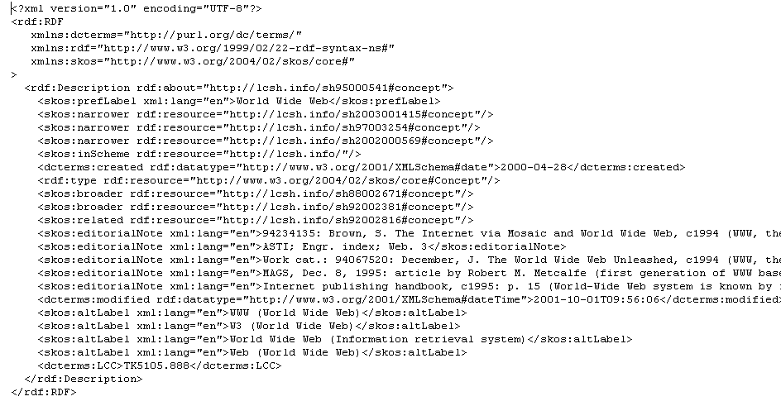
...represented with URIs and RDF

Slide 8
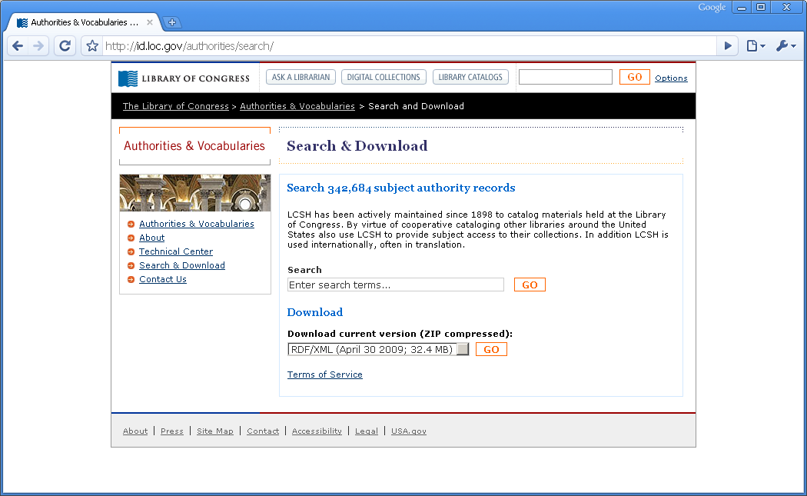
...published as open linked data (http://id.loc.gov)‏

Slide 9
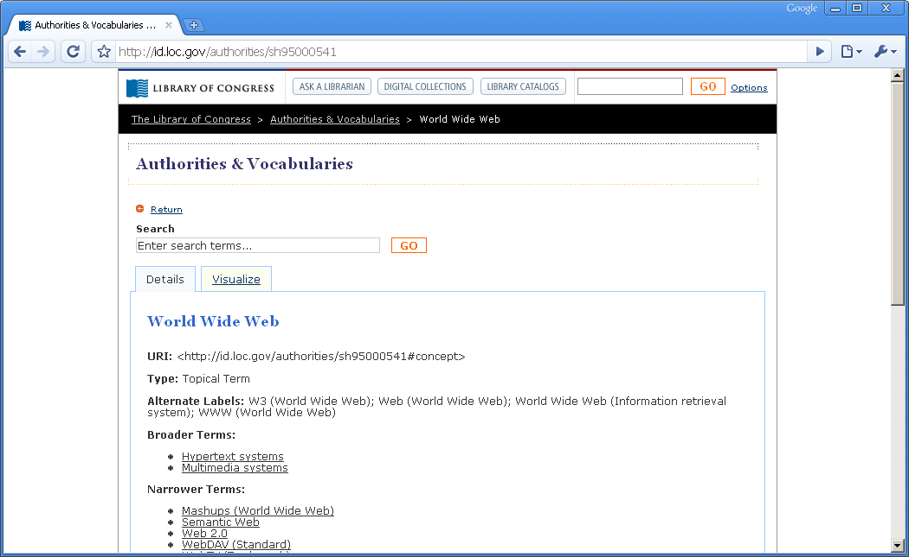
See links to broader/narrower terms...
http://id.loc.gov/authorities

Slide 10
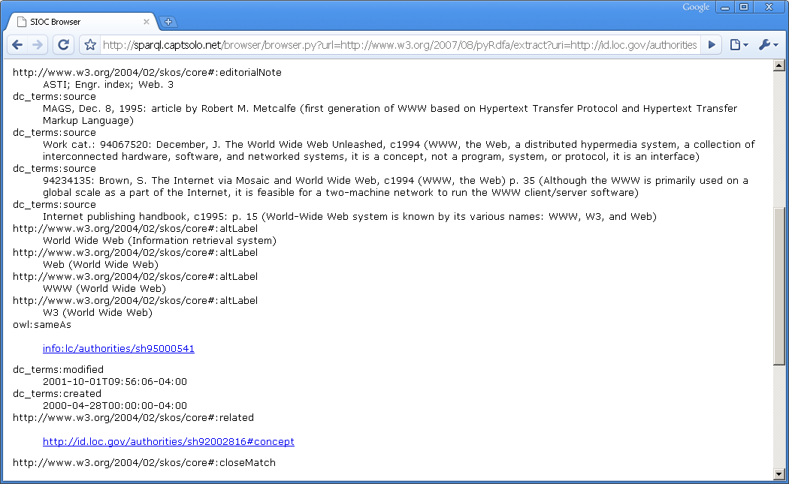
...or extract the hidden RDFa

Slide 11
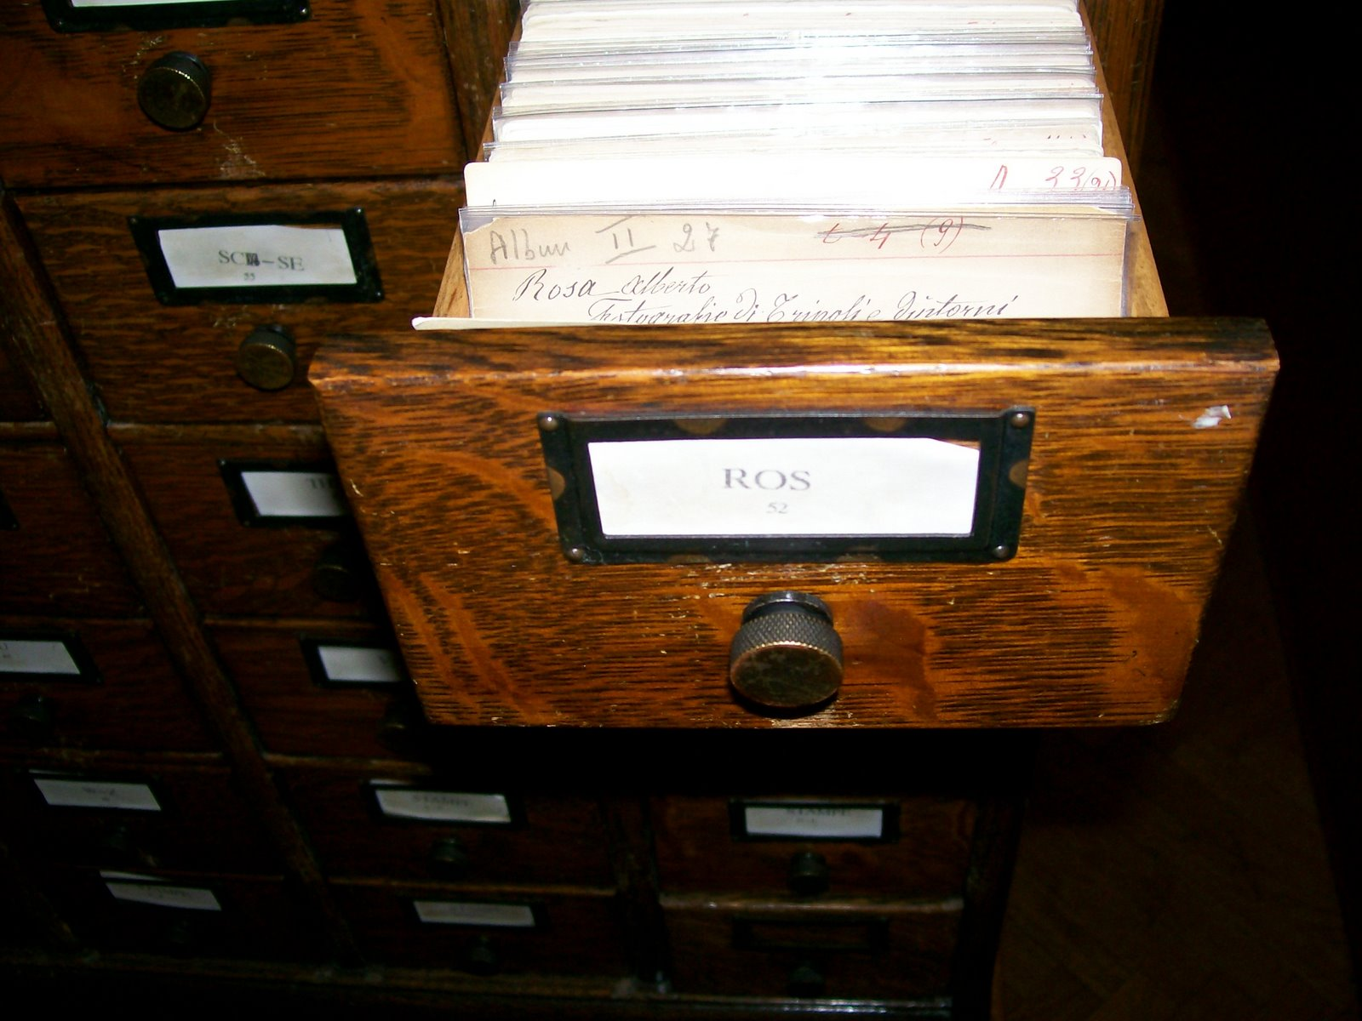
Source: http://kcoyle.net/metadata_netsl_09.ppt
Notes:
card catalog was a great leap in technology. it made modern library catalog metadata possible.
Is it constructed? Yes! AACR/1&2
What is its purpose? Jewett & Cutter expressed this best: to help a user find a book owned by the library; by author, title or subject.

Slide 12
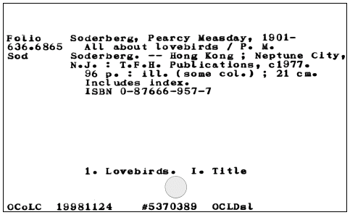
typed, then printed
From: OCLC../cataloging/cards/
Source: http://kcoyle.net/metadata_netsl_09.ppt
Notes:
Other technology allowed the card to become a very efficient way of sharing our metadata creation duties.
card as the first ALA standard. LC card product beginning in 1902.

Slide 13
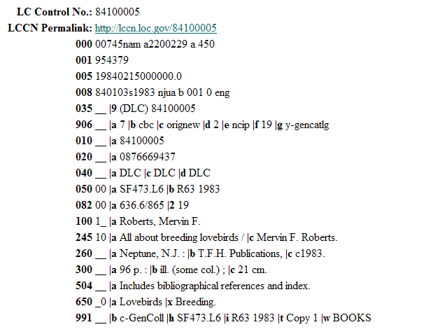
Machine-readable
catalog.loc.gov
Source: http://kcoyle.net/metadata_netsl_09.ppt
Notes:
MARC, mid-1960’s. Designed for the printing of cards. machine-readable but still mainly textual. still mainly aimed at human readers of the information. machine-oriented information separate, and not easy to input, and therefore often not taken advantage of (fixed fields). but still very valuable.

Slide 14
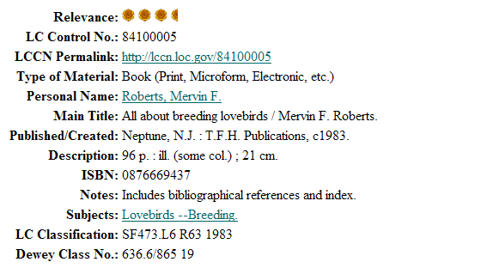
online
catalog.loc.gov
Source: http://kcoyle.net/metadata_netsl_09.ppt
Notes:
A coded document, mainly designed for display to humans. Still the same document we’ve been displaying in catalogs for over 150 years. And only designed to be used inside a library catalog. No thought to how it might play with other day, such a Google maps, or Wikipedia.

Slide 15

records in a database/catalog
Source: http://kcoyle.net/metadata_netsl_09.ppt
Notes:
locked away in a record; don’t present our data as data; databases keep users out except for the user interface, so very little functionality available to programs
each library’s information is separate (except in OCLC and some union catalogs); so the totality of library information isn’t usable; still based on physically locating items, not on making use of the information that we have.

Slide 16
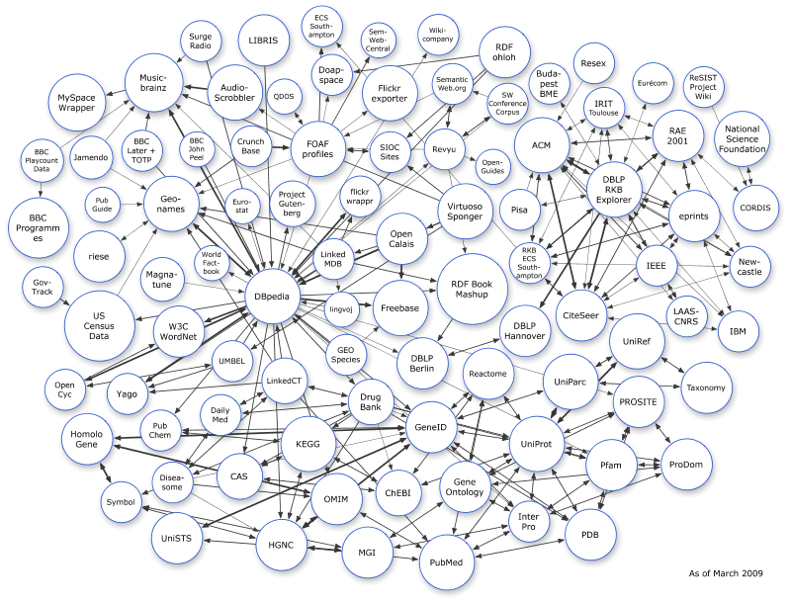
Freeing library data from its silo into The Cloud?

Slide 17
Next steps
Move towards Linked Data
1. Identify things with URIs.
2. Link related material
3. Design systems to fit the Cloud
No more complex than necessary
Simple metadata profiles (eg Dublin Core) may suffice
SKOS may be good enough for vocabularies

Slide 18
Long-term: Data outlives applications
“All technology is transitional” (David Wood)
Data will outlive today’s Application Programming Interfaces (APIs) or document formats.
“REST-ful” approaches that use basic transfer protocols such as HTTP and focus on representing data itself interoperability are better in the long term than serving data via custom-built APIs.
Focusing on the model of data (RDF) instead of the model of data documents (e.g., XML and XLST).

Slide 19
Long-term: better modular than monolithic
Monolithic, all-encompassing standards are expensive to deploy and maintain
Better for the long term are approaches that support:
modularity,
distributed maintenance,
“graceful degradation” of data interoperability

Slide 20
“It depends on your requirements!”
Closed systems may be easier to deploy
Having to integrate more than two or three APIs or data formats may take more work than designing from the start for interoperability.
It is easier to work with one data model with many specialized vocabularies than a growing pile of incompatible APIs and formats.
Complexity increases over time as legacy applications are superseded.
We cannot predict how your data will be used in the future.
Data of histrorical importance should be designed for unanticipated uses..

