Slide 1
What Makes the Linked Data Approach Different

Slide 2
RDF – a grammar for Web links
ResourceA
Resource
ResourceB
Resource
relatedTo
ResourceA
Resource
describedBy
Some text

Slide 3
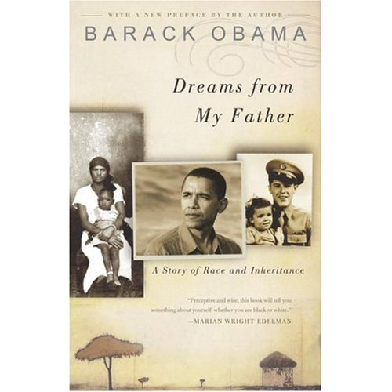
Source A: About a book by Barack Obama
dct:title
“Dreams from My Father”
http://...2773
dct:date
2004
dct:creator
_:placeholder
“Barack Obama”
foaf:name
Note that each Web link is expressed in the data as
a triple – a three-part data structure.
Each triple in the data corresponds to a link in a
conceptual graph.
http://../isbn/978-14000082773 dct:title “Dreams from My Father”
http://../isbn/978-14000082773 x:published “2004”
http://../isbn/978-14000082773 dct:creator _:placeholder
_:placeholder foaf:name “Barack Obama”

Slide 4

Source B: About the French translation
x:isTranslationOf
http://...2773
http://...5979
dct:title
“Les rêves de mon père”
X:translator
_:placeholder
“Danièle Darneau”
foaf:name
http://../isbn/978-2258075979 x:isTranslationOf http://.../isbn/978-14000082773
http://../isbn/978-2258075979 dct:title “Les rêves de mon père”
http://../isbn/978-2258075979 x:translator _:placeholder
_:placeholder foaf:name “Danièle Darneau”

Slide 5
Merge the two data sources into one set of triples
http://../isbn/978-2258075979 x:isTranslationOf http://.../isbn/978-14000082773
http://../isbn/978-2258075979 dct:title “Les rêves de mon père”
http://../isbn/978-2258075979 x:translator _:placeholder
_:placeholder foaf:name “Danièle Darneau”
http://../isbn/978-14000082773 dct:title “Dreams from My Father”
http://../isbn/978-14000082773 x:published “2004”
http://../isbn/978-14000082773 dct:creator _:placeholder
_:placeholder foaf:name “Barack Obama”

Slide 6
The processor will detect the matching URIs…
http://../isbn/978-2258075979 x:isTranslationOf http://.../isbn/978-14000082773
http://../isbn/978-2258075979 dct:title “Les rêves de mon père”
http://../isbn/978-2258075979 x:translator _:placeholder
_:placeholder foaf:name “Danièle Darneau”
http://../isbn/978-14000082773 dct:title “Dreams from My Father”
http://../isbn/978-14000082773 x:published “2004”
http://../isbn/978-14000082773 dct:creator _:placeholder
_:placeholder foaf:name “Barack Obama”

Slide 7
The processor will detect the matching URIs…
dct:title
“Dreams from My Father”
http://...2773
dct:date
2004
dct:creator
_:placeholder
“Barack Obama”
foaf:name
x:isTranslationOf
http://...2773
http://...5979
dct:title
“Les rêves de mon père”
X:translator
_:placeholder
“Danièle Darneau”
foaf:name

Slide 8
…and merge the data
dct:title
“Dreams from My Father”
http://...2773
dct:date
2004
dct:creator
x:isTranslationOf
_:placeholder
“Barack Obama”
foaf:name
http://...5979
dct:title
“Les rêves de mon père”
X:translator
_:placeholder
“Danièle Darneau”
foaf:name

Slide 9
Let’s use a Dbpedia URI to identify Barack Obama…
“Les rêves de mon père”
dct:title
dct:title
“Dreams from My Father”
http://...5979
http://...2773
x:isTranslationOf
dct:date
X:translator
2004
dct:creator
_:placeholder
“Danièle Darneau”
foaf:name
http://...Obama
“Barack Obama”
foaf:name
_:placeholder foaf:name “Barack Obama”
http://dbpedia.org/resource/Barack_Obama foaf:name “Barack Obama”

Slide 10
Wikipedia mentions a book in German about Obama
“Les rêves de mon père”
dct:title
dct:title
“Dreams from My Father”
http://...5979
http://...2773
x:isTranslationOf
dct:date
X:translator
2004
dct:creator
_:placeholder
“Danièle Darneau”
foaf:name
http://...Obama
“Barack Obama”
foaf:name
dct:subject
http://...Kennedy
“Der schwarze Kennedy”
dct:title
http://dbpedia.org/...Kennedy¹ dct:subject http://...Obama
http://dbpedia.org/...Kennedy dct:title “Der schwarze Kennedy”
¹ Full URI: http://dbpedia.org/resource/Barack_Obama_-_Der_schwarze_Kennedy

Slide 11
New York Times also has a URI for Obama, which it links to Dbpedia’s, leading to more information…
“Les rêves de mon père”
dct:title
dct:title
“Dreams from My Father”
http://...5979
http://...2773
x:isTranslationOf
dct:date
X:translator
2004
dct:creator
_:placeholder
“Danièle Darneau”
foaf:name
http://...Obama
“Barack Obama”
foaf:name
owl:sameAs
http://...6853
x:topicPage
http://topics.nytimes.com/top/reference/timestopics/people/o/barack_obama/index.html
“Barack Obama”
http://data.nytimes.com/...6853¹ owl:sameAs http://...Obama
http://data.nytimes.com/...6853 x:topicPage http://topics.nytimes.com/...
¹ Full URI: http://data.nytimes.com/47452218948077706853

Slide 12
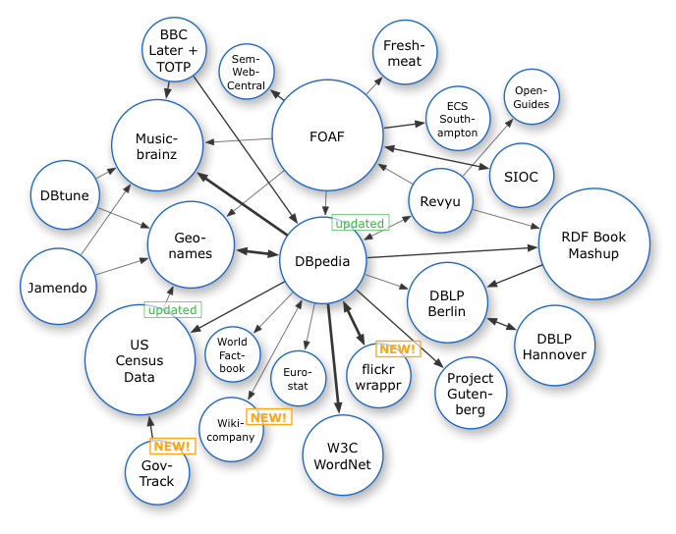
Linked Data Cloud, 2007
http://dbpedia.org

Slide 13
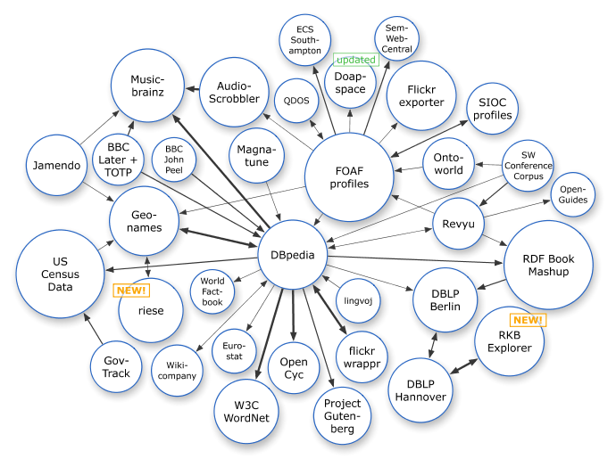
Linked Data Cloud, March 2008

Slide 14
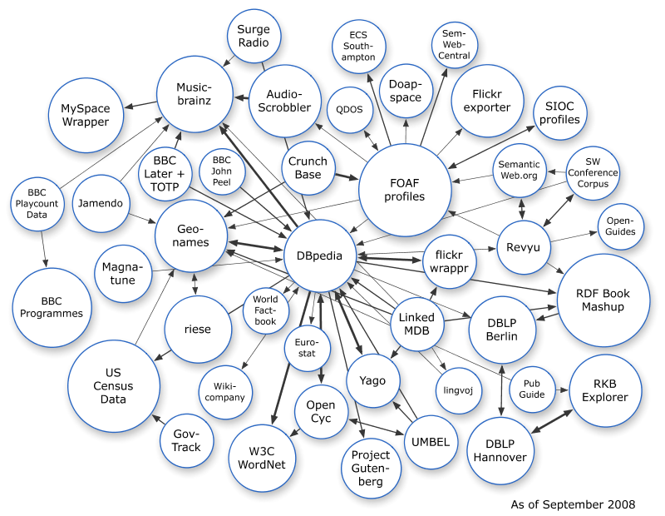
Linked Data Cloud, September 2008

Slide 15
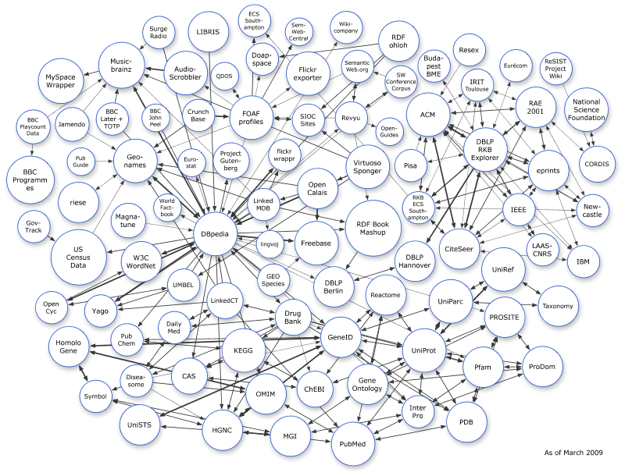
Linked Data Cloud, March 2009

Slide 16
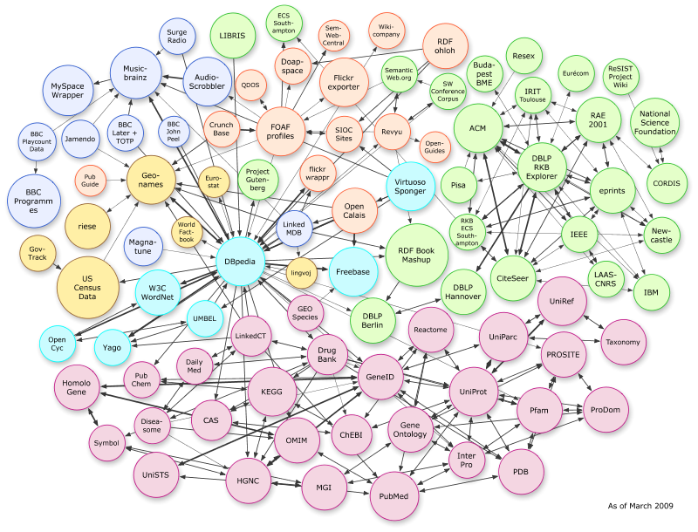
Application-specific parts of the cloud
“Bio”-related datasets
Thanks to “Linking Open Drug Data” task force of the HCLS at W3C

Slide 17
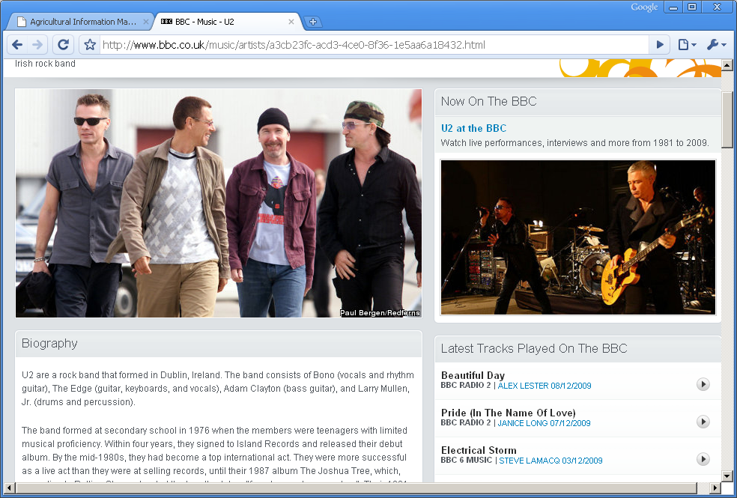
Building Web pages from Linked Data (BBC)
Source: http://www.bbc.co.uk/music/artists

Slide 18
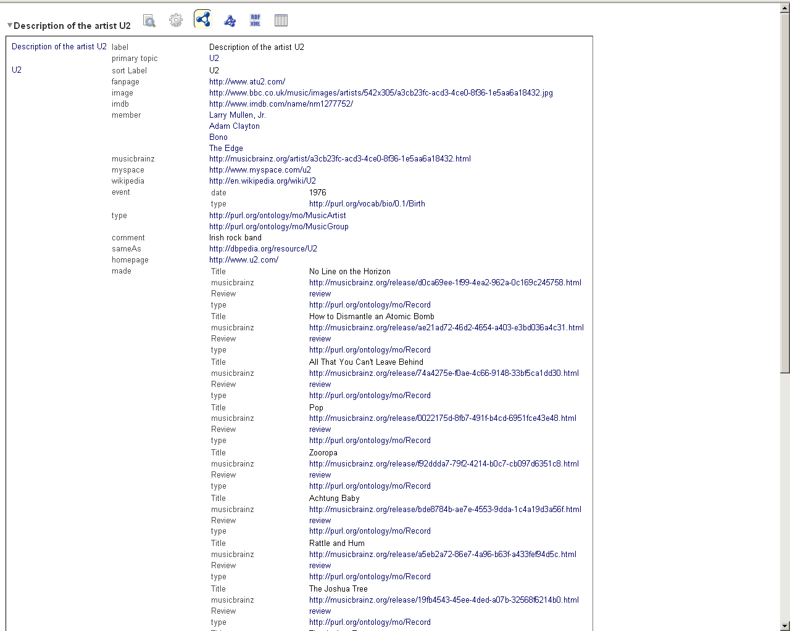
BBC’s “U2” page, under the hood…

Slide 19
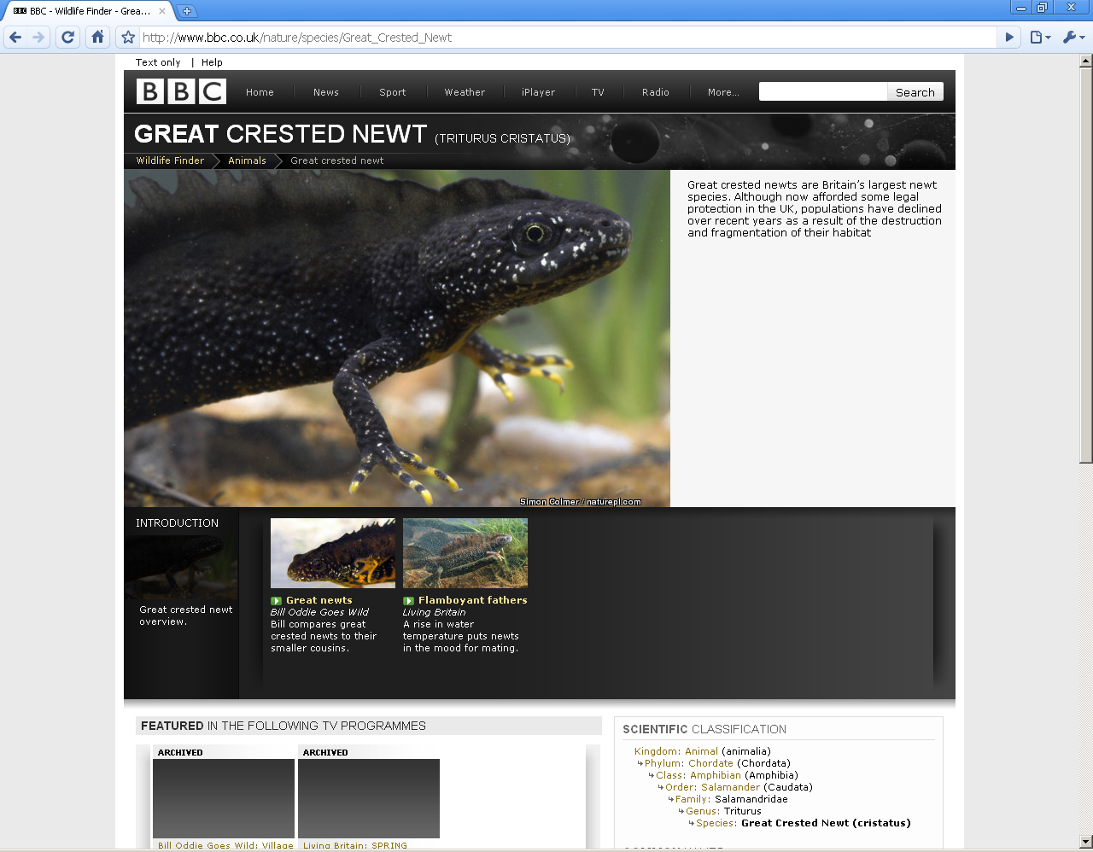

Slide 20
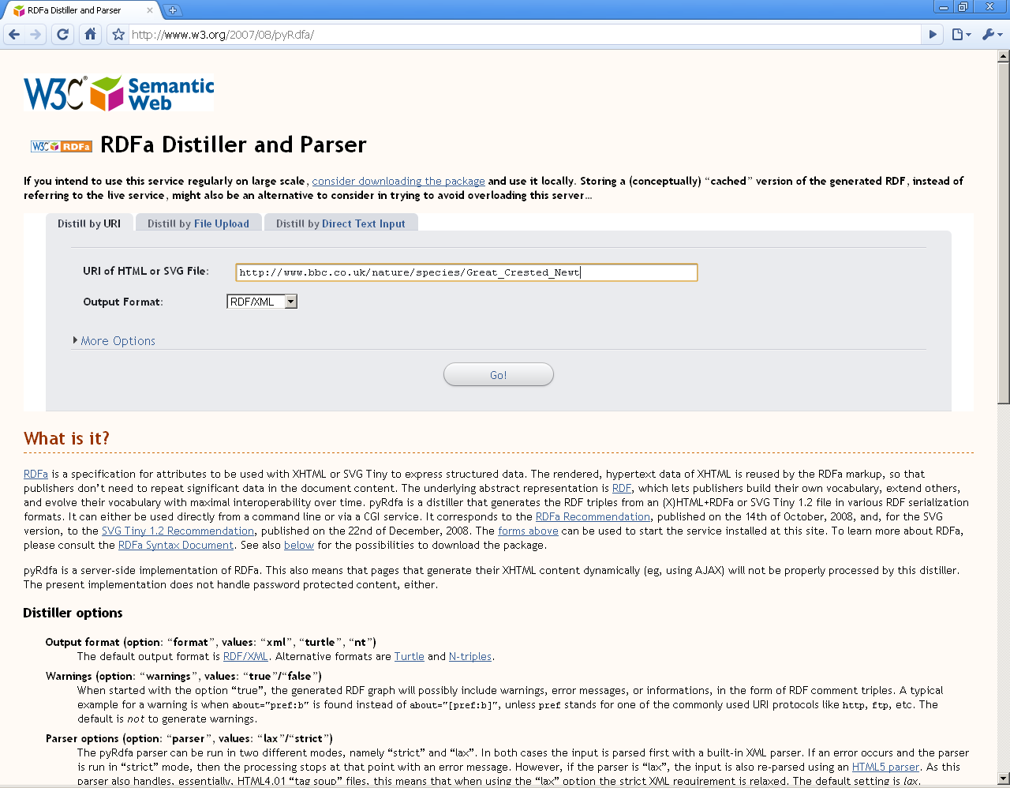

Slide 21
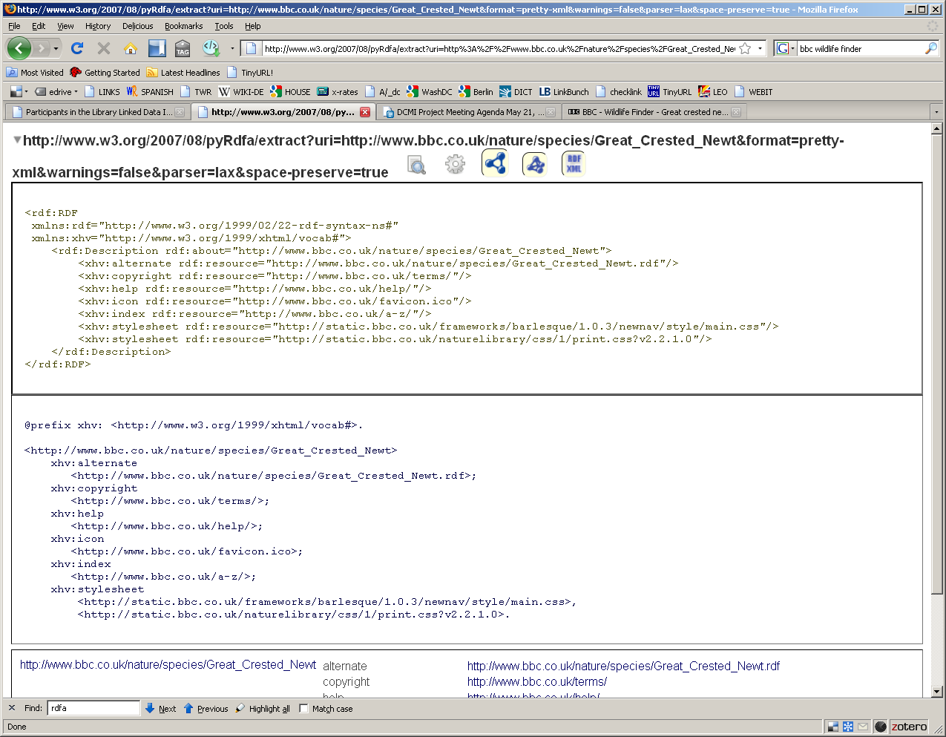

Slide 22
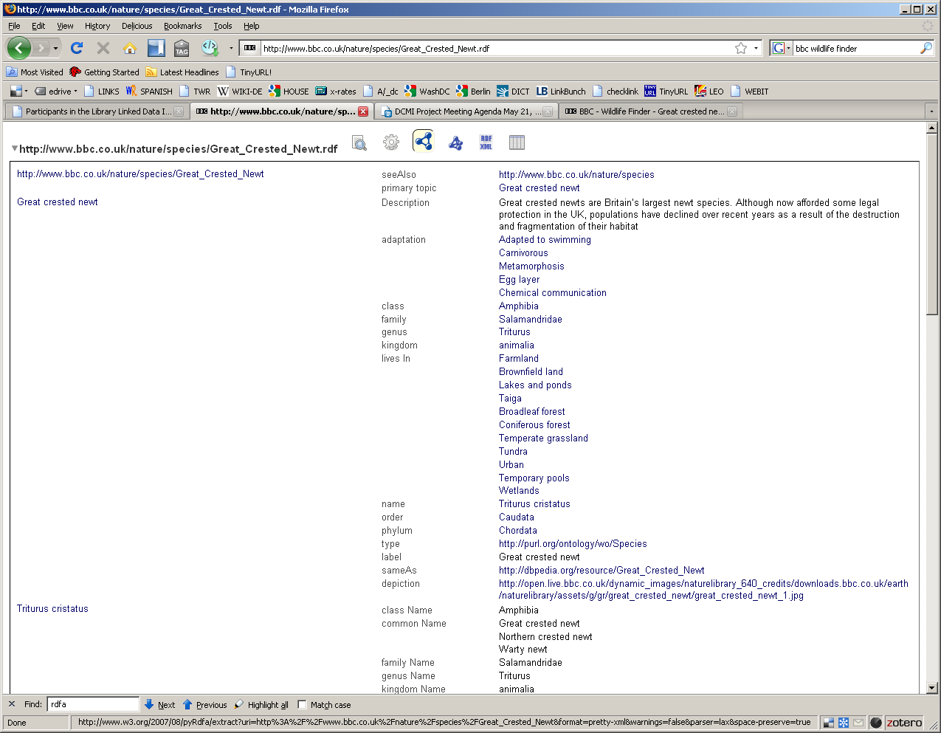

Slide 23
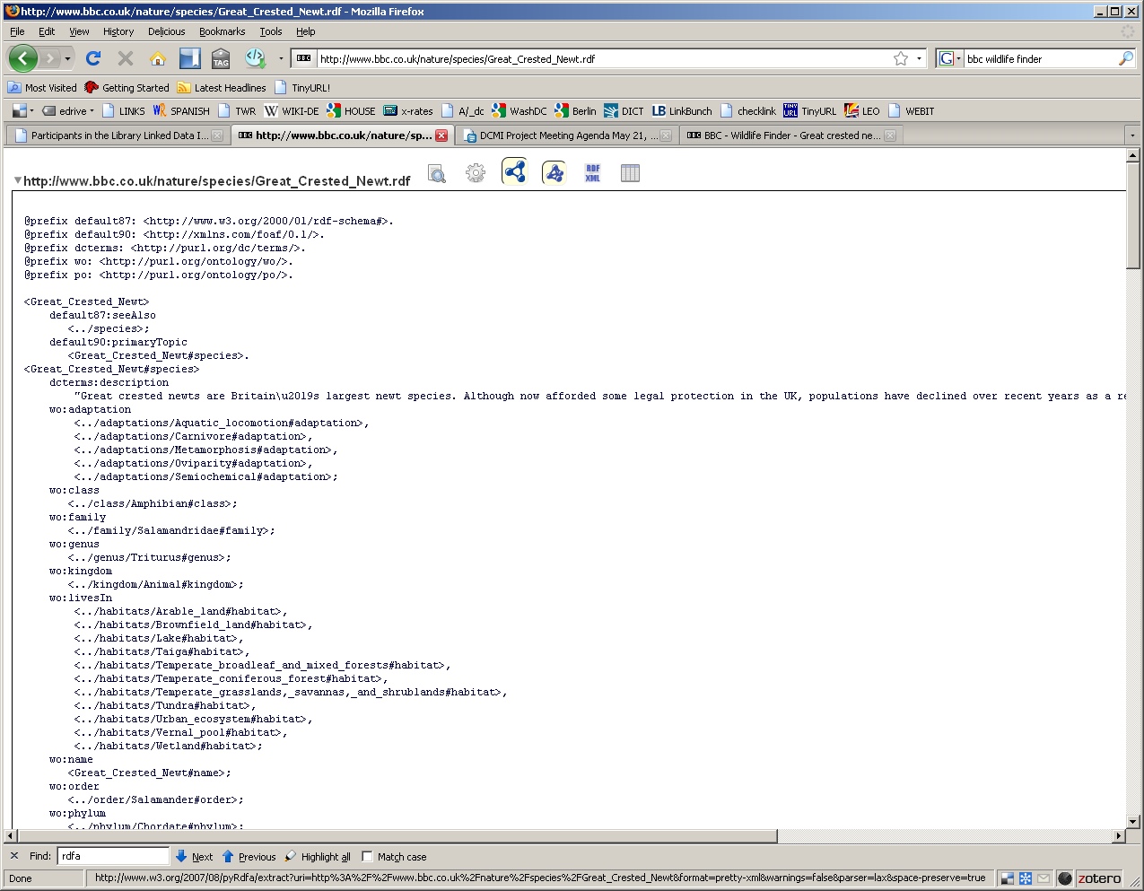

Slide 24
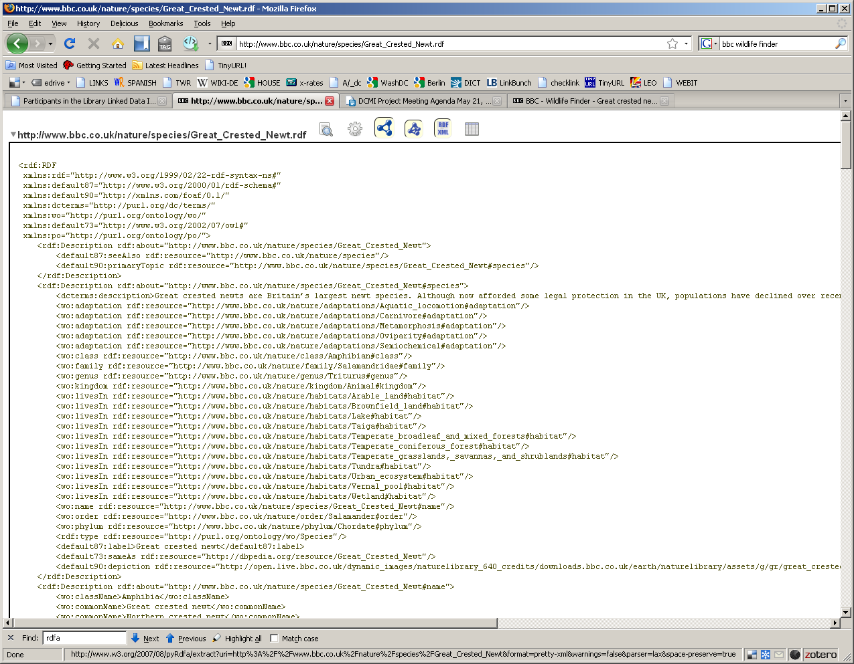

Slide 25
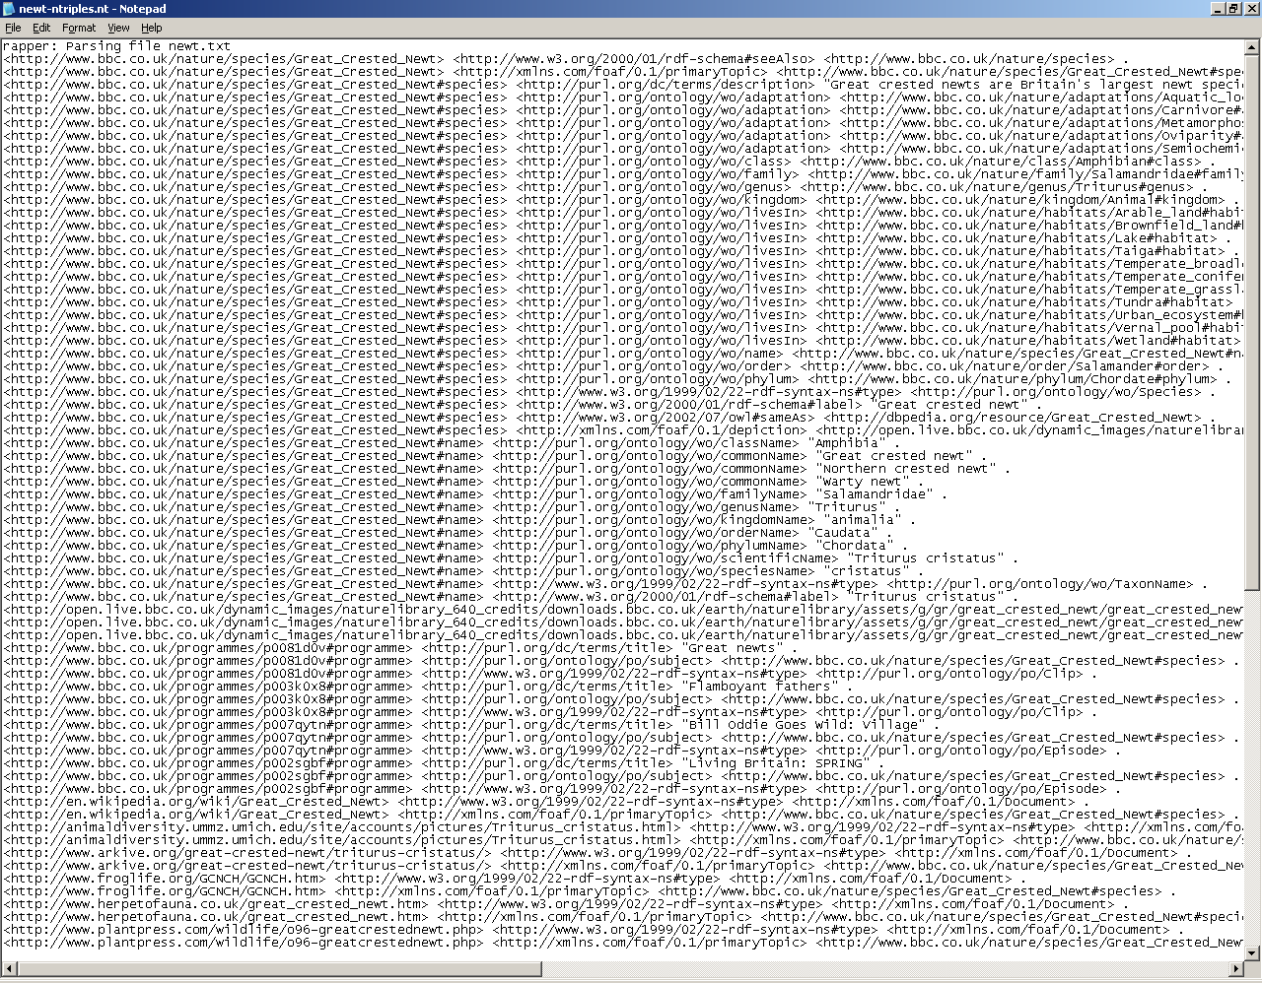

Slide 26
