Slide 1
Designing Interoperable Metadata on Linked Data Principles

Slide 2
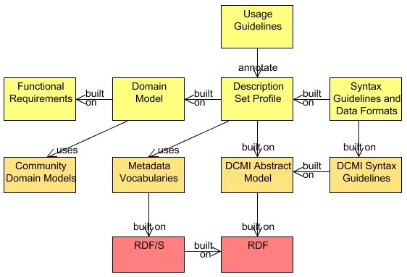
Singapore Framework
Application Profile
Domain standards
Foundation standards

Slide 3
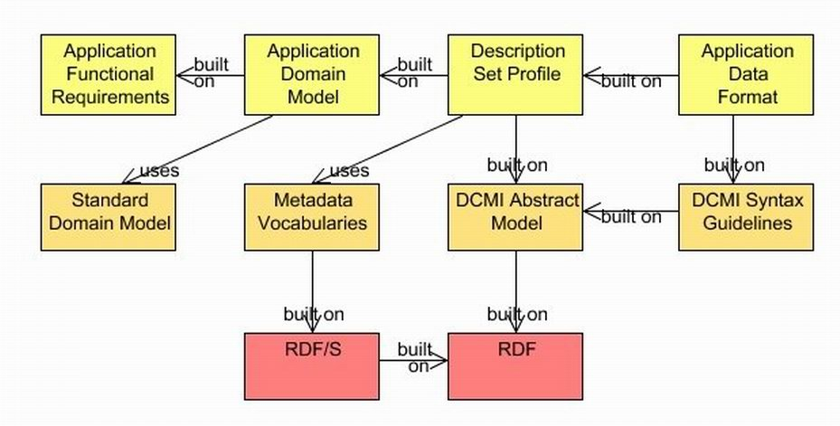
Getting from Requirements...

Slide 4
...to a Data Format

Slide 5
...based on Community Standards

Slide 6
...on the basis of Foundation Standards (RDF)‏

Slide 7
What does your application need to do?

Slide 8
Functional Requirements
What activities must the application support?
Who are the users? How expert are they?
Scholarly Works Application Profile examples:
“Facilitate identification of open access materials.”
“Be compatible with preservation metadata approaches.”
“Enable identification of research funder and project code.”
“Support navigation between different 'versions' of the same eprint.”
DC Collections Application Profile examples:
“Enable searching on the entity that owns the collection”
“Enable selection of a collection based on a textual description”

Slide 9
What things are being described?

Slide 10
The simplest domain model...!
Resource

Slide 11

A slightly more complicated domain model

Slide 12
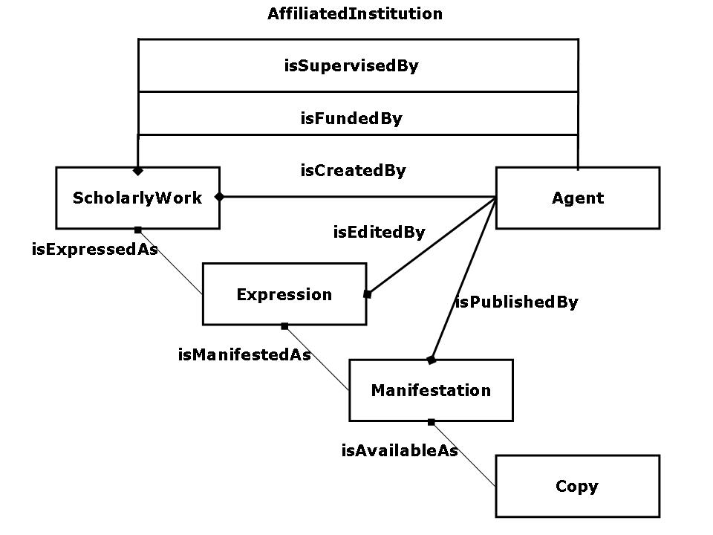
Domain Model for Scholarly Works Application Profile

Slide 13
Description Set Profile, based on DCMI Abstract Model‏

Slide 14
DCMI Description Set Profile (DSP)
A way of describing structural constraints on a description set
the resources that may be described by descriptions in the description set
the properties that may be referenced in statements
the ways a value surrogate may be given
Description templates, statement templates
Model & XML Syntax for DSP
Working draft by Mikael Nilsson (Royal Institute of Technology, Sweden)
http://dublincore.org/documents/2008/03/31/dc-dsp/

Slide 15
Description Set Profile
Description Set
Description
<http://dublincore.org/documents/2007/06/04/abstract-model/>
Statement
<http://purl.org/dc/terms/publisher>
Non-Literal Value Surrogate
Property URI
<http://example.org/org/DCMI>
Value URI
Statement
Non-Literal Value Surrogate
<http:/purl.org/dc/terms/subject>
<http://example.org/mySH/h123>
Value URI
Property URI
<http://example.org/terms/mySH>
Vocab Enc Scheme URI
“Metadata”
en
Value String
"Métadonnées"
fr
Value String
Description
<http://example.org/org/DCMI>
Statement
Literal Value Surrogate
<http://xmlns.com/foaf/ 0.1/name>
“Dublin Core Metadata Initiative”
en
Value String
Property URI
Statement
Literal Value Surrogate
<http://purl.org/dc/ terms/created>
“1995”
^^xsd:gyear
Value String
Property URI

Slide 16
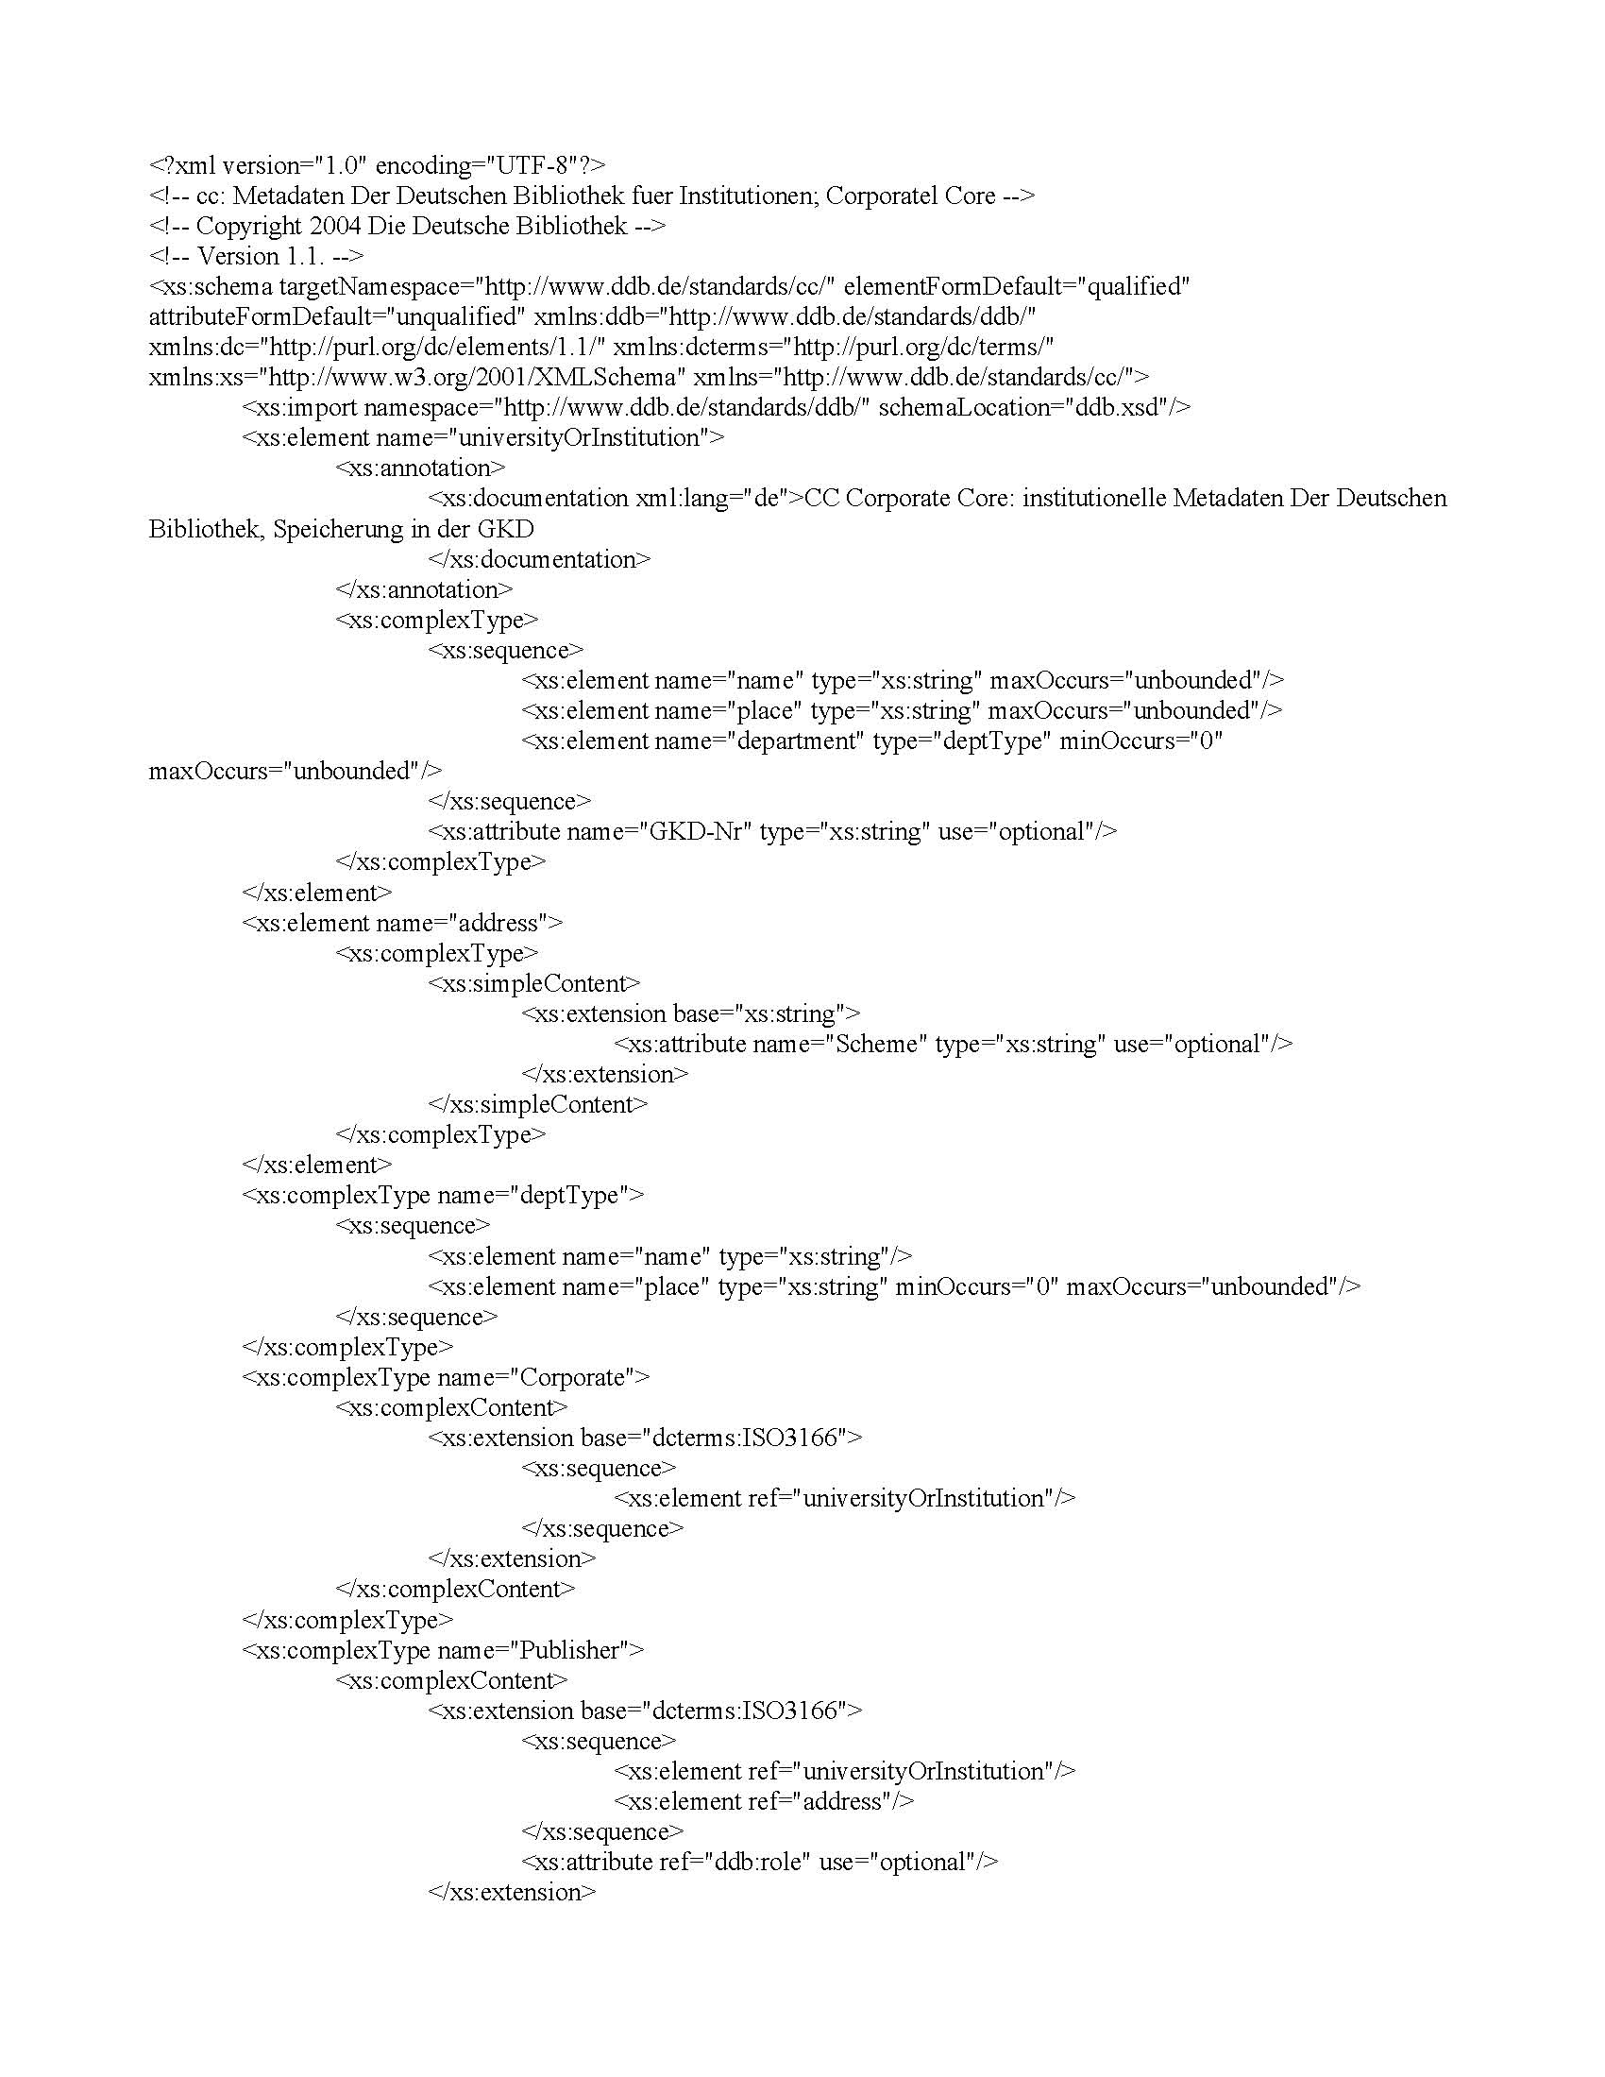
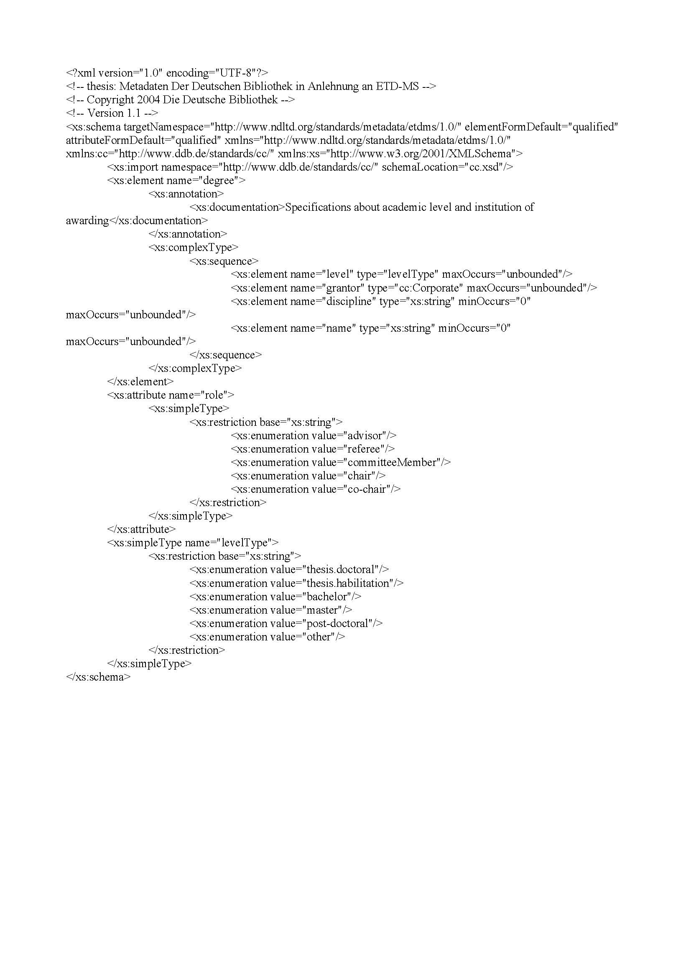
Level-1 applications s interoperate with shared or mapped schemas
Schema A
Schema B
Schema C
same
as
mapped
to

Slide 17
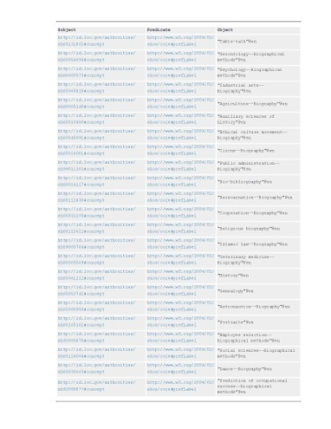
Good level-2 Application Profiles create good triples
Profile A
Profile B
Profile C

Slide 18
Good triples can be merged coherently
Profile A
Profile B
Profile C

Slide 19
Applications come and go…
Profile A
Profile B
Profile C

Slide 20
The data remains

Slide 21
Data quality is independent of profiles used to create it
SPARQL Endpoint
Queries

