Slide 1
What Makes the Linked Data Approach Different

Slide 2
RDF– a grammar for the language of data
ResourceA
Resource
ResourceB
relatedTo
ResourceA
Resource
describedBy
Some text
Describe resources using interrelated “statements” (“triples”).
Use URIs – unique, globally managed identifiers –
as the “words” of statements.

Slide 3
“Open World Mindset”
“Closed” (“normal”) IT environments
Data sources carefully controlled.
Data formats “custom-defined” for an application.
Linked data based on an “open world mindset”
Integrating data from the open Web
Systems designed to incorporate new information incrementally
By design, tolerance of incomplete information

Slide 4
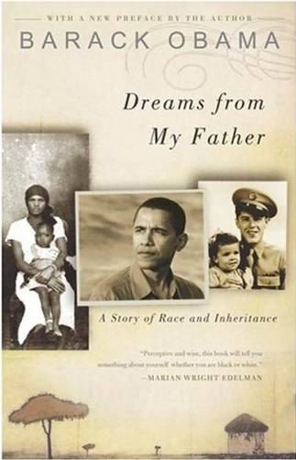
Source A: About a book by Barack Obama
Each triple in the data corresponds to a link in a
conceptual graph.
dct:title
“Dreams from My Father”
http://...2773
dct:date
2004
dct:creator
_:placeholder
“Barack Obama”
foaf:name
Each bit of information about the book is expressed
in the data as a triple – a three-part “statement”.
http://../isbn/978-14000082773 dct:title “Dreams from My Father”
http://../isbn/978-14000082773 x:published “2004”
http://../isbn/978-14000082773 dct:creator _:placeholder
_:placeholder foaf:name “Barack Obama”

Slide 5

Source B: About the French translation
x:isTranslationOf
http://...2773
http://...5979
dct:title
“Les rêves de mon père”
X:translator
_:placeholder
“Danièle Darneau”
foaf:name
http://../isbn/978-2258075979 x:isTranslationOf http://.../isbn/978-14000082773
http://../isbn/978-2258075979 dct:title “Les rêves de mon père”
http://../isbn/978-2258075979 x:translator _:placeholder
_:placeholder foaf:name “Danièle Darneau”

Slide 6
Merge the two data sources into one set of triples
http://../isbn/978-2258075979 x:isTranslationOf http://.../isbn/978-14000082773
http://../isbn/978-2258075979 dct:title “Les rêves de mon père”
http://../isbn/978-2258075979 x:translator _:placeholder
_:placeholder foaf:name “Danièle Darneau”
http://../isbn/978-14000082773 dct:title “Dreams from My Father”
http://../isbn/978-14000082773 x:published “2004”
http://../isbn/978-14000082773 dct:creator _:placeholder
_:placeholder foaf:name “Barack Obama”

Slide 7
Software detects matching URIs…
http://../isbn/978-2258075979 x:isTranslationOf http://.../isbn/978-14000082773
http://../isbn/978-2258075979 dct:title “Les rêves de mon père”
http://../isbn/978-2258075979 x:translator _:placeholder
_:placeholder foaf:name “Danièle Darneau”
http://../isbn/978-14000082773 dct:title “Dreams from My Father”
http://../isbn/978-14000082773 x:published “2004”
http://../isbn/978-14000082773 dct:creator _:placeholder
_:placeholder foaf:name “Barack Obama”

Slide 8
Software detects matching URIs…
dct:title
“Dreams from My Father”
http://...2773
dct:date
2004
dct:creator
_:placeholder
“Barack Obama”
foaf:name
x:isTranslationOf
http://...2773
http://...5979
dct:title
“Les rêves de mon père”
X:translator
_:placeholder
“Danièle Darneau”
foaf:name

Slide 9
…and merges the data
dct:title
“Dreams from My Father”
http://...2773
dct:date
2004
dct:creator
x:isTranslationOf
_:placeholder
“Barack Obama”
foaf:name
http://...5979
dct:title
“Les rêves de mon père”
X:translator
_:placeholder
“Danièle Darneau”
foaf:name

Slide 10
“Enrich” the data with a DBPedia URI identifying Barack Obama…
“Les rêves de mon père”
dct:title
dct:title
“Dreams from My Father”
http://...5979
http://...2773
x:isTranslationOf
dct:date
X:translator
2004
dct:creator
_:placeholder
“Danièle Darneau”
http://...Obama
“Barack Obama”
foaf:name
_:placeholder
foaf:name
_:placeholder foaf:name “Barack Obama”
http://dbpedia.org/resource/Barack_Obama foaf:name “Barack Obama”

Slide 11
In Wikipedia, a book in German about Obama is linked to the DBPedia URI
“Les rêves de mon père”
dct:title
dct:title
“Dreams from My Father”
http://...5979
http://...2773
x:isTranslationOf
dct:date
X:translator
2004
dct:creator
_:placeholder
“Danièle Darneau”
foaf:name
http://...Obama
“Barack Obama”
foaf:name
dct:subject
http://...Kennedy
“Der schwarze Kennedy”
dct:title
http://dbpedia.org/...Kennedy¹ dct:subject http://...Obama
http://dbpedia.org/...Kennedy dct:title “Der schwarze Kennedy”
¹ Full URI: http://dbpedia.org/resource/Barack_Obama_-_Der_schwarze_Kennedy

Slide 12
New York Times’ URI for Obama, linked to Dbpedia’s, leads to a NYT Topic Page
“Les rêves de mon père”
dct:title
dct:title
“Dreams from My Father”
http://...5979
http://...2773
x:isTranslationOf
dct:date
X:translator
2004
dct:creator
_:placeholder
“Danièle Darneau”
foaf:name
http://...Obama
“Barack Obama”
foaf:name
owl:sameAs
http://...6853
x:topicPage
http://topics.nytimes.com/top/reference/timestopics/people/o/barack_obama/index.html
“Barack Obama”
http://data.nytimes.com/...6853¹ owl:sameAs http://...Obama
http://data.nytimes.com/...6853 x:topicPage http://topics.nytimes.com/...
¹ Full URI: http://data.nytimes.com/47452218948077706853

Slide 13
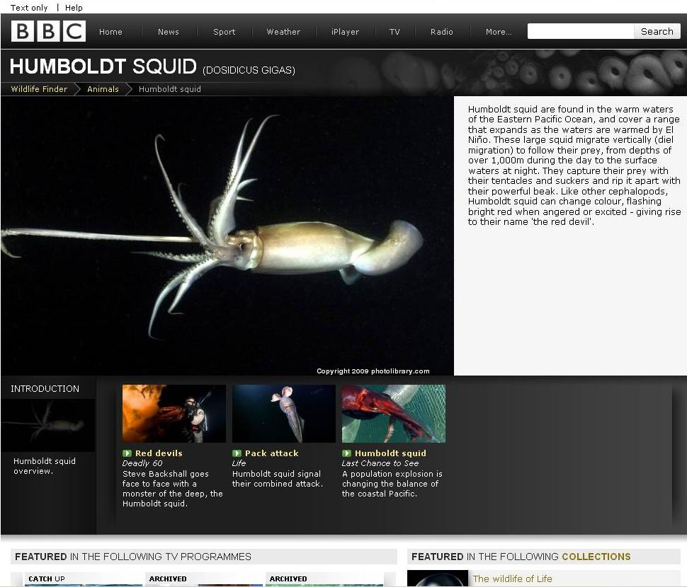
Example: BBC Wildlife Finder

Slide 14
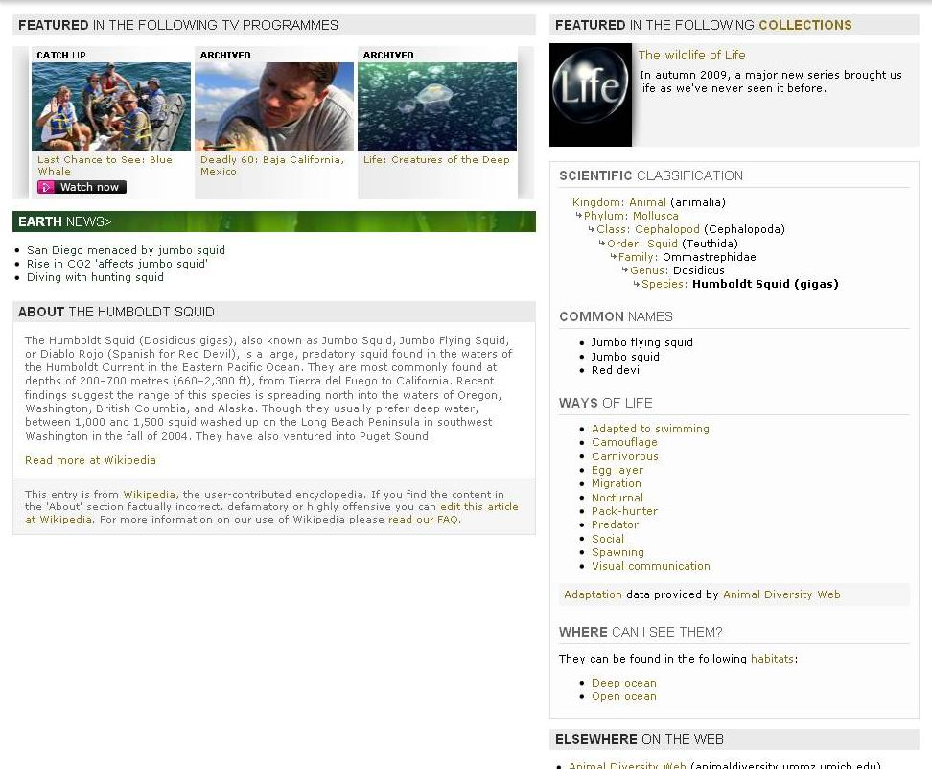
Humboldt Squid page, pulled together from a diversity of Linked Data sources
BBC TV Documentary
BBC News item
Wikipedia
Animal Diversity Web: Nocturnal way of life

Slide 15
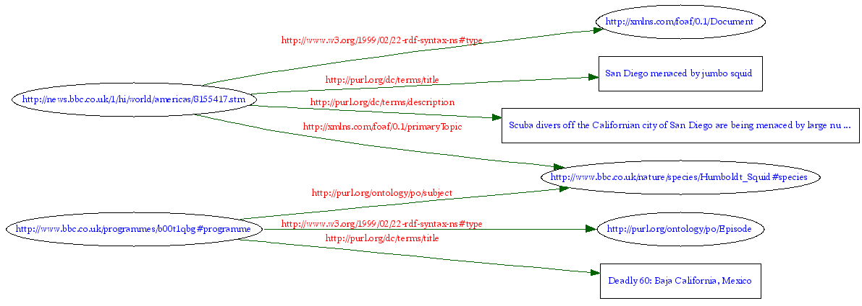
“Under the hood” of the Squid page, triples use URIs to make connections…
BBC News item
Humboldt Squid (species)
BBC TV documentary

Slide 16
Many basic relations are Dublin Core “predicates”

Slide 17
Or mappable equivalents of Dublin Core predicates

Slide 18
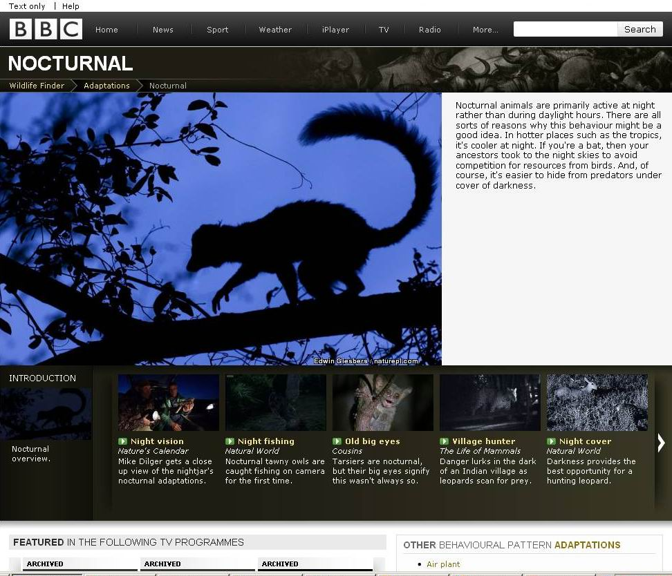
Using triples about many animals to pull together a Web page about “nocturnal” wildlife…
Humboldt Squid
has “way of life”
“Nocturnal”

Slide 19
Designing Interoperable Metadata on Linked Data Principles

Slide 20
“Application Profile” – something that takes an implementer…
Functional
Require-
ments
Domain Model
Description Set Profile
Data Format
built
on
built
on
built
on
uses
uses
built on
built on
Community Domain Models
Metadata
Vocabularies
DCMI Abstract Model
DCMI Syntax Guidelines
built
on
built on
built on
RDFS
(RDF Vocabulary Description Language)
RDF
built
on
Based on: http://dublincore.org/documents/singapore-framework/

Slide 21
…from Functional Requirements and a Domain Model
Functional
Require-
ments
Domain Model
Description Set Profile
Data Format
built
on
built
on
built
on
What a metadata application must do
What “things”are described in a metadata application
“Support navigation between ‘versions’.”
“Enable searching on the ‘owner’ of a collection.”
Resources (generically)
Authors and Books
Scholarly Works, Expressions, Manifestations, Items, Agents
as in Functional Requirements for Bibliographic Records (FRBR)

Slide 22
…to a Description Set Profile and Data Format
Functional
Require-
ments
Domain Model
Description Set Profile
Data Format
built
on
built
on
built
on
How things of the Domain Model are described
Structure of the actual data format used by an application
Use of Properties and Classes.
Their cardinality
Whether mandatory or optional
Lists of allowable values…
Components of the data structure.
How the components map to Linked Data.

Slide 23
…on the basis of Community Standards, which in turn are grounded in…
Functional
Require-
ments
Domain Model
Description Set Profile
Data Format
built
on
built
on
built
on
uses
uses
Community Domain Models
Using well-known entities, such as FRBR classes
Metadata Vocabularies
Using well-known, such as Dublin Core and FOAF
Community Domain Models
Metadata
Vocabularies
built on
RDFS
(RDF Vocabulary Description Language)

Slide 24
…in Foundation Standards for Linked Data (RDF).
Functional
Require-
ments
Domain Model
Description Set Profile
Data Format
built
on
built
on
built
on
uses
uses
built on
built on
Community Domain Models
Metadata
Vocabularies
DCMI Abstract Model
DCMI Syntax Guidelines
built
on
built on
built on
RDFS
(RDF Vocabulary Description Language)
RDF
built
on

Slide 25
DCMI guidelines, under review, offer one approach¹ to designing Linked-Data-compatible metadata records
Functional
Require-
ments
Domain Model
Description Set Profile
Data Format
built
on
built
on
built
on
uses
uses
built on
built on
Community Domain Models
Metadata
Vocabularies
DCMI Abstract Model
DCMI Syntax Guidelines
built
on
built on
built on
RDFS
(RDF Vocabulary Description Language)
RDF
built
on
¹ There is more than one way to do it. To be discussed at DC-2010 in Pittsburgh,
October 2010, http://dc-2010.org.

Slide 26
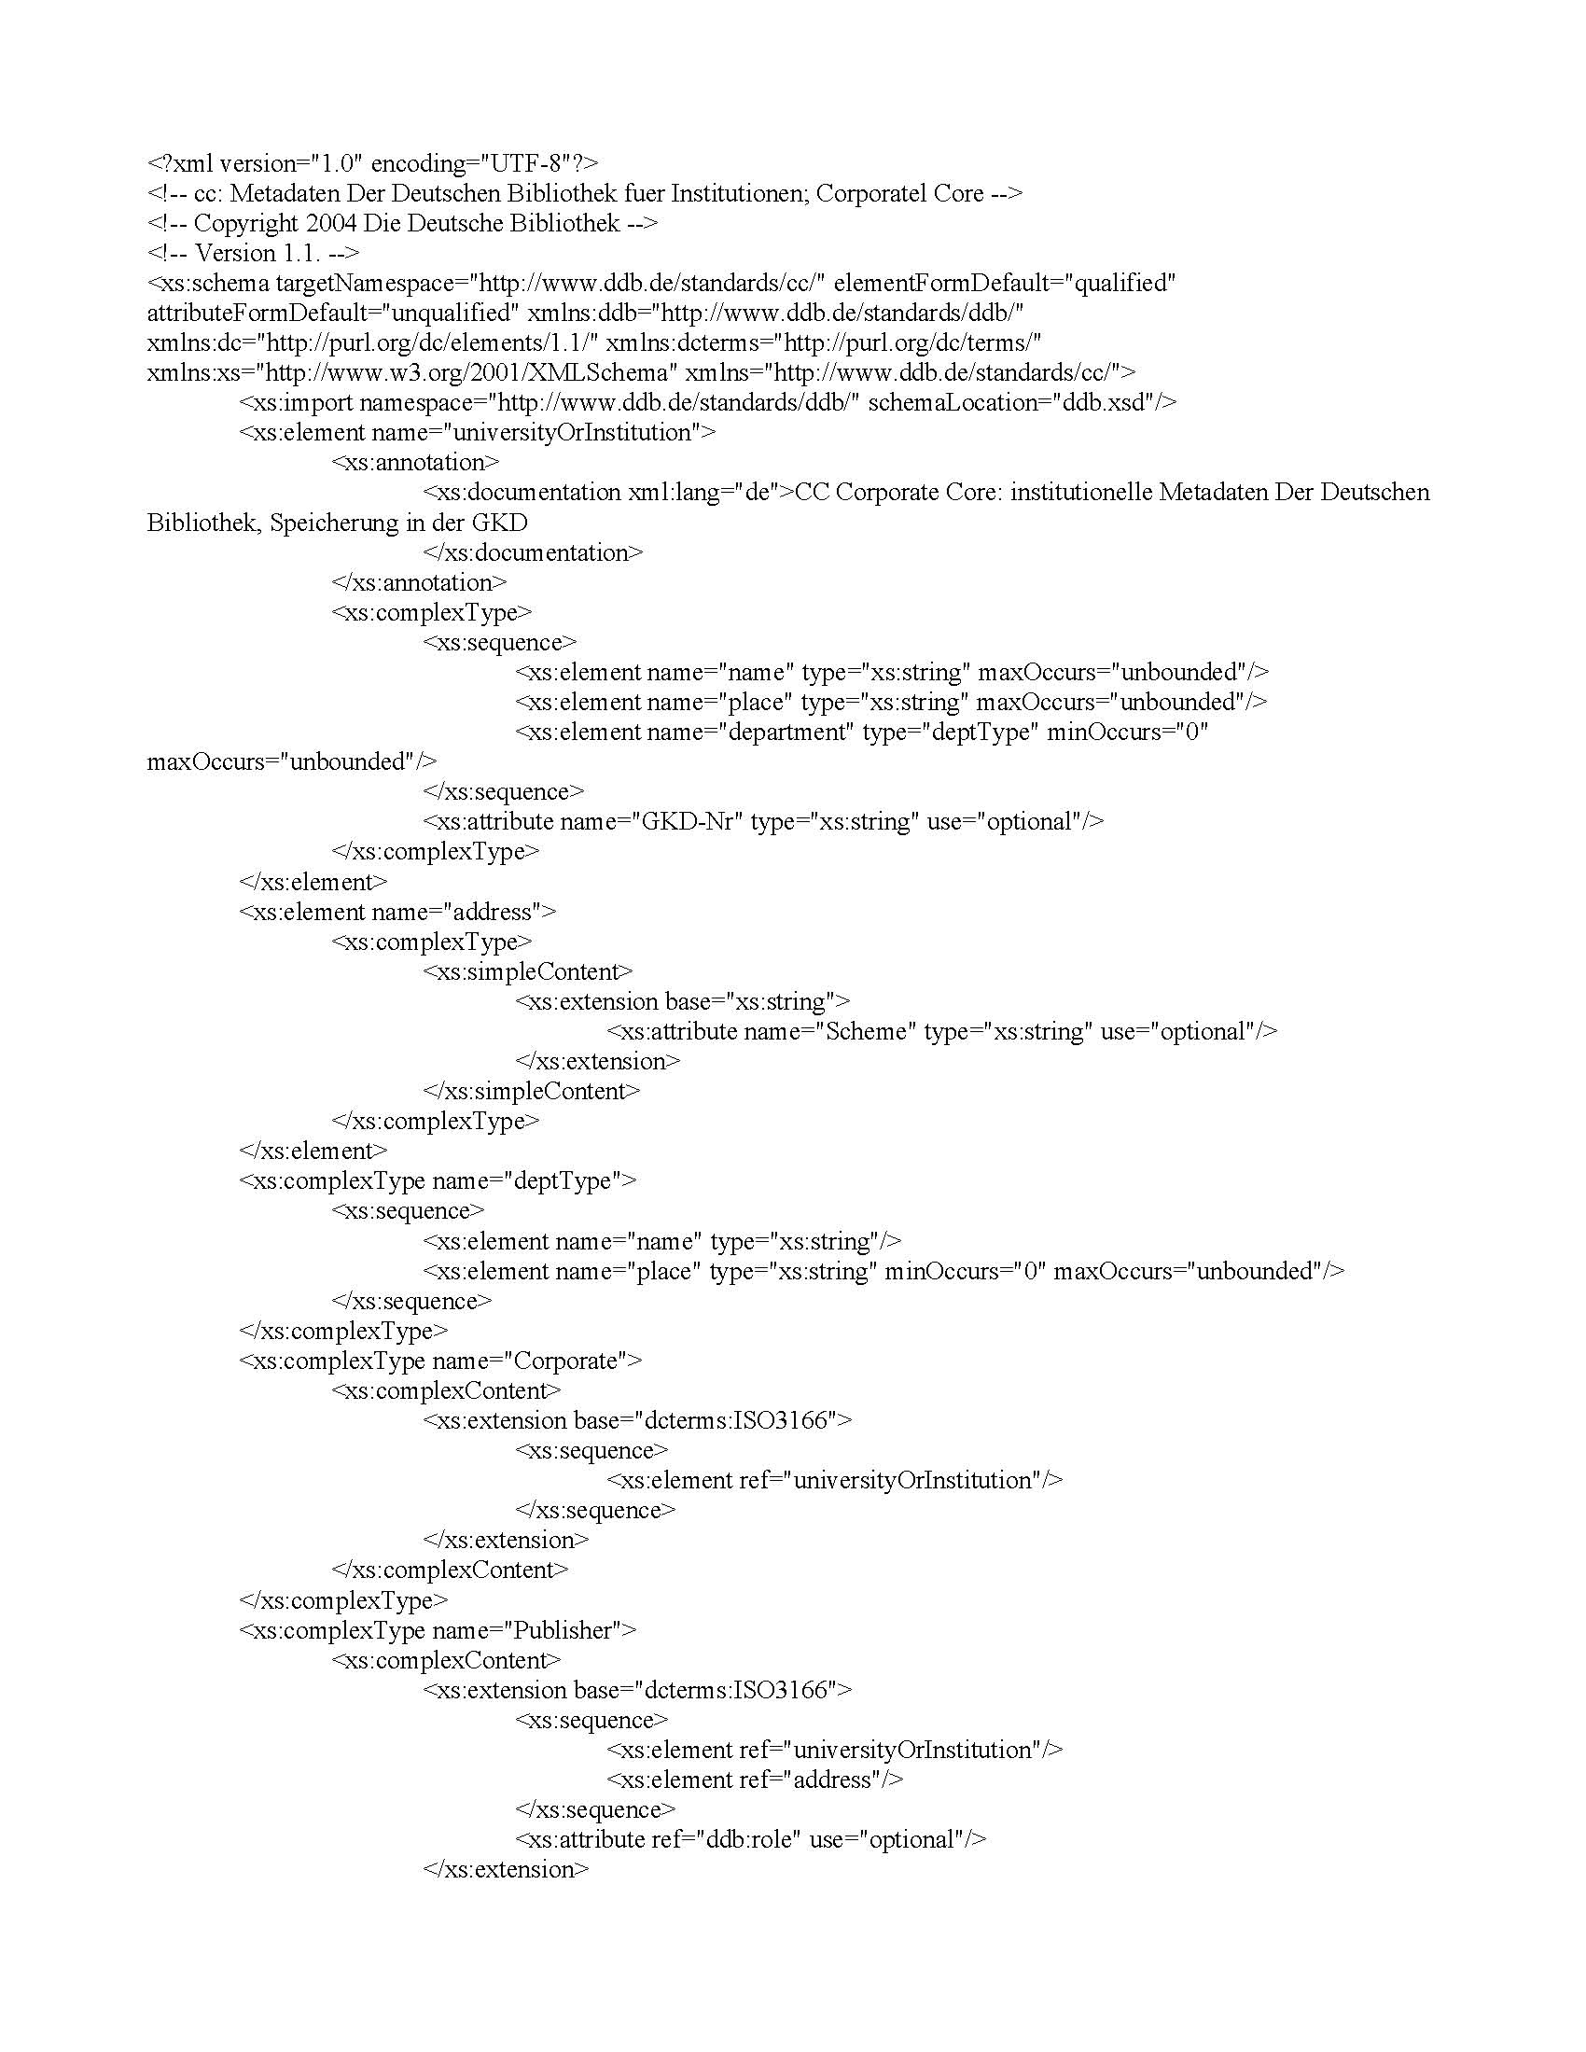
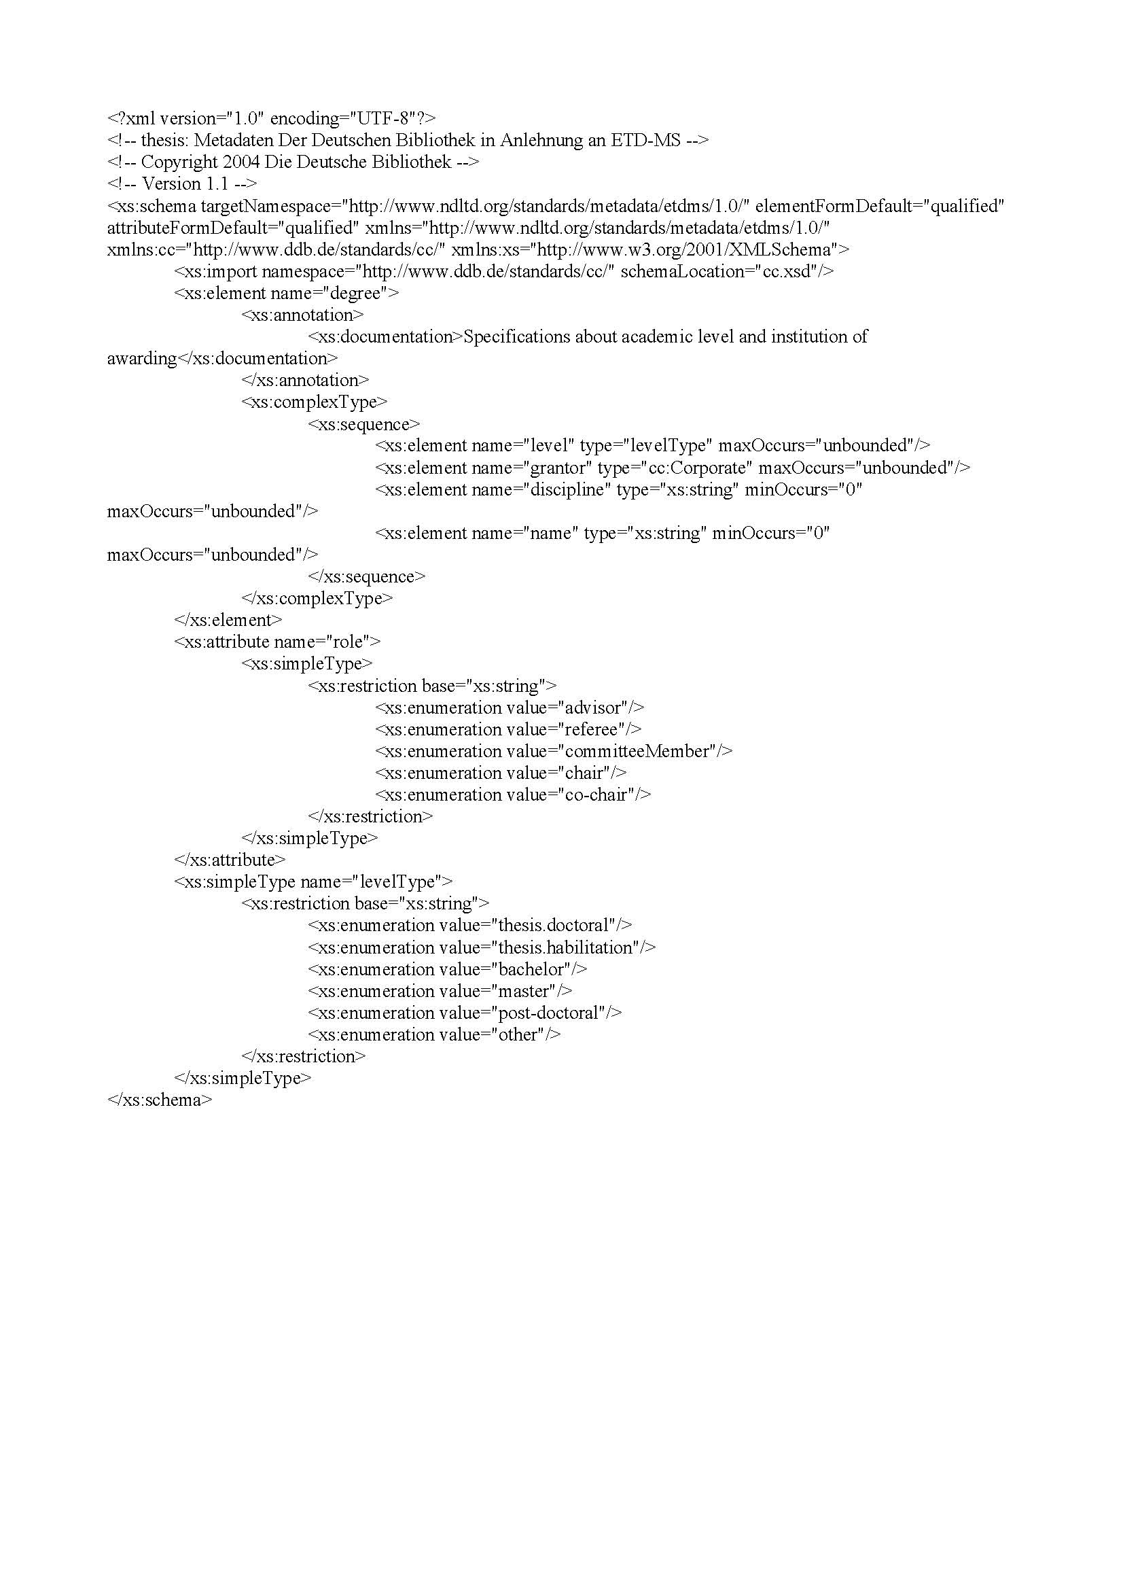
“Closed” (“normal”) IT: Integrate across silos by mapping ad-hoc data structures
Schema A
Schema B
Schema C
same
as
mapped
to

Slide 27
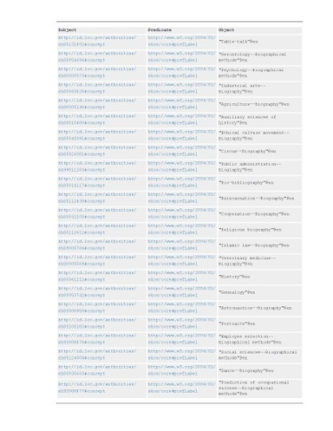
New Linked Data approach: Diverse applications create good triples
Application A
Application B
Application C

Slide 28
Good triples can be merged coherently
Profile A
Profile B
Profile C

Slide 29
Applications come and go…
Profile A
Profile B
Profile C

Slide 30
The data remains

Slide 31
Good triples, based on known vocabularies such as Dublin Core, make data “self-descriptive”
Search engine
Queries

