Slide 1
Bridging the Gap to the Linked Data Cloud

Slide 2
Description
Makx will describe how existing metadata applications can participate in the Linked Data cloud with emphasis on the role of simple, generic vocabularies such as the Dublin Core in providing a common denominator for interoperability.

Slide 3
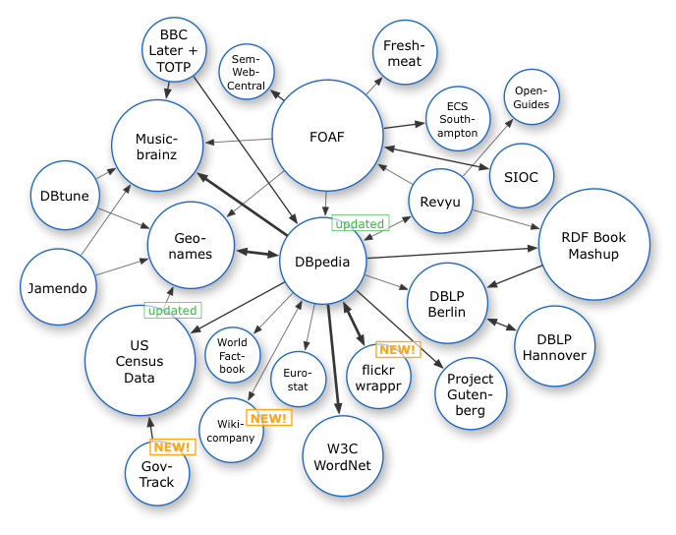
Linked Data Cloud, 2007
http://dbpedia.org

Slide 4
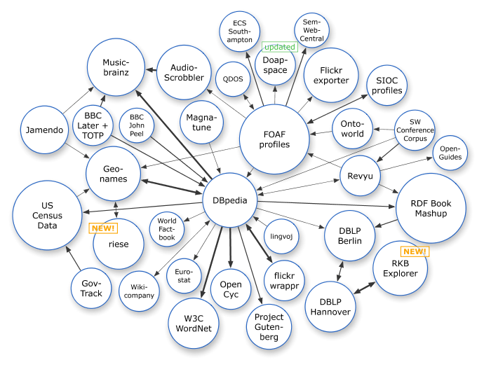
Linked Data Cloud, March 2008

Slide 5
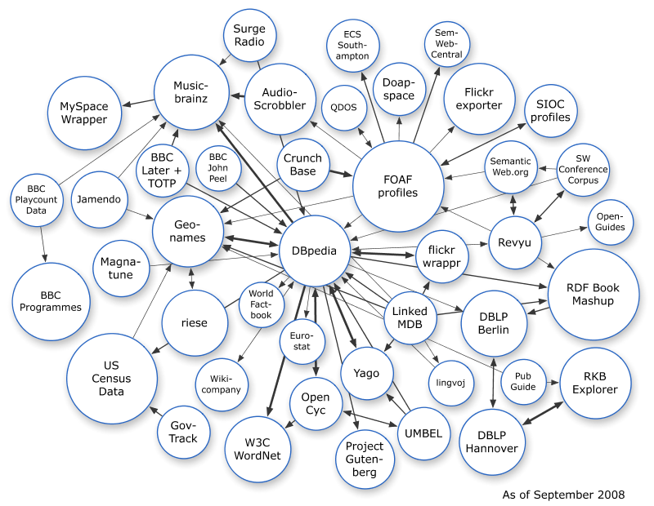
Linked Data Cloud, September 2008

Slide 6
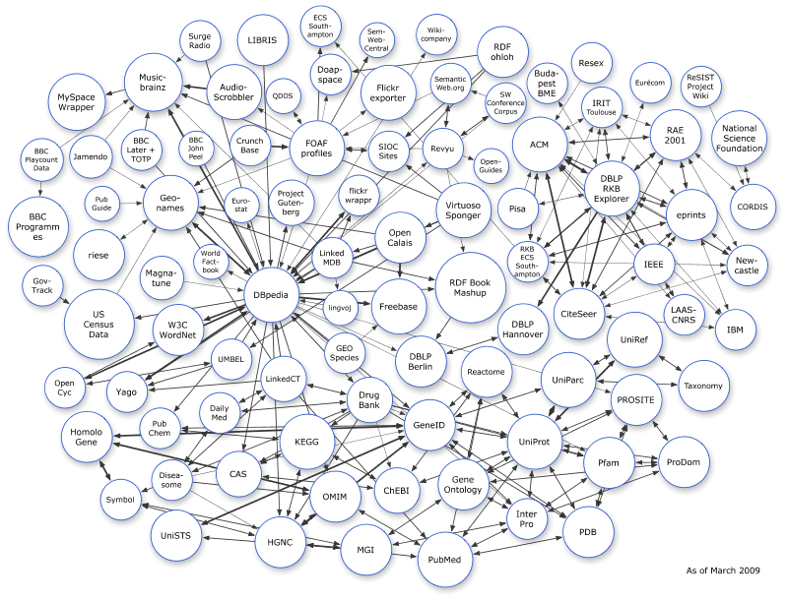
Linked Data Cloud, March 2009

Slide 7
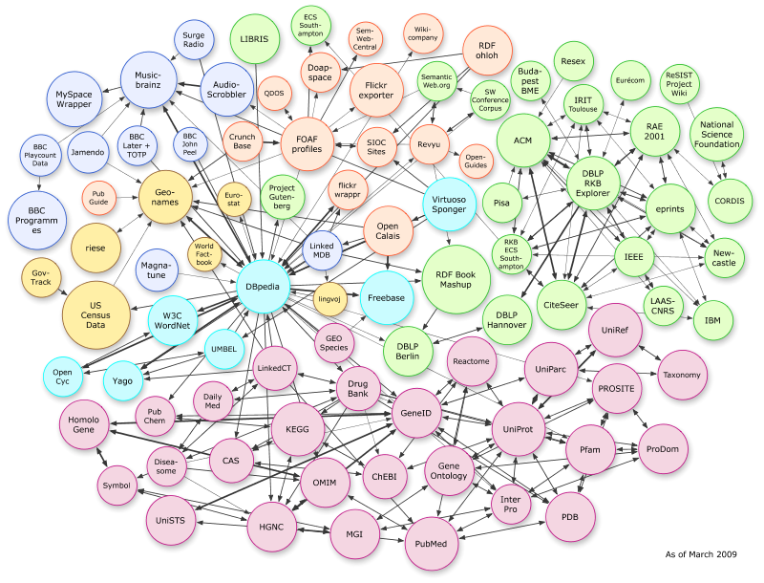
Application-specific parts of the cloud
“Bio”-related datasets
Thanks to “Linking Open Drug Data” task force of the HCLS at W3C

