Slide 1
Peer Reviewer Instructions
DCMI OCS (Open Conference System)

Slide 2
Peer Review System
DCMI uses the Open Conference System (OCS) for the conference website and managing the peer review process
You will receive an email notification from the OCS for each review assigned to you
Each of you already has an account on the OCS. If you need assistance logging in, contact Stuart Sutton (sasutton@uw.edu)
The following pages describe the six steps in the review process

Slide 3
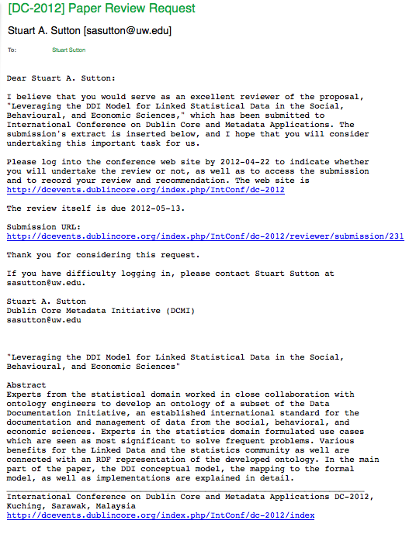
Review Request Email
Example “review request” email
For each assigned review, you will receive a separate email notification with the subject line: “[DC-2012] Paper Review Request”
The request email contains the following information:
Title and abstract of the submission (bottom of email)
The due-date for the review (30 days from date of the request email)
A direct URL to the individual submission (although you can see all of your assigned submissions by logging into your current OCS account)
An important request that you click the submission link within one week of receiving the request email and complete Step #1 by accepting/declining the individual review request

Slide 4
Step Summary
Steps 1&2: Review guidelines and accept or decline the review assignment within one week of receiving the review request email (this is extremely important since declined assignments may need to be reassigned)
Step 3: Download and review the submission file
Step 4: Enter the text of your review in the provided review form and save the text
[ Step 5: Do not use the upload additional review file function ]
Step 6: Record overall recommendation (accept/decline); and, submit the review

Slide 5
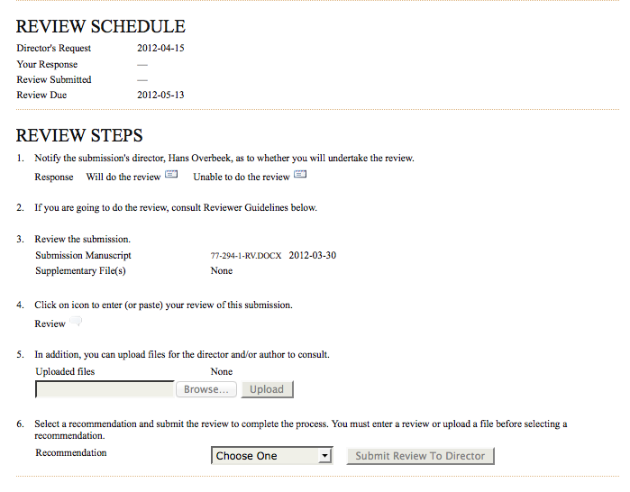
Six Steps—OCS Instructions View

Slide 6
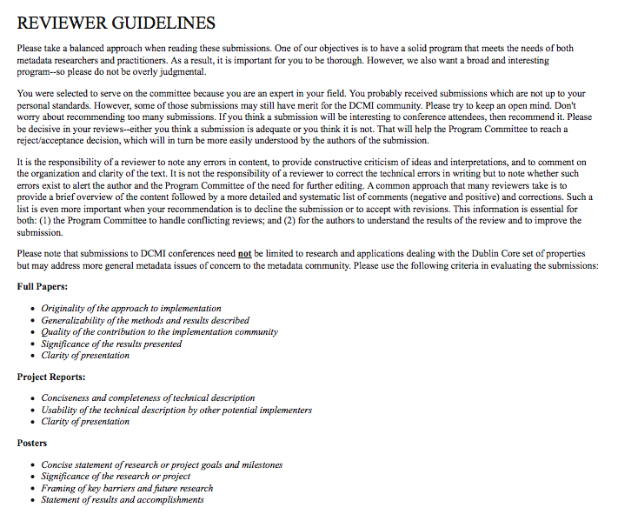
General peer reviewer guidelines are available at the bottom of the submission review page

Slide 7

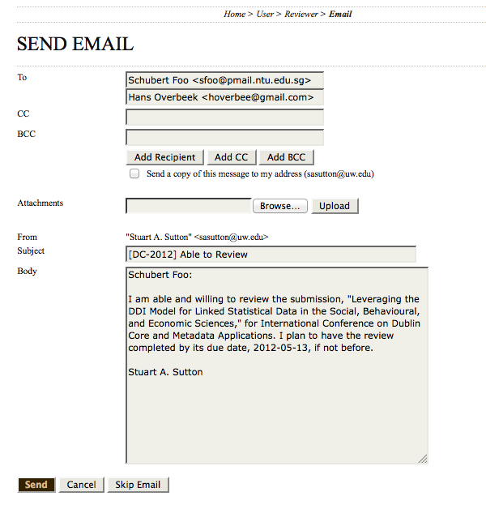
Step #1 for each assigned submission is to notify the Chairs as to whether you “will do” or are “unable to do” the review
Clicking the correct envelop icon brings up an editable email message to the Chairs
After reading the email text (and editing, if useful), click “Send”
Important Note: Until you complete Step #1, some links in the following steps are not active

Slide 8
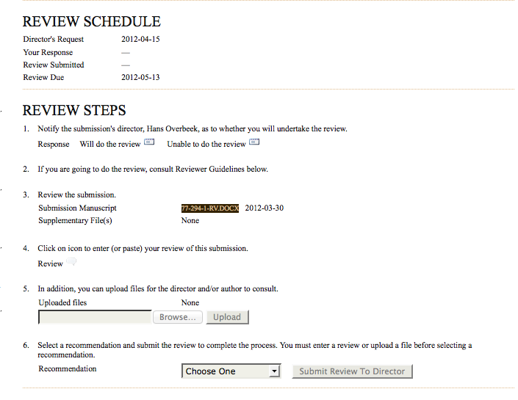
The submission file is available here for download at any time during the review process

Slide 9
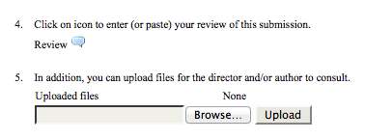
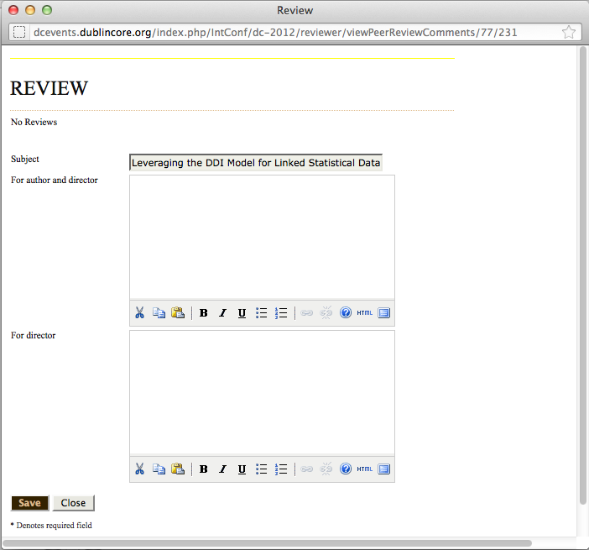
When ready to enter your review, click the icon in Step #4
Enter your review in the text entry form
Top text entry box is for reviewer comments to be seen by the author and the chairs
Bottom text entry box is for confidential comments to be seen by the chairs only
Review form text can be saved and opened again later for editing up to the point of submission of the review
Reviewers cannot change review text after submission in Step 6
Comments for author & chairs
Comments for chairs
only

Slide 10

After completing your review text, Step #6 asks you to select an overall “recommendation” for the submission:
Accept Submission: Select this option if you think that the submission can be published as it was submitted with no revisions or suggested refinements. (Note: Few submissions meet this high standard. Most can benefit from some refinement based on reviewer advice.)
Accept Submission with Revisions: Select this option if you think the submission is already acceptable but can be improved through suggested revisions.
Decline Submission: Decline a submission if in your opinion it does not meet requirements or is otherwise unsuitable. Decline a submission that holds promise or is potentially interesting but requires substantial revisions to be acceptable. DCMI peer review process does not include a second round of review for “conditional accepts”.
After selecting an overall recommendation, click the “Submit Review to Director” link to complete the review process.

Slide 11
Thank you in advance for your service to your colleagues & TO DCMI
DC-2012

