Slide 1
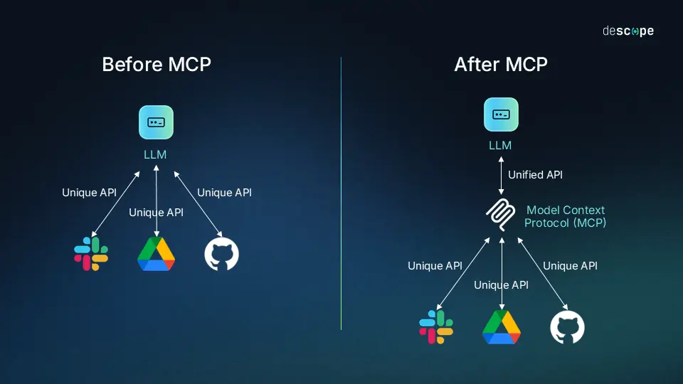

Slide 2
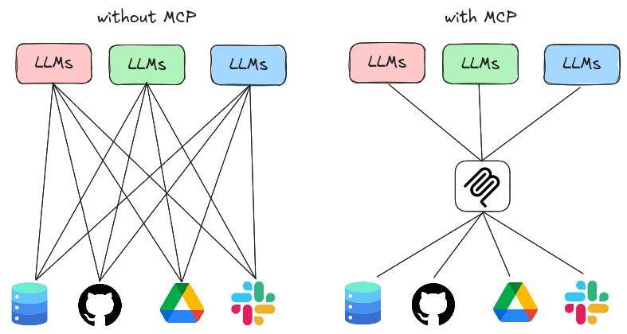

Slide 3
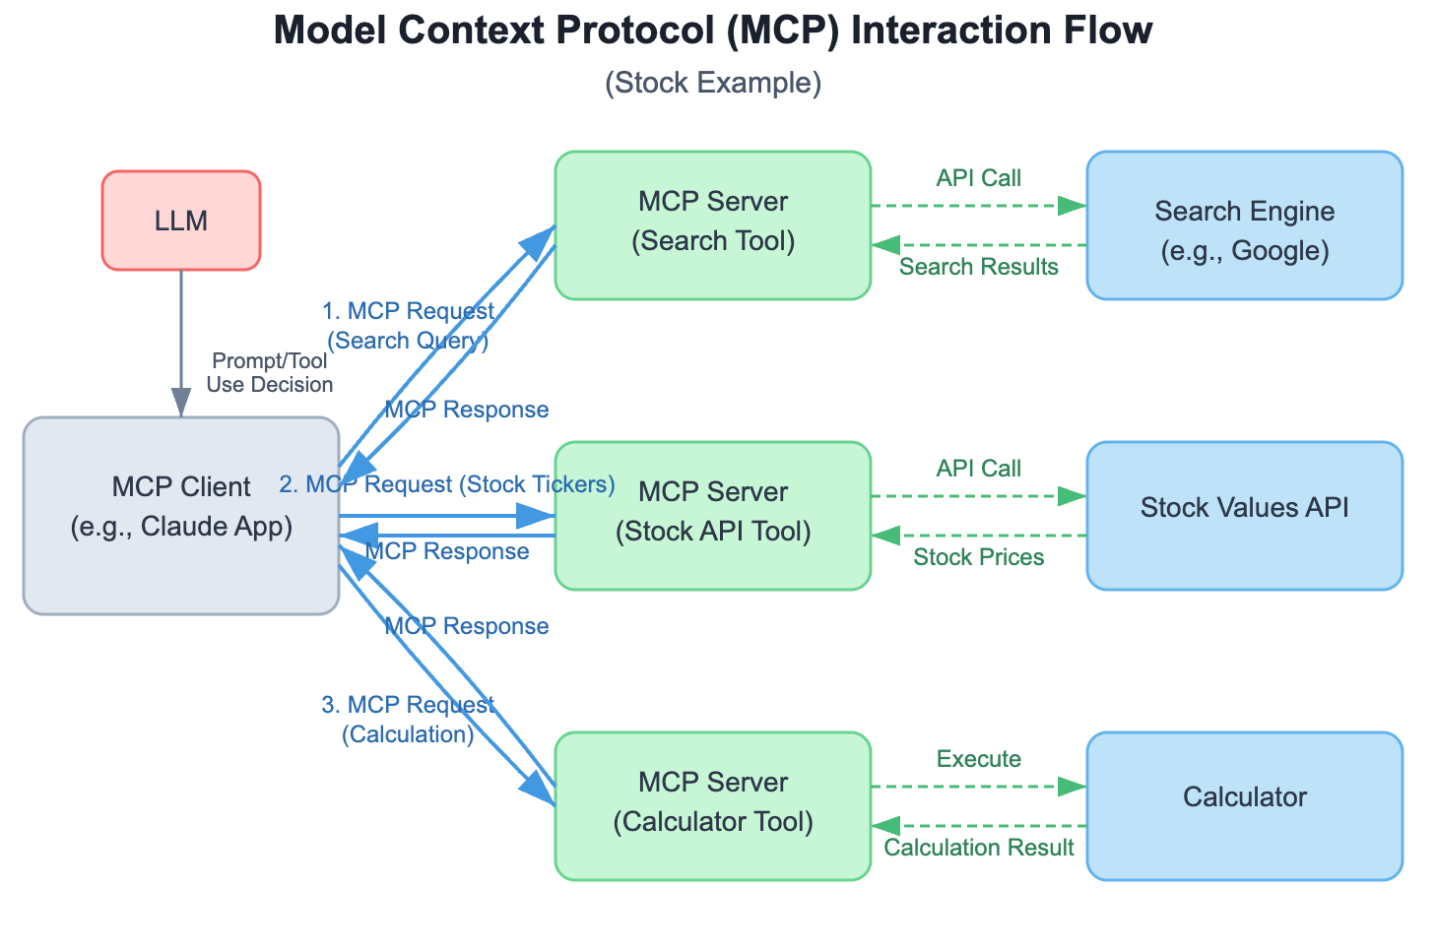

Slide 4
What is Model Context Protocol (MCP)?
Overview: MCP is an open protocol (inspired by HTTP/JSON standards) for standardized management of context in LLM systems. It defines how to capture, compress, share, and inject dynamic context (e.g., chat history, embeddings, tool outputs) across components—ensuring LLMs stay coherent without exploding token limits.

Slide 5
Why MCP?
LLMs are "stateless" by default (each call forgets prior context), leading to repetition/hallucinations.
MCP adds protocol layers: Capture (gather data), Compress (prune/summarize), Inject (feed to model), Persist (store for sessions).

Slide 6
Key Benefits
Integrates with RAG (context from vectors), agents (tool-augmented state), LangChain (chains as MCP flows).
Scales from local scripts to distributed apps (e.g., VSCode client ↔ cloud server).
Analogy: Think of MCP as "TCP/IP for LLM brains"—it handles the "conversation memory" plumbing so you focus on prompts/models.

Slide 7
Core Components of MCP
Three Pillars (Modular Design): Client: The "front-end" initiator (e.g., your Python script in VSCode, a web app, or mobile UI).
Responsibilities: Captures user inputs/history, serializes context (e.g., to JSON), sends requests via MCP endpoints.
Example: A chat loop that bundles messages + embeddings.
Server: The "back-end" processor (e.g., a Flask/FastAPI app hosting your LLM or RAG index).
Responsibilities: Receives context, compresses/prunes (e.g., via token counters or summarizers), injects into the model, returns enriched responses.
Handles heavy lifting: Model inference, tool calls, persistence (e.g., in Redis/DB).
Host: The "orchestrator" environment (could be local machine or cloud like AWS/EC2).
Ties client/server: Manages auth, scaling, and protocol compliance (e.g., MCP headers like X-Context-Tokens: 2048).
Often overlaps with server in simple setups.

Slide 8
How They Interact:
Client → Server: POST /mcp/inject with JSON payload { "history": [...], "query": "..." }.
Server → Client: Response with { "reply": "...", "compressed_context": [...] }.
MCP Data Format: Simple JSON schema—e.g., { "capture": { "messages": [] }, "compress": { "method": "truncate" }, "inject": { "prompt": "..." } }.

Slide 9
Local vs. Remote MCP – When & Why?
Local MCP:
Setup: Everything on one machine (e.g., your laptop in mcp-env). Client and server "co-located" in the same Python process—no network overhead.
Pros: Fast prototyping, no auth/latency, ideal for offline dev (e.g., using local LLMs like Llama via HuggingFace).
Cons: Doesn't scale; context persists only in-memory (or local files/DB).
Use Case: Quick chat bots in Jupyter—perfect for our first examples.
Example Flow: Script captures input, compresses locally, injects to transformers pipeline.

Slide 10
Local vs. Remote MCP – When & Why?
Remote MCP:
Setup: Client (VSCode) talks to a separate server (e.g., via API on localhost:8000 or cloud endpoint). Uses HTTP/WebSockets for MCP payloads.
Pros: Scalable (multi-user), persistent storage (e.g., cloud DB), integrates agents/tools across machines.
Cons: Network latency, needs API keys/error handling.
Use Case: Production chat apps (e.g., client in browser → server with GPU for inference).
Transition: We'll start local, then "remote-ify" by spinning up a simple server.

Slide 11
Comparison Table:
Aspect | Local MCP | Remote MCP
Deployment | Single script/process | Client + Server (API calls)
Speed | High (no net) | Medium (HTTP overhead)
Persistence | In-memory/files | DB/Cloud (e.g., Redis)
Scalability | Personal prototypes | Multi-user/production
Tools Needed | Basic Python libs | FastAPI, requests

Slide 12
MCP Server Transport — STDIO vs TCP
STDIO transport
What it is:
STDIO stands for Standard Input / Standard Output.
Every program in your OS has a standard “pipe”:
stdin → input stream (keyboard or another program can write here)
stdout → output stream (console or another program can read from here)
FastMCP can use this pipe to talk directly to the parent process.

Slide 13
How it works in MCP:
ChatGPT (client in VS Code)
|
| writes JSON requests
v
MCP Server (running as subprocess)
|
| writes JSON responses
v
ChatGPT (receives results)

Slide 14
The server runs inside the IDE process (or as a subprocess)
Communication is direct using STDIO
No networking, so it’s fast and secure
Only works locally — client must be in same process or spawned by the IDE
Example
Think of STDIO like a walkie-talkie inside the same room.
You and your friend are in the same room; you pass notes back and forth.
Fast, safe, but only works in that room.

Slide 15
TCP transport
What it is:
TCP stands for Transmission Control Protocol.
It’s a networking protocol that lets one program talk to another over IP addresses and ports.
FastMCP can use TCP to let any client connect, even if it’s on another machine.

Slide 16
How it works in MCP:
Python Client / Another Agent
|
| TCP connection → 127.0.0.1:5000 (host:port)
v
MCP Server (can be on same machine or different)
|
| Sends back tool results
v
Python Client receives result

Slide 17
Multiple clients can connect at the same time
Can run on different machines
Slightly slower than STDIO (network overhead)
Must manage host/port, firewall, security
Example
Think of TCP like a postal service.
You send a letter (request) from your house to another house (server).
The server reads your letter, writes back, and you receive the reply.
Works anywhere, not just in the same room, but slower than passing notes in-person.

Slide 18
Key Takeaways
Concept | STDIO | TCP
Speed | Very fast | Slightly slower
Scope | Local / embedded | Local or networked
Multi-client | Usually one | Multiple clients
Complexity | Simple | Need host + port, firewall
Real-world use | IDEs, VS Code plugin, ChatGPT plugin | Distributed microservices, Python scripts, agents

